Slide 1



Gut Solutions: Postbiotics in Managing IBD, IBS and Post-Chemotherapy Recovery
Hariom Yadav, PhD, FGSA
Director, USF Center for Microbiome Research, Microbiomes Institute
Professor, Neurosurgery, Brain and Spine

Slide 2
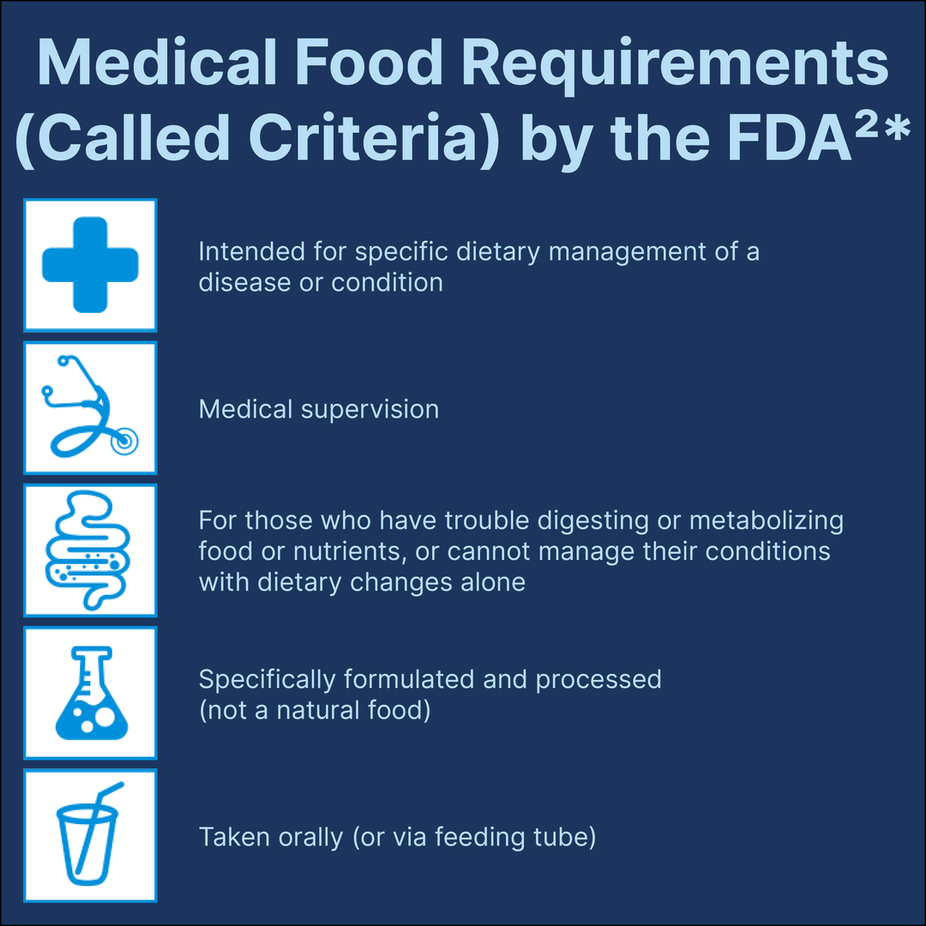
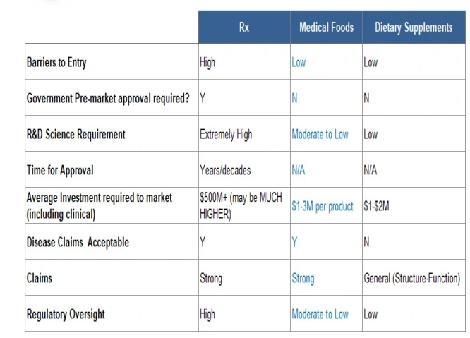
Regulatory Landscapes for Medical Foods

Slide 3
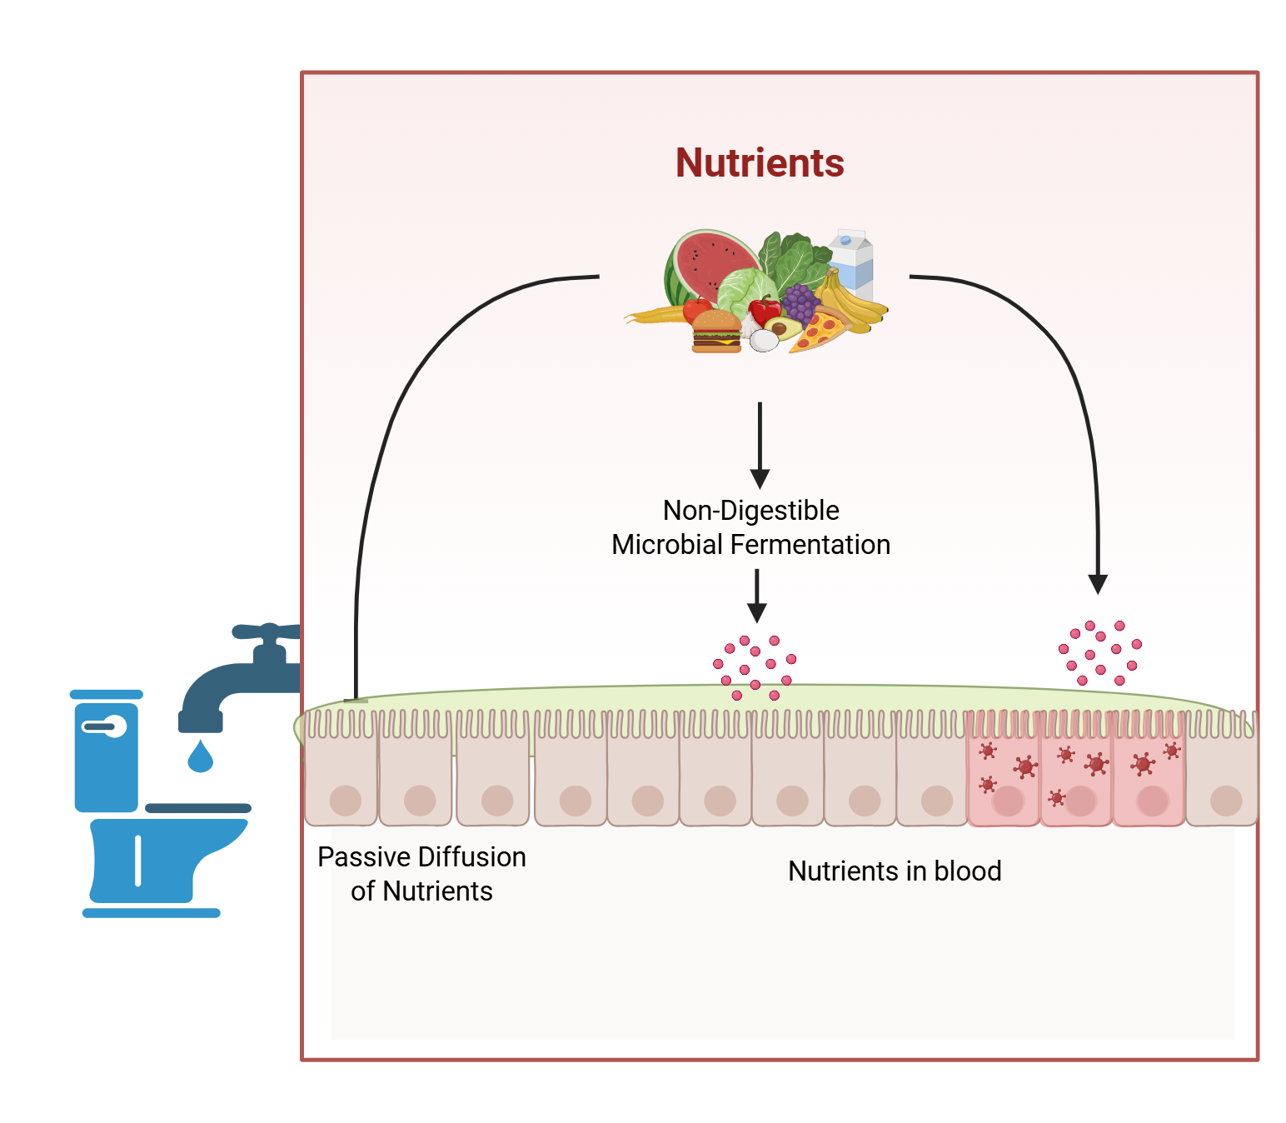
How microbiome contributes to medical food dynamics?

Slide 4
How microbiome contributes to medical food dynamics?
Microbiome Dysbiosis
Microbial Fermentation
Metabolite Production
Nutrient Absorption
Targeting microbiome-based therapies are promising for medical foods category.

Slide 5
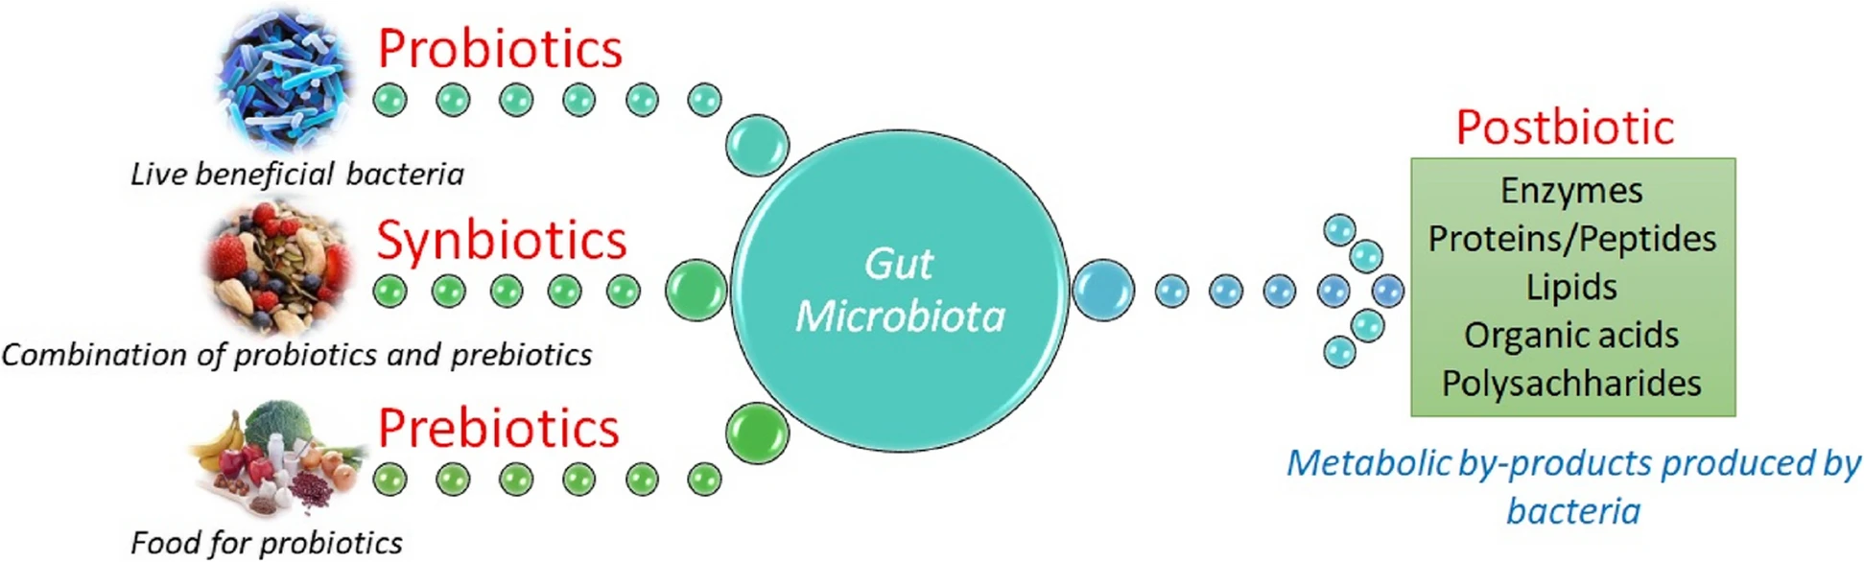
Postbiotics category
Even intact cellular ingredients

Slide 6
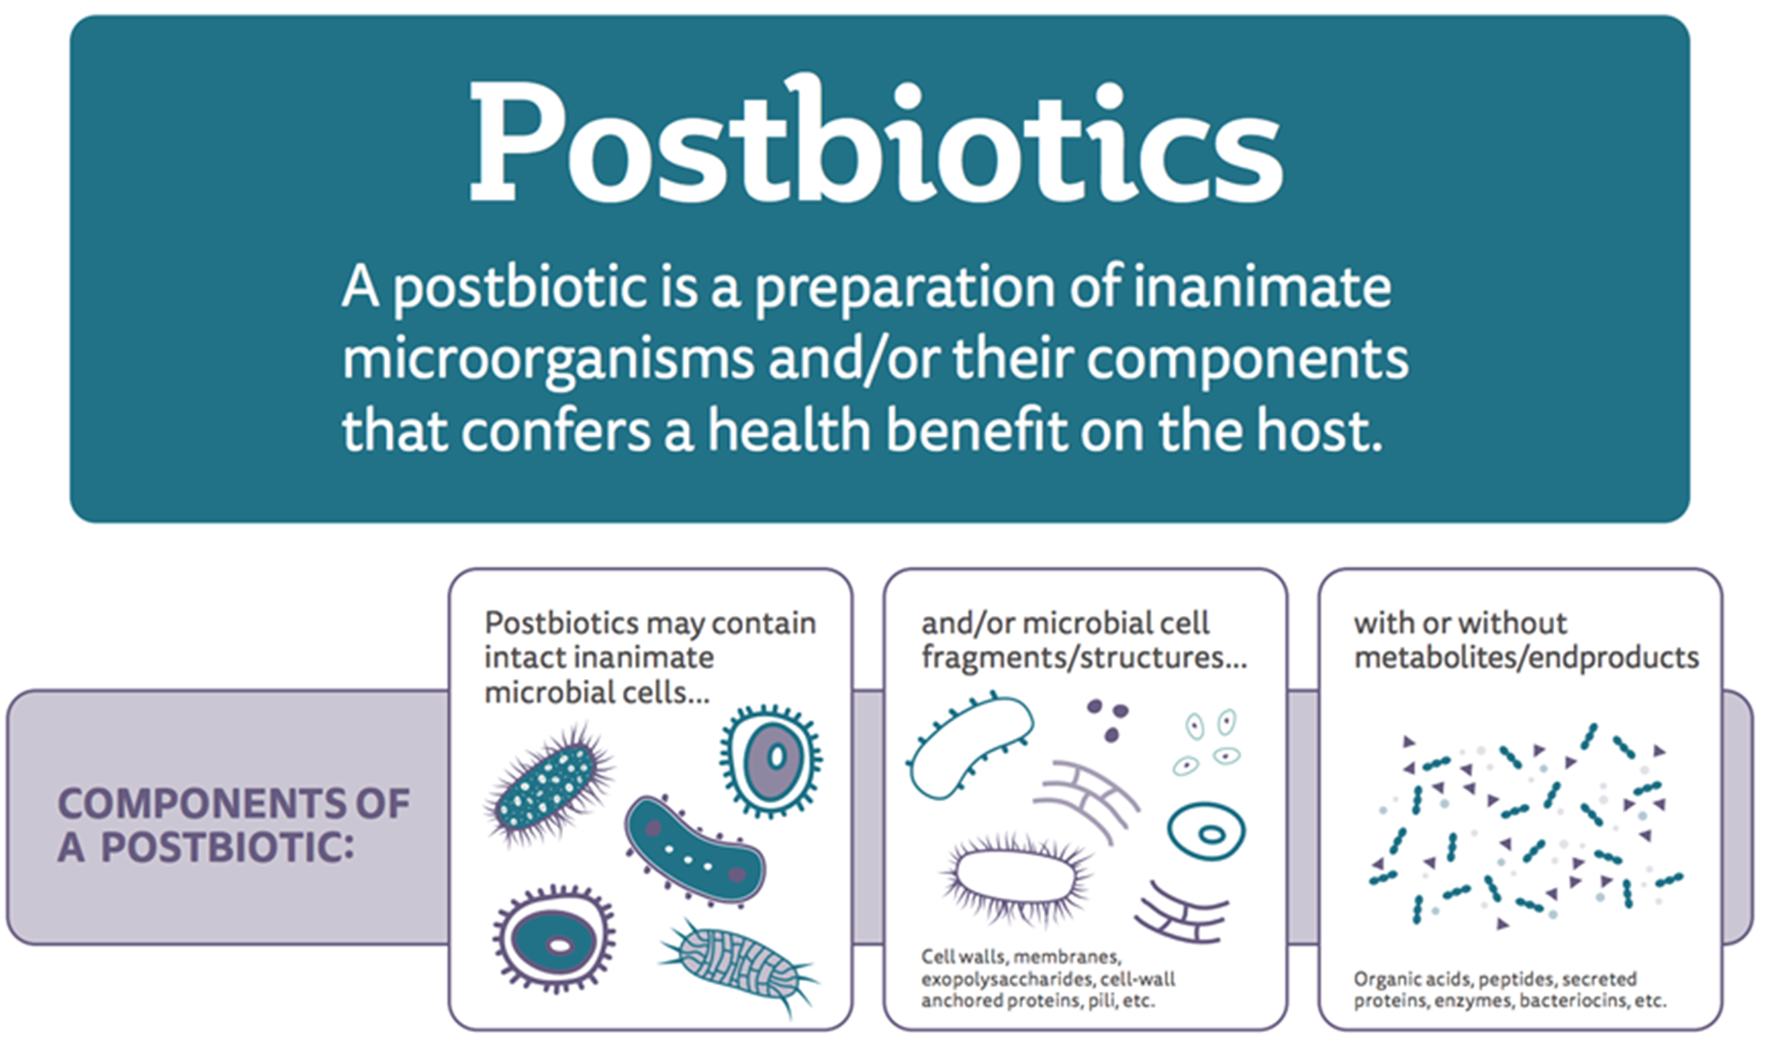

Postbiotics category
Microbial metabolites as nutrients,
Nutrient absorption, by improving gut barrier functions

Slide 7
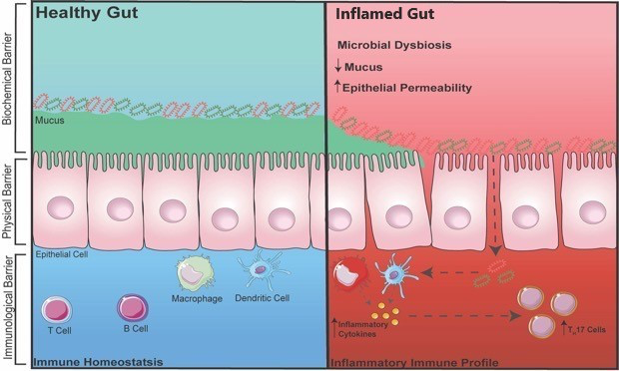
Gut Barriers: gut has a protective wall of Mucus
When the Mucus starts thinning or to go, that’s when problems begin

Slide 8
Your gut has a protective wall of Mucus
When the Mucus starts to go, that’s when problems begin

Slide 9
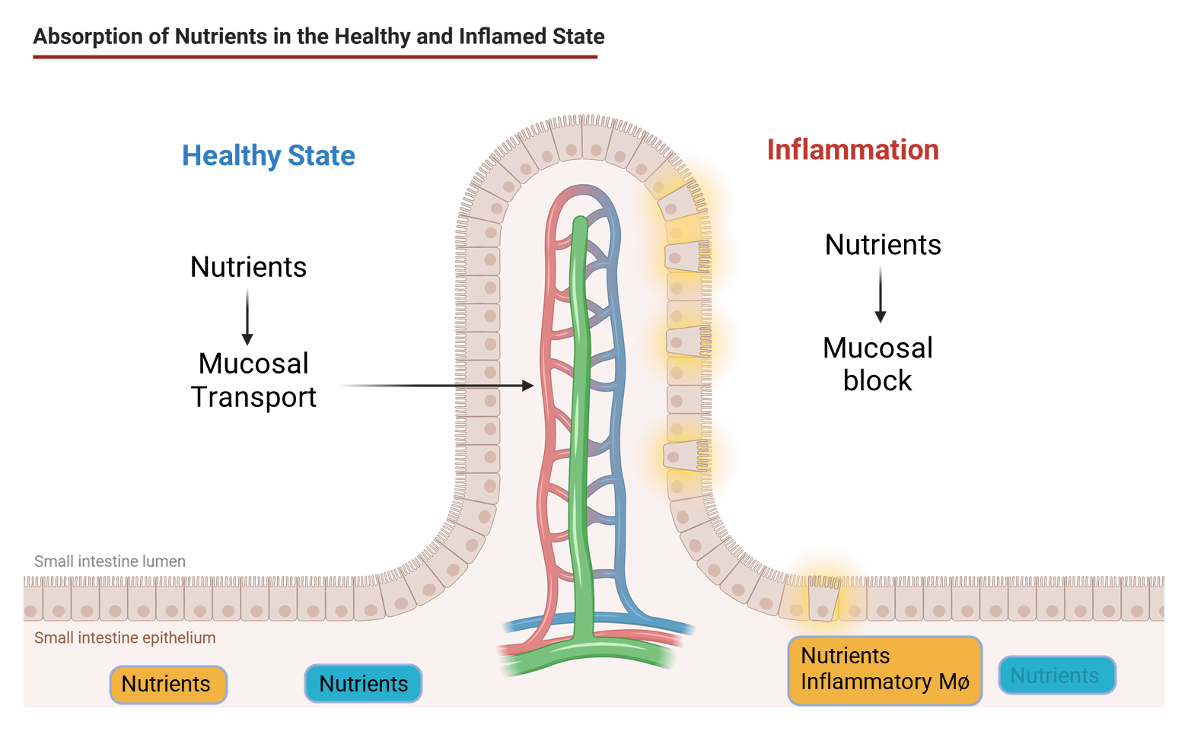
Inflammation impedes nutrient absorption in gut
Reducing inflammation in gut is important part of medical foods strategy.

Slide 10

And a “Not So Good VERSION”
Common medical conditions where our gut is inflamed?
Occasional
Inflammation
Fatigue
Pain
Bloating
Gas
Irregularity
Anxiety
Chronic
Severe abdominal pain
Severe Gas, Bloating
Nausea, Vomiting
Constant Diarrhea and Constipation
Loss of Work
Strained Relationships
IBD/IBS
TIIR
Depression
Dementia
Leaky Gut Syndrome, or also known as “EARLY AGING/INFLAMMAGING”
Requires lifestyle changes, diet changes, optimal immunity. All with minimal benefits seen
Supplementation can be a possible solution
IBD/IBS and TIIR.
Gastroenterologists
OTC, Rx and Medical Foods
Surgeries, Infusions, Drug side effects
NOT HELPED BY SUPPLEMENTATION

Slide 11

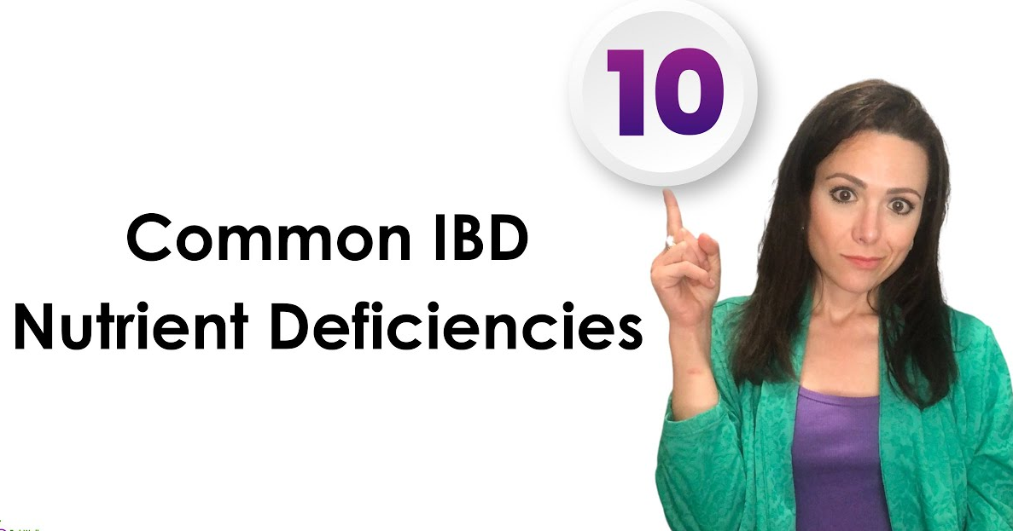
When a gastro condition needs treatment
47 Million Americans have IBD/IBS
Annual expenditures for GI is $136 B, second worst to cardio
Trauma ($103 B)
Mental Health ($99 B)
40 Million Outpatient/ER visits per year
3 Million hospital admissions ($31B)
Nearly 50% higher burden for Children and 65+
Co-morbidities
The Burden
The Gap
75M+ people in the U.S. and Europe suffer from IBD/IBS and resulting gut pain and cognitive impairment
40M+ cancer survivors experience lifelong gut side effects from chemotherapy, affecting quality of life.
Current prescription therapies are costly, often ineffective, and come with undesirable side effects.
Sources: Grandview Research, Crohn’s and Ulcerative Colitis Foundation, Institute for Health Metrics and Evaluation’s Global Burden of Disease
Financial and social costs are severe…
https://pubmed.ncbi.nlm.nih.gov/16807154/
https://gi.org/topics/irritable-bowel-syndrome/
https://shorturl.at/pjTcy

Slide 12
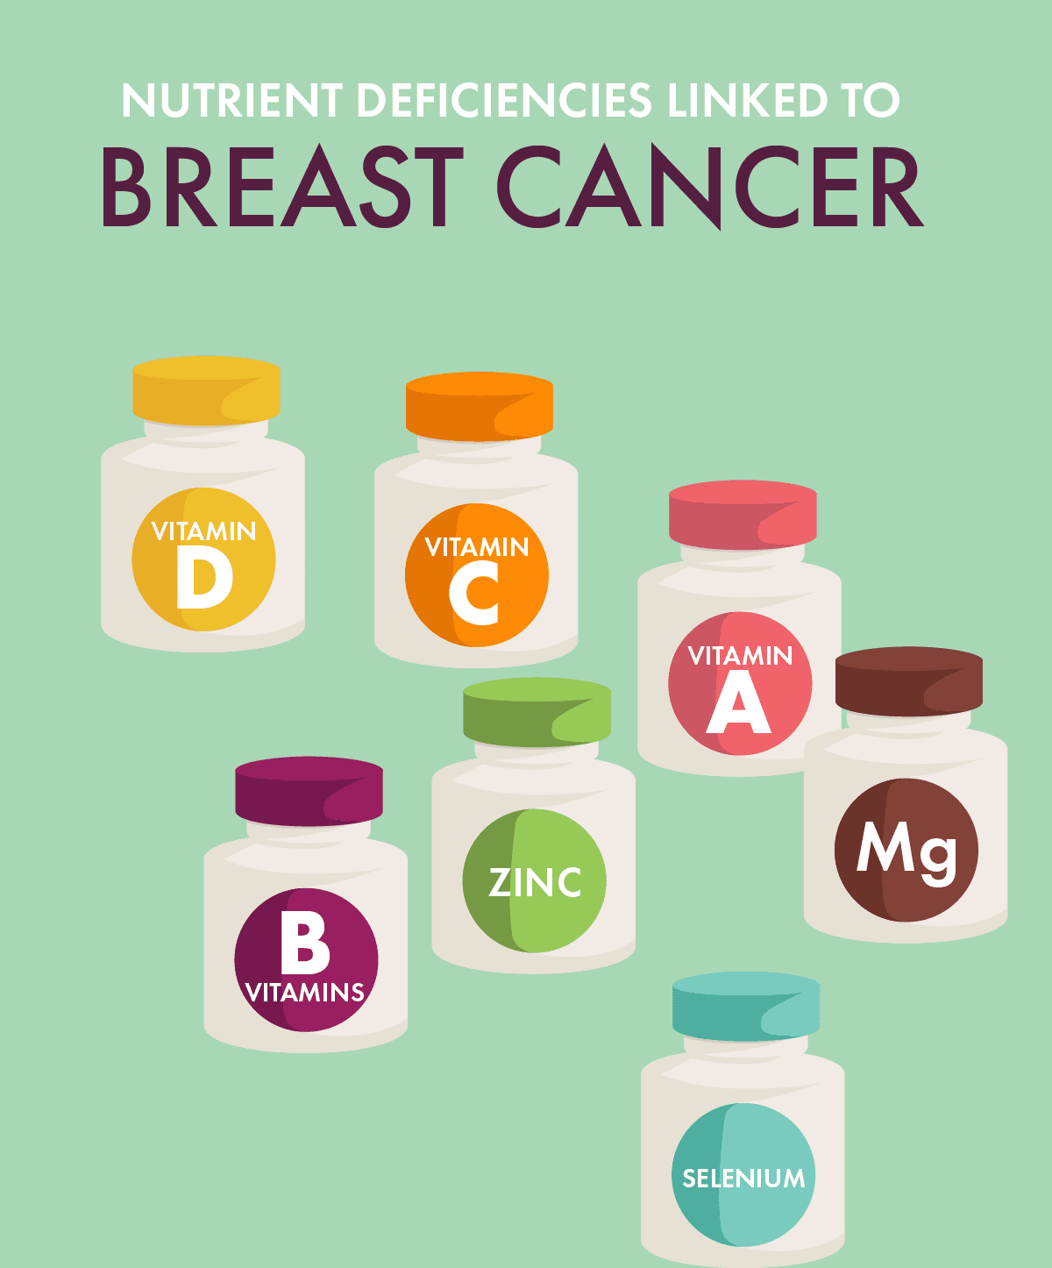
When the treatment inflicts suffering
18.1 Million Cancer Survivors (USA)
Ages 14 to 49, increased 79.1% (1990 to 2019)
1,000,000 patients per year have chemo/radiation
Therapy-Induced Inflammatory Response (TIIR)
50-80% gastro-intestinal related side effects
Fatigue, Pain, Mood, and ”Chemo Brain”
Crohn’s Like Symptoms (e.g., diarrhea, nausea)
Some opt out of treatment
Market creates opportunity as medical food
Example, Chemotherapy-Induced Diarrhea is $1.2B Market
Sources:
Grandview Research, American Cancer Treatment Centers
Henry et.., al. Support Care Center (2008), Symptoms and treatment burden associated with cancer treatment: results from a cross-sectional national survey in the U.S.. Support Care Center (2008). DOI 10.1007/s00520-007-0380-2
People w cancer living longer, but at a severe cost…

Slide 13

At WFU we discovered a dead bacteria that reduce leaky gut- a major source of inflammation in gut
What if young gut bacteria, are “re-introduced” to adults?
Wake Forest College of Medicine found solution?

Slide 14
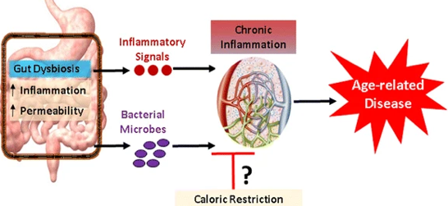
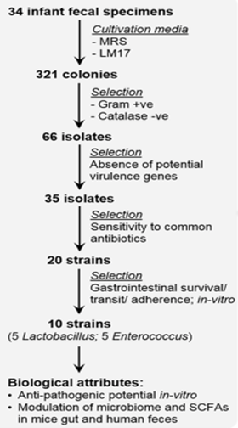
LpD3.5 reduce leaky gut- a major source of inflammation in gut
Gut permeability (µg of FITC per ml serum)
IL-6 mRNA (fold change)
IL-1β mRNA (fold change)
**
Control
**
D3.5
Control
**
Control
D3.5
D3.5
LpD3.5 is isolated, and it works both alive and dead!

Slide 15
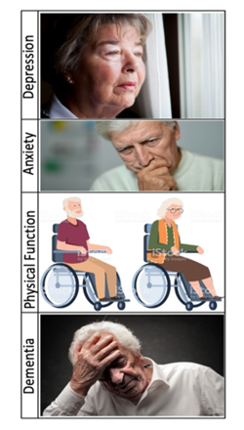
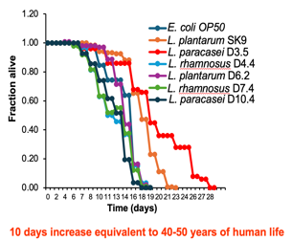
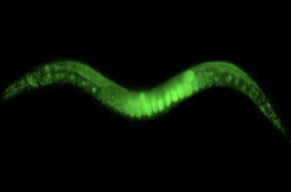
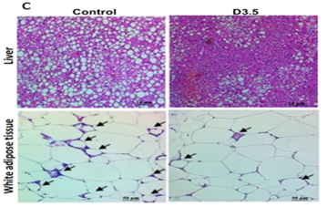
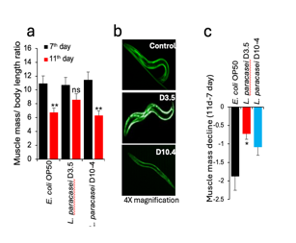
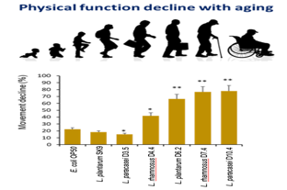
LpD3.5 promotes healthy aging by improving muscles, metabolism, gut and brain functions
Brain Health
Anti-aging
Metabolic Health
Muscle Health
LpD3.5 is isolated, and it works both alive and dead!
Notes:
Studied 1-3 day old newborns
Incredibly robust mucous barrier
Diapers collected for bacteria samples
Isolation of strain
Invertebrate Screening. Lifespan. Healthspan
Pre-clinical animal testing
A single strain of Lactobacillus paracasei found in Diaper 3.5
Efficacy Testing for Age Related Conditions
Unique strain of lactobacillus paracasei increased mucous layer
Decreased inflammation
We call this patent protected strain, PoZibio

Slide 16

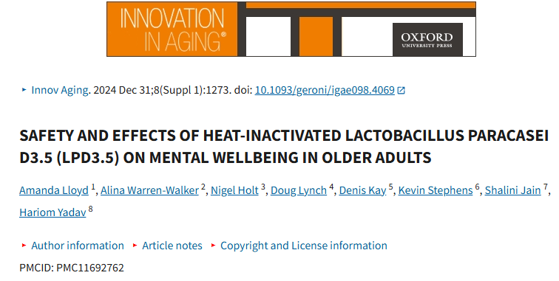
Trial #1
Safety clinical trial- improves quality of life in elderly
4 x PoZibio® capsules daily (167 mg per capsule) for 30 days, two to be consumed in the morning
and two at night
Pre-Post- Open Label trial
Done in UK
LpD3.5 is safe, tolerant with no adverse effects, and improves Quality of Life in Older Adults

Slide 17
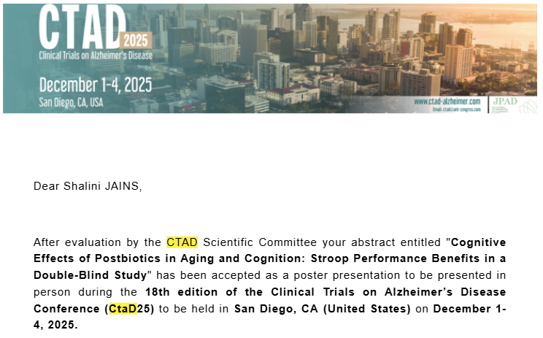
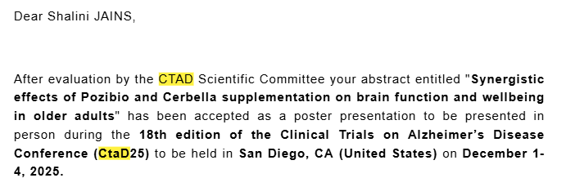
Stroop Test Results
Clinical Trial #2
Under-investigation (upcoming)
Mucin barrier markers
Leaky gut markers
Inflammation markers
Microbiome analyses
Metabolites
Samples are already collected and need to be analyzed!
UK Govt Funded Clinical Trial
PZAC Trial
TWO ABSTRACTS ACCEPTED IN NATIONAL CONFERENCE AND WILL BE PUBLISHED IN INTERNATIONAL JOURNAL
The Stroop task revealed significant improvements in inhibitory control in the intervention group after 60 days, suggesting cognitive benefits of the intervention not observed in controls
Outcomes: LpD3.5‘s impact on gut-brain axis

Slide 18
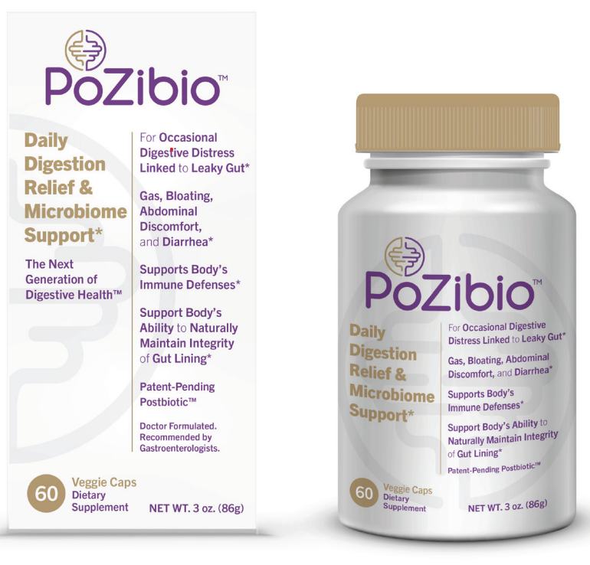
Clinical Trial #3
Gut Wellness Study: Evaluating the Impact of PoZibio® Supplementation on Digestive Health
% Reduction in symptom severity from baseline to weeks 4 & 8 across study arms
Fig 1. Bar chart showing the % reduction in average symptom scores among study arms at week 4
Fig 2. Bar chart showing the % reduction in average symptom scores among study arms at week 8
Outcomes: Impact on Gut Health Wellness

Slide 19
Trail # 4 & 5
Two Pilot Clinical Trials are ongoing
LIBD (LpD3.5 in IBD) Trial
LISA (LpD3.5 Intervention Study in Older Adults) Trial
Randomized Cross-over trial in 10 patients
60 days
Randomized Cross-over trial in 10 patients
60 days
Primary outcome:
Fecal mucin
The secondary outcomes:
Markers of leaky gut
Exploratory outcomes:
Frequency and dose of medications
Markers of inflammation
Quality of life
IBD clinical scores
Primary outcome:
Leaky gut markers
The secondary outcomes:
Mucin levels in stools,
Markers of inflammation in the gut (calprotectin in stools) and circulation (CRP, IL-6, TNF-α, and IL-1β in plasma),
Cognitive function assessed using Clinical Dementia Rating- Sum of Boxes (CDR-SB), AD Assessment Scale, Cognitive Subscale 14 (ADAS-Cog14), and AD Cooperative Study- Instrumental Activities of Daily Living (ADCS-iADL) scores.
Exploratory outcomes:
Blood levels of pTau217.
IRB Approved- Recruiting
IRB Approved- Recruiting
Outcomes: Impact on IBD and Cognition

Slide 20
Trail # 6
Clinical Trial: Colon Cancer Patients
Study Title | Postbiotics for mitigation of postoperative dysbiosis in colon cancer resections
Study Design | Pilot randomized control trial
Primary Objective/Purpose | To measure efficacy of postbiotic supplements in mitigating the gut dysbiosis induced in the perioperative period of colorectal cancer resections
Secondary Objective(s)/Purpose | To use collected data as pilot to design a microbiome-targeted intervention in future trials
Research Intervention(s)/ Investigational Agent(s) | Administration of a nutraceutical supplement (PoZibio® from Postbiotics Inc, Wiston-Salem, NC)
IND/IDE # | Not applicable
ClinicalTrials.gov NCT# | Pending
Study Population | Patients 18 years and older undergoing colon cancer surgery
Sample Size | 30
Study Duration for individual subjects | Multiple visits to coincide with standard of care clinical visits over a 1-year period
Study Specific Abbreviations/ Definitions | Colorectal Cancer - CRC
 | Day 0 (Baseline +2 days) | Day 10 (± 2 days) | Day of Surgery | Day 42 (± 14 days) | Day 120 (± 30) | Day 390 (±30 days)
Informed consent | X
Inclusion/Exclusion criteria | X
Physical exam | X
Vital signs | X
Randomization | X
Provision of intervention supplement vs placebo | X |  |  | X | X
Treatment start | X
Treatment end |  |  |  |  | X
Review AEs |  | X |  | X | X | X
Review adherence | X | X |  | X | X | X
Stool sample | X | X |  | X | X | X
Normal colon and tumor collection |  |  | X
Follow-up visit |  |  |  | X | X | X
Follow-up call |  | X
Final data collection on disease status and course of care |  |  |  |  |  | X
Outcomes: Microbiome, Side Effects, Recovery, Resilience

Slide 21
Summary
Postbiotics category can support non-prescription based medical food requirements, if proven clinically and useful to curve down leaky gut, inflammation and improve nutrient requirements
Older adults
IBD/IBS
Cancer survivors

Slide 22


