Slide 1
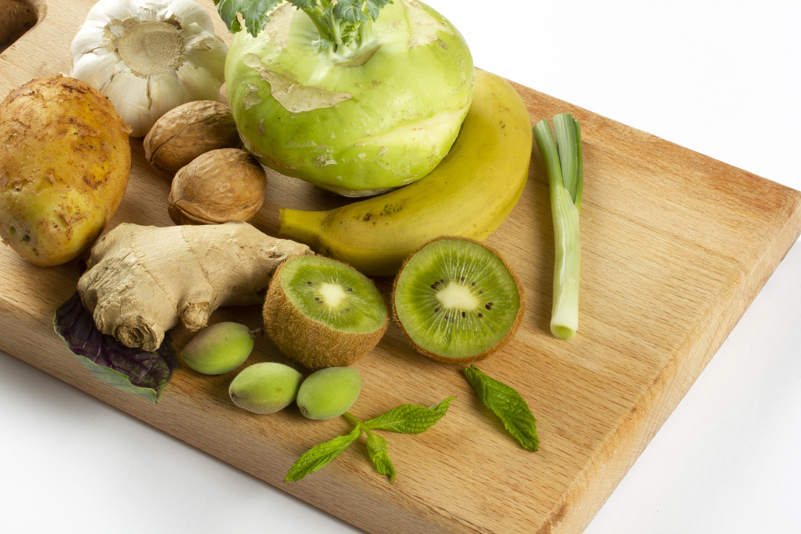

ITC Insights 2025 Consumer Insights
PREBIOTIC USERS

Slide 2

DEMOGRAPHIC OVERVIEW
Key Insights:
Respondents were skewed male overall, with the US, UK, Italy, Korea, and India all showing this pattern.
Most prebiotic users are between the ages of 35 and 54.
 | All Prebiotic Users |  | US Prebiotic Users |  | UK Prebiotic Users |  | DE Prebiotic Users |  | IT Prebiotic Users |  | KR Prebiotic Users |  | AU Prebiotic Users |  | IN Prebiotic Users
 | n=2525 |  | n=637 |  | n=265 |  | n=253 |  | n=295 |  | n=344 |  | n=325 |  | n=406
Female | n=1223 | 48% | n=304 | 48% | n=124 | 47% | n=135 | 53% | n=137 | 46% | n=167 | 49% | n=162 | 50% | n=194 | 48%
Male | n=1301 | 52% | n=332 | 52% | n=141 | 53% | n=118 | 47% | n=158 | 54% | n=177 | 51% | n=163 | 50% | n=212 | 52%
Non-binary/prefer to self-describe | n=1 | <1% | n=1 | <1% | n=0 | n/a | n=0 | n/a | n=0 | n/a | n=0 | n/a | n=0 | n/a | n=0 | n/a
18-25 | n=297 | 12% | n=85 | 13% | n=45 | 17% | n=21 | 8% | n=31 | 11% | n=30 | 9% | n=38 | 12% | n=47 | 12%
26-34 | n=630 | 25% | n=164 | 26% | n=78 | 29% | n=61 | 24% | n=71 | 24% | n=67 | 19% | n=96 | 30% | n=93 | 23%
35-44 | n=765 | 30% | n=187 | 29% | n=79 | 30% | n=83 | 33% | n=80 | 27% | n=92 | 27% | n=87 | 27% | n=157 | 39%
45-54 | n=496 | 20% | n=131 | 21% | n=38 | 14% | n=51 | 20% | n=63 | 21% | n=76 | 22% | n=69 | 21% | n=68 | 17%
55+ | n=337 | 13% | n=70 | 11% | n=25 | 10% | n=37 | 14% | n=50 | 17% | n=79 | 23% | n=35 | 11% | n=41 | 10%

Slide 3
GLP-1 DRUG USAGE: COUNTRY
Key Insights:
Prebiotic users significantly over-index over all users in each country, most notably the UK and Germany. All levels are at or around 30% with the exception of Italy. Australian users generally are at 20%, and prebiotic Australian users are at 29%.
Note: All US n=1003, All UK n=510, All DE n=500, All IT n=511, All KR n=502, All AU n=501, All IN n=502, All Respondents n=4029, Prebiotic US n=637, Prebiotic UK n=265, Prebiotic DE n=253, Prebiotic IT n=295, Prebiotic KR n=344, AU n=325, Prebiotic IN n=406, All Prebiotic Users=2525. Sum of responses marked as ‘Yes’ for question: “Are you currently taking a GLP-1 agonist?

Slide 4
GLP-1 DRUG USAGE: US, AGE & GENDER
Key Insights:
The skew is strongly male for GLP-1 drug use in the US among prebiotic users. The highest response comes from males 35-44, nearing 50%.
Note: US Female 18-25 n=38, US Male 18-25 n=47, US Female 26-34 n=79, US Male 26-34 n=85, US Female 35-44 n=73, US Male 35-44 n=113, US Female 45-54 n=75, US Male 45-54 n=56, US Female 55+ n=39, US Male 55+ n=31. Sum of responses marked as ‘Yes’ for question: “Are you currently taking a GLP-1 agonist?

Slide 5
HEALTH CONCERNS AND WHAT THEY TAKE SUPPLEMENT FOR (1st 10) ALL
Key Insights:
Examining the white space between those who have consumed and those willing to consume for the first 10 concerns reveals opportunities for addressing anxiety or stress, insomnia/sleep problems, and hair loss.
Similarly, analyzing the ‘education’ opportunity space between all those with a concern and those willing to consume for a concern shows gaps in addressing anxiety or stress, skin health, hair loss, and insomnia/sleep problems.
Note: n=2525. Results shown top 10 health concerns. Health Concerns Question: “Which of the following health conditions or concerns currently impact or impacted you within the past year?”

Slide 6
HEALTH CONCERNS AND WHAT THEY TAKE SUPPLEMENT FOR (2nd 10) ALL
Key Insights:
Examining the whitespace between those who have already consumed and those willing to consume over the next 10 issues, we identify opportunities related to mood, overweight/obese, healthy aging, depression, and lack of mental energy.
Looking at the ‘education’ opportunity space between all individuals with concerns and those willing to consume for a concern, we observe gaps in mood, oral health, high cholesterol, depression, lack of mental energy, and overweight/obese.
Note: n=2525. Results shown next 10 health concerns. Health Concerns Question: “Which of the following health conditions or concerns currently impact or impacted you within the past year?”

Slide 7
HEALTH CONCERNS AND WHAT THEY TAKE SUPPLEMENT FOR (3rd 10) ALL
Key Insights:
Examining the white space between those who have consumed versus those willing to consume for the next 10 concerns we identify gaps in awareness about poor/declining vision, sexual health, poor hydration and memory problems.
When analyzing the ‘education’ opportunity space between individuals with concerns and those willing to consume for a concern, we identify gaps related to poor hydration, poor/declining vision, lack of mental acuity, cognition, focus, athletic performance, my child’s health, and memory issues.
Note: n=2525. Results shown next 10 health concerns. Health Concerns Question: “Which of the following health conditions or concerns currently impact or impacted you within the past year?”

Slide 8
HEALTH CONCERNS AND WHAT THEY TAKE SUPPLEMENT FOR (LAST 9) ALL
Key Insights:
Examining the white space between those that have consumed versus those willing to consume, we see opportunities related to healthspan/longevity, vaginal and heart/cardiovascular problems.
Examining the ‘education’ opportunity space between all those who have a concern and those willing to consume for a concern, we see gaps in body composition, vaginal health, long haul COVID symptoms, heart/cardiovascular problems, and healthspan/longevity.
Note: n=2525. Results shown last 9 health concerns. Health Concerns Question: “Which of the following health conditions or concerns currently impact or impacted you within the past year?”

Slide 9
FAMILIARITY: ALL USERS
Key Insight:
For all supplement users, familiarity with prebiotics continues to rise, now at 20% for top familiarity and 47% for top-two familiarity, up from 20% and 35%, respectively.
Note: All Respondents=4029. Question: “How familiar would you consider yourself regarding the use of these supplements?”

Slide 10
PERCEIVED EFFECTIVENESS
Key Insights:
For prebiotic users, they do rank probiotics slightly ahead for perceived effectiveness. (41% and 73%)
Prebiotics ranks at 30% top (13th) and 65% the top 2.
Note: n varies. Question: “What is your opinion of the effectiveness/benefit of each of these supplements?”

Slide 11
PREBIOTIC: DEEP DIVE

Slide 12
WHY THEY TAKE PREBIOTICS: COUNTRY
Key Insights:
Gut health/digestion, overall nutrition support, and immunity health are the top three responses by a significant margin, with the former being the top response for most respondents except those from India, who instead rank immunity as number one.
Indian respondents, as seen with most survey questions, tend to have some of the highest response rates.
Note: US n=637, UK n=265, DE n=253, IT n=295, KR n=344, AU n=325, IN n=406, All Respondents n=4029. Question: “Why do you take a prebiotic supplement?”

Slide 13
IMPORTANT LABEL CHARACTERISTICS: COUNTRY
Key Insights
Responses are varied as usual, with Indian respondents significantly over-represented across the board. However, 'gut-friendly' is a major response in the UK. It is also the top response in the US, Germany, Italy, and Australia.
The highest response is from Korean respondents for specific activity or action on gut microbiota at 36%.
Additionally, 'plant-based' resonates in the UK and Germany.
Note: US n=637, UK n=265, DE n=253, IT n=295, KR n=344, AU n=325, IN n=406, All Respondents n=4029. Question: “When you select what prebiotic to purchase, what characteristics do you look for on the label?”

Slide 14
IMPORTANT LABEL CHARACTERISTICS: US, AGE & GENDER
Key Insights:
In the US, overall, gut-friendly also is strong, especially among those aged 45-54 and 55+, roughly matching the global data. Females and males aged 18-25 prefer prebiotic fiber, with the former also favoring the term 'plant-based.' There is a notable increase among males aged 55+ for ‘labelled as a prebiotic,’ while males 26-34 and females 35-44 mainly choose a probiotic/prebiotic combination as their top response.
Note: US Female 18-25 n=38, US Male 18-25 n=47, US Female 26-34 n=79, US Male 26-34 n=85, US Female 35-44 n=73, US Male 35-44 n=113, US Female 45-54 n=75, US Male 45-54 n=56, US Female 55+ n=39, US Male 55+ n=31. Question: “When you select what prebiotic to purchase, what characteristics do you look for on the label?”

Slide 15
EXPECTED BENEFITS: PRE COUNTRY (FIRST 10)
Key Insights:
The top responses in both countries are gut health followed by immune health then a healthy metabolism; UK responses are higher than US responses for the first two.
Source of fiber is next in the US, while in the UK, the next response is overall nutritional support followed by mental wellbeing.
Note: US n=661, UK n=620, All Prebiotic Users=1281. Question: “What benefits are you looking for when you choose to consume foods/beverages that contain prebiotics?”

Slide 16
EXPECTED BENEFITS: COUNTRY (LAST 12)
Key Insights:
In the second set of benefits we see inflammation and stress and mood, the former higher in the US, the latter higher in the UK.
Bone health as a benefit is also higher in the UK, GI discomfort heavily skewed to the US.
Note: US n=661, UK n=620, All Prebiotic Users=1281. Question: “What benefits are you looking for when you choose to consume foods/beverages that contain prebiotics?”

Slide 17
EXPECTED BENEFITS: PRO COUNTRY (FIRST 10)
Key Insights:
The top responses in both countries are gut health followed by immune health then a healthy metabolism; UK responses are quite a bit higher than US responses for the first two.
Regularity is next in the US, while in the UK, the next response is mental wellbeing.
Note: All Respondents n=2003, All Probiotic Consumers n=1523, US n=781, UK n=742.
Question: “What benefits are you looking for when you choose to consume foods/beverages that contain probiotics?”

Slide 18
EXPECTED BENEFITS: COUNTRY (LAST 12)
Key Insights:
In the second set of benefits we see skin health (high over-index in the UK), brain/mental acuity and cholesterol management in the UK.
Bone health as a benefit is also higher in the UK as is stress and mood.
Note: All Respondents n=2003, All Probiotic Consumers n=1523, US n=781, UK n=742.
Question: “What benefits are you looking for when you choose to consume foods/beverages that contain probiotics?”

Slide 19





QUESTIONS?
Our team is happy to help!
Len Monheit
CEO, Industry Transparency Center
len@itcstrategy.com
Steve Imgrund
Marketing and Communications Lead Industry Transparency Center
steve@itcstrategy.com
Maggie Feikes
Project Manager
Industry Transparency Center
maggie@itcstrategy.com

