Slide 1
From Feeding the Microbes to Supporting the Host
Dr Jelena Vulevic

Slide 2


The Current Gut Health Paradigm
Strain-specific benefits, inconsistent in practice
Require presence of target microbes, responses vary
Combine two uncertainties, outcomes hard to predict
All rely on changing the microbiota.

Slide 3
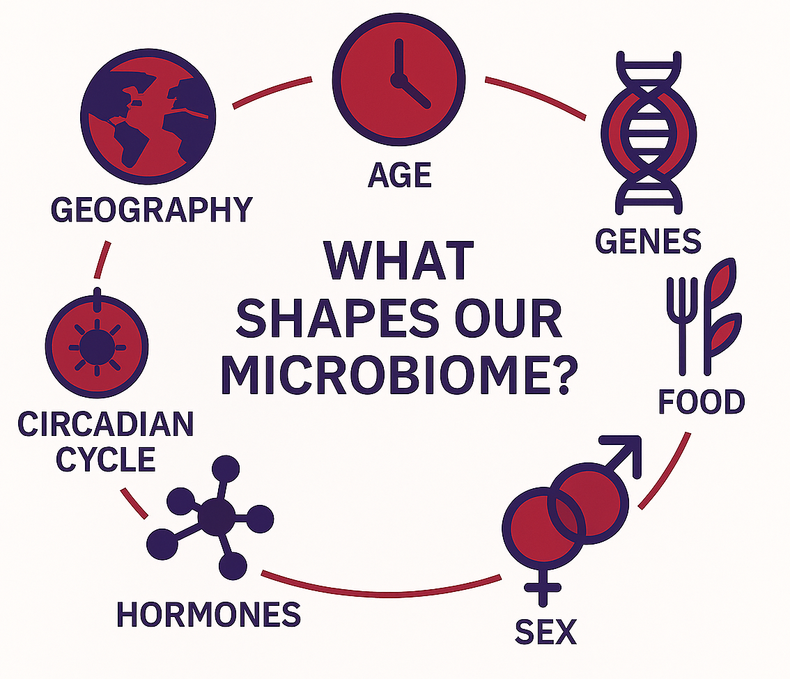
What Shapes the Microbiota?
It’s dynamic and deeply individual.

Slide 4
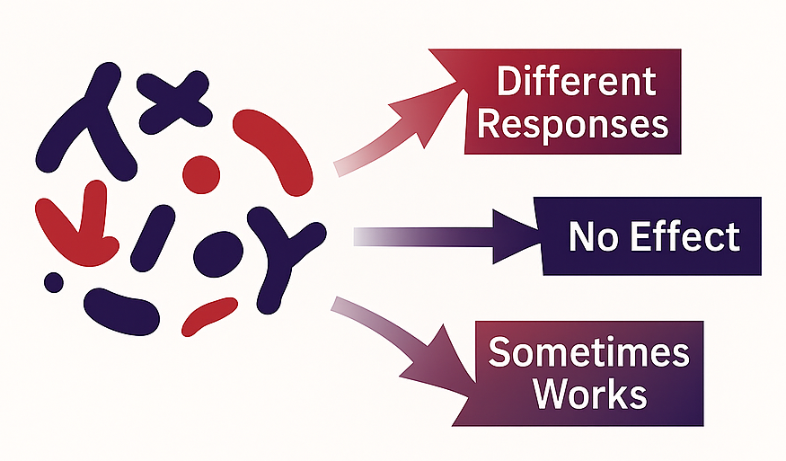
The Limits of Microbiota Modulation
Can’t be controlled, thus delivering inconsistent results.

Slide 5

The Shift: From Microbes to Host
A measurable, host-centred approach for consistent outcomes.

Slide 6
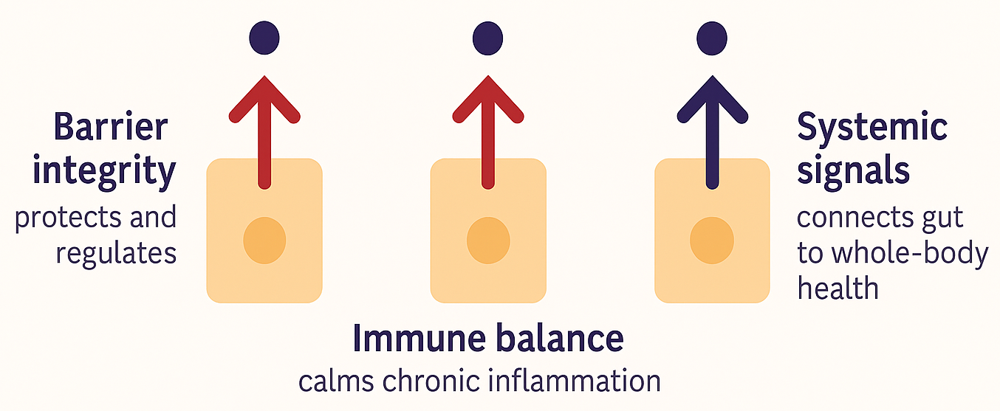
What Supporting the Host Means?
The host is where outcomes become measurable and consistent.

Slide 7

The Gut Barrier: The Host Interface
Protects → limits crossover
Connects → gut-body signalling
Regulates → inflammation & hormones
A resilient barrier protects, connects, and regulates.

Slide 8
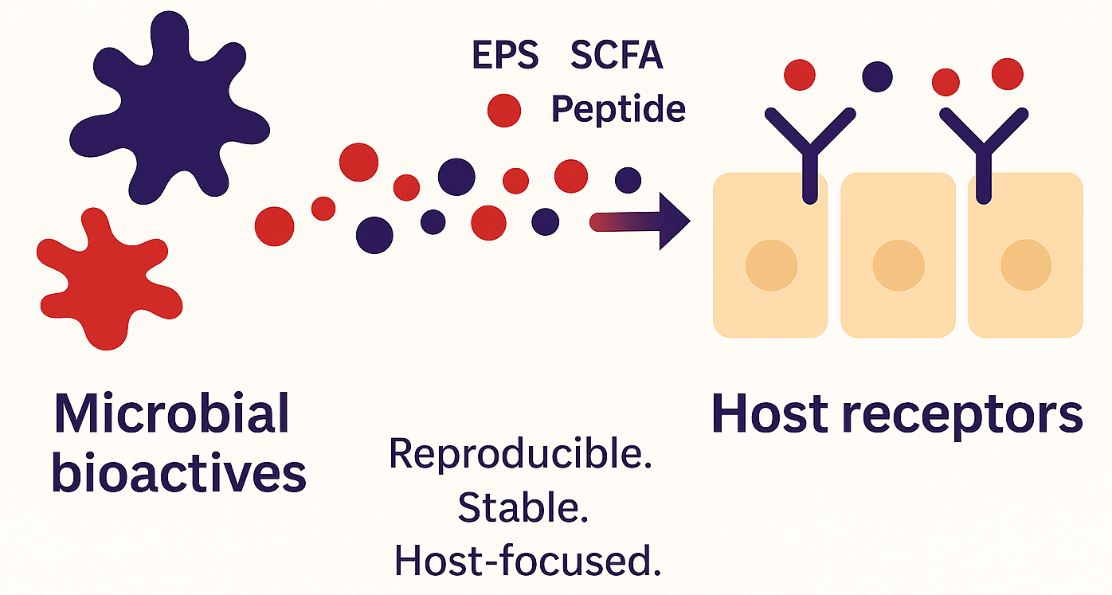
Postbiotics: The Language of Microbes
The message matters more than the microbe.

Slide 9

From Microbiota Dependence to Host Control
Stable outcomes through host-centred design.

Slide 10
What We Know So Far
Strengths → Reproducible • Stable • Easier to regulate
Challenges → Unclear dosing • Heterogeneous results • Few human data
Examples → Heat-killed probiotics • Bacterial lysates (OM-85)
Strong potential. Limited clarity. Ready for evolution.

Slide 11

From Crude Extracts to Defined Molecules
Refining bioactives for precision and predictability.

Slide 12

Exopolysaccharides (EPS):
Translating Microbial Signals to the Host
Bifidobacterial EPS: key mediators of host response.
Barrier, stress, hormone, and immune modulation.
The next generation of host-centred postbiotics.

Slide 13
Mechanistic In Vitro Data (on file)
Multi-level host effects: immune, barrier, and circadian pathways.
TLR2/4 receptor activation → immune interface
Barrier markers (Occludin, Zonulin)→ epithelial integrity
Circadian genes (BMAL1, CLOCK)→ systemic regulation

Slide 14
Human Studies: Translating Mechanisms to Real Outcomes
Mechanistic validation translating into measurable human outcomes.
↓ Inflammatory markers (CRP, IL-6)
↔ Hormonal balance (sex, cortisol)
40–55y females (Front. Microbiol. 2023)
↑ Hydration, elasticity, wrinkles, overall skin quality
40–55y females (In submission)

Slide 15
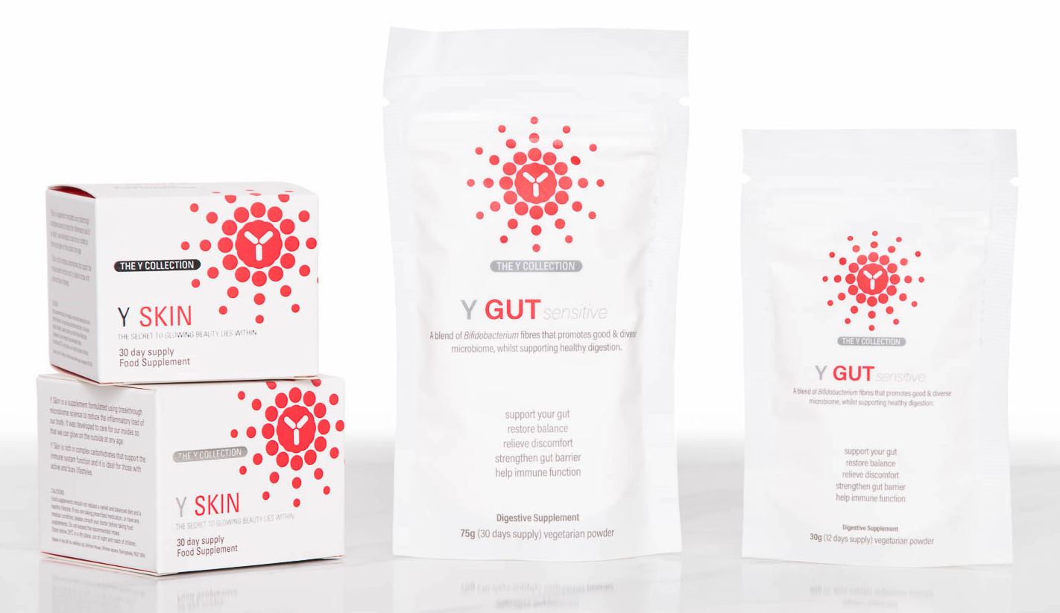

From Ingredient to Real-World Impact
Y SKIN: beauty-from-within, gut-skin axis
Y GUT sensitive: gut barrier and comfort (prebiotics + postbiotics)
Taking host-centred science from lab to life.

Slide 16
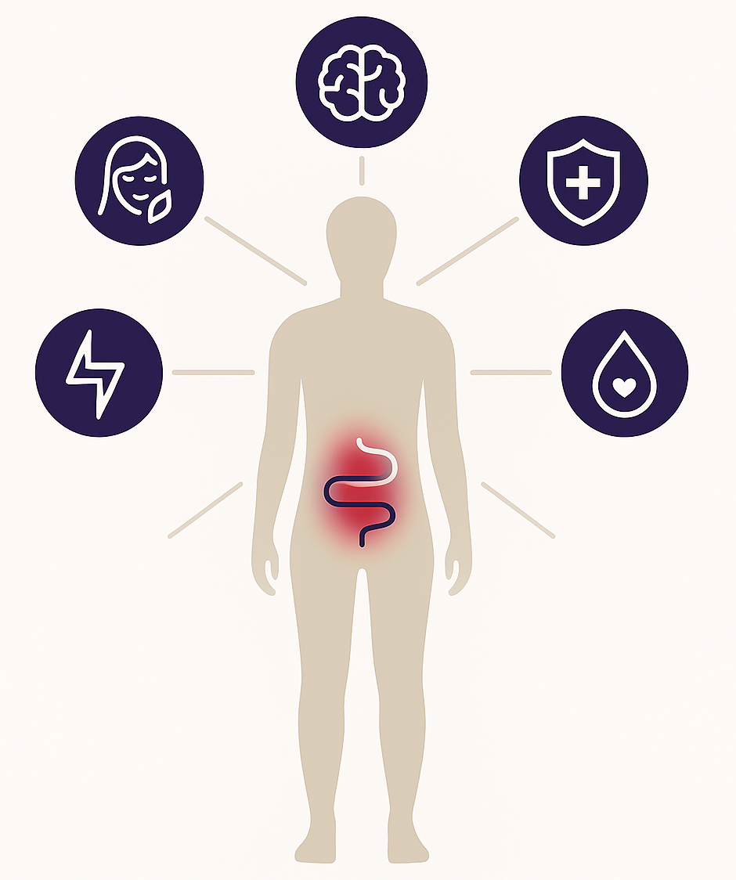
The Future of Gut Health:
Measurable, Personalised, Host-Centred
Microbiota ≠ reliable target
Host = measurable, controllable
Postbiotics & bioactives → the future of gut health
From microbiota modulation to host optimisation.

Slide 17



Thank You – let’s stay In touch!
www.vemico.co.uk
www.theycollection.com
Independent Scientific Consultancy
Contact: Dr J Vulevic
jelena@vemico.co.uk or jelena@gutperspective.com

