Slide 1
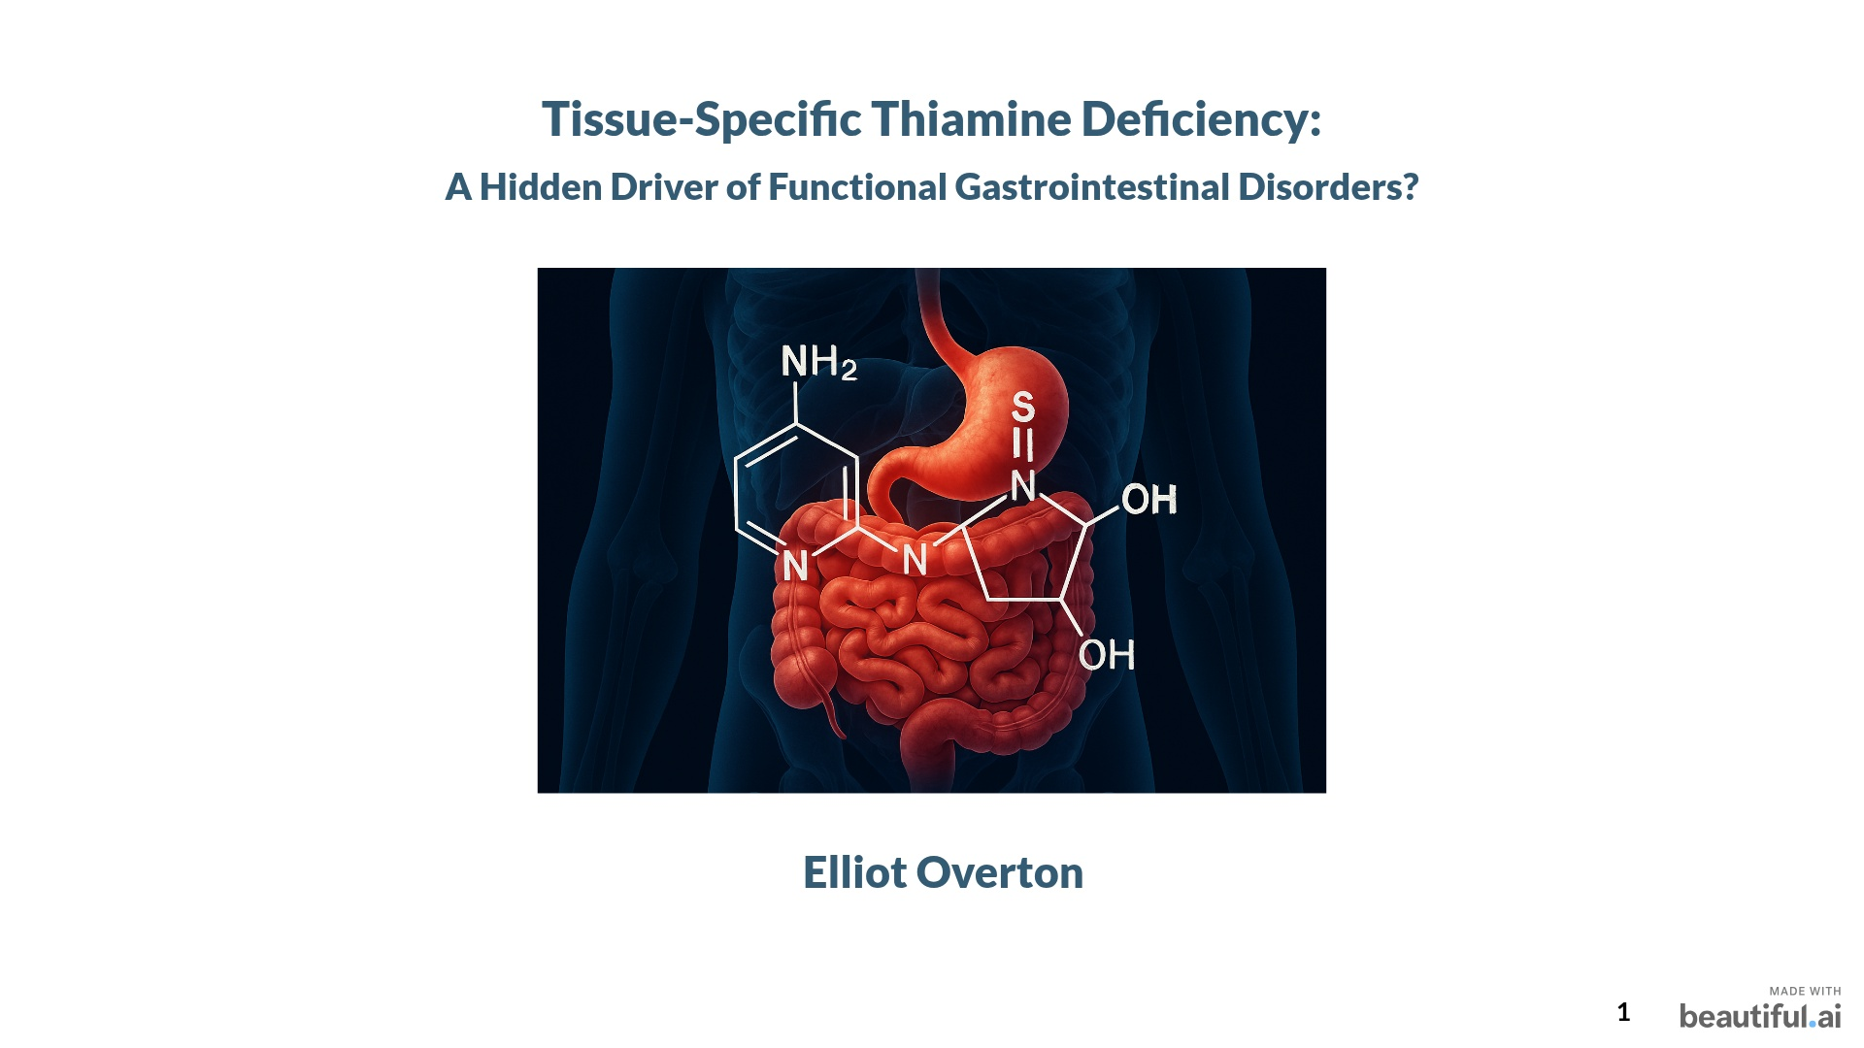


Slide 2
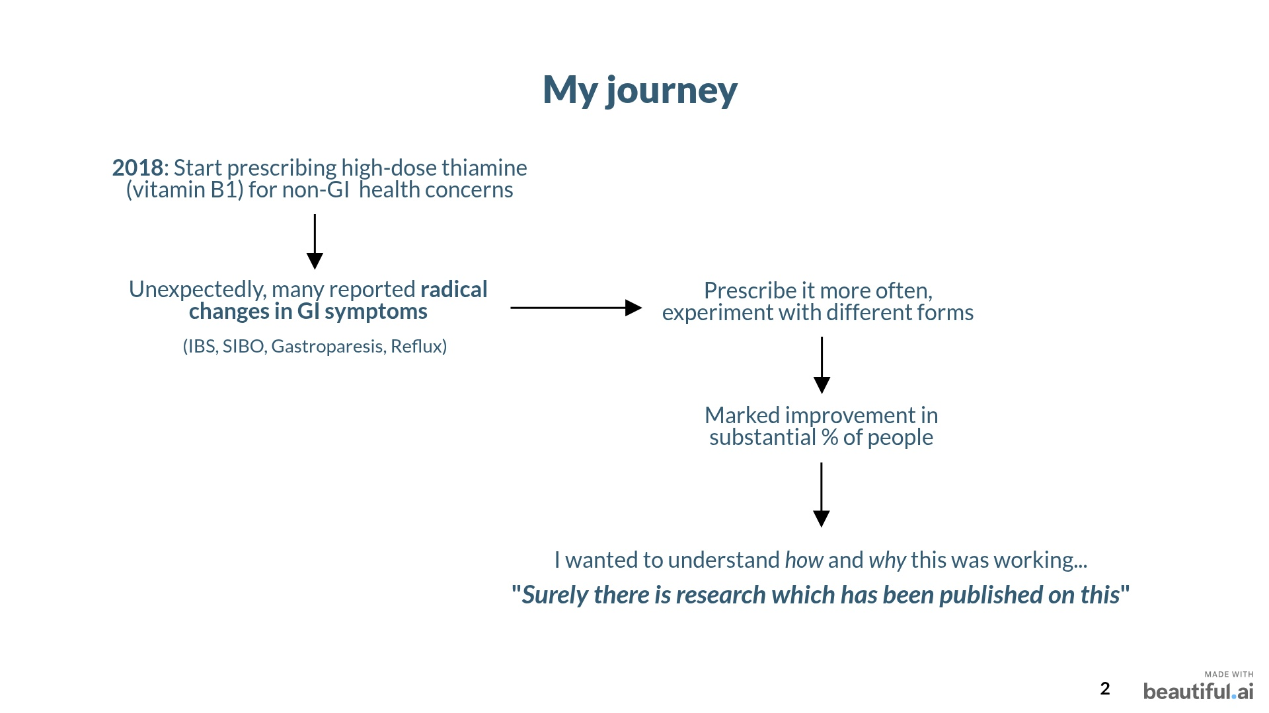
Notes:
What all have in common? – they responded to B1
Why? Well, I want you to reframe your perception, just entertain something for me

Slide 3
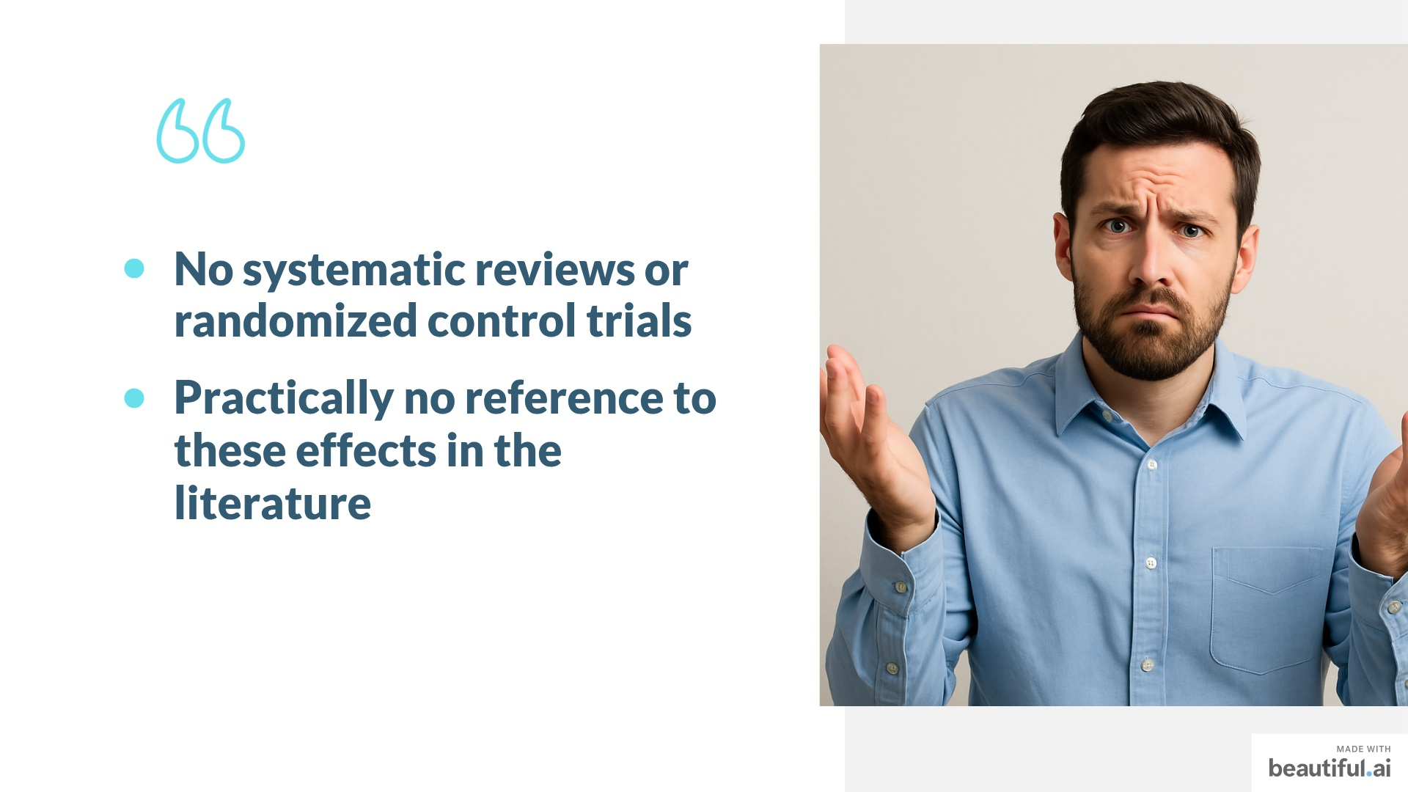
Notes:
Surprised – there were no systematic reviews, no real reviews of any kind tbh looking at this. No trials that I could see. It was bizarre? SURELY someone knew.

Slide 4
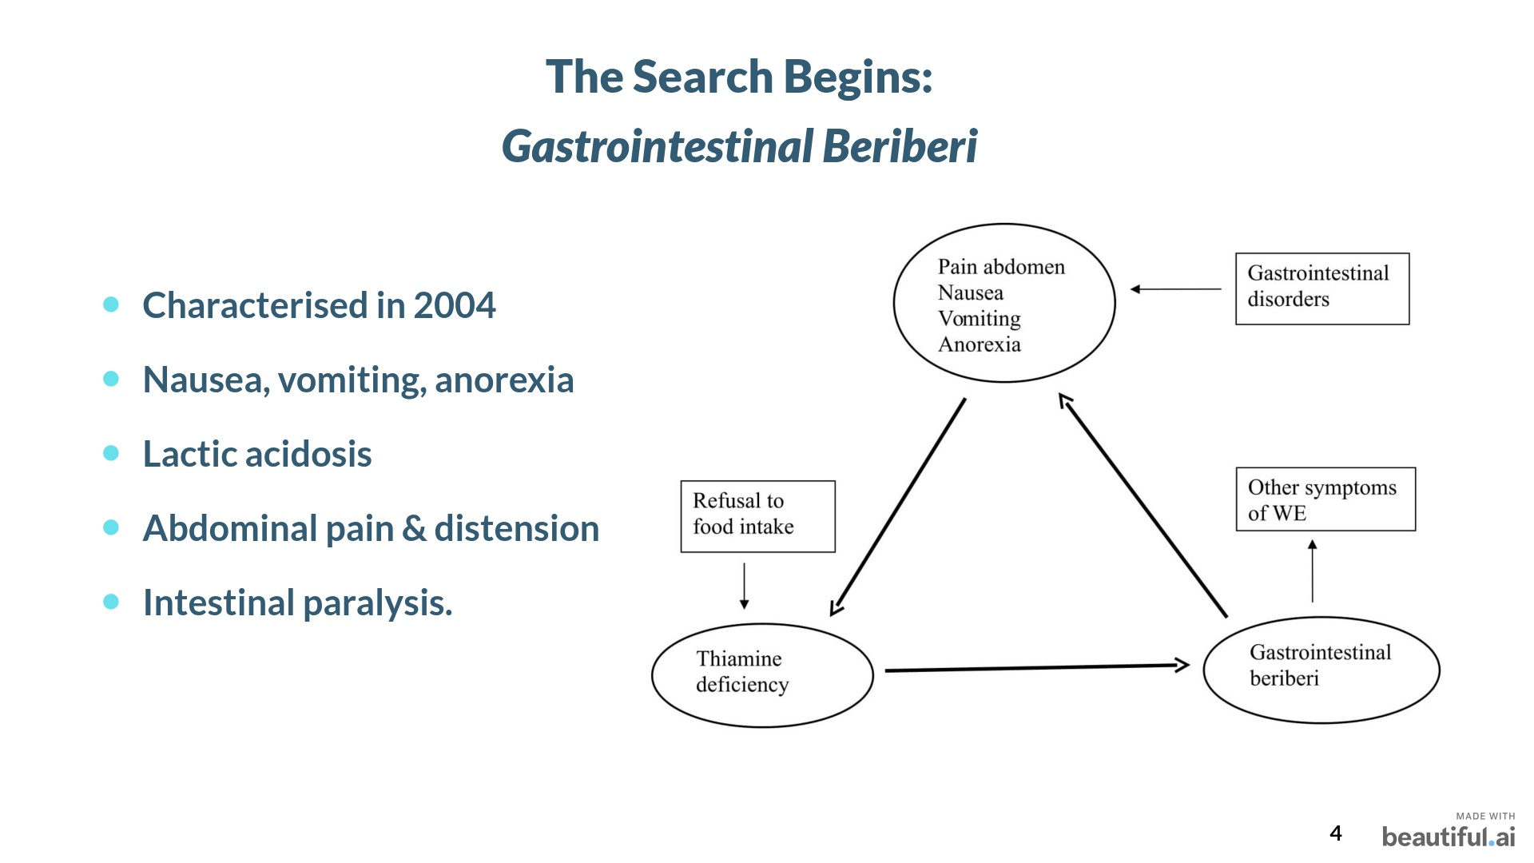

Slide 5
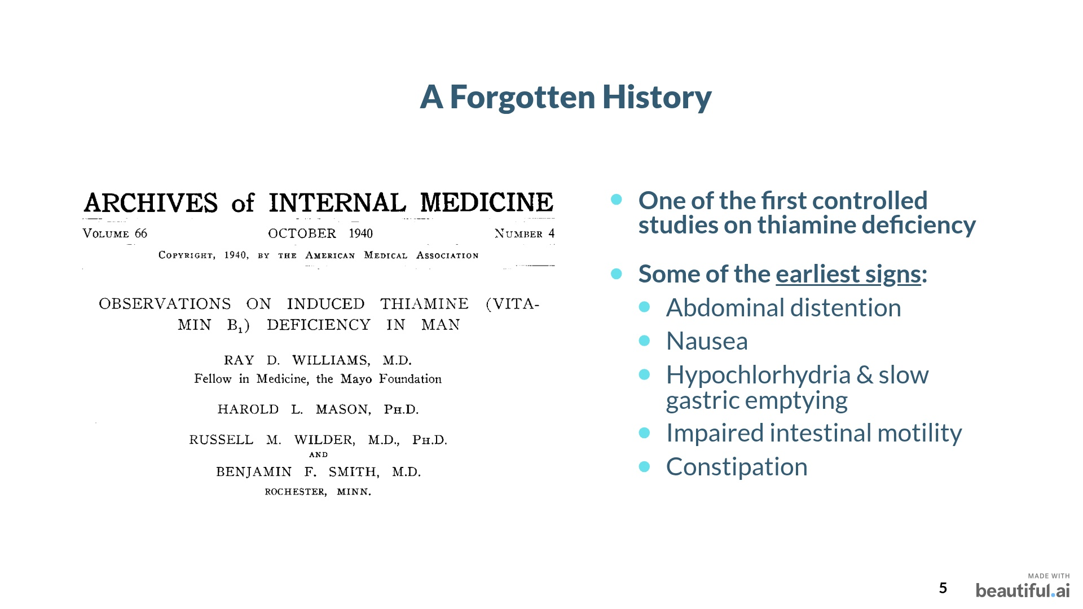
Notes:
This idea isn’t new. In the 1940s, controlled studies showed GI dysfunction as the first sign of deficiency. But somehow, this knowledge never made it into clinical guidelines.
I later stumbled upon one of the first ever controlled trials of experimental thiamine deficiency in humans. What did they find? SAME thing. In every participant – low stomach acidity, motility, impaired intestinal paralysis.
Many of the issues with CAUSE what we now know as functional gut disorders.

Slide 6
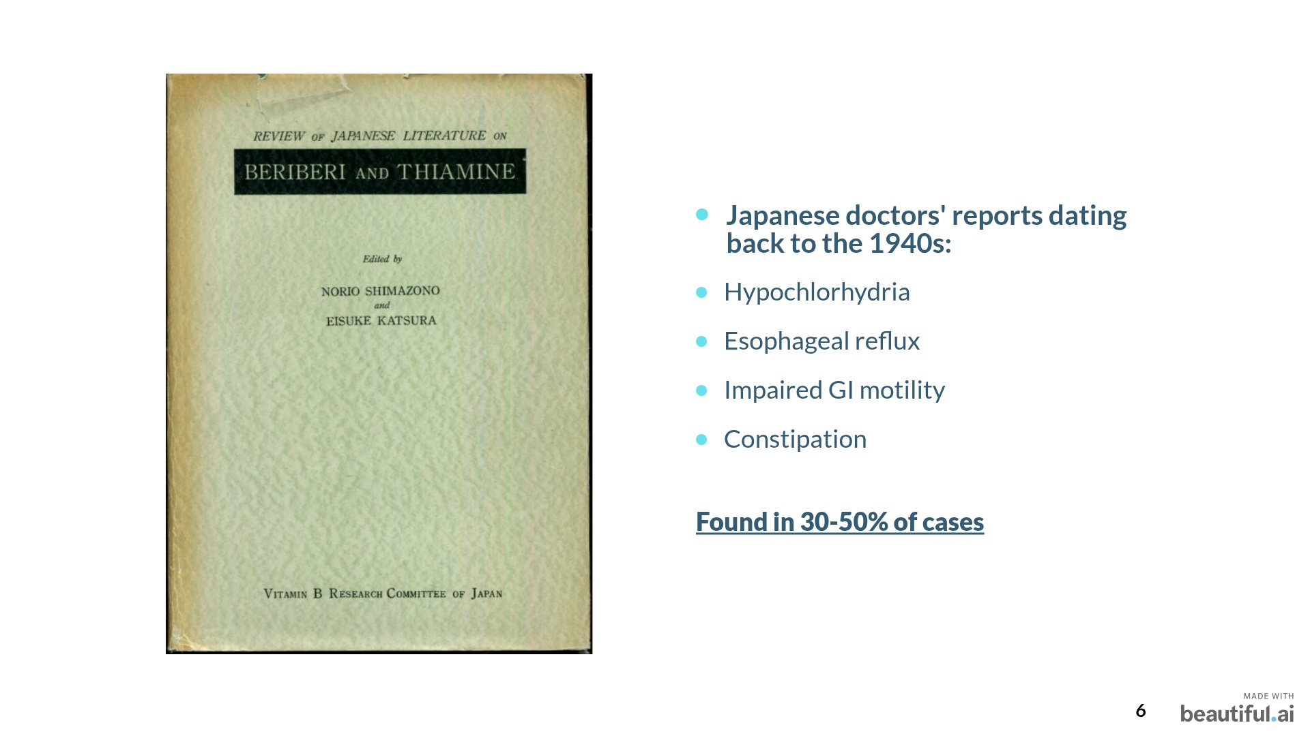
Notes:
I paid a small fortune for a book, which is now out of print. This one right here, published in 1960. In 30-50% of cases they found strong GI symptoms.

Slide 7
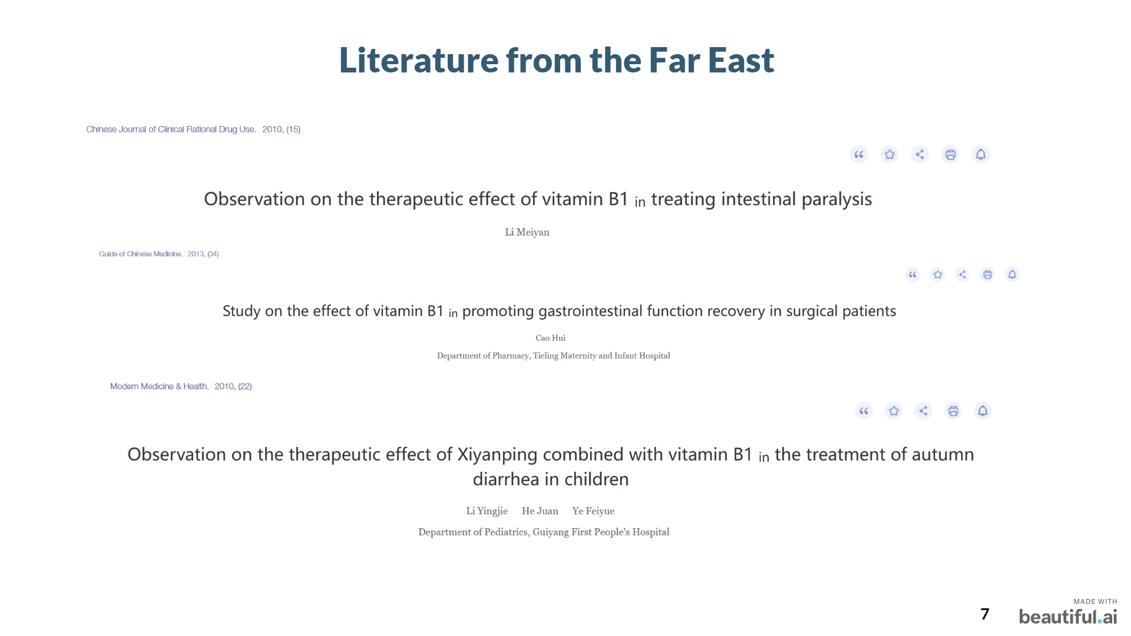
Notes:
I did the same in China, had to sign up and pay for the studies. Fortunately they are cheaper than in the west, otherwise I’d be bankrupt right now. In those papers they speak as if it was common knowledge, that thiamine was involved in the gut conditions. So I did some more digging

Slide 8
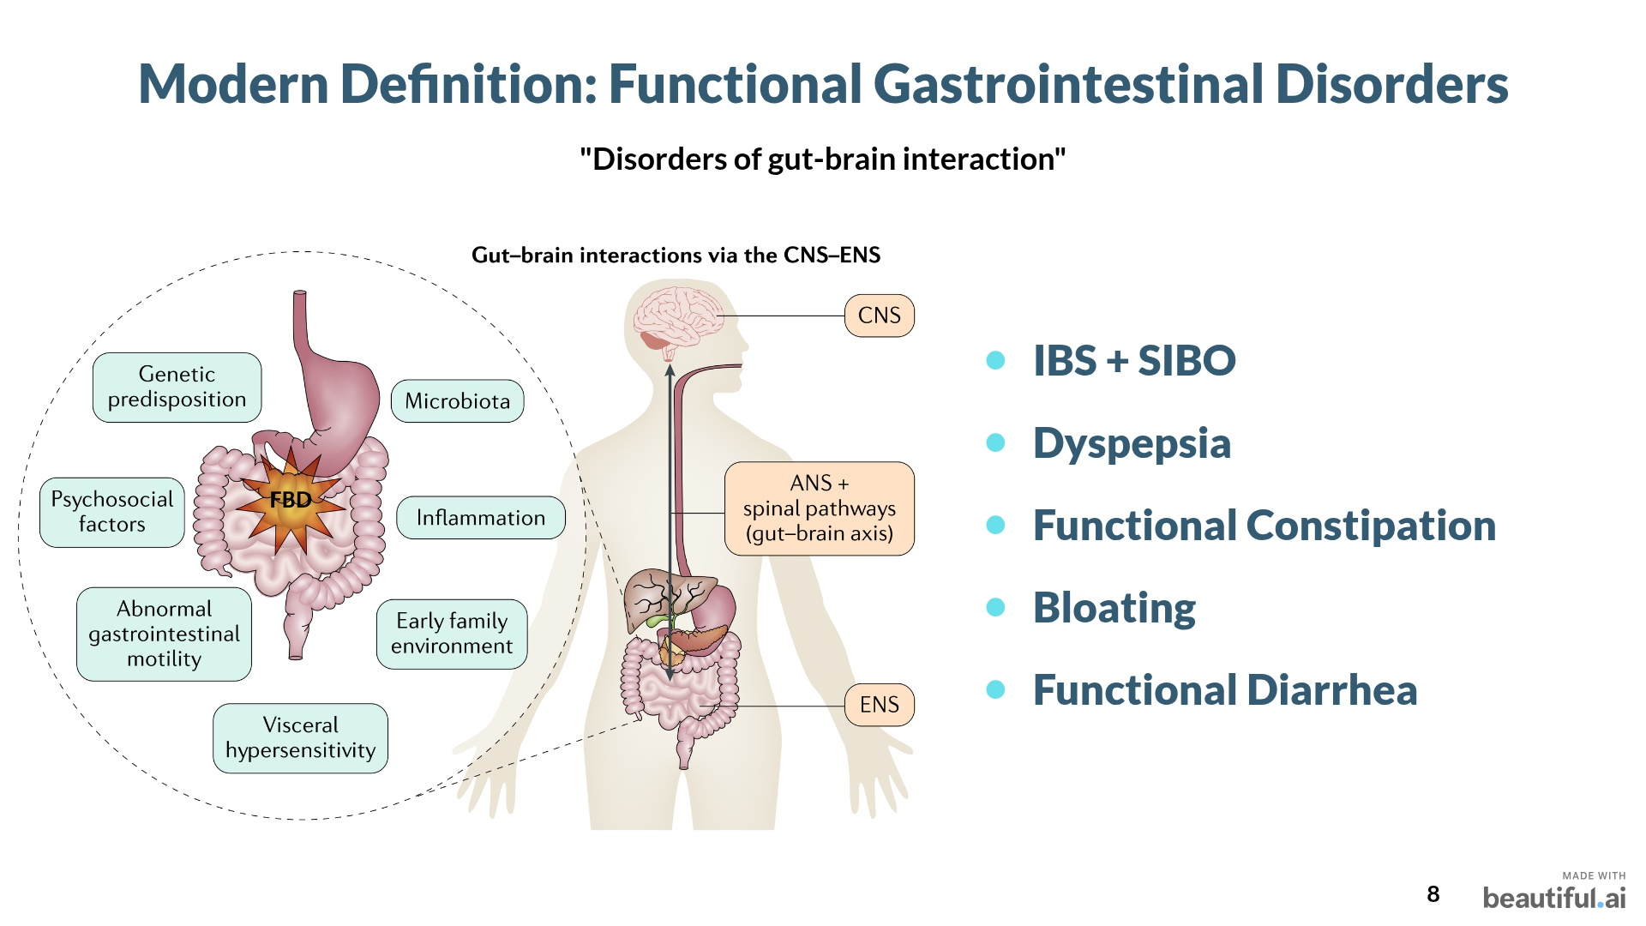
Notes:
Now we focus HEAVILY on microbes- aaaand sometimes that works. But sometimes it doesn’t. And do you remember what I said? Mitochondria, not microbes!

Slide 9
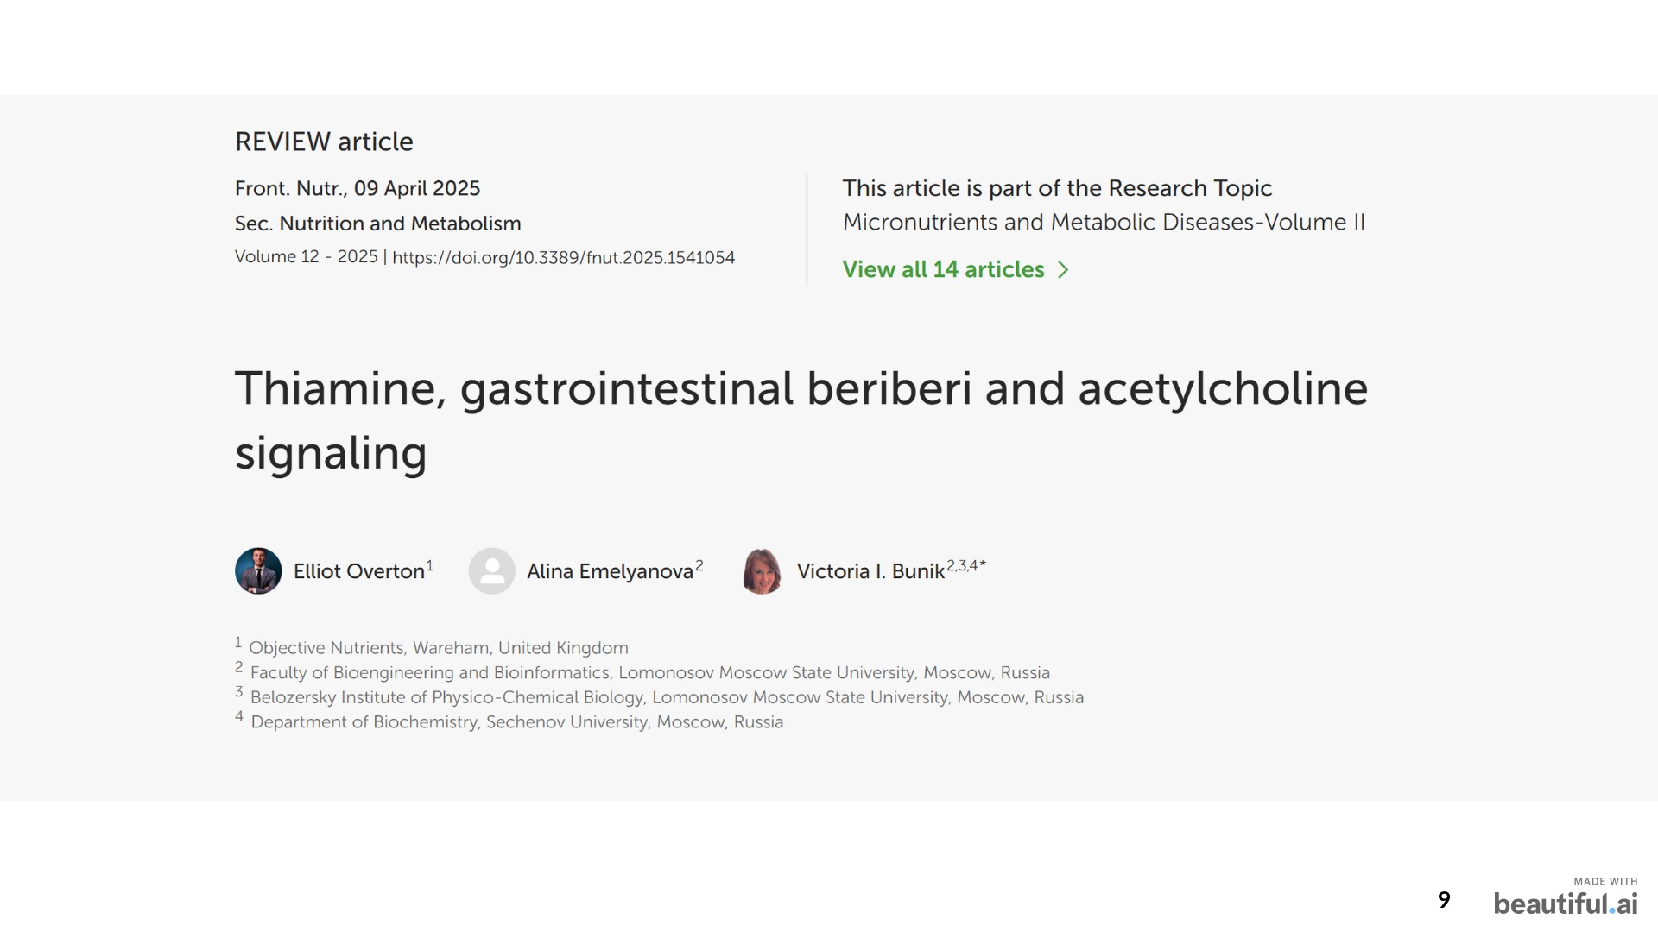
Notes:
So over the years I have studied every possible paper and mechanism which might help to explain what I was seeing, and we eventually pooled it all together into this paper: And so I believe that we have now a rough idea of what might be going on. We want to understand how, and why, thiamine can work for gut conditions, or what we call “functional gut disorders”

Slide 10
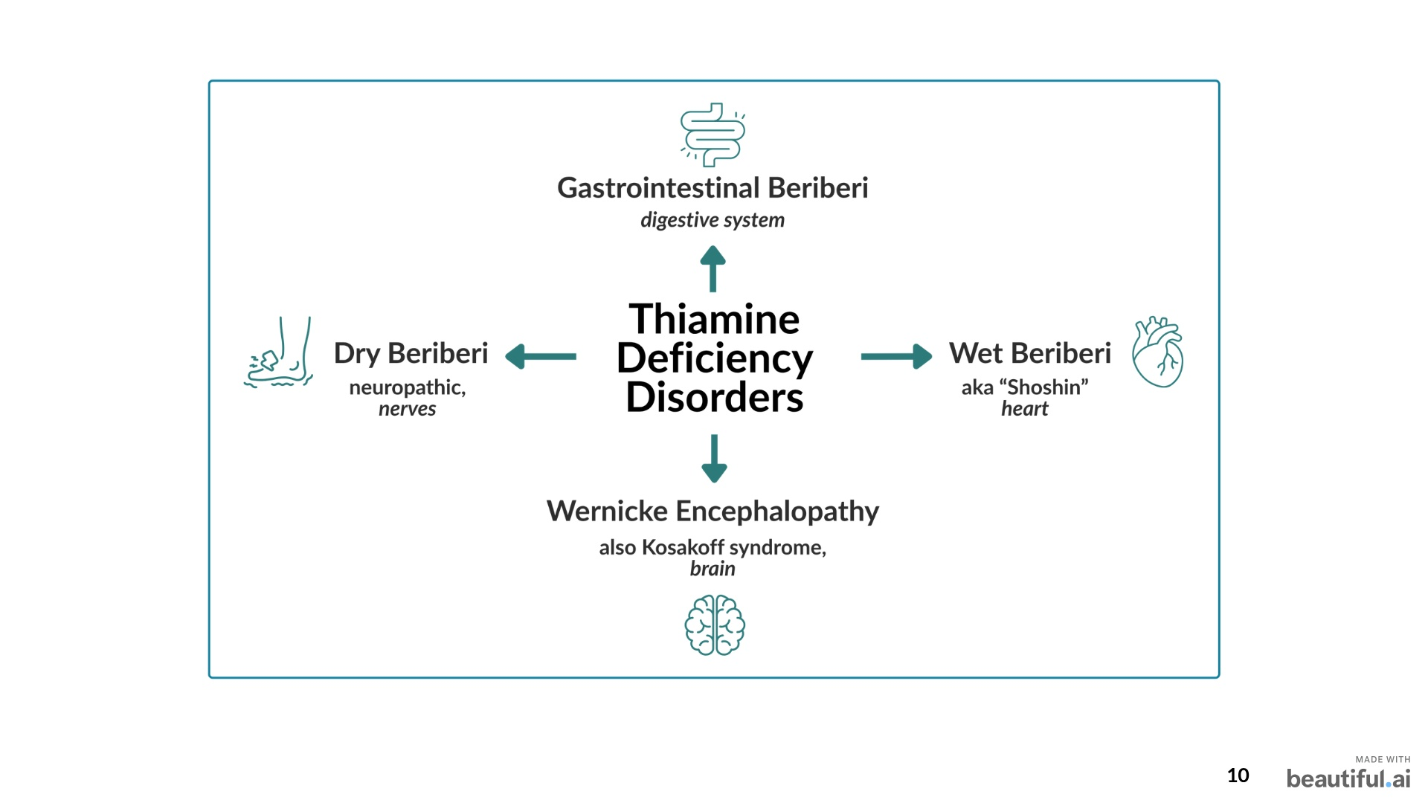
Notes:
But what are functional gut disorders? XYZ – causes, microbes, etc. Basically – most of your patients or clients with gut issues will meet the criteria for at least on functional gut disorder, OK? One study showed: 49% of females and 37% of males meet the diagnostic criteria for at least one FGID. Prevalence estimated to be between 10-40%

Slide 11
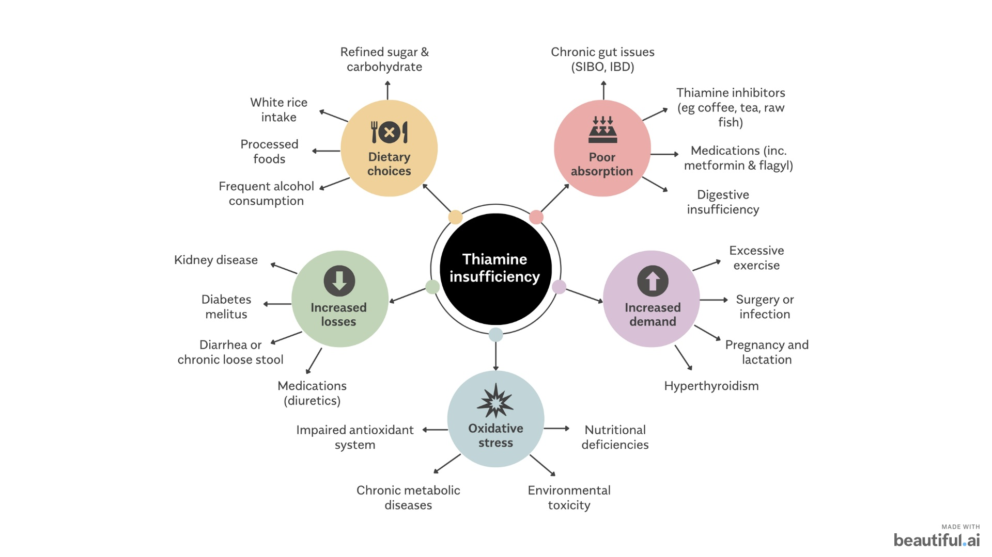

Slide 12
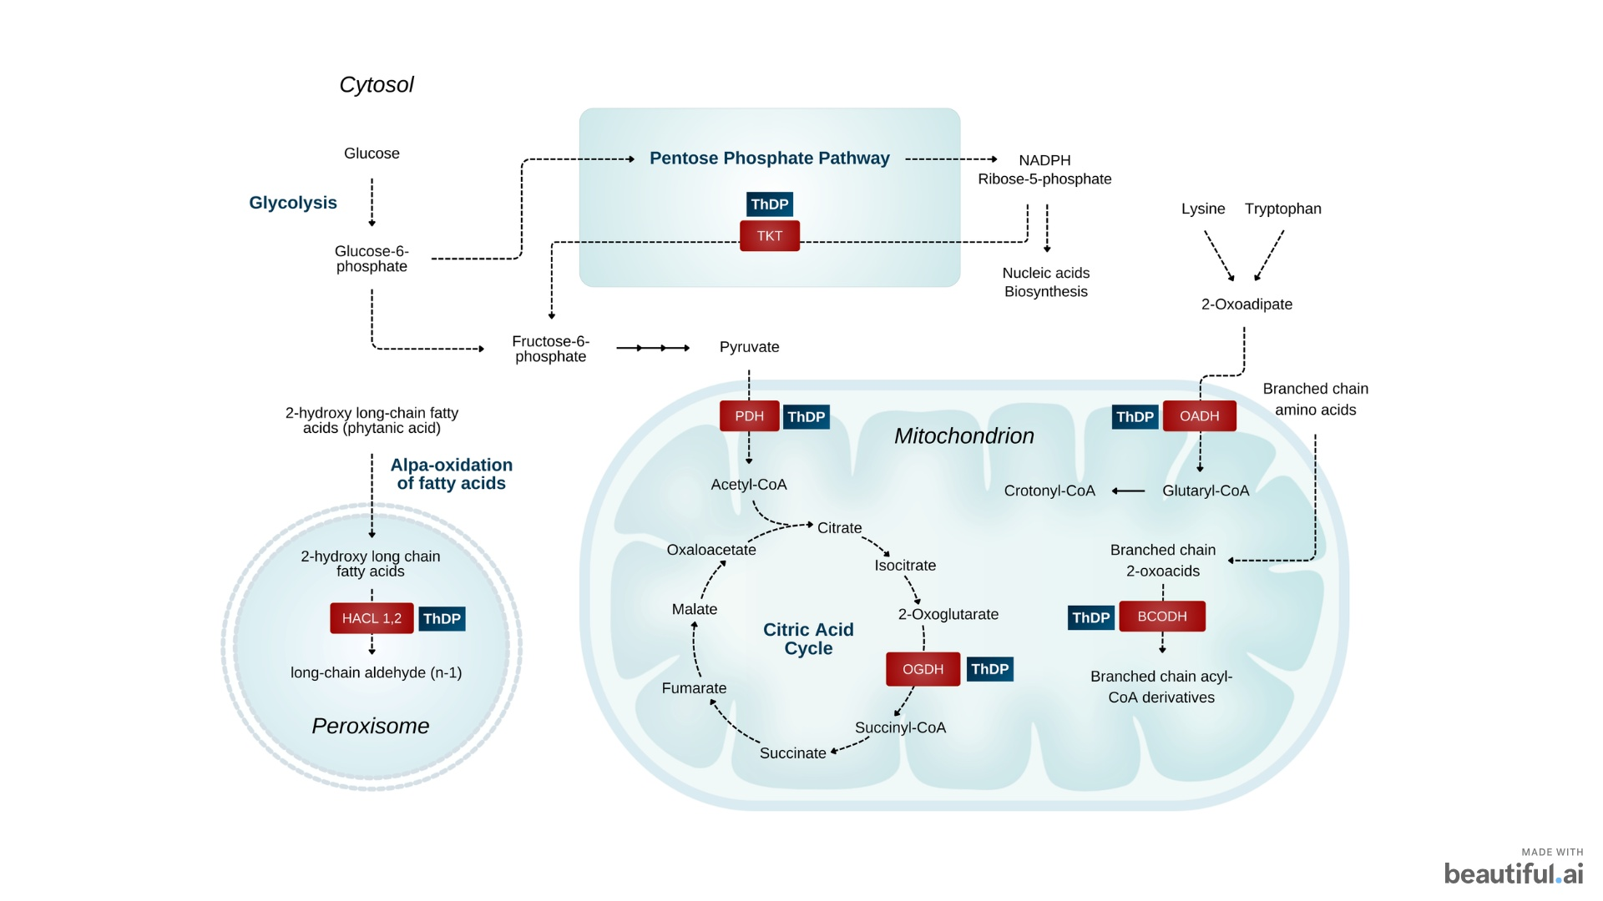

Slide 13
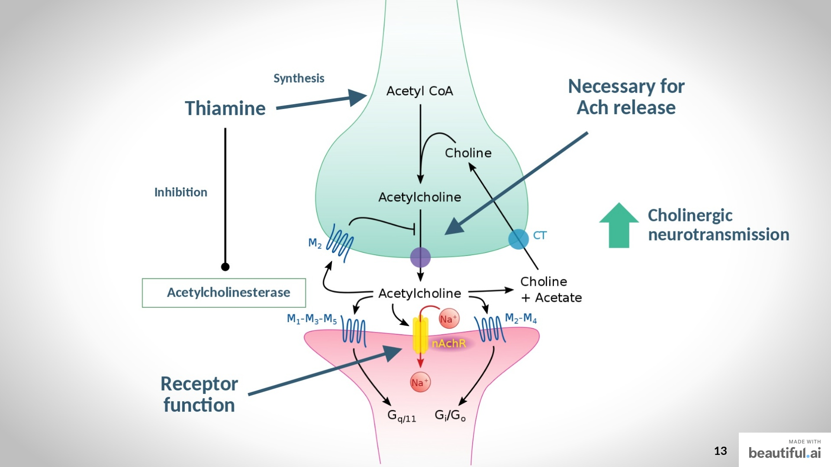


Slide 14
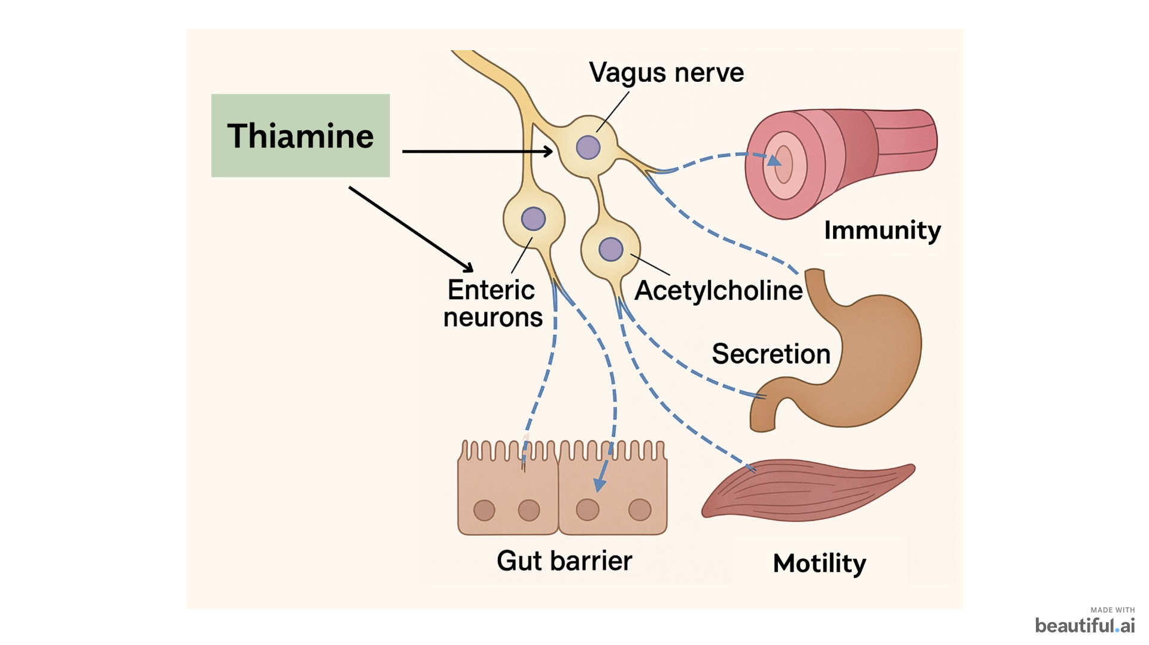
Notes:
Go back to basic phsyiologiy : The cells of your GI tract are told what to do, and at what times, by their connected neurons. Thiamine is not only necessary for the production of Ach, but through non-coenzyme mechanisms, it is necessary for the release and action of acetylcholine in neurons across the whole body. Indeed, the research suggests that thiamine is working in the gut through enhancing acetylcholine action. This is super important.

Slide 15
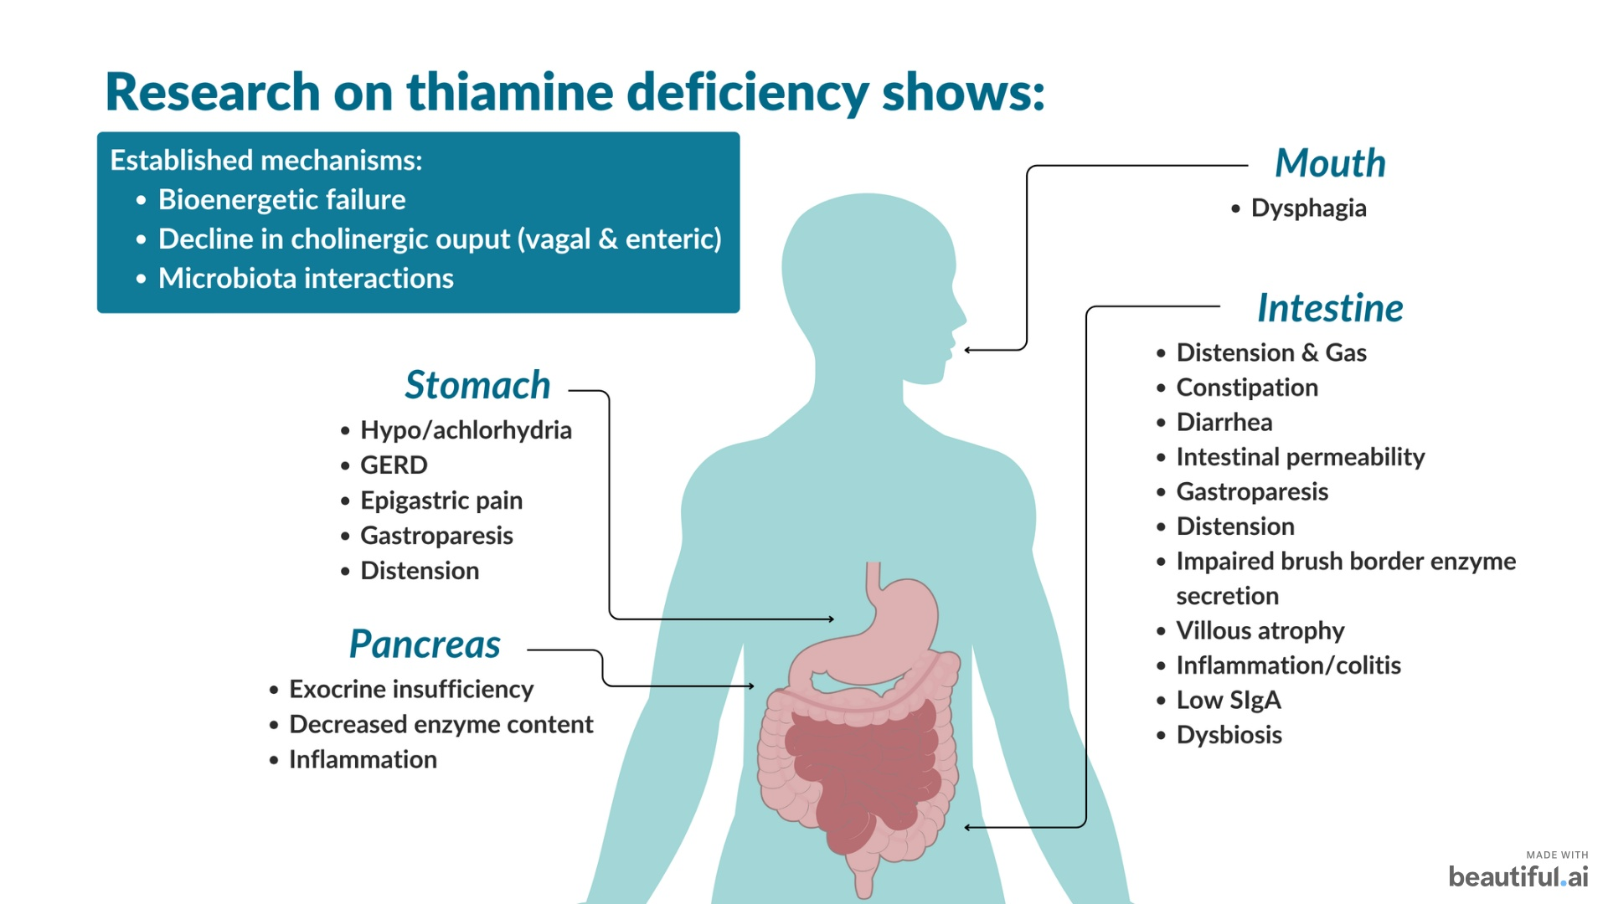

Slide 16
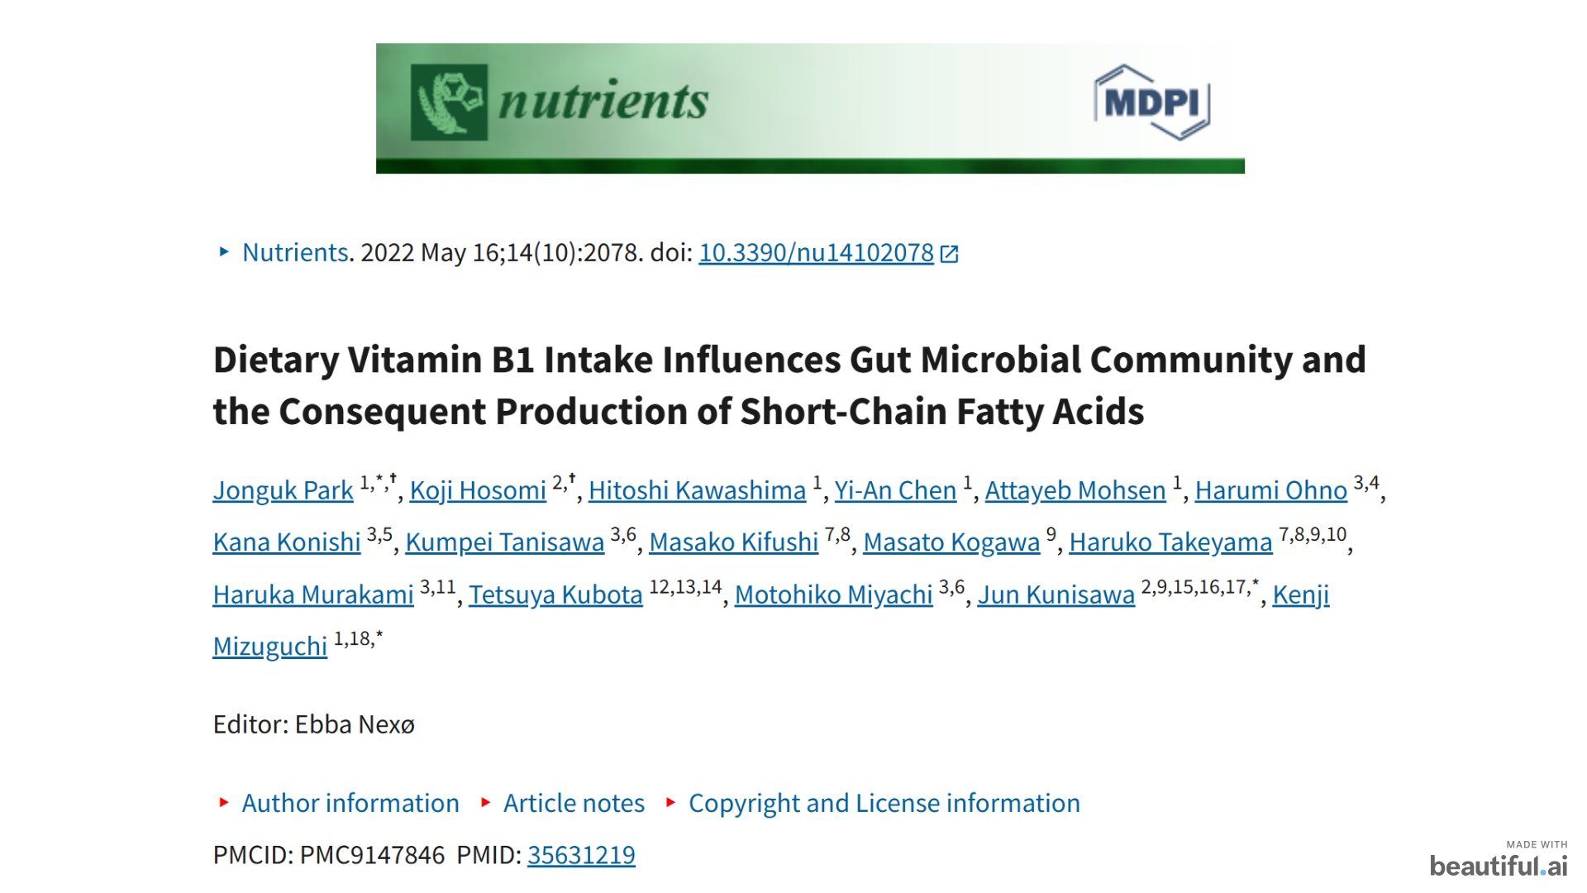
Notes:
The rate limiting factor in butyrate production!

Slide 17
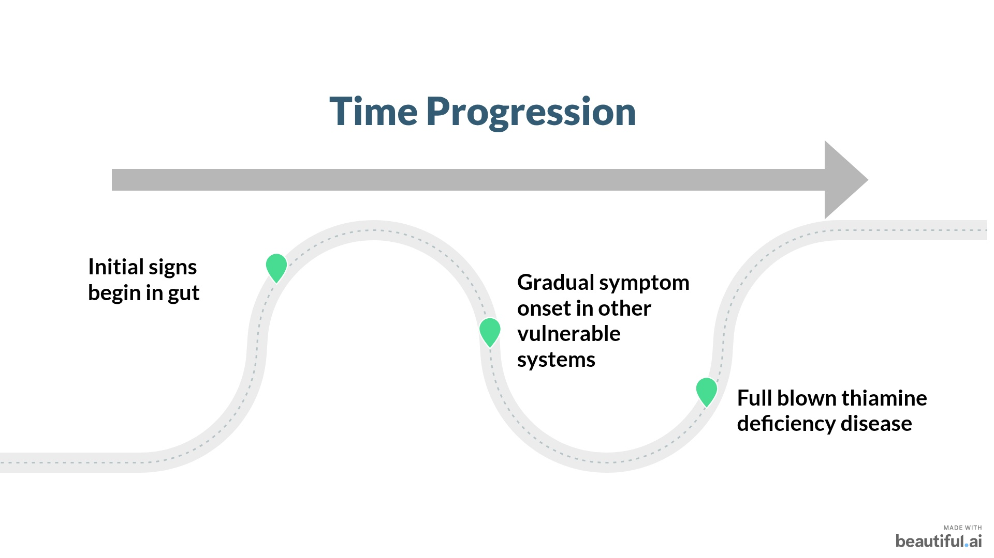
Notes:
reduced
activity of thiamine-dependent enzymes leads to a defective gut barrier

Slide 18
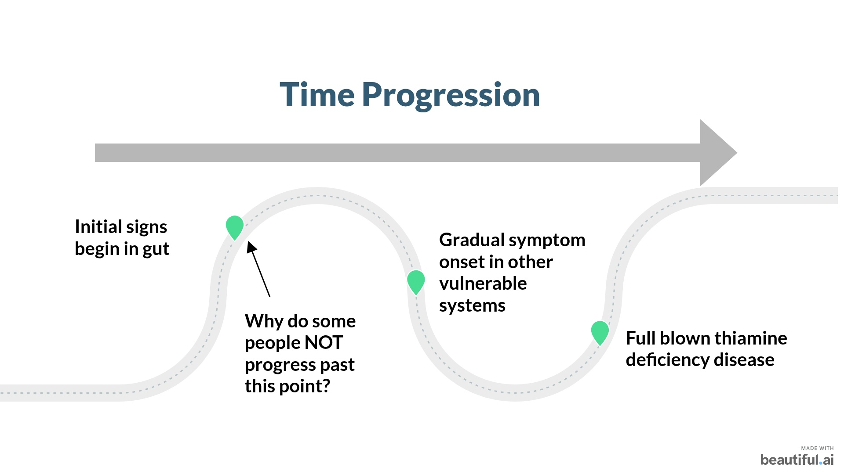
Notes:
reduced
activity of thiamine-dependent enzymes leads to a defective gut barrier

Slide 19
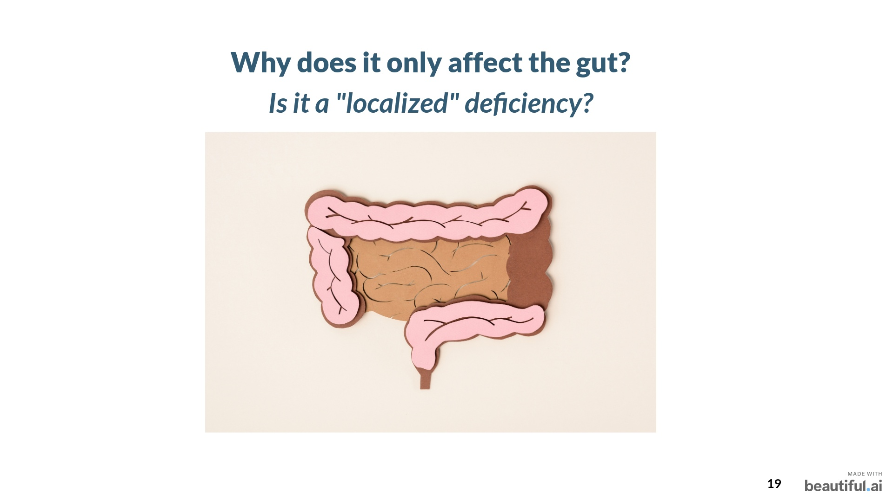
Notes:
But aside from gastrointestinal beriberi, is there any other research showing it can have more mild effects on the gut?

Slide 20
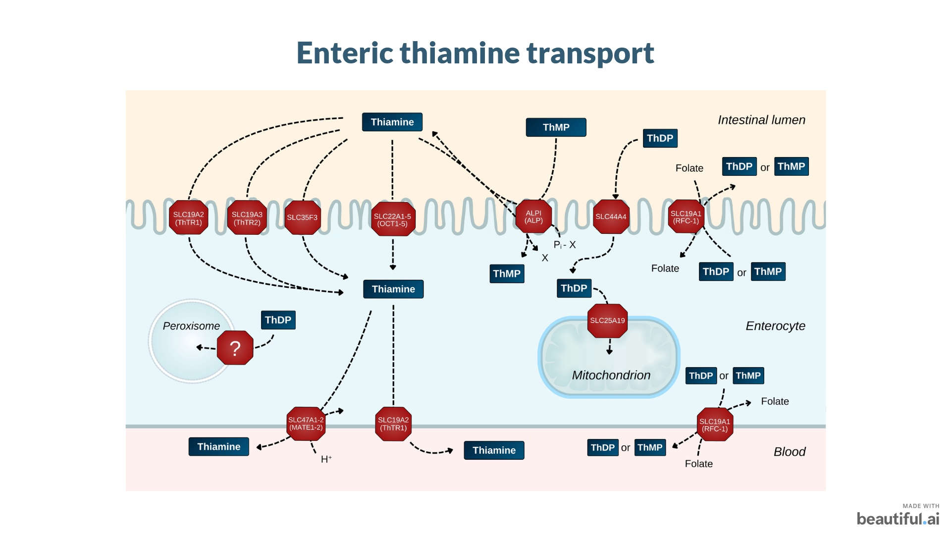

Slide 21
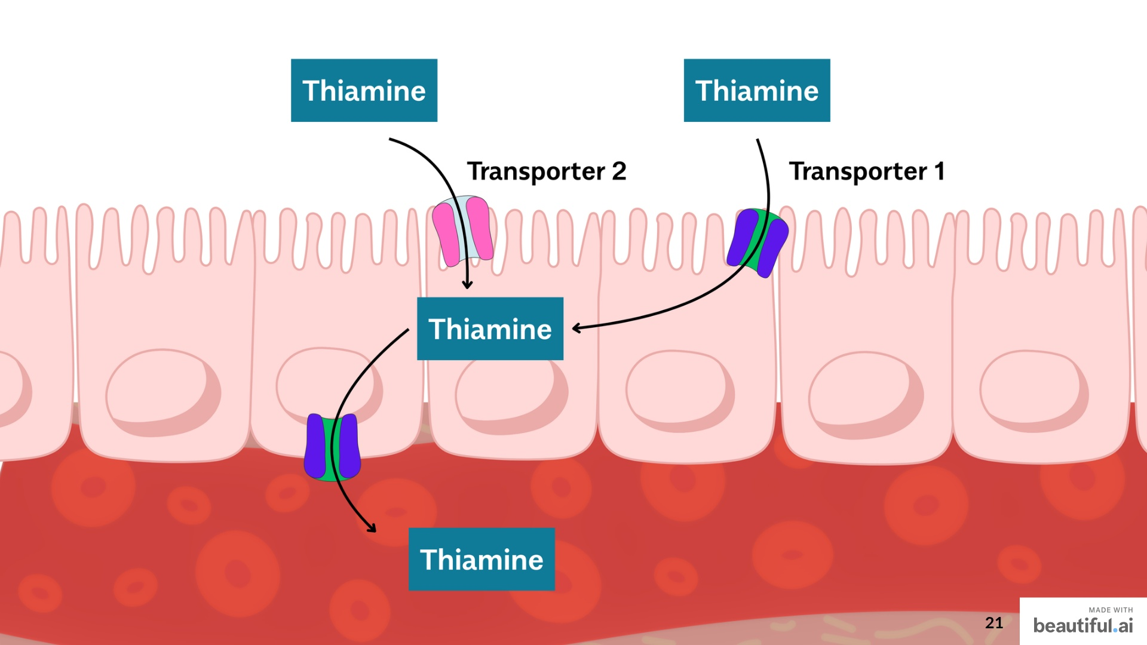

Slide 22
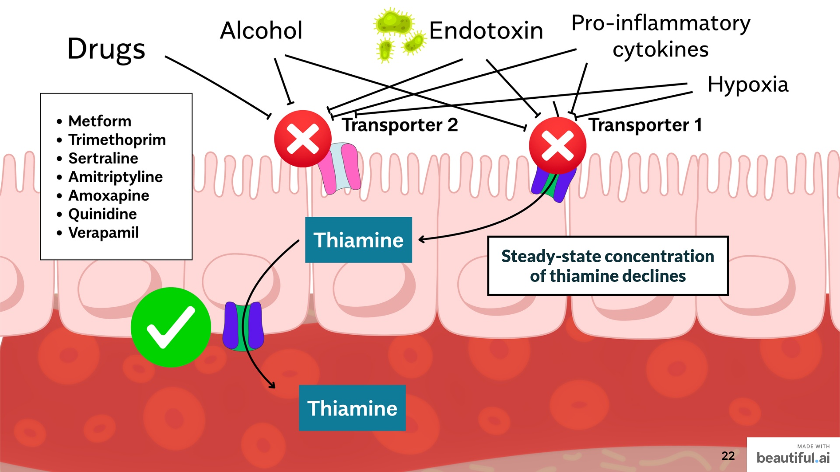

Slide 23
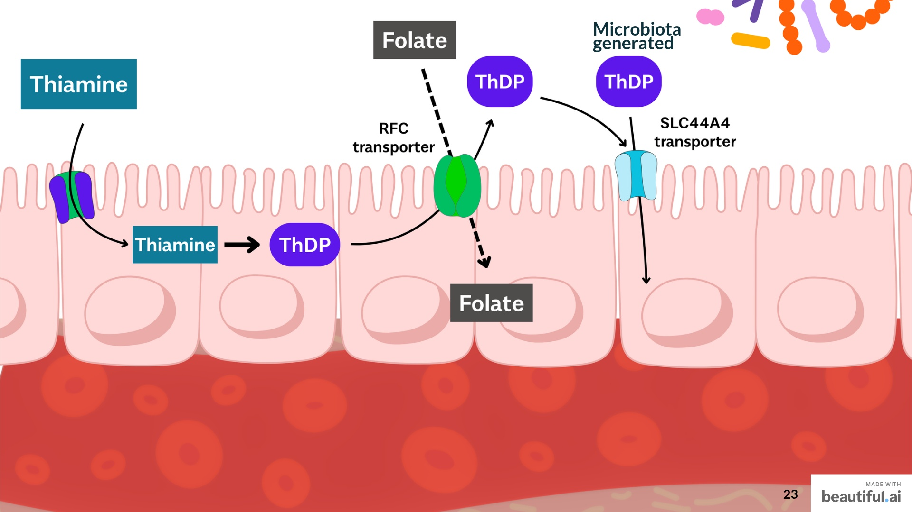

Slide 24
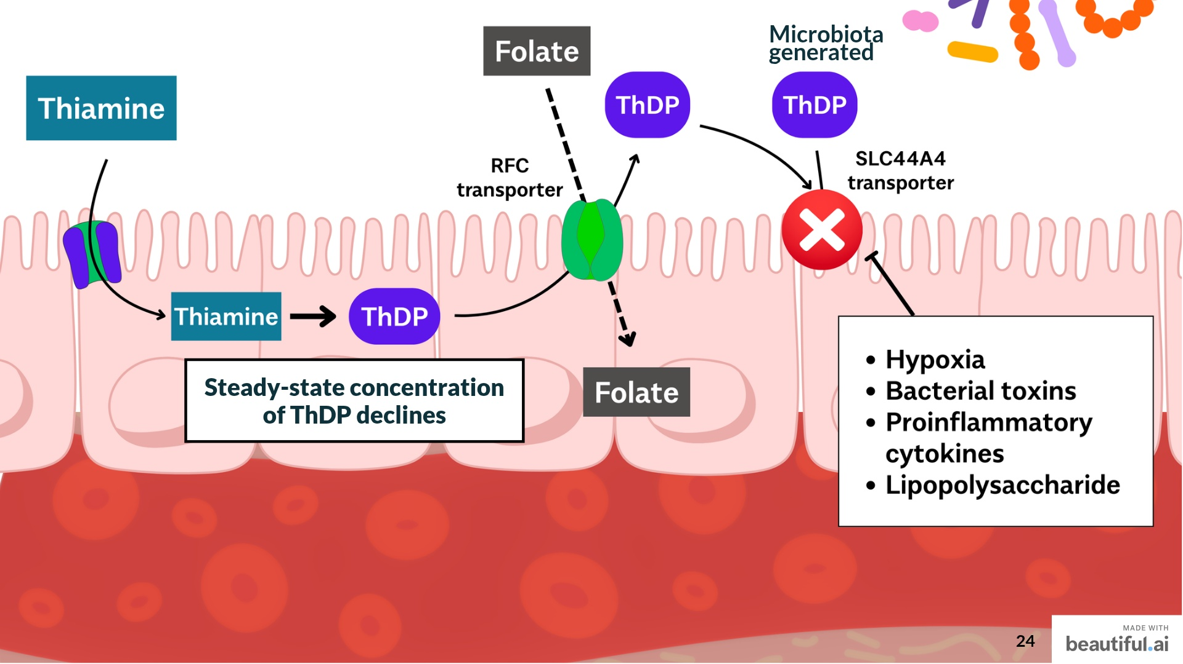

Slide 25
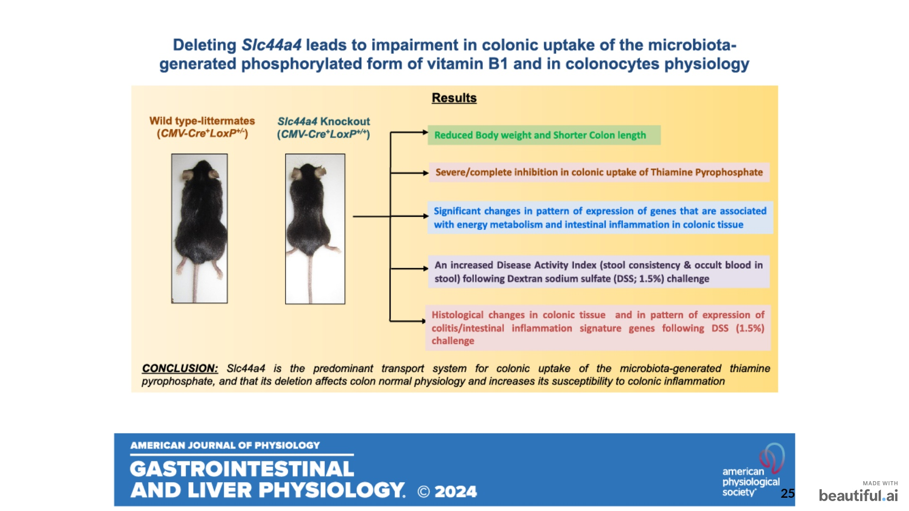


Slide 26
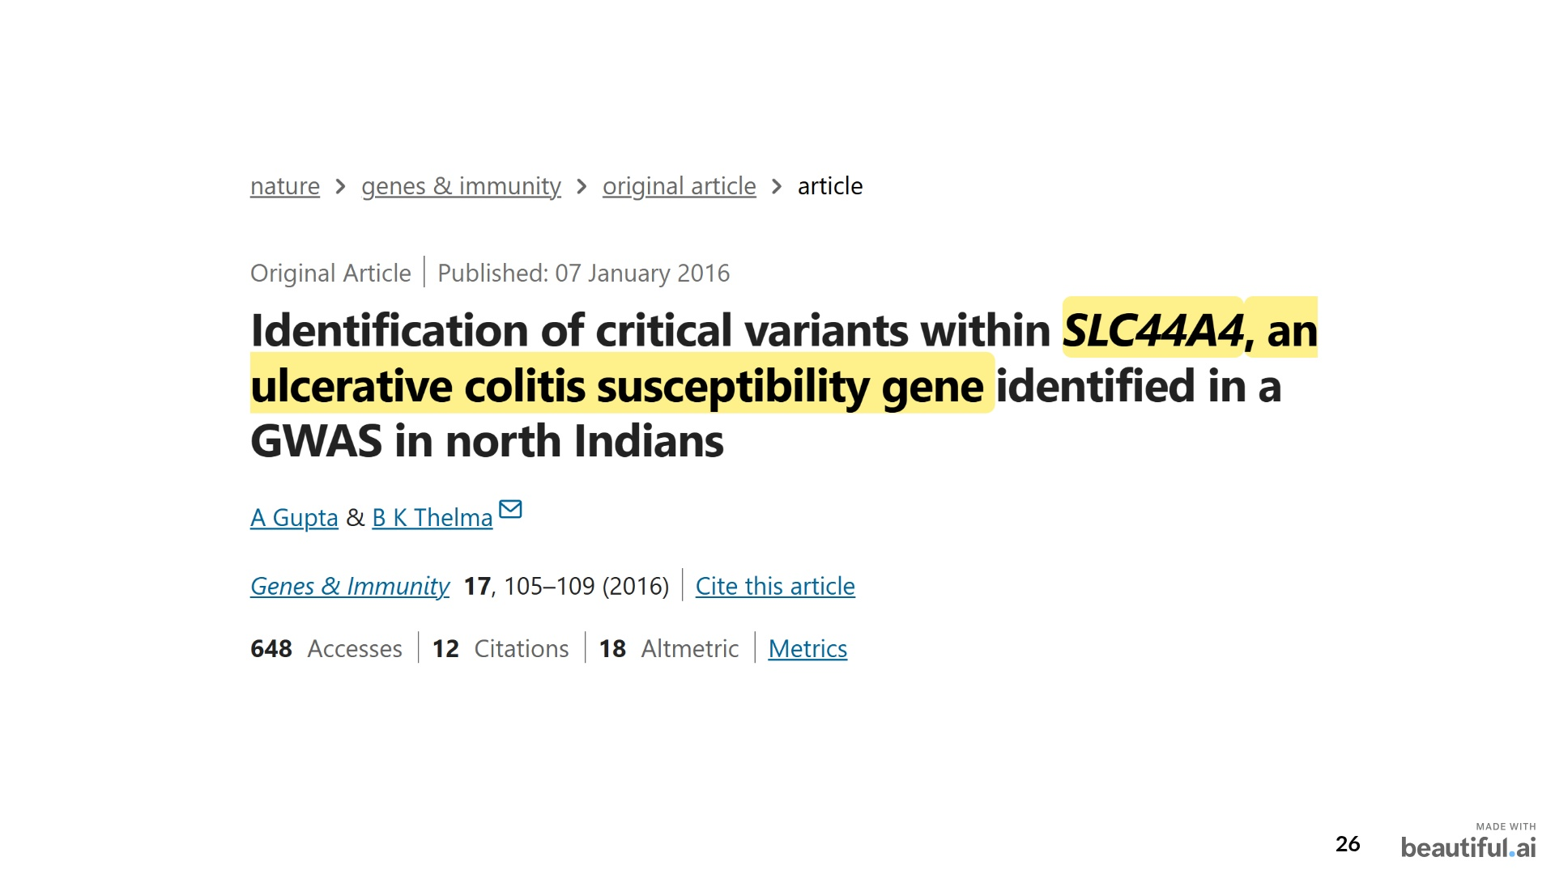

Slide 27
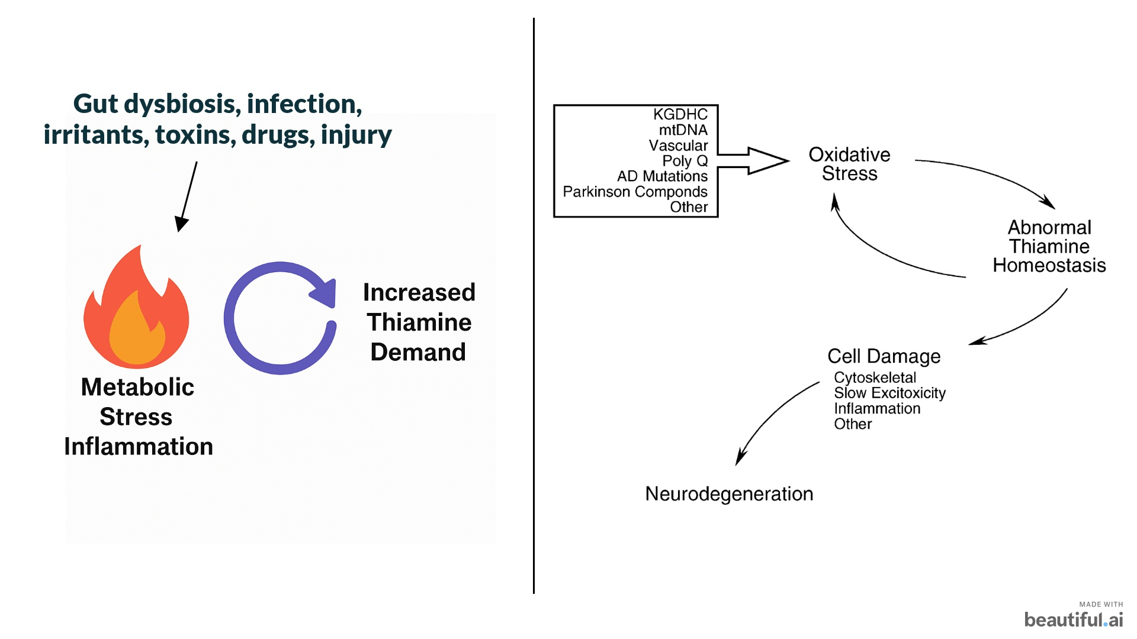

Slide 28
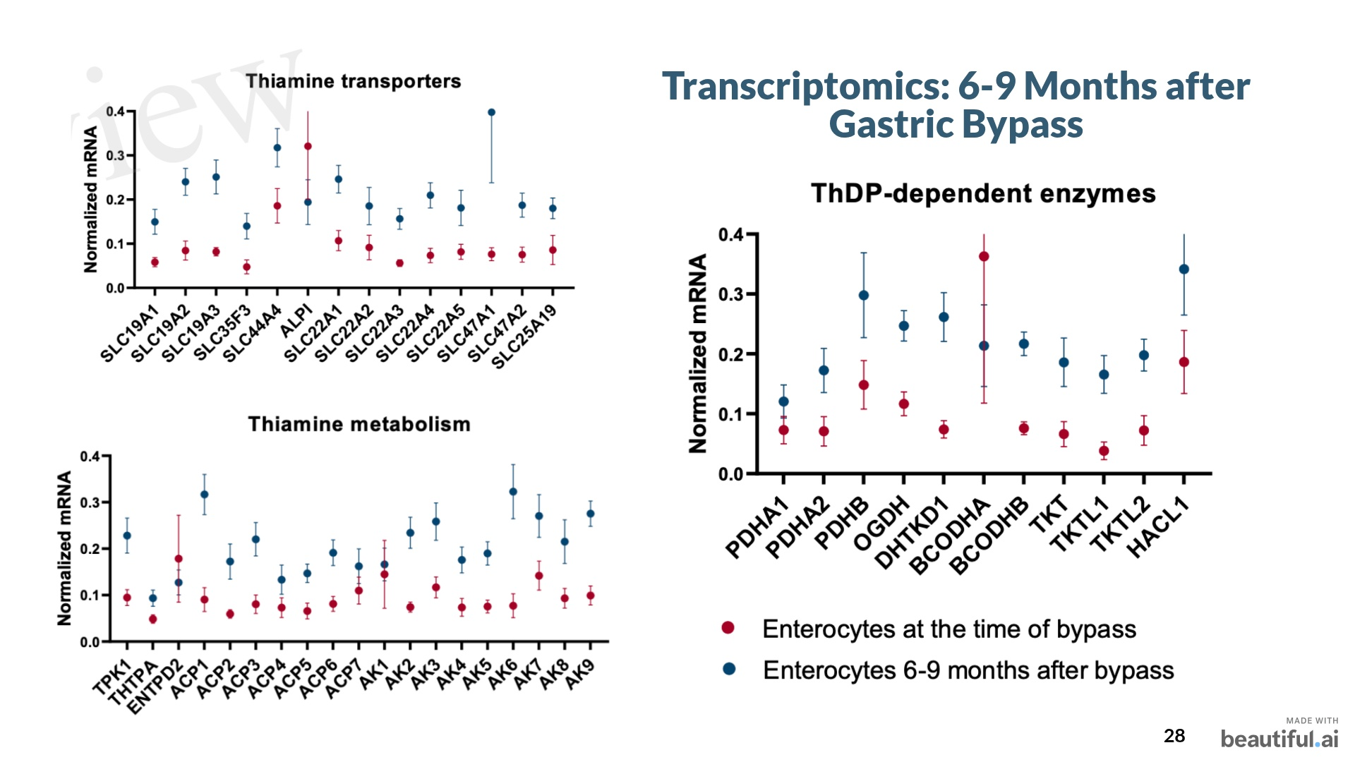

Slide 29


Slide 30
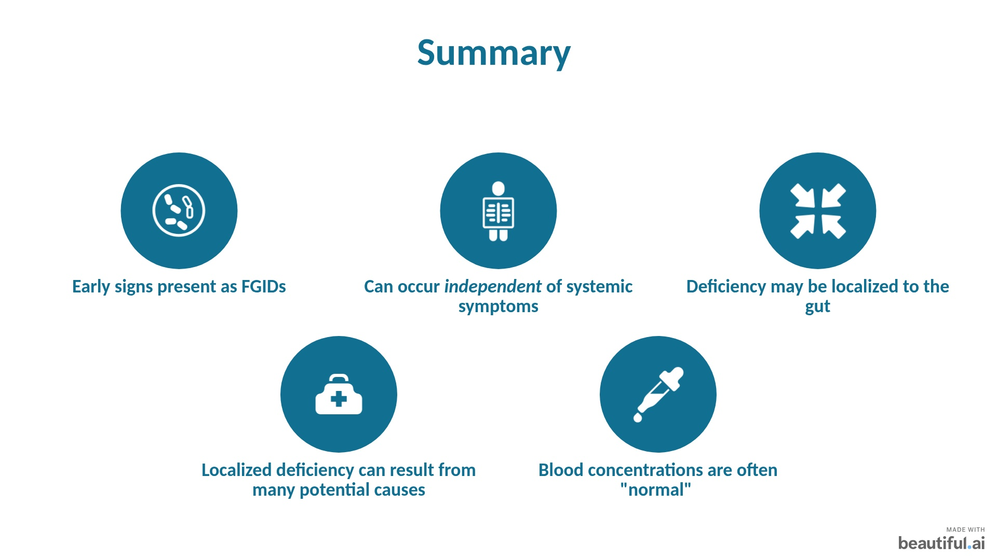
Notes:
The early signs of thiamine deficiency can occur primarily in the GUT
- It can lead to a lack of digestion secretion, digestive motility, and barrier function in any of the GI organs. Stomach – GERD or gastro, intestine – SIBO, IBS, permeability, - Colon – constipation, IBD, etc. - FGID
- The symptoms can occur long before any other systemic symptoms appear.
- The deficiency can be localized to the gut, meaning that it WILL NOT show up on your tests. This occurs for many potential reasons, but you have to understand that your body will PRIORITIZE certain regions of the body. The gut is exposed to many bad things, and those bad things can deplete vitamin B1.
- This is a safe, non-toxic therapy – and there is no harm in testing. Ill show you why to use it, when to use it, and how to use it.

Slide 31
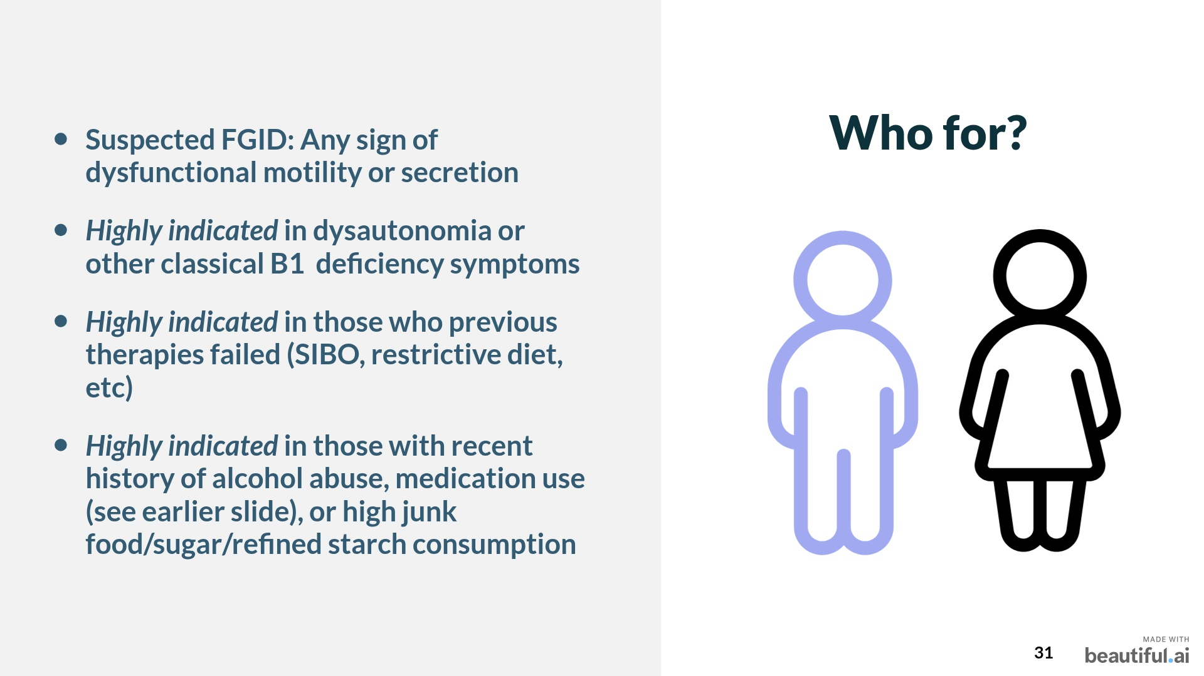

Slide 32
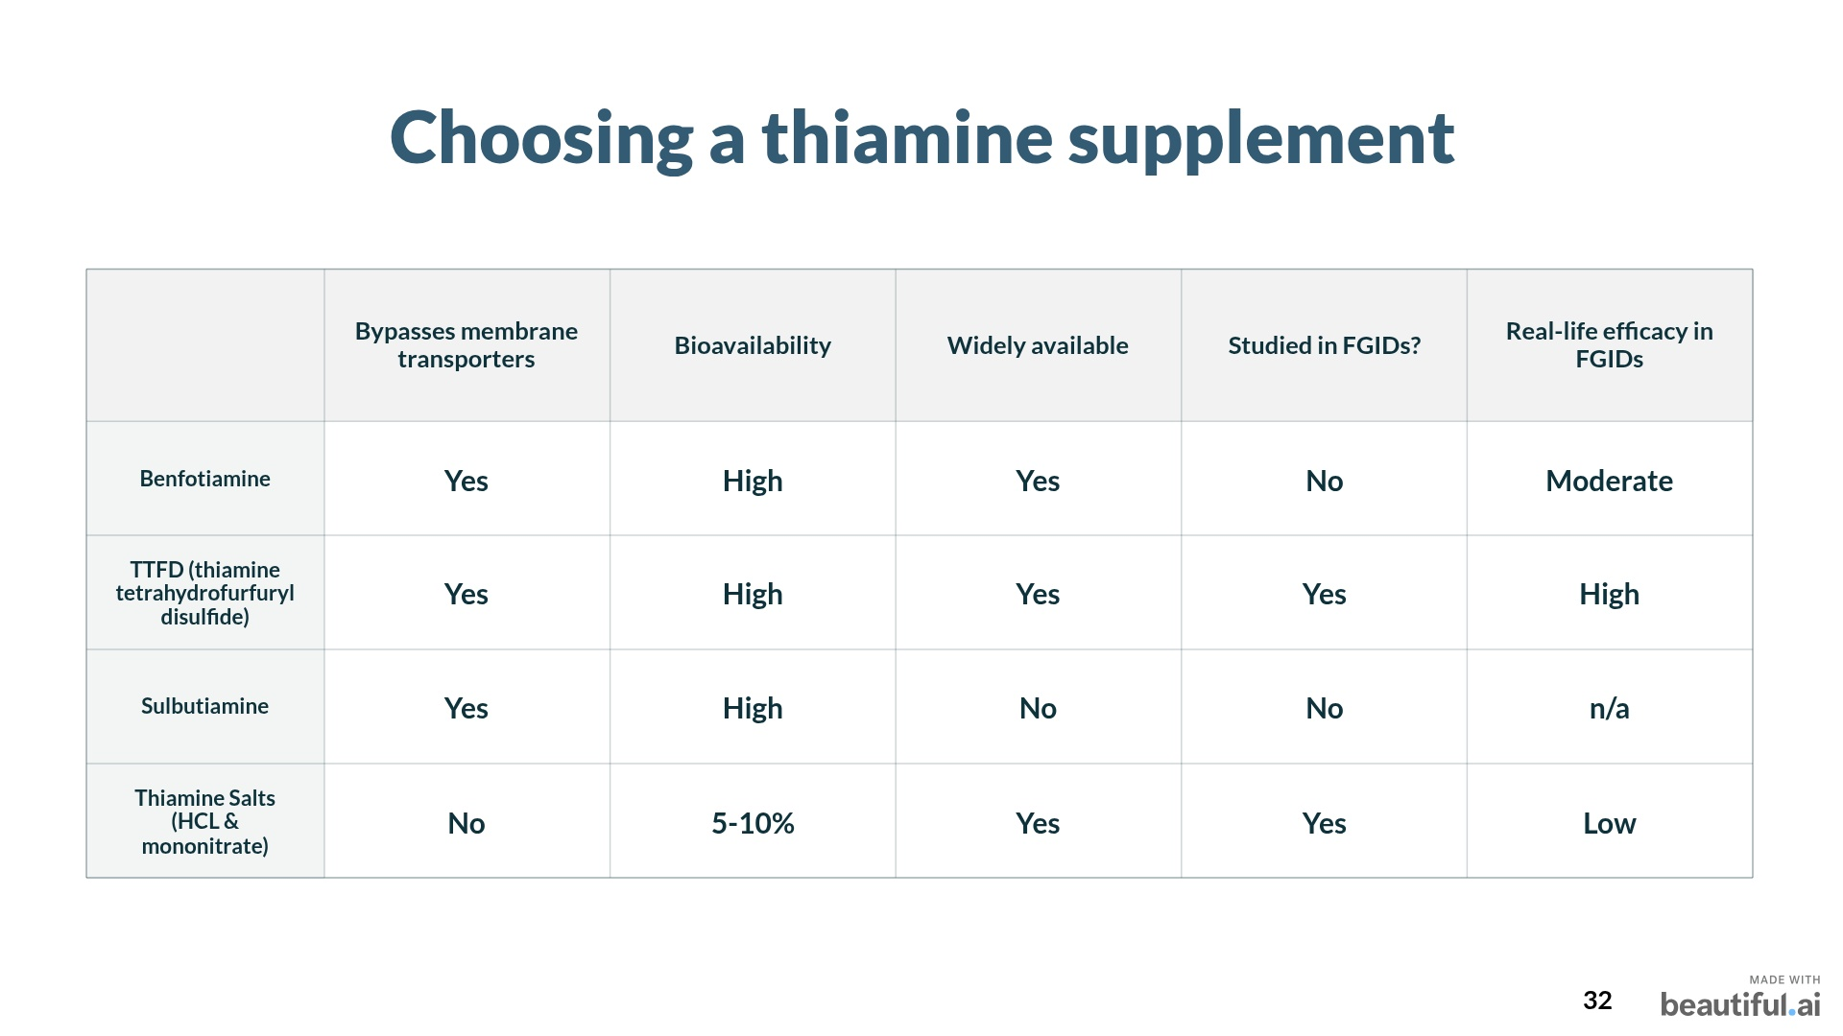

Slide 33
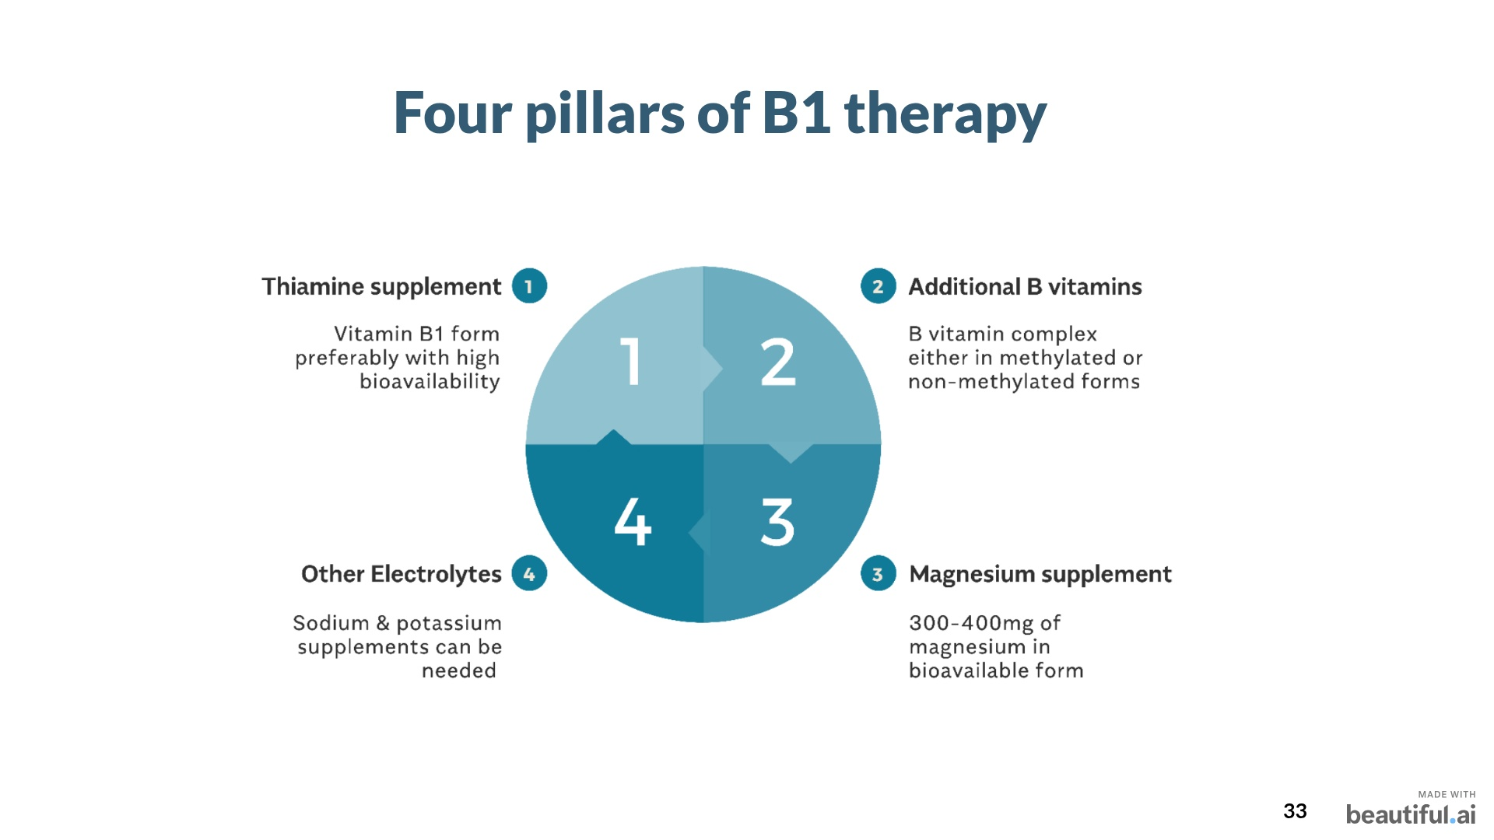

Slide 34


