Slide 1
When
Your Home Disrupts
Your Microbiome
Pejman Katiraei, DO

Slide 2
Pejman Katiraei, DO
Western University of Health Sciences – Doctor in Osteopathy 2003
LLU: Pediatric Residency, Pediatric Chief Residency, Pediatric Faculty, Founder of Loma Linda University Wholistic Medicine Clinic
Fellowship in Integrative Medicine, University of Arizona (Andrew Weil MD)
Fellowship in Systems Biology – 1 of 30 physicians in US formally trained
Trained in Functional Medicine, Biomedical Approaches, Osteopathy, Medical Herbalism, Holistic Nutrition, Mold, etc.
10+ year experience treating 1,000’s of children with severe behavioral and learning challenges
Heavy clinical/research focus on how damp environments impact children with ASD and mental health.
Notes:
Is this really necessary??

Slide 3
Clinical Observation: Children exposed to damp environment can develop significant/chronic gastrointestinal and microbiome imbalances.
Working Hypothesis: These gut and microbiome imbalances are due to the downstream immuno-metabolic effects of dampness.

Slide 4
How Toxins Impact the Gut and Mitochondria
 | Glyphosate | Heavy Metals | Processed Foods | Sugar/ SAD | Phthalate/ Etc. | COVID | Air Pollution
Disrupt Mitochondria and Metabolism | ✓ | ✓ | ✓ | ✓ | ✓ | ✓ | ✓
Disrupt The Gut and Microbiome | ✓ | ✓ | ✓ | ✓ | ✓ | ✓ | ✓
Notes:
500,000 children estimated with lead toxicity. 3.6 million US homes with significant lead pain hazards

Slide 5
TOTAL TOXIN LOAD

Slide 6
1 in 3
of ALL children
are exposed to dampness!

Slide 7
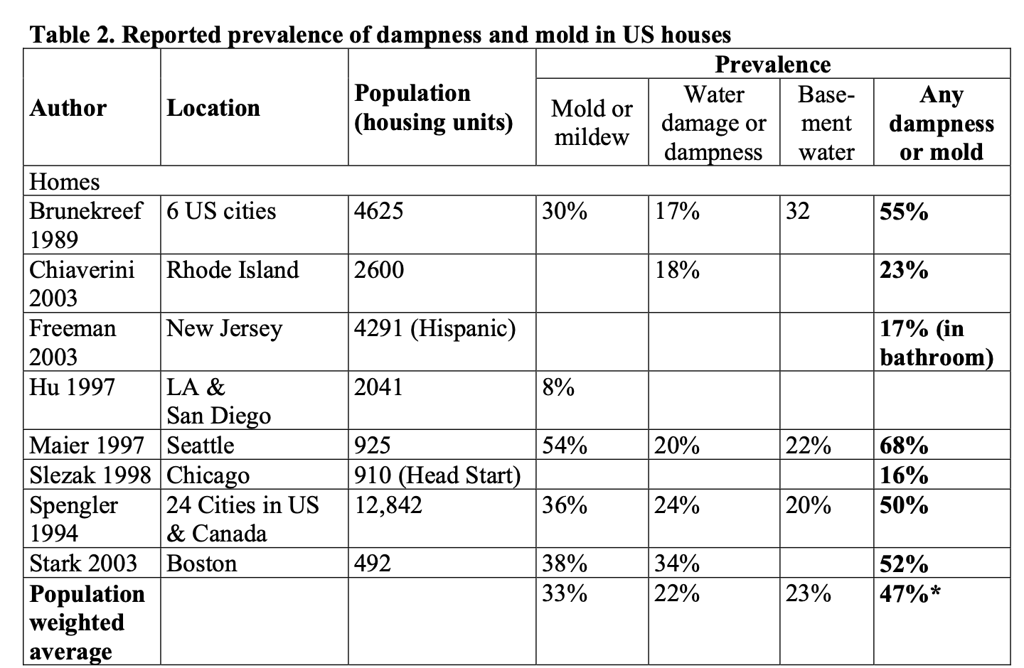
US EPA: “Public Health and Economic Impact of Dampness and Mold”
Mudarri D, Fisk WJ. Indoor Air. 2007, 17(3), 226-35

Slide 8

Flooding and Mold
112 buildings damaged by flood waters after Hurricanes Rita and Katrina found that mold growth was present in 45%..., with heavy mold growth in 17% of homes.
>3 feet of flooding = more likely to be affected.
Annu. Rev. Public Health 2010. 31, 165–78

Slide 9
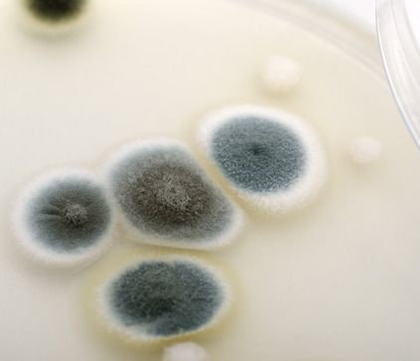
+ H20 =
“Construction techniques…with large amounts of fiberboard and gypsum board…have produced an epidemic of Stachybotrys contamination of buildings.”
Molds were found in significantly higher concentrations in newer compared to older… homes.
Meggs W. Toxicology and Industrial Health. 2009, 25(9-10), 571–576

Slide 10

“Changes in building design…
contaminants are readily produced and may build up to much higher concentrations than are found outside.”
Insulated or sealed attic
“Airtight
Construction”
Insulated
windows and
doors
“Air-sealing”
1) Jones A. Atmospheric Environment. 1999, 33(28), 4535-4564,
Image: https://www.nrcan.gc.ca/energy-efficiency/homes/what-energy-efficient-home/20548

Slide 11
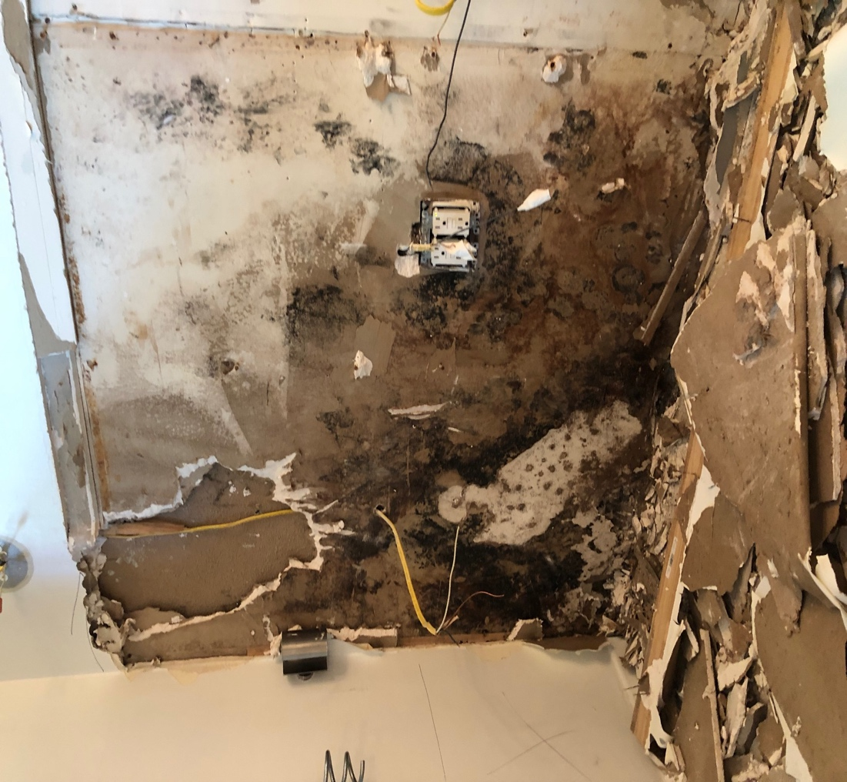
Dampness Creates Dangerous Combination of Toxins = BIOTOXIN ILLNESS
Co-infections/contaminations¹: (1) Multiple molds and mycotoxins (2) G- and G+ bacteria (3) Microbial particulates (4) Microbial volatile organic compounds (5) Proteins (6) Galactomanans (7) 1-3-b-D-glucans (8) LPS – endotoxins
Actinomyces - Valinomycin
Combination of mycotoxins (and endotoxins) could induce toxicity at very low levels…
1) Thrasher JD, Crawly S. Toxicology and Industrial Health. 2009, 25(9-10), 583–615

Slide 12
Signs of Biotoxin Illness – Infant Born Into Dampness
Early onset, and severe colic that lasts well past 3 months of age.
  Future sleep disorder (difficulty falling or staying asleep – sometimes severe)
Significant reflux that lasts past 6 months of age
Multiple food sensitivities or allergies
Eczema, asthma, or allergies
ENT congestion and inflammation (tonsillar and adenoid hypertrophy, significant nasal congestion – leading to recurrent ear infections).
Early onset of sensory issues (overwhelmed easily in loud and crowded environments, pickiness, hair washing/clothing)
Delayed speech and gross motor skills

Slide 13
EXPOSURE =
SYSTEMIC EXPOSURE

Slide 14
Mycotoxins in Serum of Exposed Individuals
Mycotoxins, specifically trichothecenes, aflatoxins, and ochratoxins, can be detected in human tissue and body fluids in patients who have been exposed to toxin producing molds in their environment.¹
Trichothecenes and stachylysin are present in the sera of individuals exposed to S. chartarum in contaminated indoor environments.²
In this study, we were successful in demonstrating the presence of trichothecene mycotoxins in serum samples from individuals exposed to mold (primarily Stachybotrys) in water-damaged indoor environments.³
Our findings indicate that these highly toxic compounds can actually be found in people exposed to these environments and, therefore, have the potential to negatively affect the health of such individuals.⁴
Hooper D, et al. Int. J. Mol. Sci. 2009, 10, 1465 – 75 2) Thrasher JD, Crawley S. Toxicol Ind Health. 2009, 25(9-10), 583-615
3) Brasel TL, et al. Appl Environ Microbiol. 2005, 71(11), 7376-88 4) Brasek TL, et al. Arch Environ Health. 2004, 59(6), 317-23

Slide 15
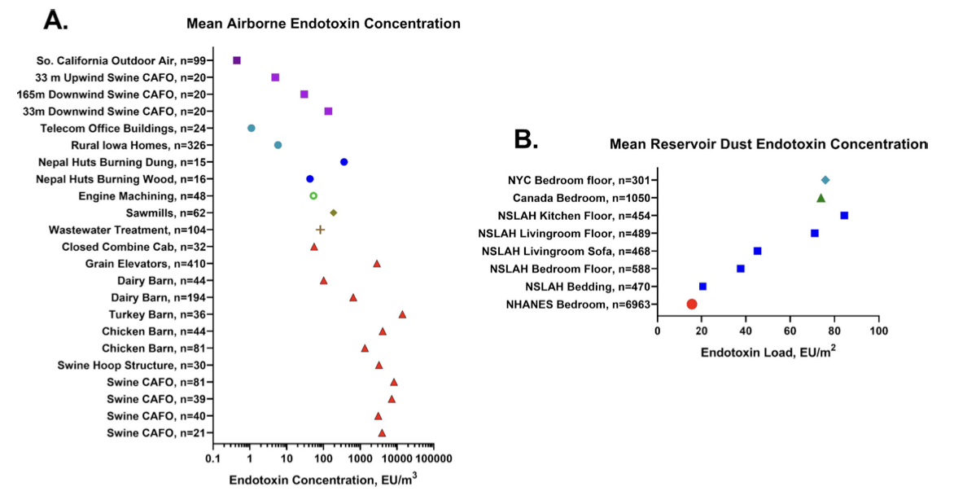
Endotoxins in Serum of Exposed Individuals
Thorne P. J Allergy Clin Immunol. 2021 July ; 148(1): 61–63

Slide 16

MYCOTOXINS CAN BE PASSED THROUGH THE PLACENTA AND BREAST MILK!
Mycotoxins can be secreted into the milk, “so that relatively high levels can be achieved.”¹
Especially in habitual consumers of bread, bakery products and cured pork meat ochratoxin is found often in breast milk… in considerable levels.
In Italy 74% of human breast milk samples yielded high amounts of ochratoxin; in certain samples very high concentrations of up to 405 ng/l.
1) Hof H. GMS Infectious Diseases 2016, 4 2) Wells L, et al. Toxins 2016, 8, 30 | Hof H. GMS Infectious Diseases 2016, 4

Slide 17

Children are the most vulnerable!
Infant exposure:
  In utero + breast milk
  Crawling, mouthing, inhalation
  (12-24” above ground)
Infant remains exposed during
first 2-3 years during:
  Immune priming
  Neuronal development, plasticity, pruning…
  Microbiome formation
  Liver capacity developing
HIGH exposure – low body mass, vulnerable organ systems

Slide 18
DAMPNESS AND THE MICROBIOME

Slide 19
A Healthy Microbiome and Gut Eliminate Mycotoxins!
A HEALTHY microbiome can:
Degrade and aid in detoxification of mycotoxins
Decrease adsorption/bioavailability of mycotoxins
Dysbiosis may cause bioactivation of masked mycotoxins
Guerre, P. Toxins. 2020, 12, 769

Slide 20
Environmental Mold Exposure AND Microbiome
No studies have directly examined the role of inhaled mycotoxins on the microbiome.
Below studies all relate to impact of ingested mycotoxins.
Mycotoxins can enter the gut from the basolateral side (systemic circulation into enterocytes). At very low doses these systemic mycotoxins can disrupt the gut barrier and trigger inflammation.
Mycotoxins are secreted through the bile into the gut.

Slide 21
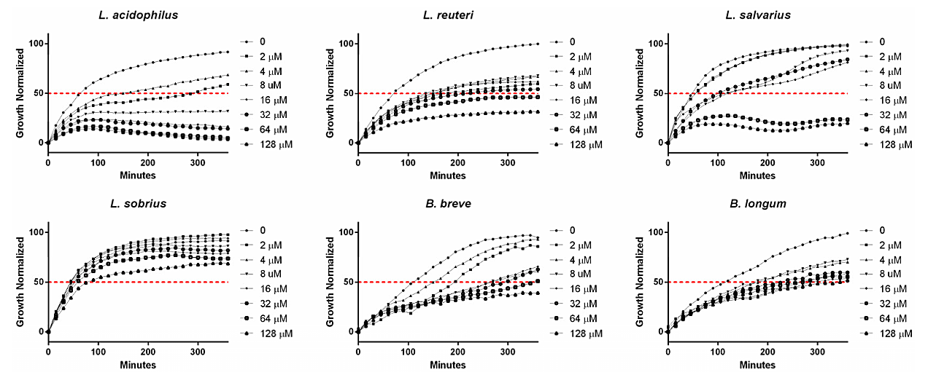
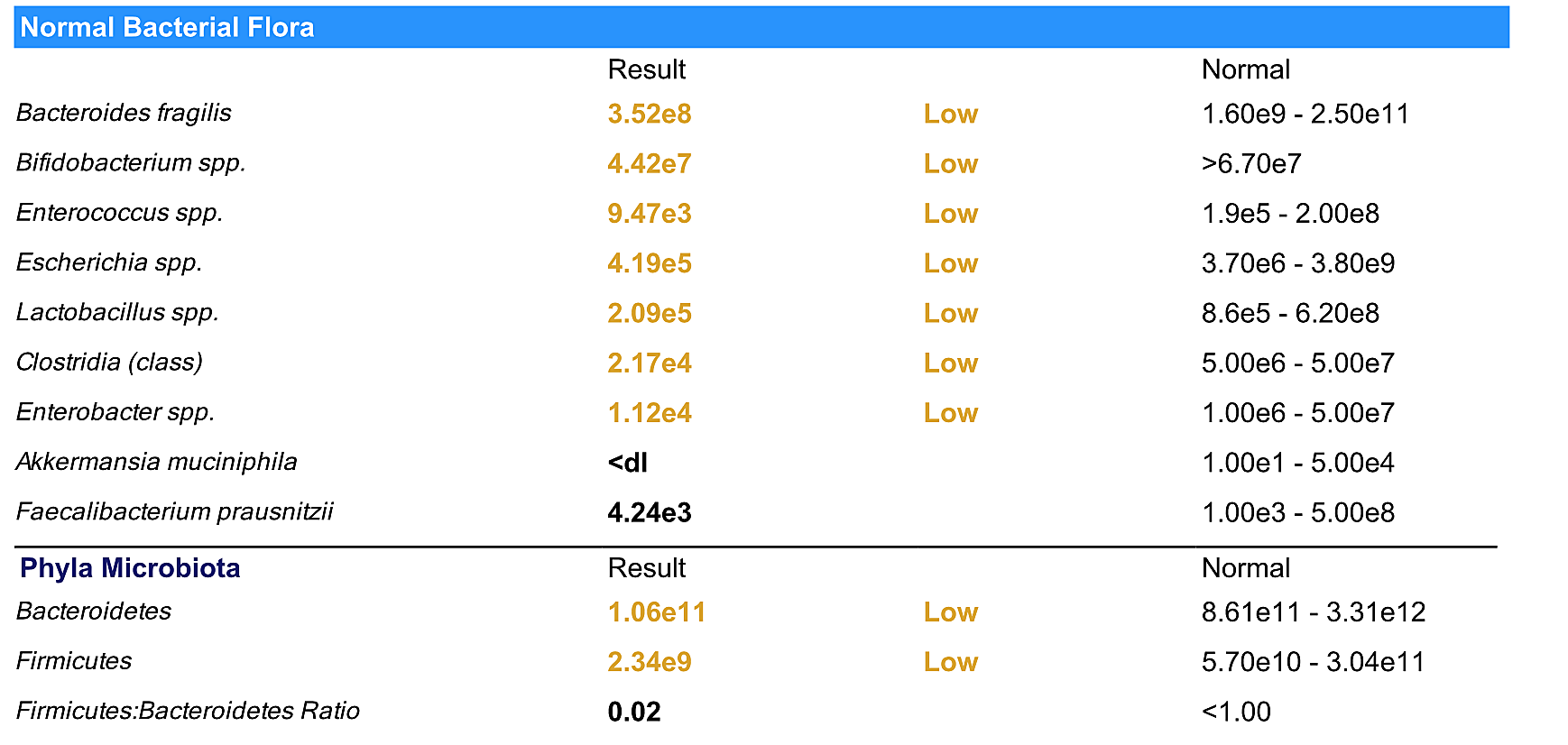
Penicillin = Toxin from Penicillium Mold
Mycotoxins decrease the diversity of the gut microbiota (rat model) – sometimes permanently
Sondergaard TE, et al. Toxins (Basel). 2016, 8(12), 355 Liew W, Mohd-Redzwan S. Front Cell Infect Microbiol. 2018, 8, 60
Broom L. Animal Nutrition. 2015, 1(4), 262-65

Slide 22
Mycotoxin Alter The Gut Microbiota
”The ability of mycotoxins to alter the composition of the gut microbiota...(can be due to) the toxic effects of mycotoxins on cells increase mucus and gut secretions, and diapedeses (responsiveness) of cells of the immune system, leading to marked changes in chime composition as well as in the environment in which the microbes grow.”
Guerre, P. Toxins. 2020, 12, 769

Slide 23
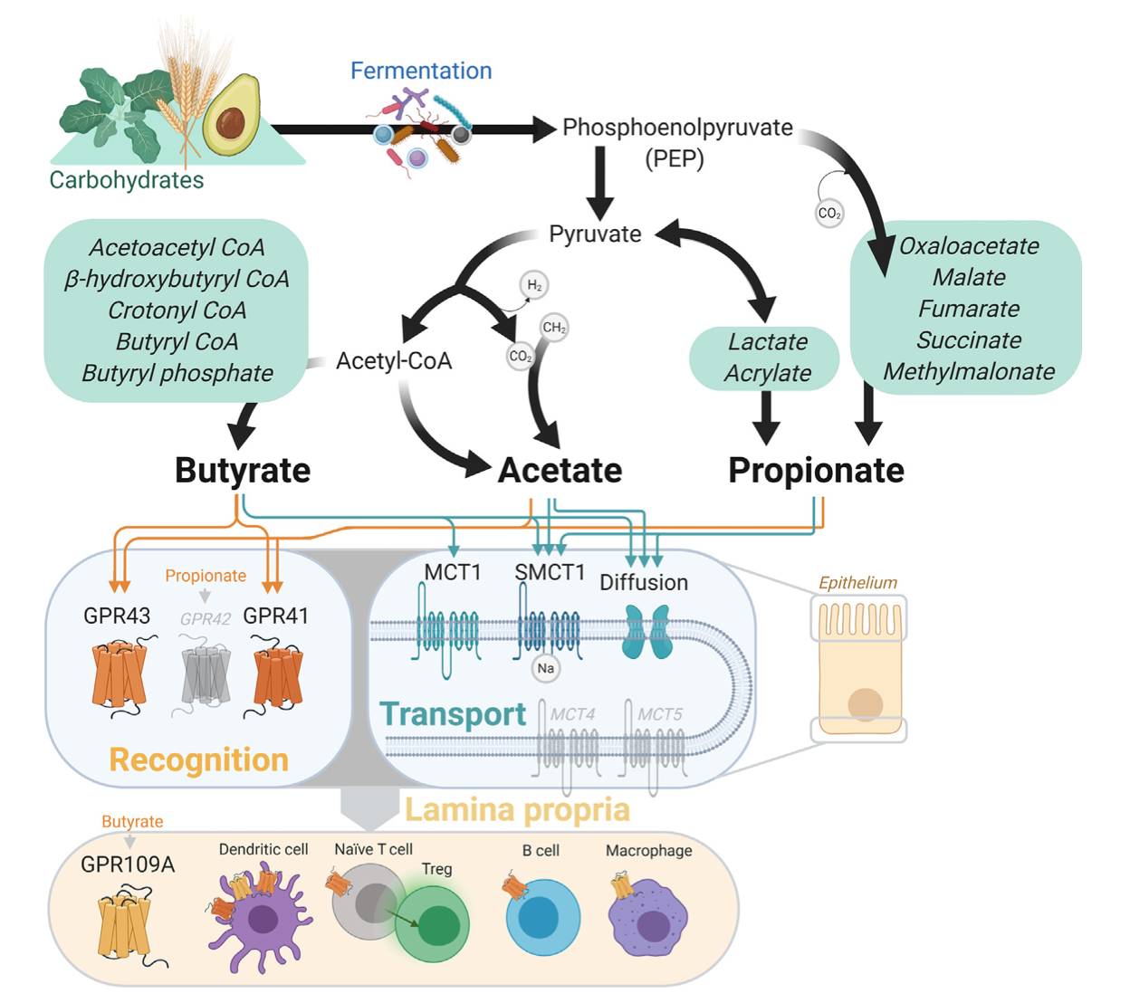
Mycotoxins Alter Gut Metabolism
By likely impacting composition and/or metabolism of the colonic microbiota, mycotoxins can “significantly reduce acetic, butyric and total SCFA concentration.”¹
SCFA HAS antifungal activity. Sodium butyrate inhibited both the growth and filamentation of C. albicans.²
X
X
Broom L. Animal Nutrition. 2015, 1(4), 262-65 2) Jawhara S. Microorganisms. 2022, 10, 1014

Slide 24
DAMPNESS AND THE GUT

Slide 25
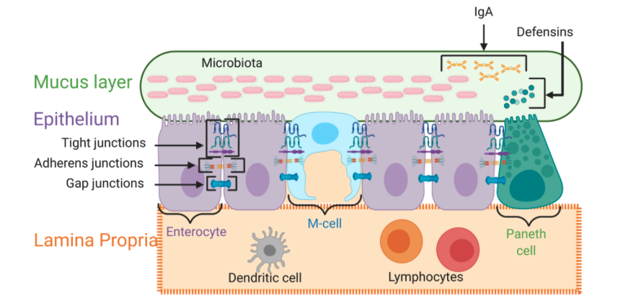
Mycotoxins Can Disrupt the Gut
2
1
Image: Sharma L, Riva A. Microorganisms 2020, 8(11), 1744
1) Liew W, Mohd-Redzwan S. Front Cell Infect Microbiol. 2018, 8, 60 2) Ren Z, et al. Food and Agricultural Immunology, 25:4, 600-606

Slide 26
Mycotoxins Damage The Gut
Mycotoxins can cause
  Significant Intestinal Permeability (Leaky Gut)
    Altered expression (at transcriptional and protein levels) as well as distribution of different TJs (CLDN3, CLDN4, OCLN and ZO-1)
    Cleavage of OCLN and a significant reduction in ZO-1 protein levels
  Damage to Intestinal Cells and Microvilli
    Depletion of glutathione and subsequent increased generation of ROS damages cells
    Microvilli degenerate in presence of mycotoxins
  Leucocyte and lymphocyte infiltration
1) Liew W, Mohd-Redzwan S. Front Cell Infect Microbiol. 2018, 8, 60 | 2) Akbari P, et al. Arch Toxicol. 2017, 91, 1007–1029
Notes:
Transepithelial electrical resistance

Slide 27
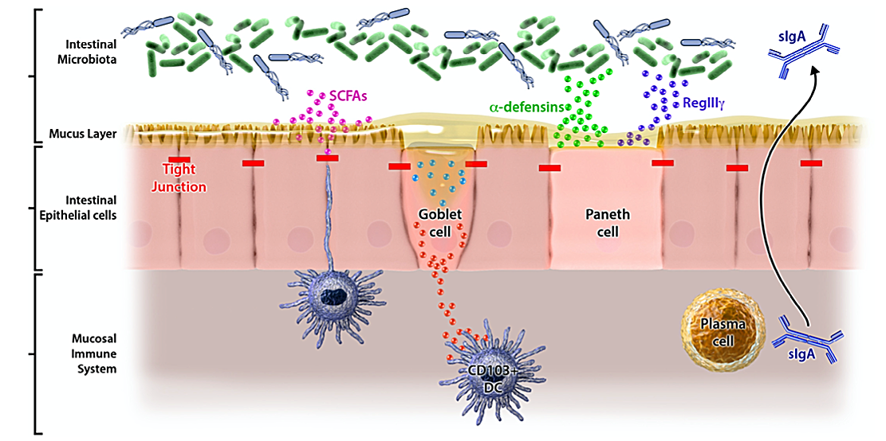
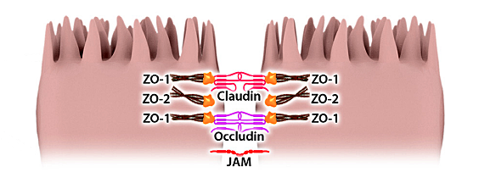
Tiny Amounts of Mycotoxins Can Damage The Gut
Cleavage and damage to tight junctions
Villi
Leukocyte infiltration
Cellular toxicity
DON disintegrates a human Caco-2 cell monolayer within the first few hours of exposure in concentrations as low as 1.5 μM
1) Liew W, Mohd-Redzwan S. Front Cell Infect Microbiol. 2018, 8, 60
2) Akbari P, et al. Arch Toxicol. 2017, 91, 1007–1029 | Image: Samadi N, et al. Ann Allergy Asthma Immunol. 2018, 121, 168–173
Notes:
Transepithelial electrical resistance

Slide 28
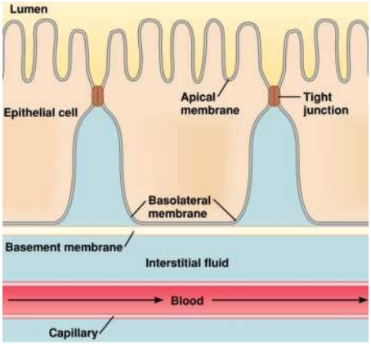
Inhaled Toxins Can Impact the Gut!
(Mycotoxin induced intestinal permeability)…is much more pronounced when DON is applied to the basolateral” (systemic side!)
ENVIRONMENTAL EXPOSURE = SYSTEMIC EXPOSURE
? GLYPHOSATES, AIR POLLUTION…
Akbari P, et al. Arch Toxicol. 2017, 91, 1007–1029
Image: https://www.proprofs.com/quiz-school/story.php?title=epithelia_2

Slide 29
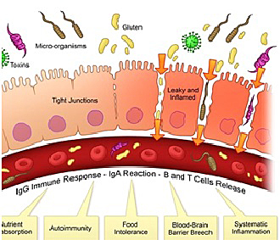
Mycotoxins Increase Intestinal Permeability
By increasing intestinal permeability mycotoxins allow entry of other gut proteins (food proteins) that is normally restricted…
Grenier B, Applegate TJ. Toxins. 2013, 5, 396-430
Imagine: https://mischelfamilychiropractic.com/food-sensitivity accessed 05/01/2023

Slide 30
Leaky Gut and Food Sensitivities
“Considering the apparent lactational transfer of various mycotoxins, exposure of infants deserves special attention.
Even minor changes in the (developing infant’s) barrier function can lead to exposure to luminal antigens in early phases of life and may result in accelerated immunological responses and clinical manifestations, such as allergies in later stages of life.”
Akbari P, et al. Arch Toxicol. 2017, 91, 1007–1029
Imagine: https://mischelfamilychiropractic.com/food-sensitivity accessed 05/01/2023
Notes:
Transepithelial electrical resistance

Slide 31
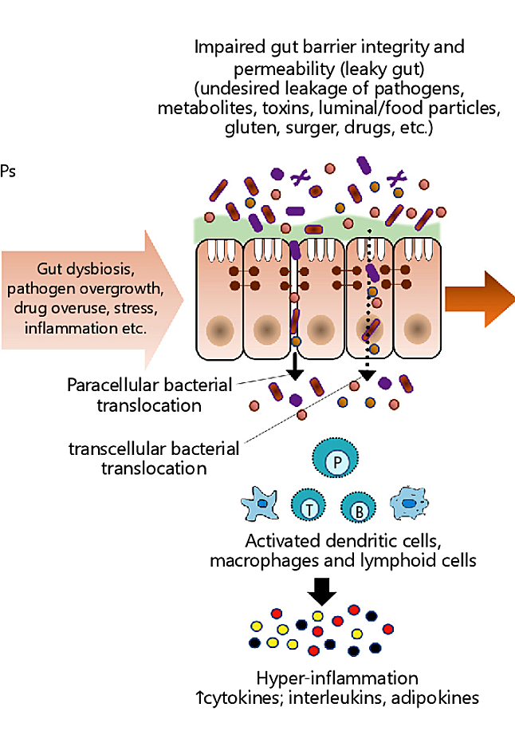
Inflammatory Bowel Disease Risk
By weakening the gut immune response (and altering permeability), mycotoxins make gut vulnerable to translocation of pathogens (pathogenic E Coli, Salmonella, parasites, viruses)^{1,2}
The entry of pathogens into the gut lumen is (“a key step in the induction and persistence of inflammatory bowel diseases”).³
Akbari P, et al. Arch Toxicol. 2017, 91, 1007–1029 2) Grenier B, Applegate TJ. Toxins. 2013, 5, 396-430
3) Liew W, Mohd-Redzwan S. Front Cell Infect Microbiol. 2018, 8, 60 Image from: Nagpal R, Yadav H. Ann Nutr Metab. 2017, 71(S1), 11-16
Notes:
Transepithelial electrical resistance

Slide 32
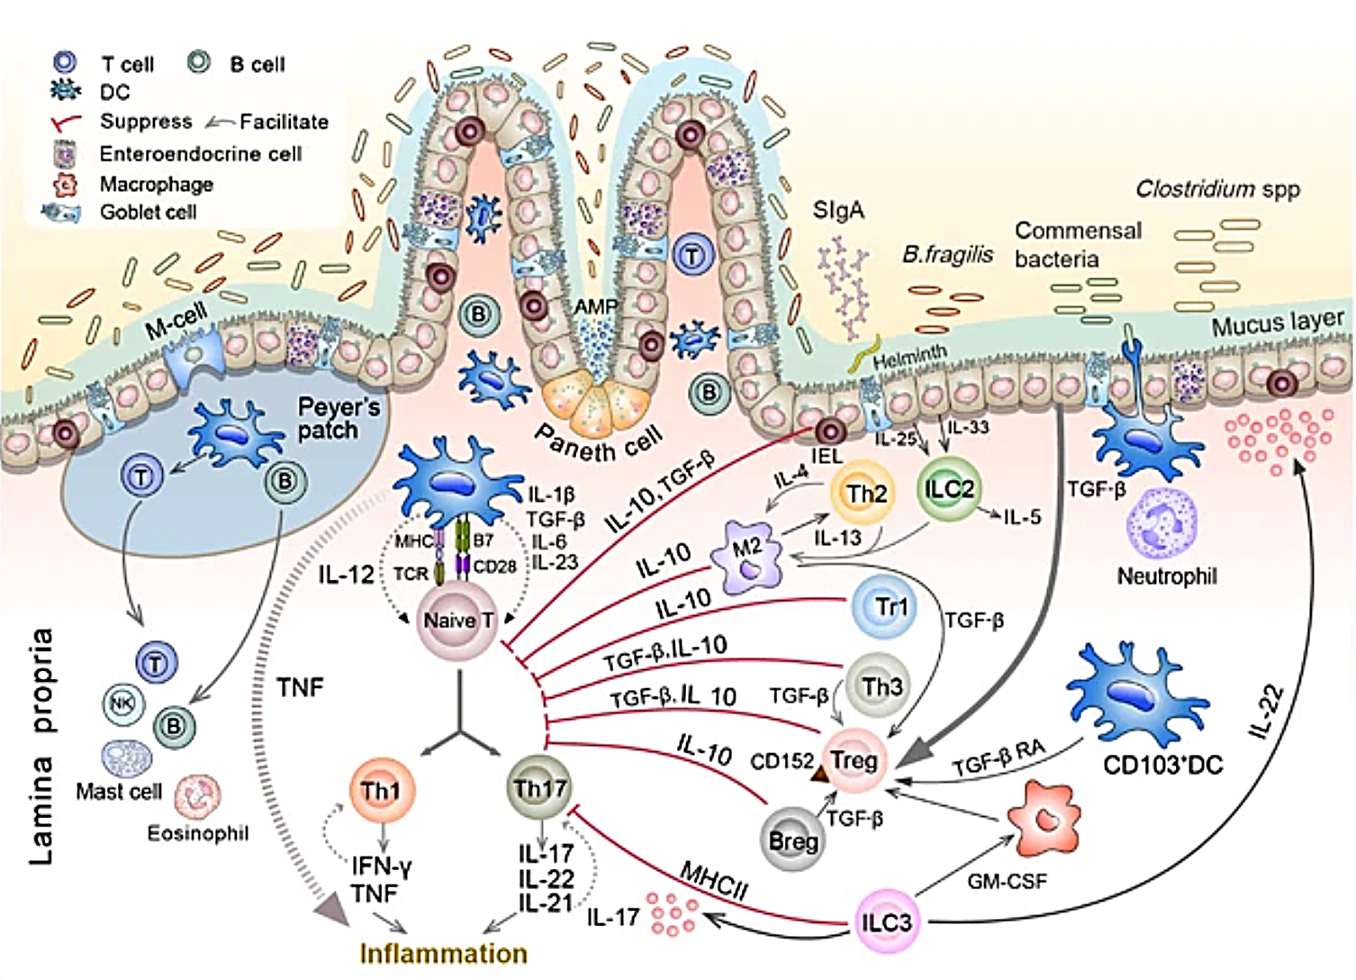
Mycotoxins Alter The Gut Immune Response
Mycotoxins can suppress host immune response through
Decreased expression of IFN-γ in Peyer’s Patches¹
Impact on antigen-presenting cells, ultimately reducing the T cell stimulatory capacity and the production of intestinal specific Ig (immunoglobulins)¹
Decrease levels of IL-8 in the intestine²
1) Grenier B, Applegate TJ. Toxins. 2013, 5, 396-430 | 2) Liew W, Mohd-Redzwan S. Front Cell Infect Microbiol. 2018, 8, 60 | Image: Zhou H, et al. Front. Immunol. 2021, 18, 1-13

Slide 33
HOW DOES THE IMMUNE RESPONSE SHAPE THE MICROBIOME?

Slide 34
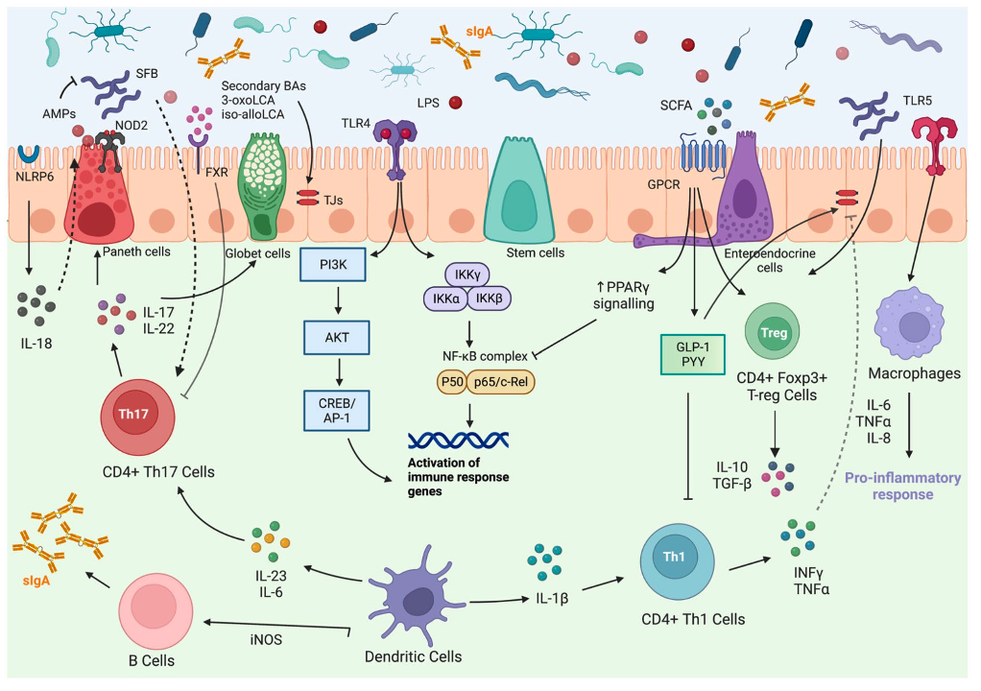
The Gut Immune Response is Complex
Vincenzo F, et al. intern Emerg Med. 2024, 19(2), 275-93

Slide 35
Macrophages and the Gut
Macrophages are an essential population of tissue-specific innate immune cells that function as “housekeepers”… The resident gut macrophages are usually considered as the major gatekeepers, as they play key roles in engulfing pathogens, triggering inflammation, and regulating wound healing.
Macrophages signals are essential in regulating the gut microbiota. Numerous studies have demonstrated that macrophages depletion by clodronate administration led to large alterations in the intestinal bacteria profile, which are characterized as increases in Firmicutes, specifically the Lactobacillaceae and Clostridiaceae families.
Zhang H, et al. J Transl Int Med. 2023, 11(4), 382–392
Notes:
Zhang H, et al. J Transl Int Med. 2023, 11(4), 382–392

Slide 36
Fungal dysbiosis: immunity and interactions at mucosal barriers
Innate immune cells are important for the clearance of fungi and for the initiation of adaptive immune responses during fungal infections.
Neutrophils, CCR2+Ly6C+ monocytes, CX3CR1+ mononuclear phagocytes, CD11b+CD103+ dendritic cells, natural killer cells and epithelial cells have important functions in antifungal immunity by having a role in recognition, phagocytosis and killing of fungi as well as through their indirect activation by cell-cell crosstalk..
Iliev I, Leonardi I. Nat Rev Immunol. 2017, 17(10), 635–646

Slide 37
Microbe-Immune Crosstalk: Evidence That T Cells Influence the Development of the Brain Metabolome
In the absence of T-cells, the developmental trajectory of the gut microbiota and of the host’s metabolic profile was altered.
Caspani G, et al. Int. J. Mol. Sci. 2022, 23, 3259
Notes:
Caspani G, et al. Int. J. Mol. Sci. 2022, 23, 3259

Slide 38
SIgA’s Critical Role in the Gut
SIgA influences the composition of the intestinal microbiota, downregulates proinflammatory responses normally associated with the uptake of highly pathogenic bacteria and potentially allergenic antigens, and promotes the retro-transport of antigens across the intestinal epithelium to DC subsets in GALTs.
Secretory IgA (SIgA) serves as the first line of defense in protecting the intestinal epithelium from enteric toxins and pathogenic microorganisms. Through a process known as immune exclusion, SIgA promotes the clearance of antigens and pathogenic microorganisms from the intestinal lumen by blocking their access to epithelial receptors, entrapping them in mucus, and facilitating their removal by peristaltic and mucociliary activities.
SIgA has been identified as having the capacity to directly quench bacterial virulence factors, influence composition of the intestinal microbiota...
Mantis N, et al. Mucosal Immunology. 2011, 6(4), 603-11

Slide 39
SIgA’s Critical Role in the Gut
Secretory IgA (SIgA) has a crucial role in the gut through its binding to bacterial antigens, thus preventing their direct interaction with the host through immune exclusion and maintaining mucosal homeostasis… SIgA can also limit overgrowth of select species, thus stimulating diversity.
This antibody represents a key host mechanism in regulation of the commensal community, and innate receptor signaling in T cells seems to decide the specificity of IgA to constrain the composition of the intestinal bacteria, ensuring a benign symbiotic relationship.
IgA might be more reactive against disease-driving bacteria… SIgA can enable an increased microbiota diversity by limiting overgrowth of selected species.
Dzidic M, et al. J Allergy Clin Immunol. 2017, 139(3), 1017-25

Slide 40
The Role of SIGA on Microbiome
IgA is the predominant antibody isotype produced at mucosal surfaces and is a critical mediator of intestinal immunity… In the lumen, these antibodies can bind and ‘coat’ offending pathogens, and provide protection against infection through neutralization and exclusion.¹
IgA plays a critical and non-redundant role in shaping the composition of the gut microbiota in humans.²
IgA mediates microbial homeostasis at the intestinal mucosa. Within the gut, IgA acts in a context-dependent manner to both prevent and promote bacterial colonization and to influence bacterial gene expression, thus providing exquisite control of the microbiota.³
SIgA has been shown to both promote colonization of certain commensal species and neutralize pathogens and pathobionts, playing a dual role in shaping the intestinal microbial community.⁴
Immune exclusion is the primary mechanism by which SIgA blocks microorganisms and toxins from attaching to mucosal target epithelial cells, thereby preventing surface damage, colonization, and subsequent massive invasion⁵
1) Palm N, et al. Cell. 2014, 158(5), 1000–1010 2) Catanzaro J, et al. Sci Rep. 2019, 9, 13574 3) Huus, K.E., et al. Nat Rev Immunol. 2021, 21, 514–525
4) Donald K, et al. Cell Reports. 2024, 43, 114835 5) Wang J, et al. Front Microbiol. 2020, 11, 106

Slide 41
Multi-faceted functions of secretory IgA…
Blocking of interaction with epithelial cells possibly through agglutination of mucosal microorganisms may not be the only mechanism by which SIgA exerts its protective function.
Recent evidence argues for a more direct effect on the bacterial viability or pathogenicity, as for example by perturbation of the bioenergetic machinery, impact on motility, disruption of virulence factors involved in bacterial entry.
Corthesy B. Front in Immunol. 2013, 4, 185

Slide 42
Antibodies and Fungal Dysbiosis
…humoral immune mechanisms such as the complement and antifungal antibodies play an important role in antifungal immunity and might be involved in shaping the mycobiota at the mucosal surfaces.
Iliev I, Leonardi I. Nat Rev Immunol. 2017, 17(10), 635–646

Slide 43
THE IMMUNE SYSTEM CREATES SUSCEPTIBILITY TO BIOTOXIN ILLNESS

Slide 44
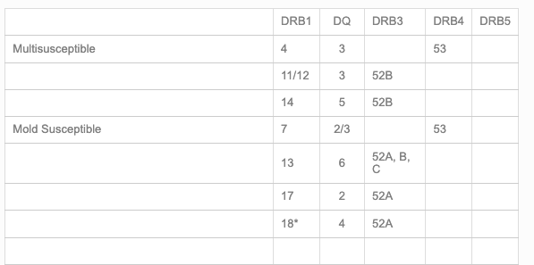
Genetic-Immune Subtypes and Mold Susceptibility
“we know the frequency of mold illness-susceptible patients approximates 24% of the normally distributed population. Almost a quarter of the normal population is genetically susceptible to chronic mold illness.”
https://www.survivingmold.com/resources-for-patients/diagnosis/lab-tests

Slide 45
The Microbiota is Impact Immune Genetics (HLA…)
  The composition of the gut microbiota is affected by a number of factors, including the innate and adaptive immune system. The major histocompatibility complex (MHC), or the human leukocyte antigen (HLA) in humans…determines the specificity of T lymphocyte and natural killer (NK) cell responses, including those against the commensal bacteria present in the human gut.
  Our results show a statistical association between host HLA haplotype and gut microbiota composition.
  Individuals with similar HLA genes have similar microbiota.
Andeweg S, et a. mSphere. 2021 Jul-Aug; 6(4): e00476-21

Slide 46
DAMPNESS AND
THE IMMUNE SYSTEM

Slide 47
Mycotoxins and Our Immune Response
Trichothecene mycotoxins have a strong immunosuppressive effect.
These mycotoxins suppress the host immunity and make them more sensitive to the infection of pathogens, including bacteria and viruses.
WU Q, Et al. Int J Mol Sci. 2018, 19(11), 3307

Slide 48
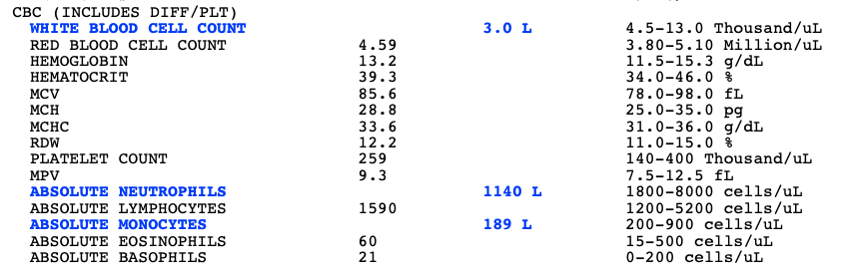
Mycotoxins and Immune Suppression
Stachybotrys species (black mold) can produce a cyclosporin-like immunosuppressive agent capable of increasing skin graft survival in rats.
Animal experiments show pancytopenia after ingestion of S. chartarum.
Mycophenolic acid is a mycotoxin produced by Penicillium.
Cyclosporine is produced by Trichoderma polysporum (a fungus).
Hossain M, et al. J Allergy Clin Immunol. 2004, 113(2), 200-8

Slide 49
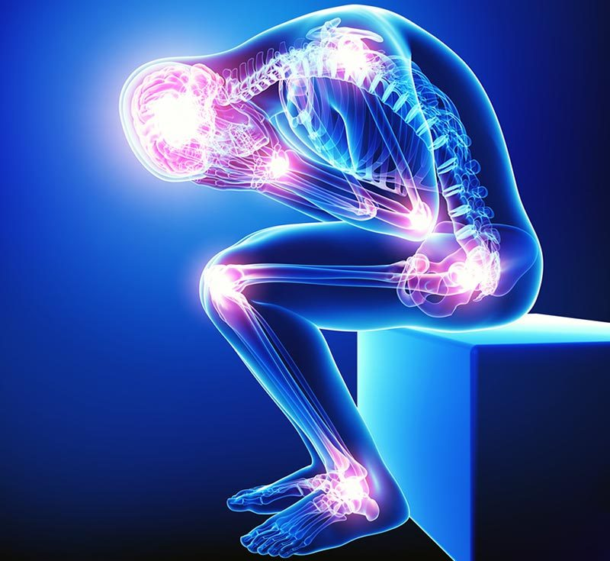
“Subtoxic” concentrations are enough to cause harm
Prolonged exposure to mycotoxins, even in subtoxic concentrations… modulate proinflammatory cascades and ultimately have long-term consequences on our health.
Noncytotoxic concentrations (0.1−1 μM)… (alter) transcription factor NF-κB
Del Favero G, et al. Chem Res Toxicol. 2020, 33(2), 492-504

Slide 50
Mycotoxins change the immune systems of rat pups
Intravenous administration of Deoxynivalenol (DON) (inhalation??) in pregnant pigs at the end of gestation was shown to alter mRNA expression of IFN-g, IL-17, IL-2, and TNF-a, in the blood leukocytes of the piglets…
And induce significant decrease in the population of regulatory T cells, and an increase in cytotoxic and Ɣ𝜹T cells in blood samples of these piglets, 1-3 weeks after birth.
Toutounchi NS, et al. Frontiers in Immunology. 2021, 12, 79152

Slide 51
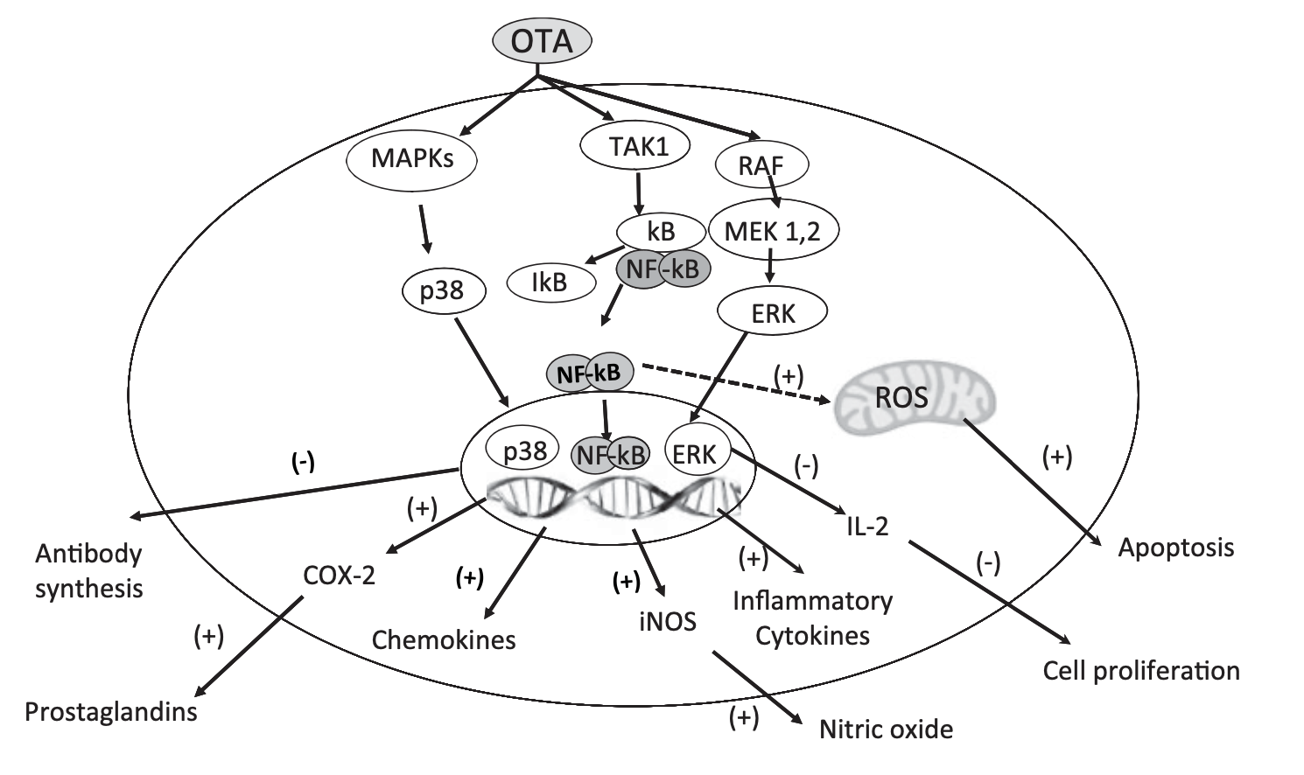
Mycotoxins change the immune systems of rat pups
Oral exposure to Ochratoxin modulates the immune response even at levels far below the toxicity threshold
Exposure of 13-day-old chicken embryos via the chorioallantoic membrane to OTA significantly decreased the number of immunoglobulin-bearing cells of embryonic bursa.
OTA also decreased the antibody response in pups from dams exposed to OTA. Similarly, chicks hatched from OTA-contaminated (0.01–1.00 mg OTA/egg) eggs showed a significant reduction of the total antibody.
OTA was described as modulator of humoral and cellular immunity, inflammation, nitrosative stress and gut immunity.
Marin D, Taranu I. Toxin Reviews. 2015, 34, 1

Slide 52
Damp Indoor Spaces and Health (IOM) – Immunotoxicity
Pier and McLoughlin (1985):
(Mycotoxins exposure results in) alterations in serum proteins and immunoglobulin profiles, reduced antibody formation, thymic aplasia, reduced cell-mediated immune responses, increased delayed cutaneous hypersensitivity, and impaired bacterial clearance and acquired immunity in mice, rats, cattle, turkeys, and guinea pigs.
T-2 toxin reduces complement (primarily C3) formation, diminishes serum immunoglobin (IgA and IgM, but not IgG), and diminishes antibody production.
Institute of Medicine. 2004. Damp Indoor Spaces and Health. Washington, DC: The National Academies Press.

Slide 53
FINDINGS IN CHILDREN EXPOSED TO DAMPNESS

Slide 54
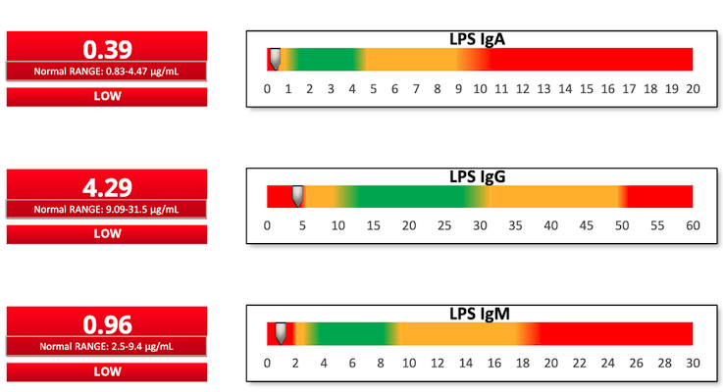
Gut Immune Reactivity to LPS

Slide 55
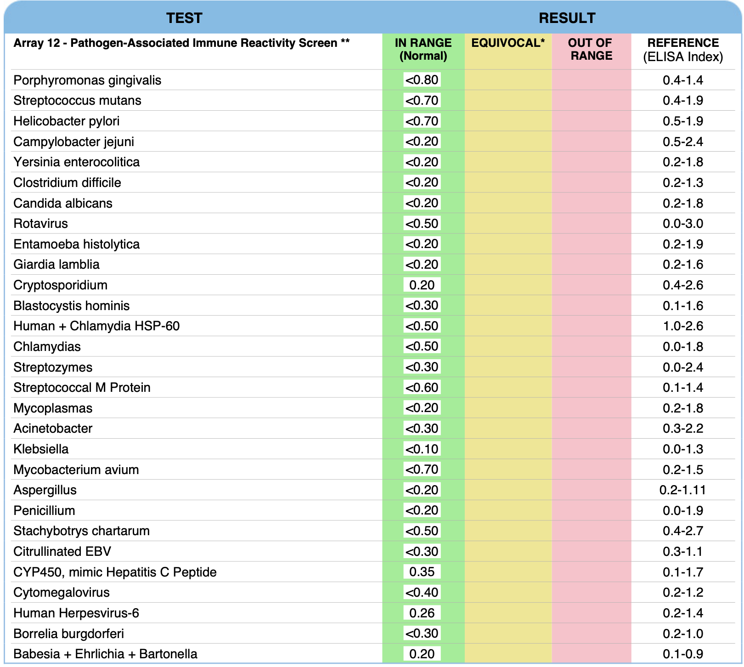
3-year-old male with ASD exposed to dampness
IGG, IGA, and IGM Response
Notes:
Quincy F

Slide 56
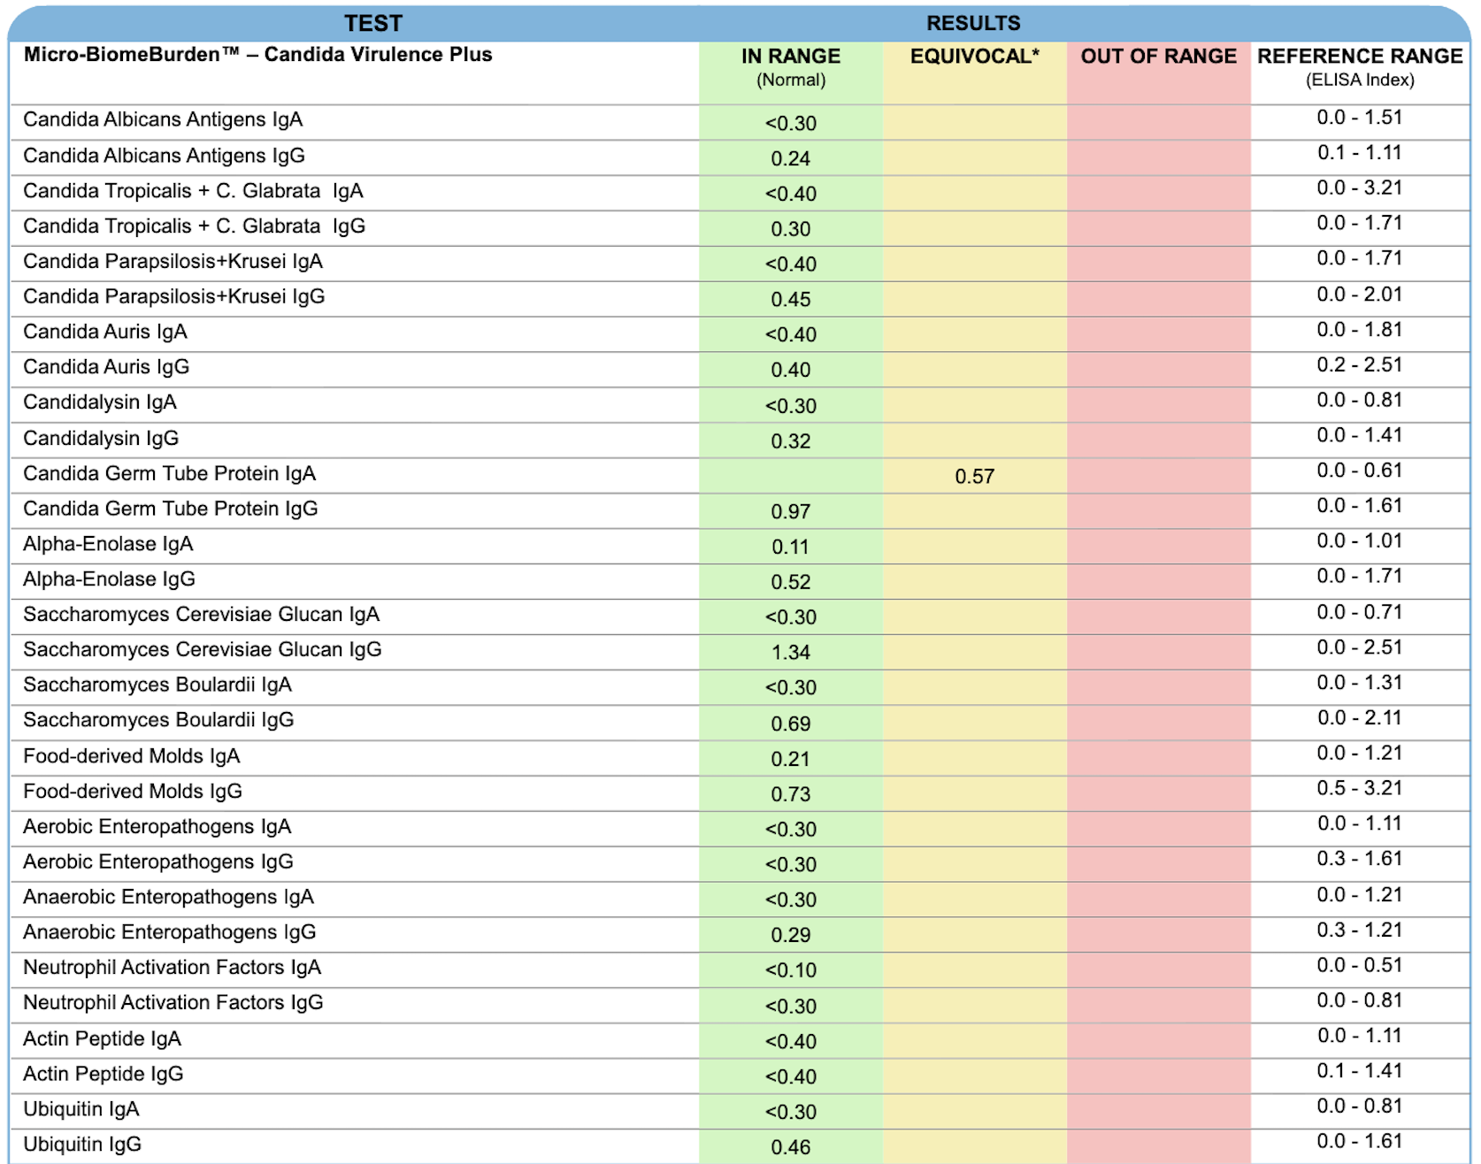
Child with ASD exposed to dampness

Slide 57
WHAT IS BEHIND
THIS IMMUNE SUPPRESSION?

Slide 58
Mitochondria: A master regulator in macrophage and T cell immunity
Currently, mitochondria may be considered as the master metabolic regulator of T cells, implicating that by controlling mitochondrial metabolism we could control lymphocyte fate and function.¹
The mitochondrion acts as a master regulator to fine-tune immune responses elicited by macrophages and T cells.²
1) Desdín-Micó G, et al. Mitochondrion. 2018, 41, 51-57 2) Liu P, Ho P. Mitochondrion. 2018, 41, 45-50
Notes:
Mitochondrion. 2018, 41, 45-50

Slide 59
Mitochondria and T Cell Exhaustion
T cell exhaustion is a hallmark of cancer and persistent infections, marked by inhibitory receptor upregulation, diminished cytokine secretion, and impaired cytolytic activity.
We show that mitochondrial insufficiency is a cell-intrinsic trigger that initiates the functional exhaustion of T cells.
Wu H, et al. Nature Communications. 2023, 14, 6858

Slide 60
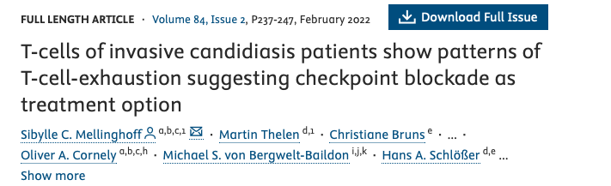
T-cell exhaustion

Slide 61
Mitochondria and B Cells
The differentiation of naive B cells in Peyer’s patches to IgA+ plasma cells in the lamina propria of the intestine involves a metabolic shift…
Regulation of mitochondrial homeostasis and functions is likely to be critical for the development of B cell lineages…
Sandoval H, et al. Mitochondrion . 2018, 41, 58–65

Slide 62
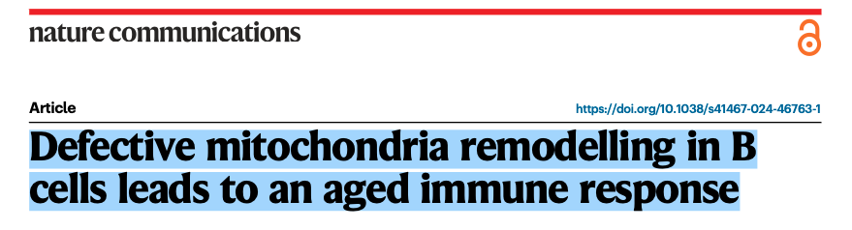
Tfam KO B (blocked mitochondrial biogenesis) cells could not remodel their mitochondria content after antigen encounter, resulting in an inadequate immune response. This immunodeficient phenotype is characterised by a severe blockage of activated B cells at the pre-GC (germinal center) stage.¹
Mitochondrial dynamics dictate the fate and function of B cells.²
1) Iborra-Pernichi M, et al. Nat Commun. 2024, 15(1), 2569 2) Li W, et al. J Immunol Res. 2024, 5577506
Notes:
mature germinal centre

Slide 63
Natural Killers Are Also Impacted
Alterations in the metabolic profile of NK cells directly influence the proliferation, activation, and cytotoxic capacity of these cells.
Metabolic changes can impact intracellular signals, molecule production, secretion, and cell activation which is essential as the first line of immune defense.
Osuna-Espinoza KY, Rosas-Taraco AG. Front. Immunol. 2023, 14, 1064101.

Slide 64
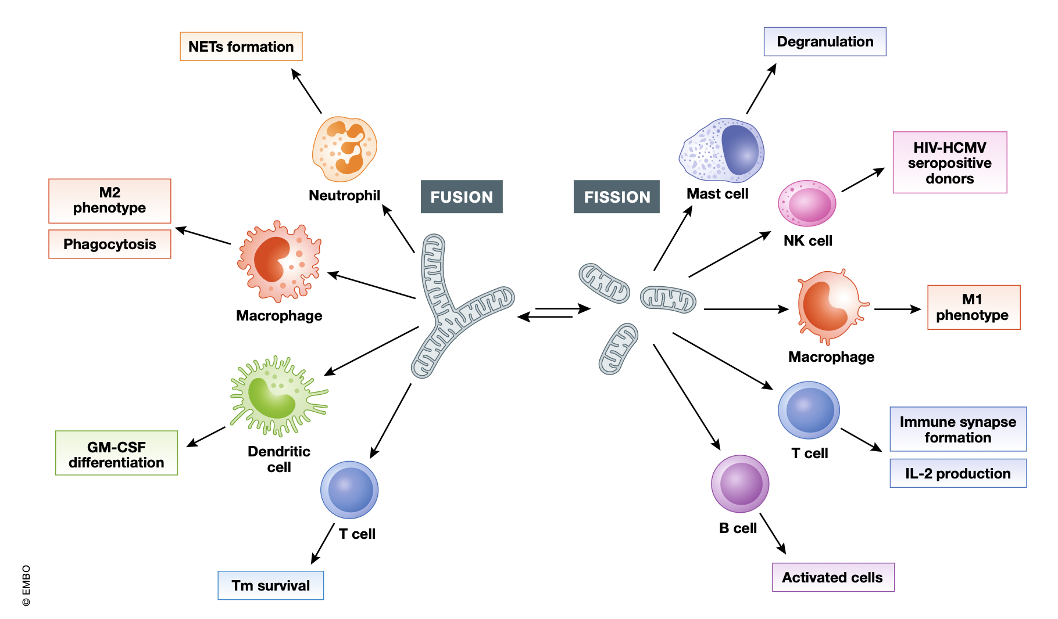
Mitochondria and Macrophages
Mitochondria are essential organelles directing the fate and function of innate and adaptive immune cells.
Studies have shown that mitochondrial dynamics are also critical in macrophage function.
Mitochondrial metabolism plays a crucial role in DC differentiation.
Cervantes-Silva M, et al. EMBO reports 22: e53086 | 2021

Slide 65
Mitochondria and Macrophages
Following M1 polarization (pro-inflammatory), (when) the mitochondrial ETC complex of macrophages was either partially or completely suppressed, leading to impaired OXPHOS function, and macrophages were unable to transform to M2 phenotype even when exposure to IL-4 stimulation .
Restoration of mitochondrial dynamics by up-regulation of MFN1/2, which promotes mitochondrial fusion, successfully inhibits pro-inflammatory macrophage polarization…
Li P, et al. Front. Immunol. 2025, 16, 1520814

Slide 66
DAMPNESS AND THE MITOCHONDRIA

Slide 67
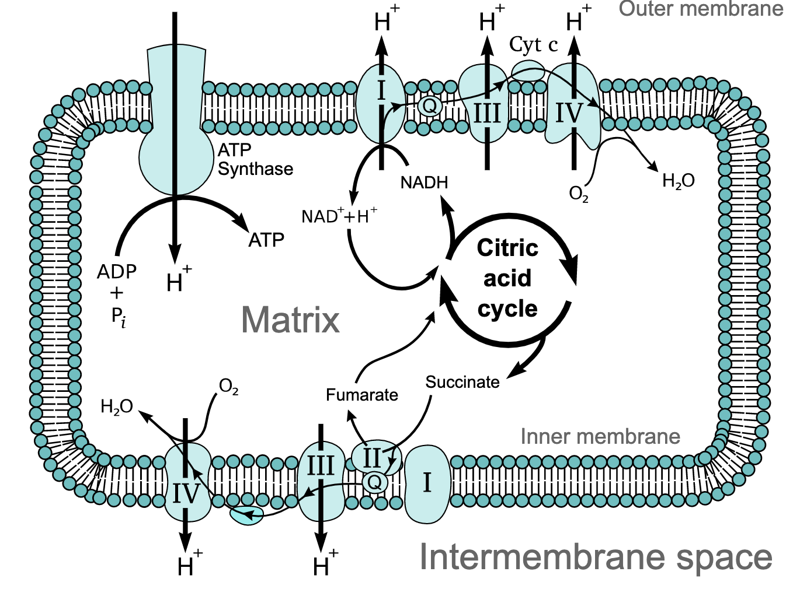
Mycotoxins and The Mitochondria
Mycotoxins can:
  Deplete, disrupt or ”collapse”
  mitochondrial membrane potential
  Reduce the activities of mitochondrial complexes I,II, III, IV, and V, and ATP content
  Release of mitochondrial cytochrome c, activation of caspase-9/-3 leading to cellular (death)
  Induce mitochondrial swelling
  Controlled proton leak
Islam MT, et al. IUBMB Life. 2018, 70(11), 1084-92 | Huang D, et al. Trends in Food Science & Technology. 2019, 88, 33-45
Sava V, et al. NeuroToxicology. 2006, 2, 82–92 | Wei Y, et al. Toxicology. 1985, 36 (2-3), 119-130
https://upload.wikimedia.org/wikipedia/commons/8/89/Mitochondrial_electron_transport_chain%E2%80%94Etc4.svg Accessed 03/17/22

Slide 68
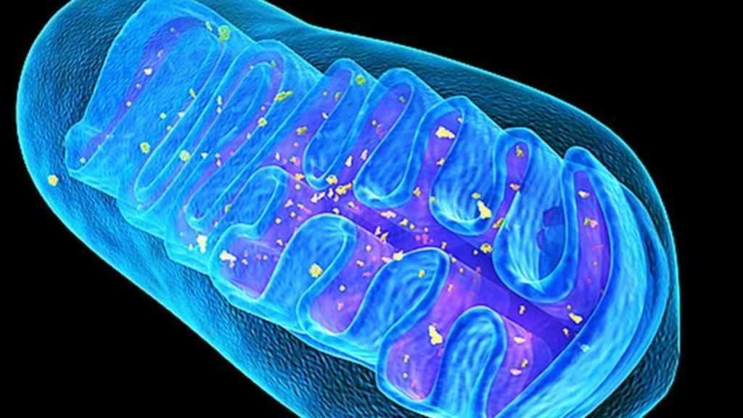
Mycotoxins harm the genetics of the mitochondria
Trichothecenes can:
Inhibit mitochondrial biogenesis and respiration… and mitochondrial transcription and translation (how mitochondria rebuild and heal)…
Change the expression of numbers of miRNAs and specific mitochondria-associated miRNAs which may be involved in mitochondria-dependent toxicity…
Huang D, et al. Trends in Food Science & Technology. 2019, 88, 33-45
Bin-Umer M, et al. Toxins 2011, 3, 1484-150 | Aibara S, et al eLife. 2020, 9, e58362

Slide 69
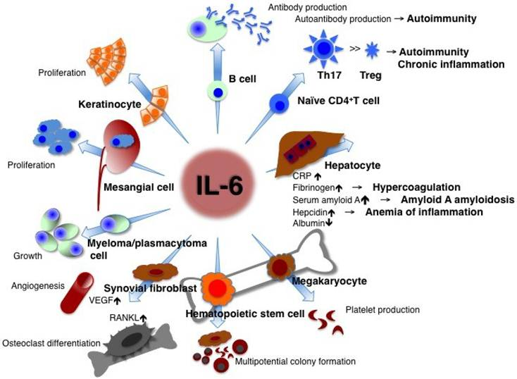
Endotoxins and Inflammation
Endotoxins can trigger elevations of IL-6 (etc.)¹⁻⁵
1) Wang Q, et al. J Surg Res. 1998, 76(1), 27-31 2) Wang P, et al. World J Gastroenterol. 2002, 8(3), 531-6.
3) Dofferhoff A, et al. Journal of Endotoxin Research. 1995;2(1):37-44 4) Abraham E, et al. Domestic Animal Endocrinology. 1996, 13(6), 491-501
5) Kayama F, et al. Cytokine. 1997, 9(9), 688-95 Image: Tanaka T, Kishimoto T. Int J Biol Sci. 2012, 8(9), 1227-1236

Slide 70
Inflammation and The Mitochondria
Interleukin-6 Drives Mitochondrial Dysregulation and Accelerates Physical Decline…¹
Six weeks of (human)IL-6 induction resulted… dysregulated energy utilization... (and) downregulation of mitochondrial biogenesis genes, and an overall decrease in total mitochondrial numbers.
“Chronic inflammation, through cytokines such as TNF-α and IL-6, can impair mitochondrial oxidative phosphorylation and inhibit ETC activity…” ²
IL-6 Reduces Mitochondrial Replication…³
The pro-inflammatory cytokine IL6 suppresses mitochondrial function…⁴
1) Nidadavolu S, et al. The Journals of Gerontology, 2023, 78(10), 1740–1752 2) Nunes P, et al. Clin. Bioenerg. 2025, 1, 6
3) Skuratovskaia D, et al. Int. J. Mol. Sci. 2021, 22, 1774 4) 3) Xu et al., Cell Reports, 2025, 44, 115403

Slide 71
Actinomycetes and The Mitochondria
Actinomycetes (G+ bacteria found in Dampness) produce Valinomycin¹
Valinomycin, has often been used to dissipate the membrane potential of cells and mitochondria (and) induces mitochondrial cytochrome c release.²
In low doses valinomycin uncouples oxidative phosphorylation and causes dissipation of the mitochondrial membrane potential…³
Valinomycin triggers rapid loss of mitochondrial membrane potential⁴
1) Zhang D, et al. J Antibiot. 2020, 73(5), 265-282 2) Shinohara Y, et al. Eur.J.Biochem.269, 5224–5230 (2002)
3) Morrison M, et al. Cellular Oncology. 2005, 27, 231–236 4) Furlong I, et al. Cell Death Differ. 1998, 5, 214–221

Slide 72
A COMMON FINDING IN CHILDREN LIVING IN DAMP ENVIRONMENTS

Slide 73

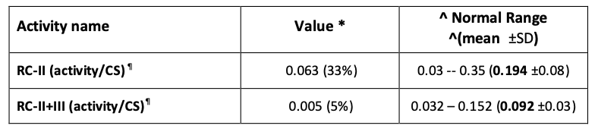
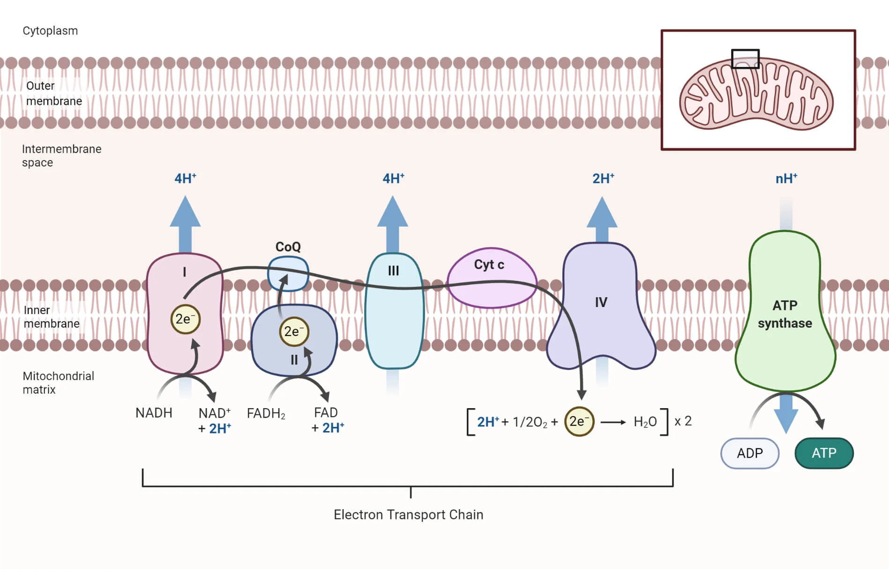
Common Mitochondrial Finding in This Population
Common Clinical Findings:
Hypotonia
Delayed Gross Motor Development
Easily exhausted/low energy
Etc.
X
Image: https://microbenotes.com/electron-transport-chain/ accessed 11/11/25

Slide 74
Conclusion
The downstream immuno-metabolic consequences of biotoxin illness may be a significant contributor to the persistent gut and microbiome imbalances in children exposed to damp environments.
Notes:
Is this really necessary??

Slide 75
Conclusion
We have yet to fully identify or understand the full scope of toxins released in damp environments.
We are only beginning to understand the true systemic effects of these biotoxins.
Notes:
Is this really necessary??

Slide 76
Conclusion
Significant research is needed to quantify the true scope of dampness-induced gut dysfunction.
  Contribution to ASD and other conditions?
This exposed can be prevented!
Damage from this exposure is treatable!
Notes:
Is this really necessary??

Slide 77

Thank You!
Drk@wholistickids.com
Image: ChatGPT 08/27/25 from

