Slide 1
The Estrobolome & Gut-Hormone Interplay: Implications for Women’s Health
Samantha Ford, MS
Business Director

Slide 2
Topics Covered
What is the estrobolome?
The intricate relationship between the GI and estrogen metabolism
Shifts in the gut microbiome post-menopause
Dysbiosis in menopausal syndrome and related conditions
Prebiotics as therapeutic intervention for estrogen regulation

Slide 3
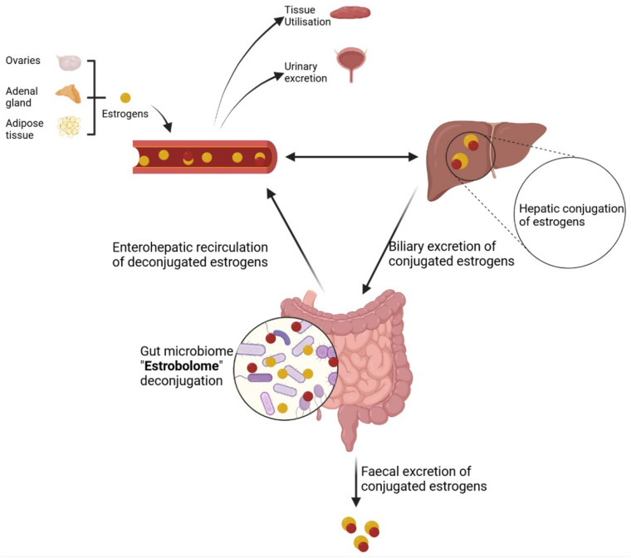
The Estrobolome
Estrogens (estradiol, estrone, estriol) are metabolized in the liver into inactive (conjugated) forms and released into the intestine.
Specific microbial metabolites within the small intestine deconjugate these estrogens back into active forms, enabling reabsorption into circulation.
The estrobolome = the group of gut bacteria and their genes that metabolize estrogen.
Liaquat M, Minihane AM, Vauzour D, Pontifex MG. The gut microbiota in menopause: Is there a role for prebiotic and probiotic solutions?. Post Reprod Health. 2025;31(2):105-114. doi:10.1177/20533691251340491
Notes:
The estrobolome – what exactly is it? Estrogens (which are produced in the ovaries, adrenal gland and adipose tissue) enter circulation, and are metabolized (in the liver) into inactive/conjugated forms – then released into the small intestine. A specific set of gut bacteria and their metabolites can deconjugate estrogens back into their active form, enabling reabsorption into circulation. Any remaining/deconjugated estrogen is excreted. The estrobolome is the group of gut bacteria and their genes that metabolize estrogen.
These may be reabsorbed into the blood circulation, used by peripheral tissues, and returned to the liver through enterohepatic recycling for re-conjugation. Some of the conjugated and deconjugated estrogens are excreted via urine and stool.
Post Reprod Health. 2025 Jun;31(2):105-114. doi: 10.1177/20533691251340491

Slide 4


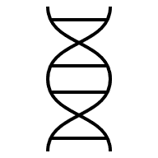

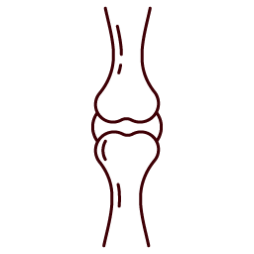


Estrogen: the body’s quiet conductor
Reproductive Health
Menstrual Health
Fertility
Reproductive Health
Skin
Hair
Immune health
Adipose storage and distribution
Cholesterol
Metabolic Health
Digestive Health
Gut microbiota
Cardiovascular Health
Bone Health
Bone mineral density
Joint health
Cognitive Functions
Memory
Mood
Notes:
Why is this a critical and emerging area of microbiome research? A variety of tissues express estrogen receptors, including, intestine, brain, bone and adipose tissue. estrogen has been shown to influence a variety of physiological responses including neural development [29], cardiovascular health [16], bone density, fertility, hair/skin, digestive

Slide 5
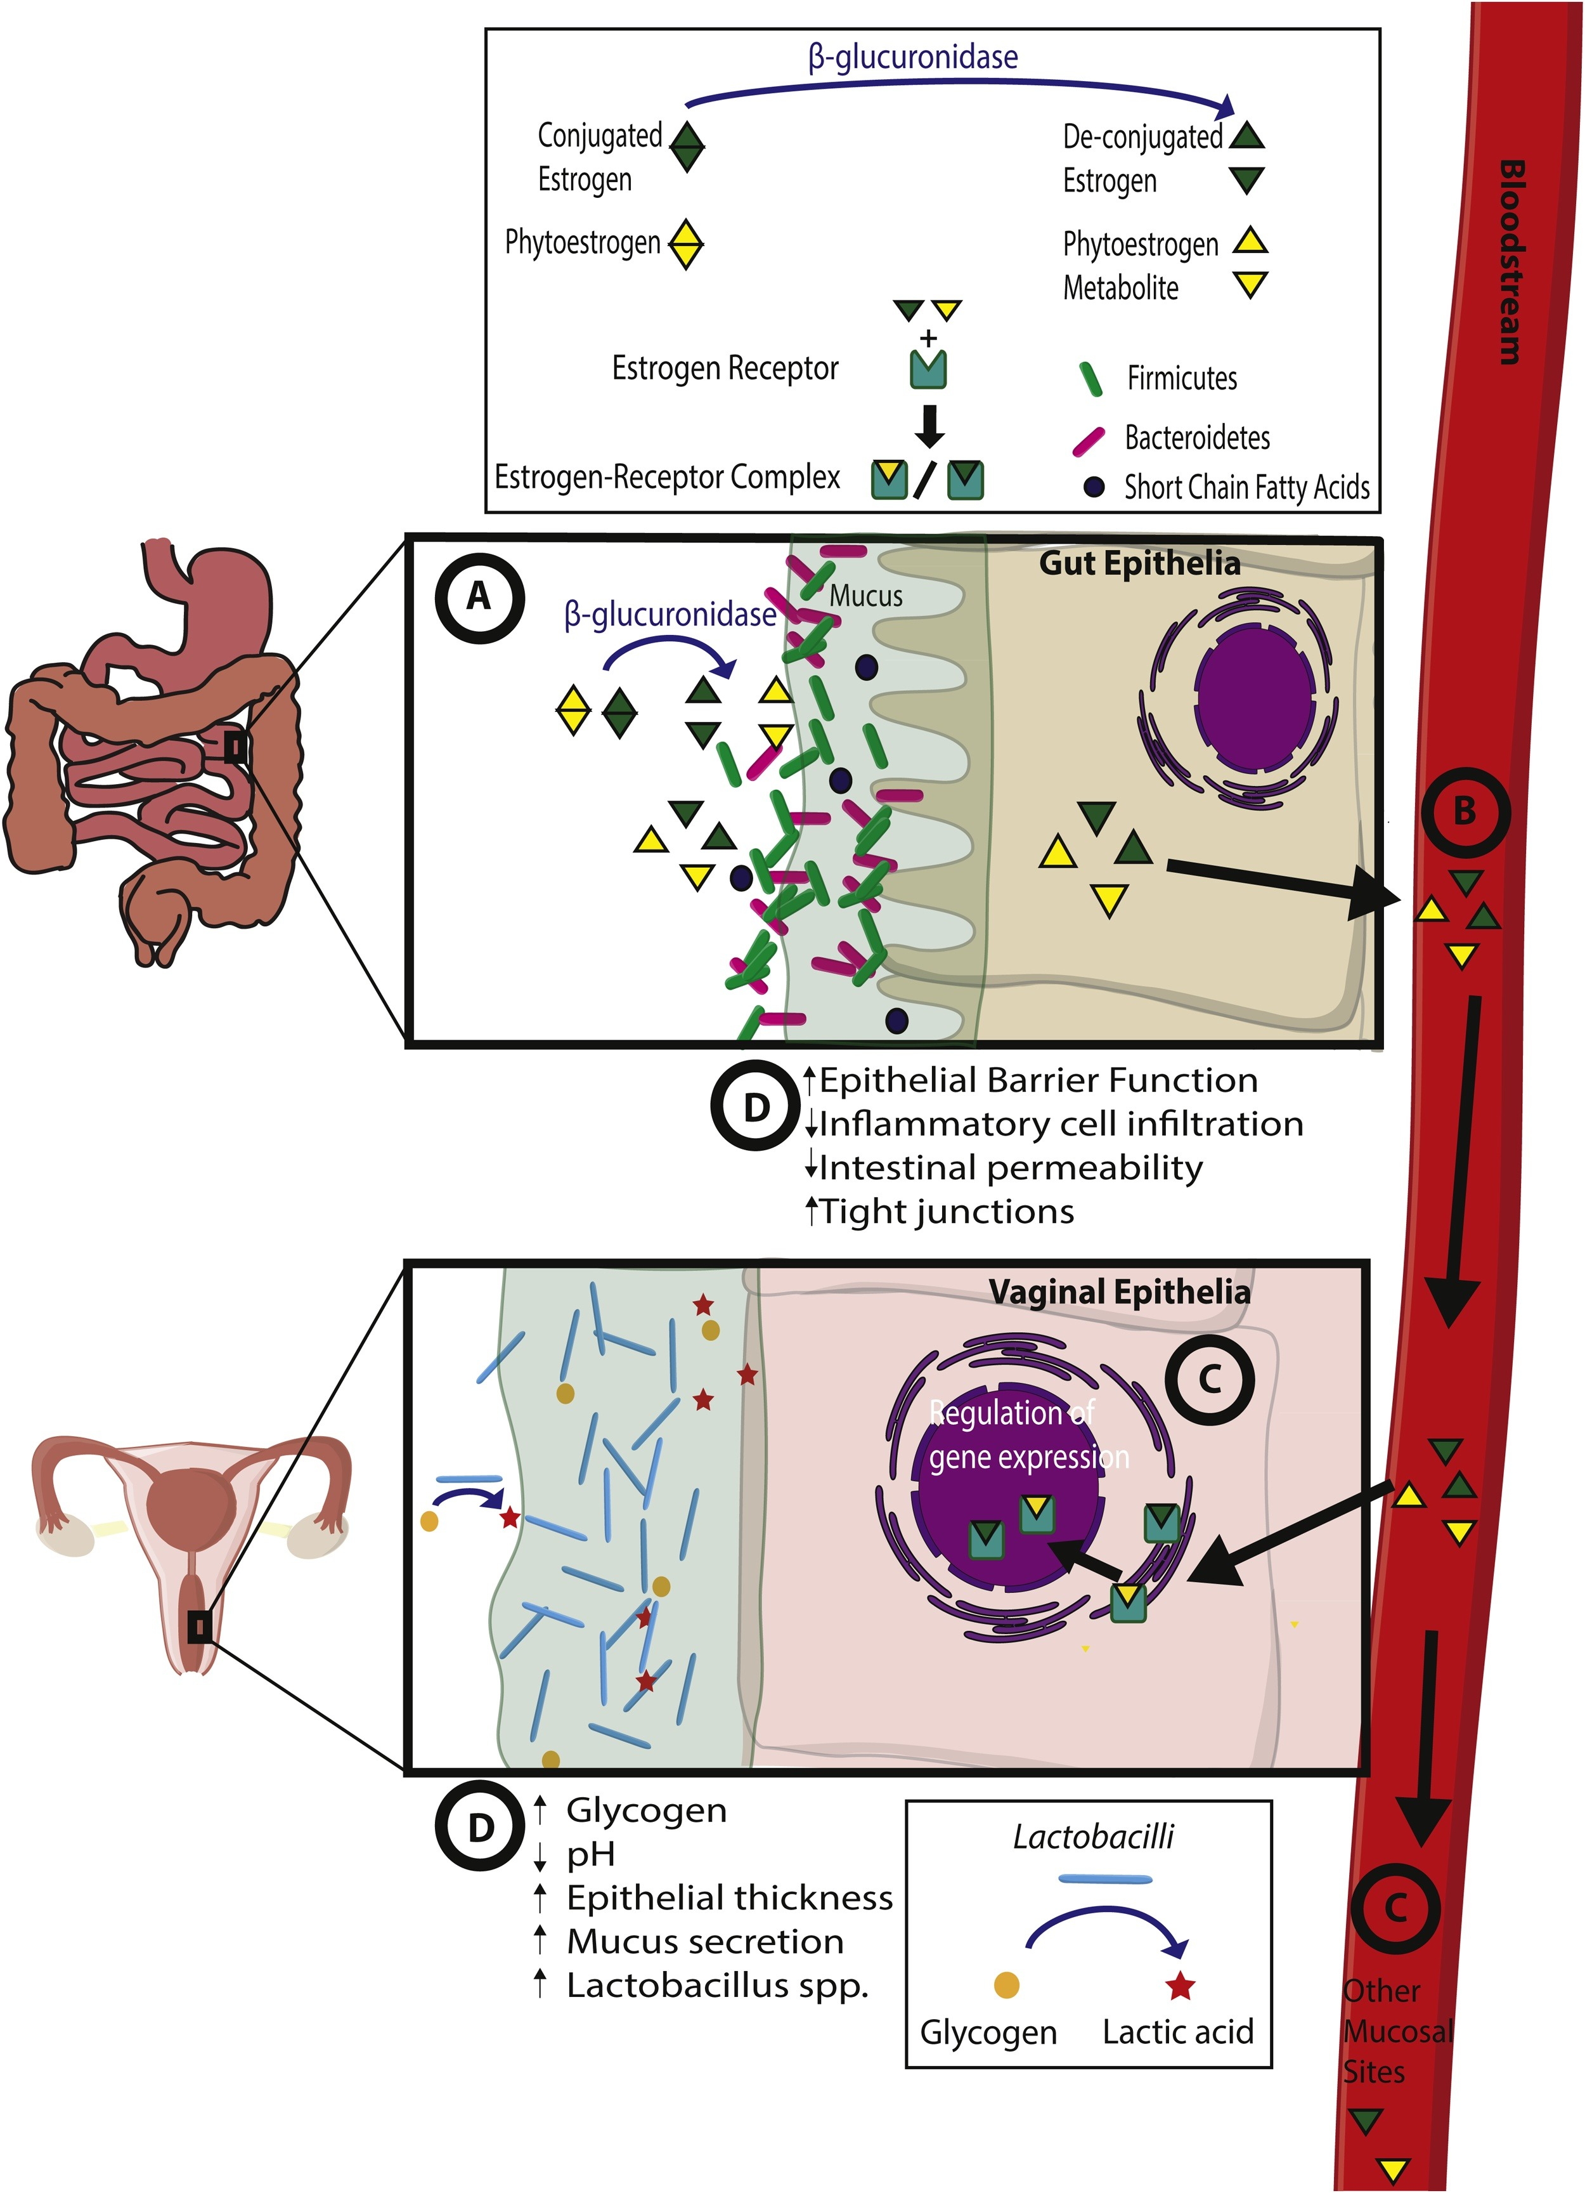
The Gut Microbiome and Estrogen Metabolism are Intricately Connected
β-glucuronidase-encoding taxa are widely distributed across the microbiome (>93% within the Bacteroidetes and Firmicutes phyla). Dysbiosis can result in excess or inadequate estrogen metabolism = balance is key.
Conjugated estrogen secreted via bile acids is deconjugated through microbial secretion of β-glucuronidase
A
Estrogen (and phytoestrogen) reabsorbed through the gut and enter circulation
B
Act on receptors at various mucosal sites throughout the body
Gut dysbiosis disrupts homeostasis in estrogen metabolism and vice versa
C
Trigger a cascade of intracellular signaling, gene activation and epigenetic mechanisms
D
(1) Baker JM, et al. Estrogen–gut microbiome axis: Physiological and clinical implications. Maturitas. 2017;103:45–53. doi:10.1016/j.maturitas.2017.06.025
(2) Hu S, et al. Gut microbial beta-glucuronidase: a vital regulator in female estrogen metabolism. Gut Microbes. 2023;15(1):2236749. doi:10.1080/19490976.2023.2236749
Notes:
Bile acid-secreted conjugated estrogen and phytoestrogens are deconjugated by the gut microbiome through bacterial secretion of β-glucuronidase. This enables the metabolized estrogen and phytoestrogens to be reabsorbed by the gut and translocate into the bloodstream
Metabolized estrogen and phytoestrogen is then transported to distal mucosal sites through the circulatory system.
Estrogen and phytoestrogen metabolites then act on estrogen receptors at distal sites (shown here using the vaginal epithelia as an example).
Downstream effects of estrogen receptor binding in the vaginal epithelium which leads to physiological changes through downstream gene activation, epigenetic effects and triggering of intracellular signaling cascades.
Dysbiosis in the gut microbiome potentially disrupts this homeostasis at this site through disruption of estrogen metabolism. A reduction in gut microbiota diversity leads to a decrease in the estrogen metabolism through a lack of estrogen metabolizing bacteria as well as other metabolic effects such as a reduction of short chain fatty acids. A lack of estrogen metabolizing bacteria leads to a decrease in circulating estrogens which may influence hypoestrogen-related disease.
A disrupted gut not only results from estrogen loss — it perpetuates it
I emphasize B-glucuronidase because this enzyme is critical to the entire process. BGUS-encoding microbes are widespread across the microbiome – The Human Microbiome project identified over 279. The vast majority fall within the phyla Bacteroidetes and Firmicutes. The clinical implication here: managing estrogen-related disorders isn’t simply about isolating and upregulating production of this enzyme. It’s about balance. Dysbiosis can lead to excess estrogen metabolism due to high presence of opportunistic bacteria with more aggressive expression of these metabolites. The opposite is also true – so balance is key.
Estrogen–gut microbiome axis: Physiological and clinical implications
Baker, James M. et al.
Maturitas, Volume 103, 45 - 5

Slide 6
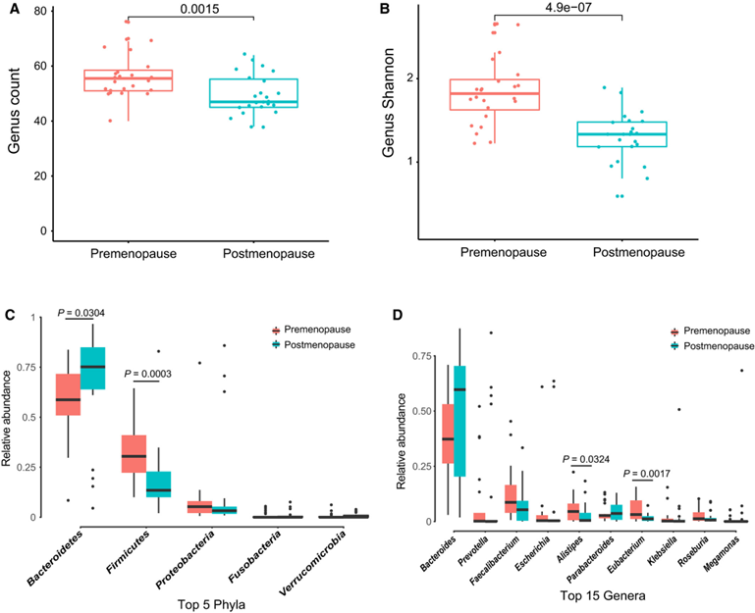

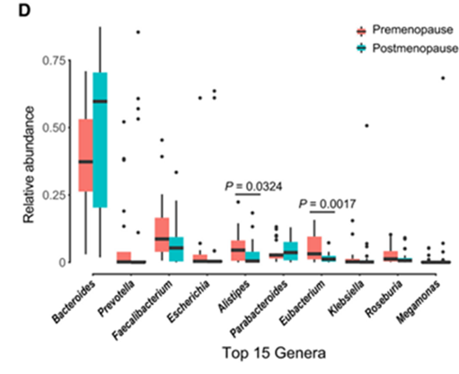
Differences in the Gut Microbiota: pre- vs. post-menopause
Metagenome-wide association study with shotgun sequencing, comparing gut microbiota premenopausal vs postmenopausal women (n=48, matched for age and BMI)
Significant alterations in ratio of Firmicutes / Bacteroidetes + significant reductions in commensal Faecalibacterium
Significantly lower gut microbial diversity
Zhao H, et al. Compositional and functional features of the female premenopausal and postmenopausal gut microbiota. FEBS Lett. 2019;593(18):2655-2664. doi:10.1002/1873-3468.13527
Notes:
The connection has been demonstrated in research – simply looking at the microbial profile in females pre- vs postmenopause. An example demonstrated here - Metagenome-wide association study with shotgun sequencing, comparing gut microbiota of 24 premenopausal and 24 postmenopausal women, matched for age and BMI (Controlled for confounders: excluded recent antibiotic use and matched lifestyle and diet)
Postmenopausal women displayed significantly lower gene-, genus-, and species-level richness and Shannon diversity compared to premenopausal counterparts (Wilcoxon tests, p < 0.01). PERMANOVA analysis confirmed menopausal status significantly influenced overall gut microbiome composition (R² = 0.038, p = 0.0108).
Postmenopause – significant depletions in phylum Firmicutes, including genera Faecalibacterium, Eubacterium, Roseburia, and metabolic pathway-related taxa. Significant increases in phyla Bacteroidetes and Verrucomicrobia, with rises in genera Bacteroides, Staphylococcus, Tolumonas. (Tolumonas = toluene-producing and was negatively correlated with bone mineral density)
FEBS Lett 2019; 593(18): 2655–2664. https://doi.org/10.1002/1873-3468.13527

Slide 7
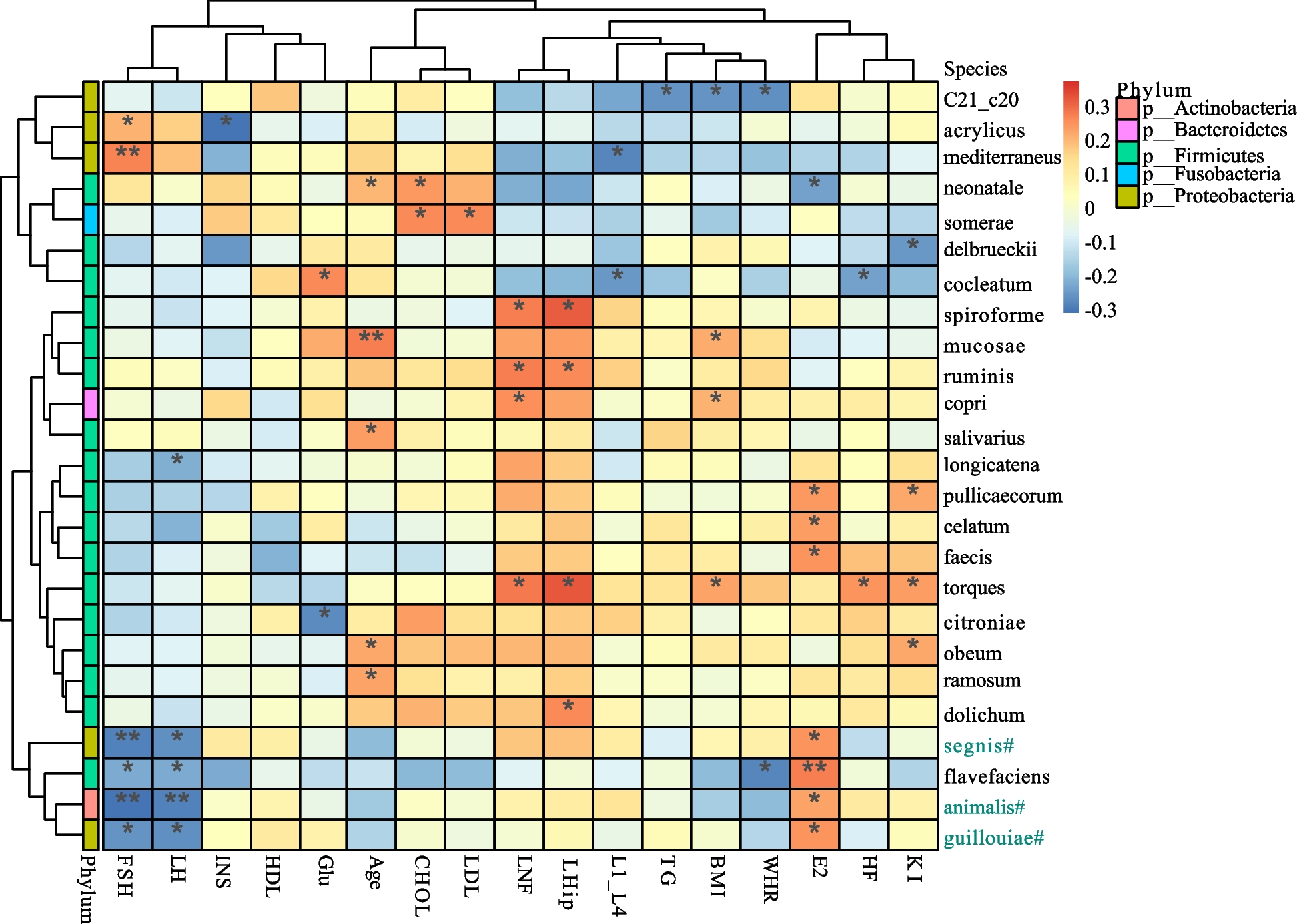
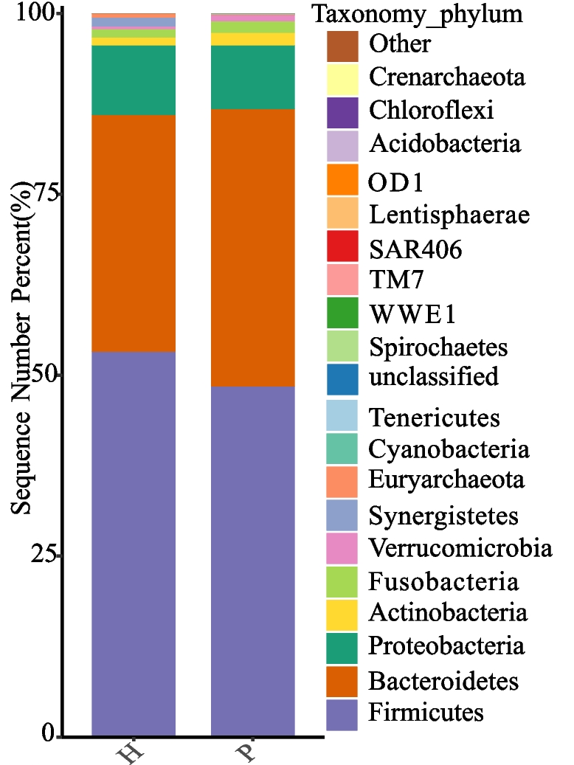
Gut Dysbiosis is Observed in Menopausal Syndrome
Average relative abundance of microbiota at the phylum level in healthy (H) vs menopausal syndrome (P)
The relationship between menopausal syndrome (MPS) and gut microbes
Non-MPS had significantly higher: Aggregatibacter segnis (Proteobacteria), Acinetobacter guillouiae (Proteobacteria), Bacteroides animalis (Bacteroides).
Symptom severity positively correlated with Ruminococcus torques (Firmicutes) negatively correlated with Clostridium cocleatum (Firmicutes).
Yellow/red: positive correlation. Blue: negative correlation. * 0.01 ≤ p<0.05，** 0.001 ≤ p<0.01.
Liu Y, Zhou Y, Mao T, et al. The relationship between menopausal syndrome and gut microbes. BMC Womens Health. 2022;22(1):437. Published 2022 Nov 8. doi:10.1186/s12905-022-02029-w
Notes:
The relationship between menopausal syndrome and gut microbes
Design: Case-control study
Participants: n=77 females with moderate-severe menopausal symptoms (MPS) +
n=24 age-matched healthy menopausal females (control)
Methods: data collected on demographics, hormone panel, metabolic panel, BMD, Kupperman Index and microbiome analysis (16S rRNA gene sequencing)
Results: Abundance of 14 bacterial species differed significantly between MPS vs. control
Spearman correlation analysis found significant protective association (healthier hormone profile) with Aggregatibacter segnis (Proteobacteria), Acinetobacter guillouiae (Proteobacteria), Bacteroides animalis (Bacteroides).
Symptom severity was positively correlated with Ruminococcus torques (Firmicutes) and negatively correlated with Clostridium cocleatum (Firmicutes).

Slide 8
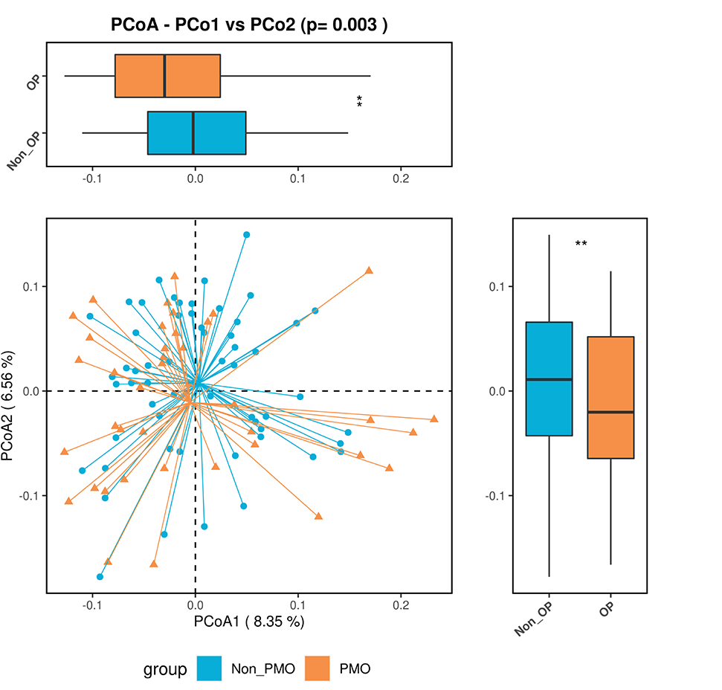
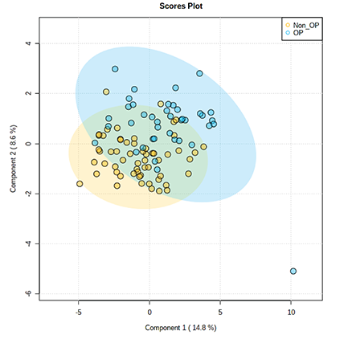
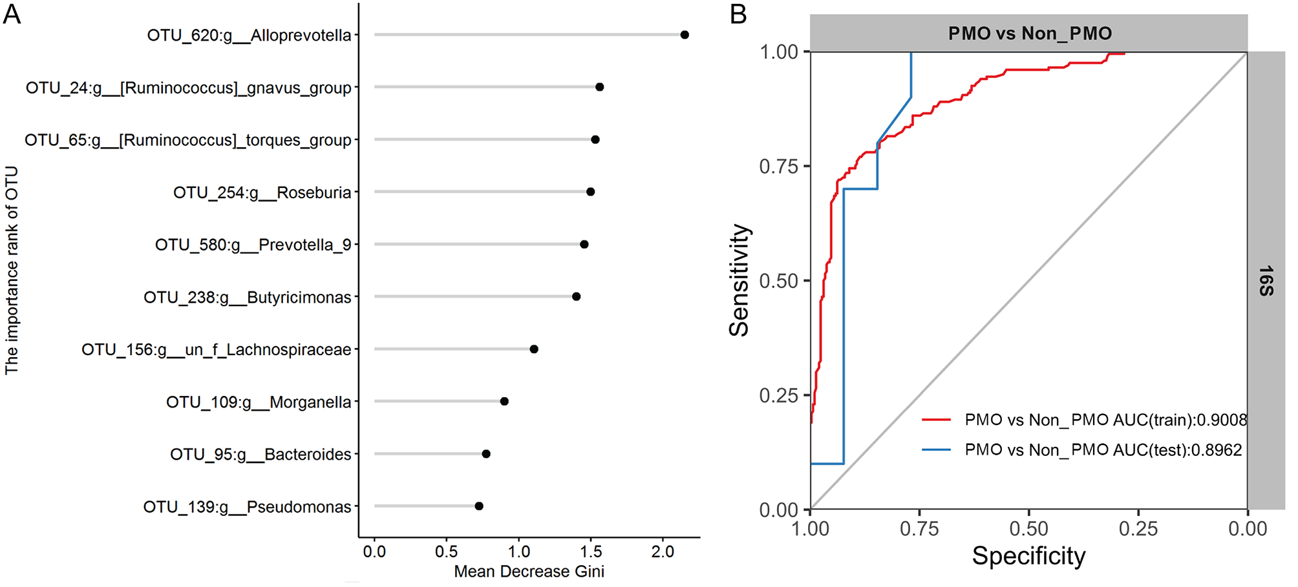
Gut Microbial Signatures are Significantly Correlated with Bone Mineral Density in Postmenopausal Women
Gut Microbial Diversity and Fecal Metabolites in Postmenopausal Women with Osteoporosis (PMO) vs Postmenopausal without Osteoporosis (non-PMO)
Significantly higher beta diversity in non-PMO vs PMO
Significantly different fecal metabolite composition
Baceterial-based classification model able to distinguish non-PMO vs PMO with 90% accuracy
Wang H, Liu J, Wu Z, et al. Gut microbiota signatures and fecal metabolites in postmenopausal women with osteoporosis. Gut Pathog. 2023;15(1):33. Published 2023 Jul 6. doi:10.1186/s13099-023-00553-0
Notes:
case-control study of 98 postmenopausal women grouped by bone mineral density (osteoporosis vs non-osteoporosis). Stool samples analyzed for bacterial (16S rRNA) and fungal (ITS) profiles; fecal metabolites measured using LC–MS. Their key findings: PMO women had lower bacterial diversity and distinct fungal profiles and vice versa. Certain bacteria (Veillonella, Parabacteroides) and fungi were enriched in PMO, while others (Prevotella, Enterobacterium) were more common in non-PMO. Metabolites linked to inflammation and bone metabolism differed significantly between groups. Correlation networks suggest gut microbes and metabolites jointly influence bone health. The researchers were able to build microbial signature model that predicted osteoporosis status with ~90% accuracy
Analysis of intestinal microbial diversity in PMO and non-PMO patients. Box plot demonstrating α-diversity index, including Chao1 index, Abundance-based Coverage Estimator and Shannon index, Simpson index and J index in intestinal bacteria (A) and intestinal fungi (B) of PMO and non-PMO patients, repectively. Brown: PMO; Blue: non-PMO. PCoA plot was used to analyze the differential beta-diversity index in intestinal bacteria (C) and intestinal fungi (D) of PMO and non-PMO patients, repectively. *P < 0.05, **P < 0.01

Slide 9
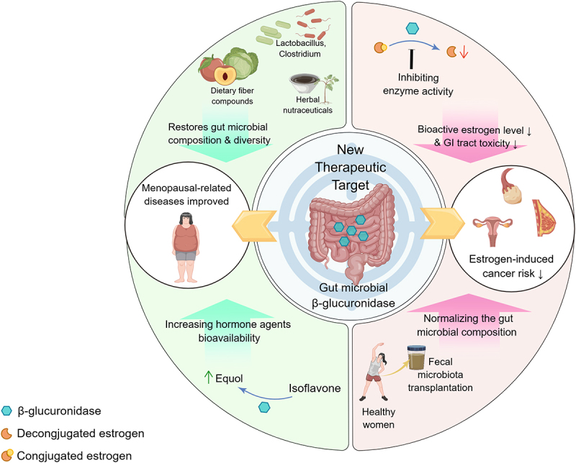
Gut Microbiome Modulation as an Emerging Therapeutic Target for Estrogen Regulation and Related Conditions
Dietary Fiber + Targeted Prebiotics
Plant Polyphenols
Microbial Diversity
Robust SCFA production
Minimize inflammation
Healthy gut motility and bile formation
Strengthen epithelial tight junctions
Minimize opportunistic pathogens
Balanced β-glucuronidase activity
Hu S, et al. Gut microbial beta-glucuronidase: a vital regulator in female estrogen metabolism. Gut Microbes. 2023;15(1):2236749. doi:10.1080/19490976.2023.2236749
Notes:
Gut β-glucuronidase is emerging as a new therapeutic target in the improvement of menopausal disorders such as menopausal syndrome, as well as in the prevention and treatment of gynecological cancers. As for improving menopausal symptoms, the composition and diversity of the gut microbiota can be normalized through the intake of dietary fiber, herbal nutrients, and beneficial gut microbiota, and by increasing the bioavailability of estrogenic agents, such as soy isoflavones, which can be converted into efficiently absorbed estradiol. In the prevention and treatment of gynecological cancers, by inhibiting gmGUS enzyme activity and reducing the level of biologically active estrogens, and reducing the intestinal side effects of anti-cancer drugs, which exerts a synergistic effect and suppress the progression of gynecological cancers.
A number of gut bacterial species across major phyla, and especially Firmicutes and Bacteroidetes, possess enzymes like β-glucuronidases^{18,19} and sulphatases, ²⁰ which deconjugate the excreted estrogens

Slide 10
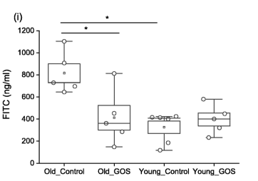
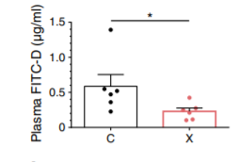
Prebiotic Xylooligosaccharides and Galactooligosaccharides improve gut barrier function and reduce intestinal permeability in animal models
Spectrophotometric analysis of plasma FITC-dextran (FITCD) level 2 h post oral gavage at 7 weeks of age in non-obese diabetic mouse model supplemented with XOS (X) vs control (C)
FITC-dextran assessment of gut barrier function old (n=24) and young (n=24) mice showed significantly increased intestinal permeability in old vs young mice, with decreased values in old animals fed GOS
(1) Hansen CHF, et al. Targeting gut microbiota and barrier function with prebiotics to alleviate autoimmune manifestations in NOD mice. Diabetologia. 2019;62(9):1689-1700. doi:10.1007/s00125-019-4910-5
(2) Arnold JW, et al. The pleiotropic effects of prebiotic galacto-oligosaccharides on the aging gut. Microbiome. 2021;9(1):31. Published 2021 Jan 28. doi:10.1186/s40168-020-00980-0
Notes:
Investigate whether prebiotic xylooligosaccharides (XOS) can alleviate autoimmune manifestations in NOD mice and determine if effects are microbiota-dependent.
XOS improved intestinal integrity (lower FITC-dextran permeability, fewer microbes in mesenteric lymph nodes). Upregulated mucin (Muc1, Muc2) and tight junction genes (Ocln, Tjp1), especially in colon.

Slide 11

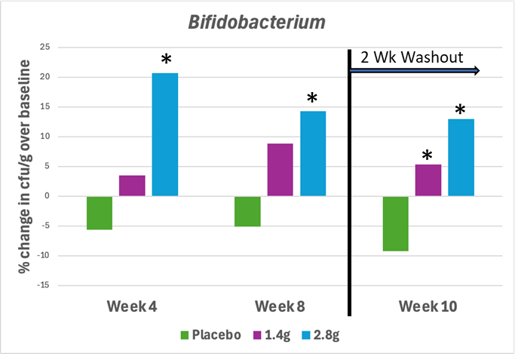
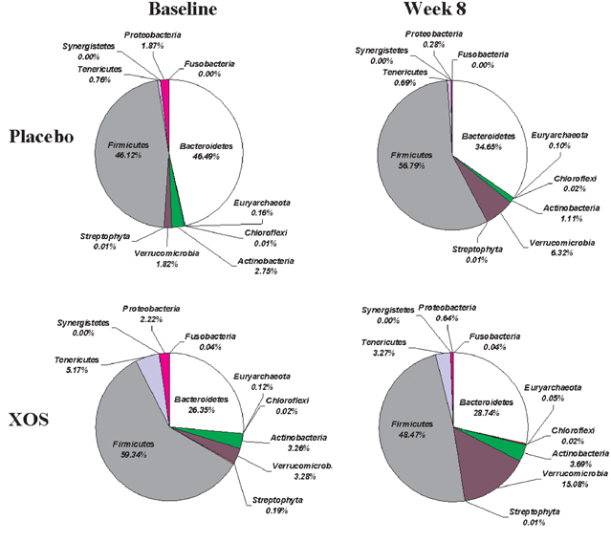
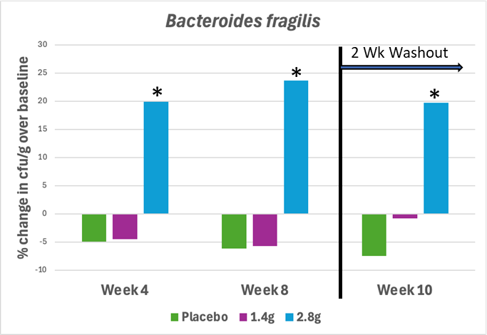
Xylooligosaccharides Support Favorable Shift in Microbial Composition and Alter Firmicutes/Bacteroides Ratio
Effects of XOS supplementation on gut microbiota in healthy participants
Design
Double-blind, randomized, placebo-controlled
32 healthy adult participants
1.4g or 2.8g of PreticX® per day, or placebo
8-week supplementation with 2-week washout
Results
Increase in absolute Bifidobacterium from baseline significantly greater
Increase in absolute Bacteroides fragilis from baseline significantly greater (2.8g) at all time points
Significant increase in relative Akkermansia (2.8g) vs placebo (p=0.041)
*p<0.05 vs placebo
Finegold SM, et al. Xylooligosaccharide increases bifidobacteria but not lactobacilli in human gut microbiota. Food Funct. 2014;5(3):436-445. doi:10.1039/c3fo60348b
Notes:
Double-blind, randomized, placebo-controlled
32 healthy adult participants
1.4g or 2.8g of PreticX® per day, or placebo
8-week supplementation with 2-week washout
Results
Increase in absolute Bifidobacterium from baseline was significantly greater for both doses at week 10 and the higher dose also at week 4 and week 8
Increase in absolute Bacteroides fragilis from baseline was significantly greater for the 2.8g per day dose at all time points
Significant increase in relative Akkermansia for the 2.8g dose compared to placebo (p=0.041)

Slide 12
Xylooligosaccharides Promote Gut Motility
*
*
*
*
*
*
*
*
*
*p<0.05 vs placebo
*p<0.05 vs baseline
Design
Double-blind, randomized, placebo-controlled
700mg of PreticX® per day, or placebo for 6 weeks
56 young women with constipation (mean age 22)
Results
Beginning at week 2 the PreticX® group had significantly more weekly stools compared to placebo
Design
Open label intervention
3g of PreticX® per day for 4 weeks
27 pregnant women with constipation
Results
PreticX® significantly increased the number of weekly stools from one-per-week to nearly seven-per-week
(1) Jeon JH, et al. Effect of xylooligosaccharide-sugar mixture on defecation frequency and symptoms in young women with constipation: a randomized, double-blind, placebo-controlled trial. J Nutr Health. 2015;48:19–29.
(2) Tateyama I, et al. Effect of xylooligosaccharide intake on severe constipation in pregnant women. J Nutr Sci Vitaminol (Tokyo). 2005;51(6):445–448.

Slide 13


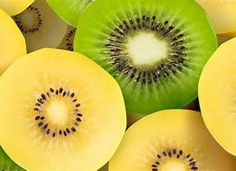
Freeze Dried Whole Kiwifruit are Strong Prebiotic Substrates for Protective Microbial Species
High-methoxy Pectin
Contributes to faecal bulking & water holding
Acts as a matrix for bacteria to adhere to & proliferate
Upregulates stress response genes to improve survival of probiotics
Substrate for growth of key bacteria (SCFA producers)
Faecalibacterium prausnitzii
Ruminococcaceae
Lachnospiraceae
Bacillus spp.
Bifidobacterium spp.
Lactobacillus
Notes:
The pectin in Kiwifruits is part of the reason Actazin and Livaux are so effective
The specific prebiotic benefits of pectin include that it acts a substrate for good bacteria to ferment and grow on. The high methoxy pectin in Actazin and Livaux retains its original structural and compositional complexity.
High methoxy pectin is a substrate for Faecalibacterium prausnitzii
Other users of pectin include members of the Ruminococcacea family (like F. prau) and Lachnospiraceae family.
Some Bacillus species and Bifidobacterium species can use intact or partially hydrolysed pectin
Some Lactobacillus can use hydrolysed pectin oligosaccharides
Additionally, pectin that is not used for bacterial growth has the following benefits:
It contributes to faecal bulk and water-holding
It acts as a matrix (scaffold) for bacteria to adhere and proliferate
When administered as a synbiotic, while not utilised for growth it upregulates stress-response genes (e.g. acid-resistance) to improve the survival of co-administered probiotics (e.g. Lactobacilllus). This benefit is potentially very important for its use as a synbiotic for bacteria that cannot directly utilise pectin as a substrate.

Slide 14
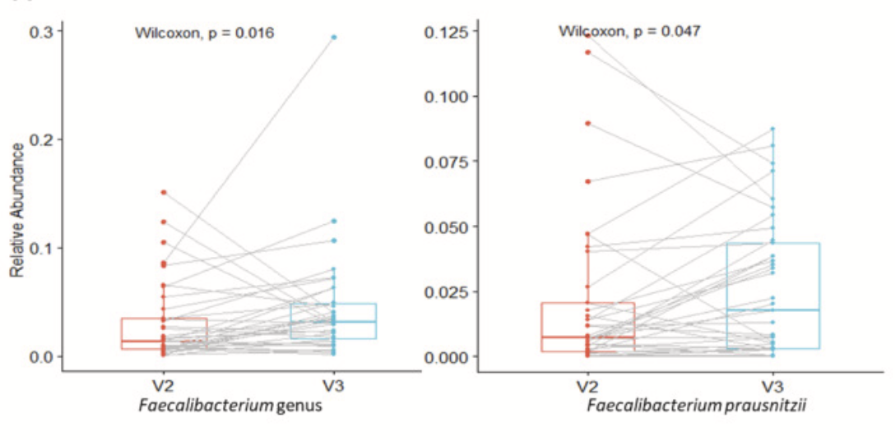
Gold Kiwifruit Powder Significantly increases Faecalibacterium prausnitzii: a key commensal and major SCFA-producer in the gut
Design:
Double-blind, randomized, placebo-controlled, parallel-arm trial
85 healthy adults (ages 18–60)
600 mg Livaux/day or placebo
28 days
Results:
Significant increase in Faecalibacterium prausnitzii (p = 0.047)
Decrease in hydrogenotrophic Blautia spp.
Decrease in bloating
McKeen S, et al. Livaux® gold kiwifruit powder consumption at 600 mg per day for 28 days increases Faecalibacterium prausnitzii numbers and decreases bloating and hydrogenotrophic species numbers in healthy individuals, consistent with slow fermentation: A randomized controlled trial. Bioactive Carbohydrates and Dietary Fibre. 2025;33; 100468 https://doi.org/10.1016/j.bcdf.2025.100468

Slide 15
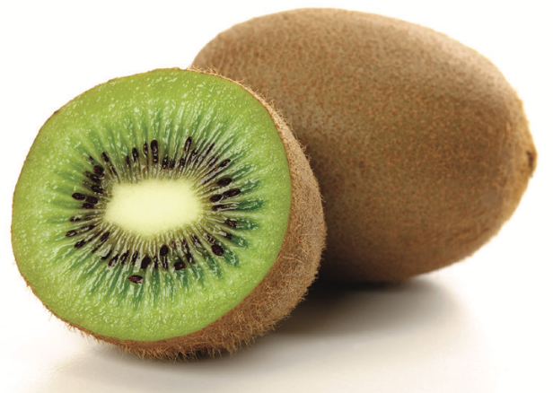
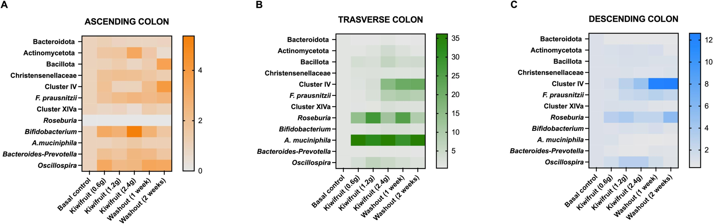
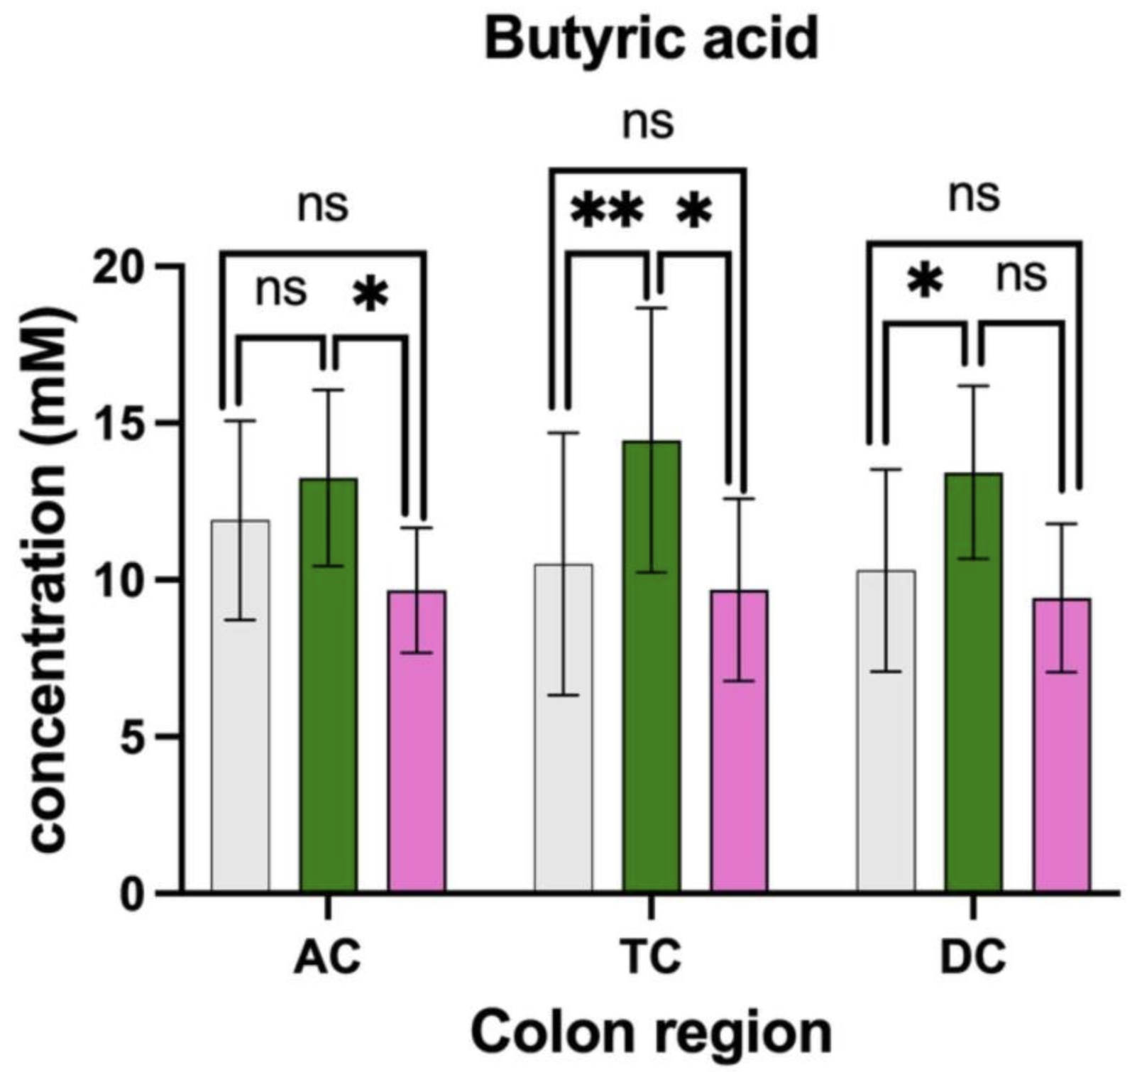
Freeze Dried Whole Green Kiwi Fruit
Actazin® promotes the growth of Akkermansia, Bifidobacteria, and Faecalibacteria and increases butyrate
Simulator of the Human Intestinal Microbial Ecosystem (SHIME®)
Dynamic long-term gut model using human donor samples
Goya-Jorge E, et al. Butyrogenic, bifidogenic and slight anti-inflammatory effects of a green kiwifruit powder (Kiwi FFG®) in a human gastrointestinal model simulating mild constipation. Food Res Int. 2023;173(Pt 2):113348. doi:10.1016/j.foodres.2023.113348
Notes:
Clostridium cluster IV – strong butyrate producers

Slide 16


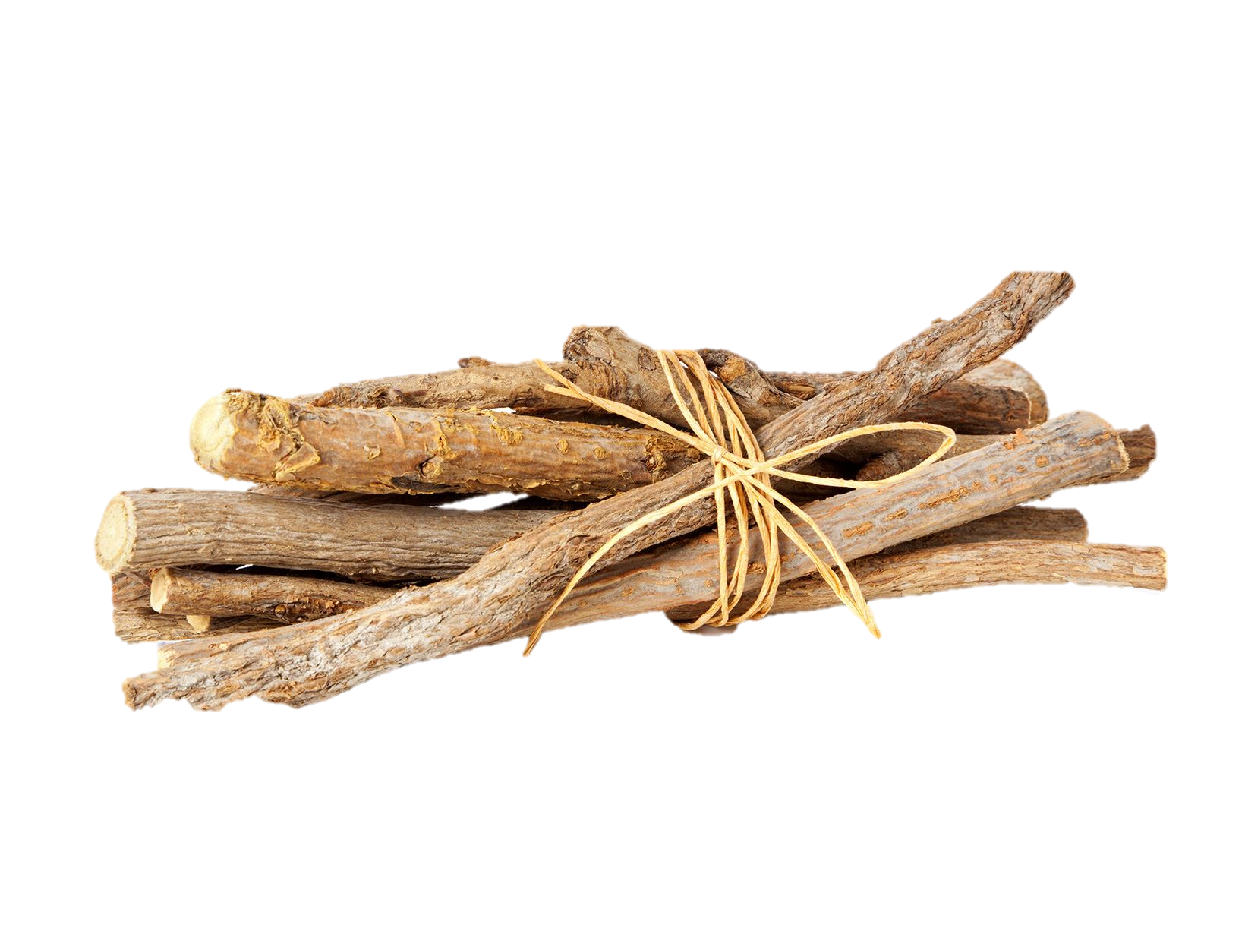
Flavonoid Rich Licorice Extract
Flavonoids are prebiotic and support digestive health
Flavonoids are a class of polyphenolic secondary metabolites found in plants widely researched to benefit digestive health
Flavonoids and flavonoid metabolites can shape gut microbiota by inhibiting the growth of various pathogens and increasing beneficial genera
01
02
Flavonoids inhibit gut inflammation
03
Flavonoids are studied to improve gut immunity
Pei R, Liu X, Bolling B. Flavonoids and gut health. Curr Opin Biotechnol. 2020;61:153-159. doi:10.1016/j.copbio.2019.12.018
Notes:
https://www.sciencedirect.com/science/article/pii/S0958166919301569#:~:text=Flavonoids%20and%20flavonoid%20metabolites%20can,of%20primary%20into%20secondary%20bile

Slide 17
Flavonoid-Rich Licorice Extract
GutGard® significantly improves stress-induced gut dysbiosis
GutGard® at 150 mg HED promotes the growth of beneficial bacteria and known butyrate producers in the gut (Bacteroides spp, Bifidobacterium spp and Akkermansia spp)
Restraint stress induced gut dysbiosis
Normal control, stress control, and GutGard®-treated groups.
120-minute daily restraint stress for 10 days.
GutGard® administered for 7 days before and 10 days during restraint stress.
Natural Remedies In-house study

Slide 18
Summary and Key Takeaway
A correlation exists between the gut microbiome and estrogen-related disorders, including perimenopausal and menopausal symptoms.
Gut microbiome modulation is emerging as a therapeutic target for management of estrogen- and other hormone-related conditions.
A diet rich in selective prebiotics, fibers and plant polyphenols may promote microbial diversity, gut-barrier integrity and enzyme regulation to support hormonal balance.

Slide 19



Thank you!
s.ford@aidp.com
https://www.linkedin.com/in/samantha-ford-aidp/
https://www.linkedin.com/company/aidp-inc/
Notes:
Estrogen–gut microbiome axis: Physiological and clinical implications
Mechanism of Microbiota-Gut-Brain in Perimenopausal Depression: An Inflammatory Perspective
Gut feeling: Exploring the intertwined trilateral nexus of gut microbiota, sex hormones, and mental health
Compositional and functional features of the female premenopausal and postmenopausal gut microbiota - Zhao - 2019 - FEBS Letters - Wiley Online Library
Spotlight on the Gut Microbiome in Menopause: Current Insights – PMC
The gut microbiota in menopause: Is there a role for prebiotic and probiotic solutions? - Marrium Liaquat, Anne Marie Minihane, David Vauzour, Matthew G Pontifex, 2025
Gut microbial beta-glucuronidase: a vital regulator in female estrogen metabolism – PMC
Study on gut microbiota and metabolomics in postmenopausal women | BMC Women's Health | Full Text

