Slide 1


From Gut Feeling to Business –
Is there Really a Market for Microbiome foods
Mika Aalto - Co-founder / Gutly Foods

Slide 2


GUTLY - MISSION
®
Gutly transforms Northern superfoods and side-streams into personalized smart foods for T2D prevention (and beyond).
Notes:
Gutly's aim is simply to turn scientifically chosen, super rich raw materials to personalized smart food.

Slide 3
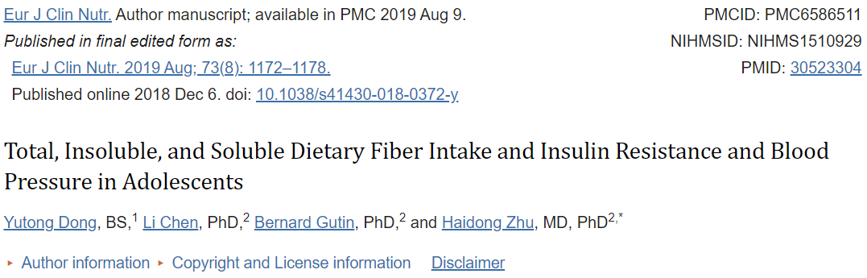
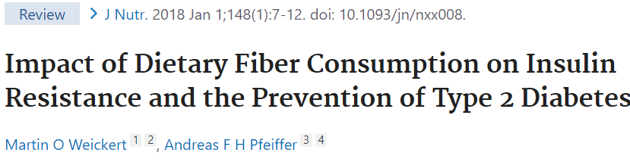
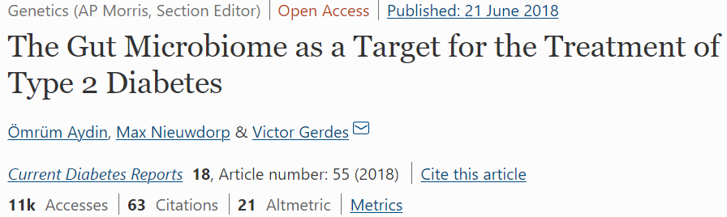
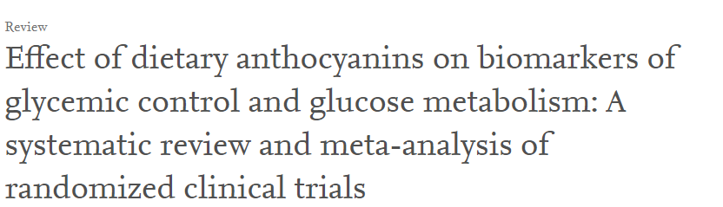
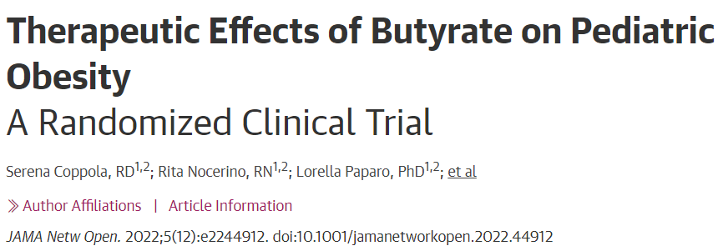
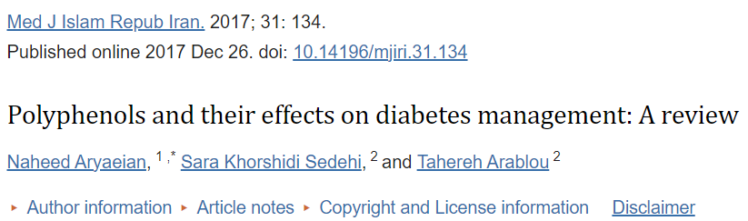
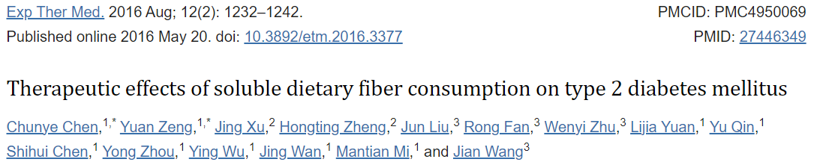
”Increased intake of soluble DF over a short-duration in Chinese patients with D2M was able to significantly improve blood glucose levels and insulin resistance.”
THERE IS CLEAR SCIENTIFIC
EVIDENCE THAT SPECIFIC
NUTRIENTS AND GUT MICROBES
HAVE POSITIVE IMPACT
ON BLOOD GLUCOSE LEVELS AND INSULIN RESISTANCE
“Person’s gut microbiota could predict how quickly their blood sugar would increase in response to eating a particular food.”
“Experiments in animal and human studies have produced growing evidence for the causality of the gut microbiome in developing obesity and T2D.”

Slide 4
”Increased intake of soluble DF over a short-duration in Chinese patients with D2M was able to significantly improve blood glucose levels and insulin resistance.”
…AND YET, THE MARKET FOR FOOD BASED T2D ”THERAPIES” IS SMALL AND FRAGMENTED.
“Person’s gut microbiota could predict how quickly their blood sugar would increase in response to eating a particular food.”
“Experiments in animal and human studies have produced growing evidence for the causality of the gut microbiome in developing obesity and T2D.”

Slide 5
FOOD AS A VEHICLE MAKES SENSE
Food -> supplement for everyday fiber because:
  Dose + diversity: Whole grains and varied plants deliver dose-response improvements and broader effects than single isolates.
  Matrix synergy: Fibers + polyphenols + proteins + cell structure in real foods change fermentation and outcomes.
  Real-world performance: Kiwifruit can match psyllium for constipation and comfort – another proof that foods can be targeted and effective.
  Affordability – It’s easily available for all
  The question? Evidence-level nutrition and food - can we get both and make it a business?

Slide 6
TURNING SCIENCE TO SMART FOOD THERAPY - CASE GUTLY
SCIENCE
RAW MATERIALS
PERSONALIZATION
OPTIMIZATION
POLYPHENNOLS
GRAINS
PHENOTYPES
DENSITY
OLIGOSACCARIDES
BERRIES
MICROBIOME?
BALANCE
INULIN
SEEDS
OMEGA 3
NEW NC
50 % SIDE STREAMS
MICRO NUTRIENTS
NUTS
NEW MECHAN
AMINOACIDS
BEANS
…
ROOTS…
DATA + AI

Slide 7
THE MARKET EXIST – BUT IS IT MICROBIOME DRIVEN?
    Market size & growth (global / Europe)
    Digestive health food & drinks: ~$60B in 2024, forecast 5–7% CAGR
    Europe (digestive health products): $14.1B (2023), ~7.3% CAGR to 2030; key formats include dairy and bakery/cereals.
    Prebiotics (ingredient market across foods & drinks): $8.5B (2023), forecast ≈ 14% CAGR
    Food fibers: $8.1B (2024), forecast ≈ 9% CAGR
    Synbiotics (pre+probiotics in foods/supps): $1.0B (2024), ≈8% CAGR to 2030
Notes:
Hot sub-segments (food & bev)
Probiotic/prebiotic sodas: still small but scaling fast – est. $478M (2024) → $766M (2030) (≈8% CAGR). FMCG majors are entering.
Probiotic dairy (yogurts/drinks): multiple trackers show mid-to-high single-digit CAGRs through 2030s; estimates vary widely by source and scope (category definitions differ).
Kefir: niche but steady growth as a “natural probiotic” alternative in Europe/North America.

Slide 8
MARKET DEVELOPMENT – STRONG SIGNALS
  Consumer demand & positioning
  Gut health is a top wellness benefit in current consumer trend trackers (Innova, 2025).
  Broader wellness priority remains high (McKinsey: 70–80% treat wellness as important), supporting ongoing spend on gut-healthful foods.
  Modern sodas/functional beverages with gut claims are drawing incremental demand, not just cannibalizing legacy soda (Circana).
    M&A / BigCo moves: PepsiCo signed a $1.95B deal to acquire Poppi (prebiotic soda). Coca-Cola launched Simply Pop prebiotic sodas (6 g fiber/can).

Slide 9
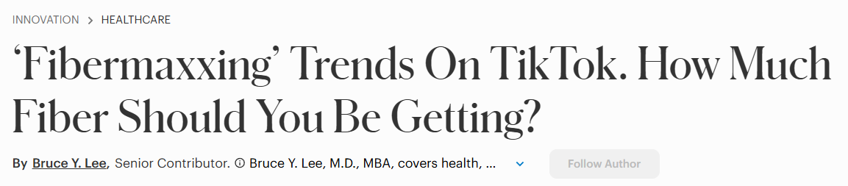

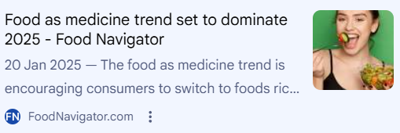
FROM HYPE TO HABITS – SCIENCE OR SOME?
TikTok’s fibermaxxing is moving prunes, pulses & wholegrains - experts approve, with “add gradually” guidance.
Food-is-Medicine is scaling beyond pilots with RCT-backed improvements in diet quality & food security. “Design SKUs for clinical programs.”

Slide 10
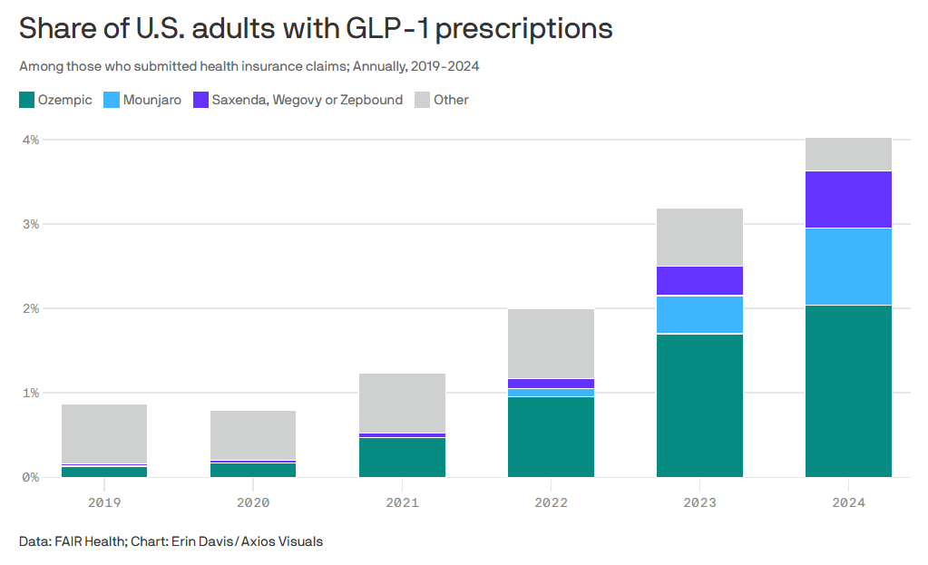
FROM HYPE TO HABITS – LOOK BEYOND
GLP-1 users mean smaller portions, more function: satiety, protein, fibre.
Prebiotic > probiotic (for foods): faster growth in prebiotic fibre fortification, simpler benefits.
Consumers want tasty basics with benefits - not wellness theatre.
Two decades of IFIC tracking show taste is the #1 purchase driver every year since 2006
Price ranks #2; in 2024, 76% of U.S. consumers cited it as a key driver (vs. 85% for taste)
Healthfulness/nutrition is #3 in the U.S. (ahead of convenience); in the EU, “food safety” often competes for the third spot after cost and taste.
Notes:
Taste (does it taste great?)
Two decades of IFIC tracking show taste is the #1 purchase driver every year since 2006. IFIC
Price/value (can I afford it?)
Price ranks #2; in 2024, 76% of U.S. consumers cited it as a key driver (vs. 85% for taste). Food Industry Executive
Healthfulness/nutrition
Typically #3 in the U.S. (ahead of convenience); in the EU, “food safety” often competes for the third spot after cost and taste. IFIC+1

Slide 11
THE HARD PART ISN’T THE SCIENCE - IT’S THE BUSINESS
Claims & compliance (EU): If you want on-pack effects, structure ranges around 3 g/day β-glucan for LDL and the post-prandial glucose condition (now ≥2 g β-glucan/30 g available carbs).
Tolerability & CX: FODMAP-heavy fibres can cause gas; mix fibre types and pair with clear hydrate + gradual instructions.
Accessibility: Price per gram of fibre matters. If you want to position as a cost-effective way to hit 30 g fibre/day with matrix effect, its getting harder.
Clinical channel fit: How to build clinic-ready SKUs that meet fibre + whole-grain targets and sodium/sugar caps: simple outcomes (regularity, satiety, energy).
Taste: if positioned as food it should taste good!

Slide 12

MICROBIOME FOODS: PICK A POSITION
SUPPLEMENTS
FOOD
HEALTHY
FOOD
GOAL-FIRST EFFICACY
SAFETY/QUALITY PROOF
TASTE/FORMAT
TASTE
PRICE/VALUE
HEALTHFULNESS/NUTRITION

Slide 13
There is a market, but The Market is still under development.
In foods, taste and price beat science at the shelf - use science to support, not to sell.
Ride the trend - don’t try to invent it.
Be smart with positioning:
  If it’s positioned as food, taste is non-negotiable.
  If it’s positioned as a supplement, efficacy and proof matter more than price.
Convenience and occasion drive use - make it easy to choose, easy to use, everywhere.
KEY TAKE AWAY Microbiome foods can be effective, but winning in market is harder than winning in R&D.
Notes:
If you keep quality tight and sugar reasonable, edible formats can outperform pills simply because people stick with them.

Slide 14
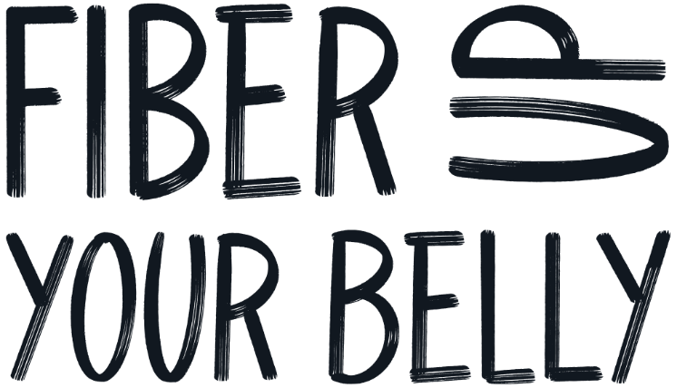
THANK YOU
Mika Aalto
mika.aalto@gutlyfoods.com
Phone: +358 400 528151

