Slide 1
Unraveling Heterogeneous Responses to Microbiome-Targeted Interventions with Microbial Community-Scale Metabolic Models
Nick Quinn-Bohmann
11.18.2025 | Gibbons Lab

Slide 2
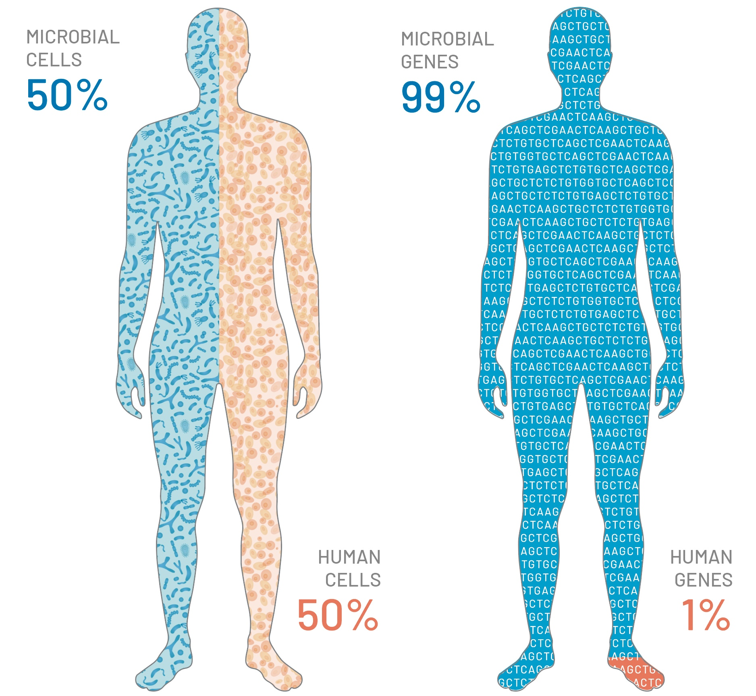
The Human Microbiome
Our unique microbiome governs our physiology through digestion, immune system regulation, and metabolic health
Image redrawn by ISB from Gaby D’Alleandro / © AMNH.

Slide 3
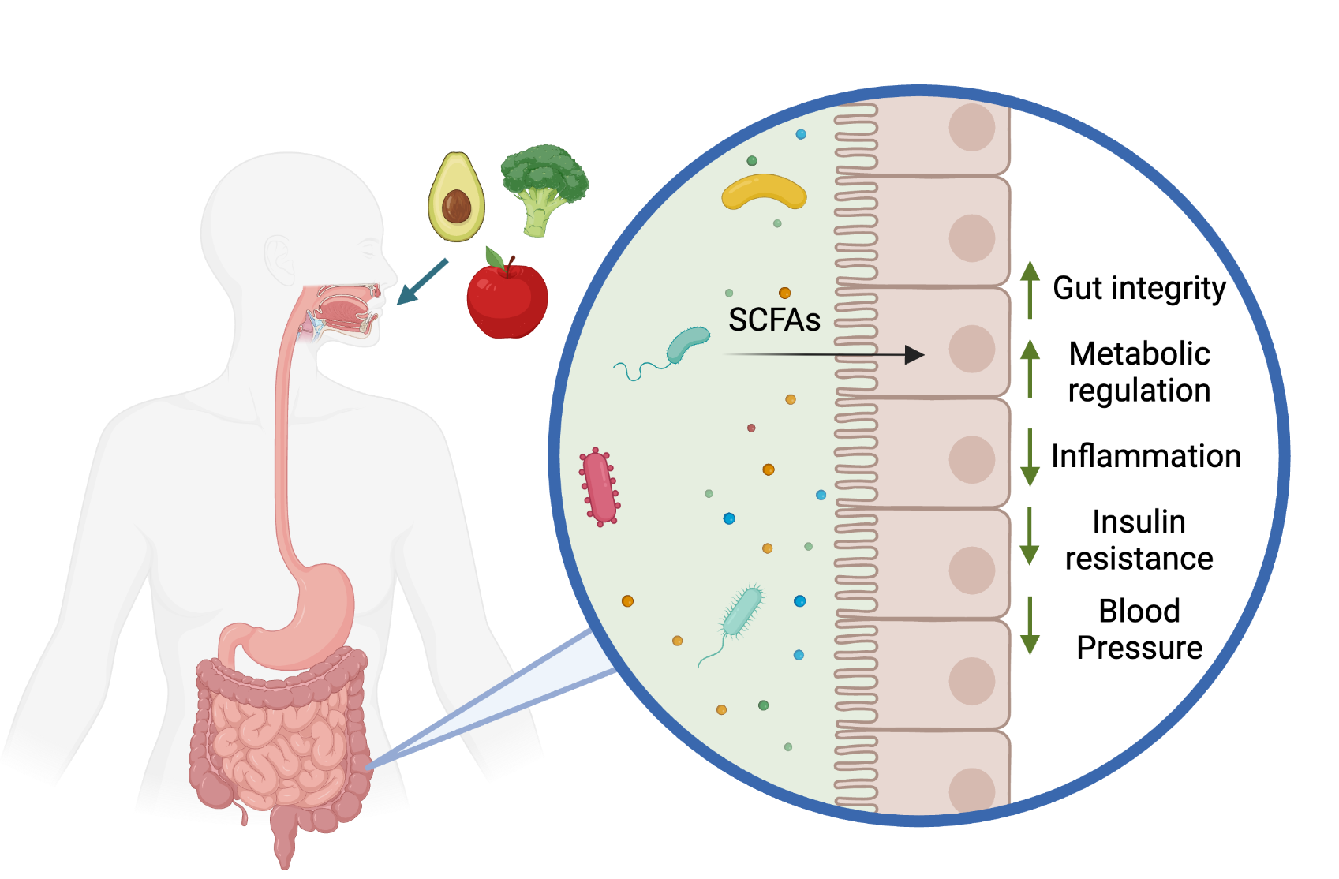
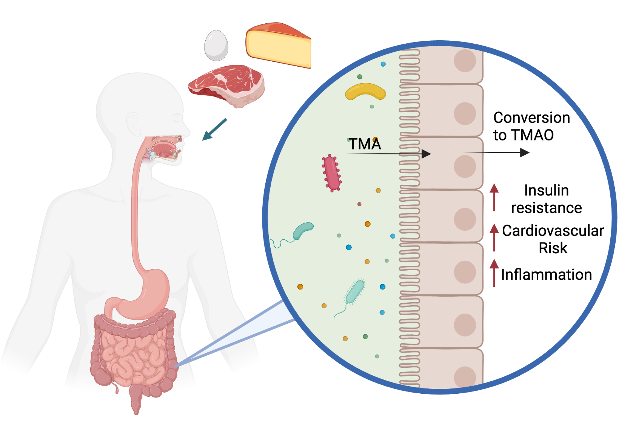
Metabolic Output from the Gut Microbiome Influences Host Health
Carnitine- & choline-rich diets promote production of risk-associated TMA
Fiber-rich diets promote production of beneficial SCFAs
Created with BioRender.com

Slide 4
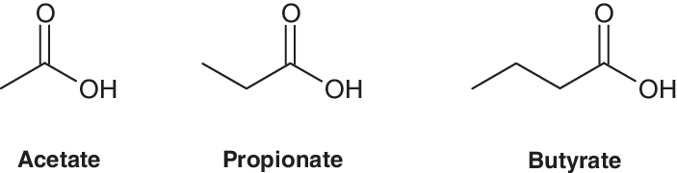
Short-Chain Fatty Acids from the Microbiome Provide Physiological Benefits
Acetate
Stimulates GLP-1 and PYY release, regulating blood glucose and appetite
Weakly anti-inflammatory
Propionate
Regulates serum cholesterol, insulin sensitivity, hepatic lipogenesis
Decreases inflammatory cytokine production
Butyrate
Primary energy source for colonic enterocytes
Stimulates GLP-1 & PYY release
Inhibits inflammation through HDAC inhibition & decreasing cytokine production

Slide 5
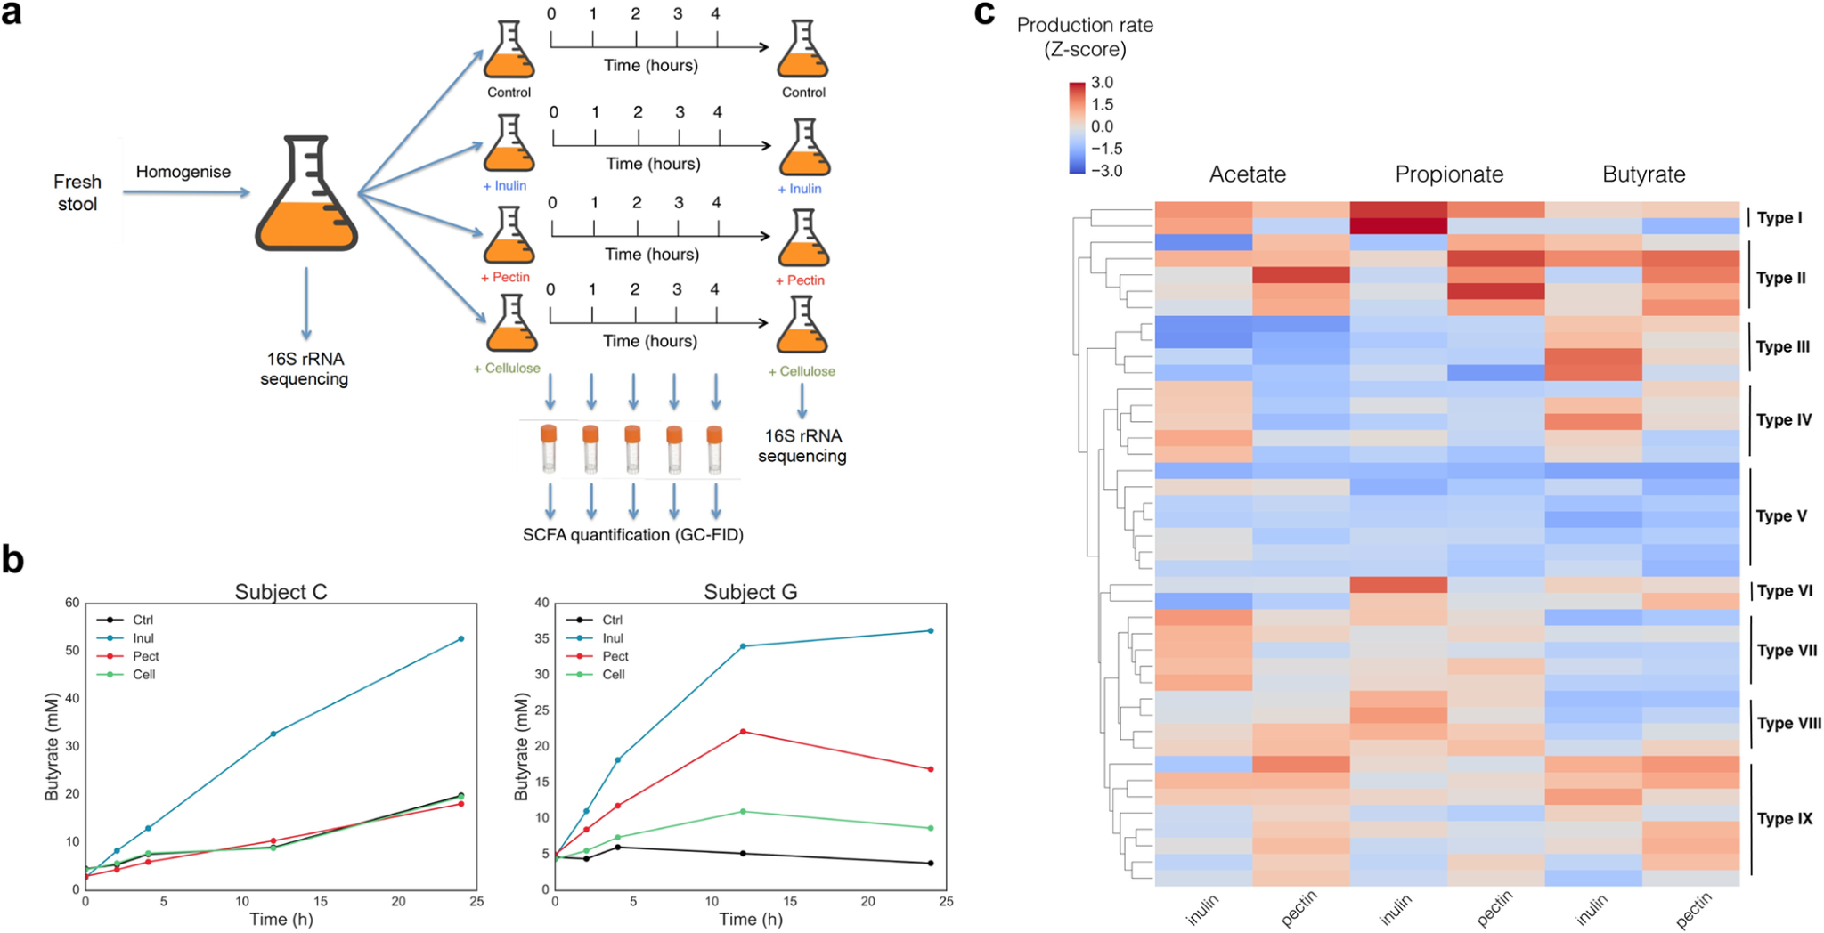
Metabolism in the Gut Microbiome is Individual-Specific
Identical diets can yield different metabolic outputs
Taxon-taxon interactions, cross-feeding, niche space occupation all impact metabolism
Sensitivity to small taxonomic or metabolic perturbations
Predicting and effectively engineering metabolic output from the microbiota remains challenging
Acetate
Propionate
Butyrate
Gurry et al., 2021, PLoS One

Slide 6
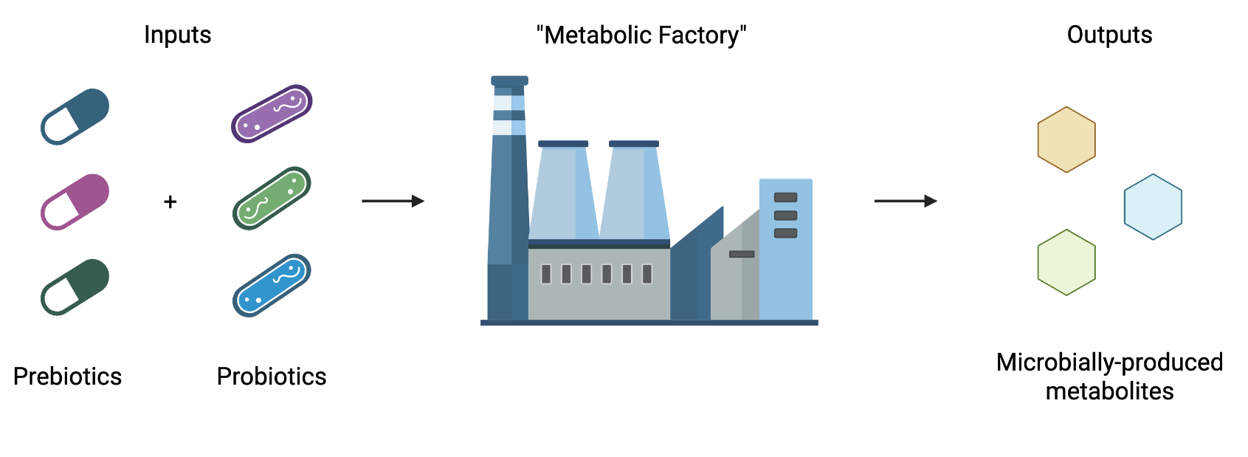
Leveraging Predictive Modeling to Determine Optimal Interventions to Modulate Metabolic Outputs
Created with BioRender.com

Slide 7
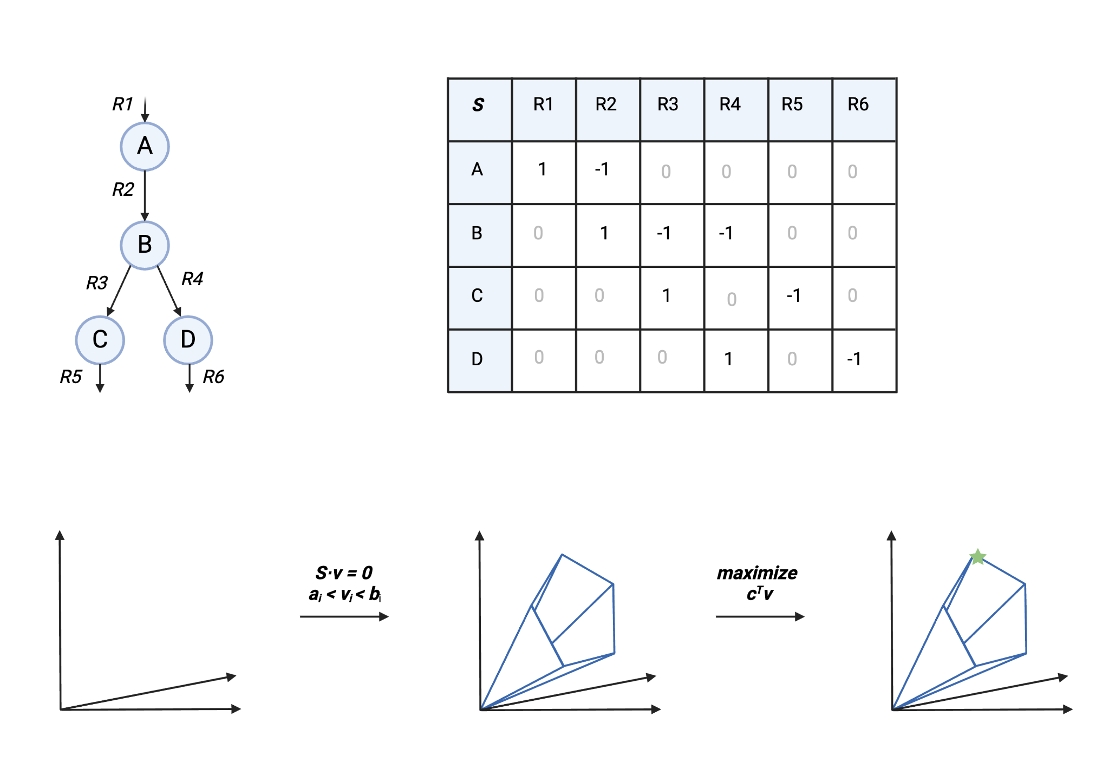
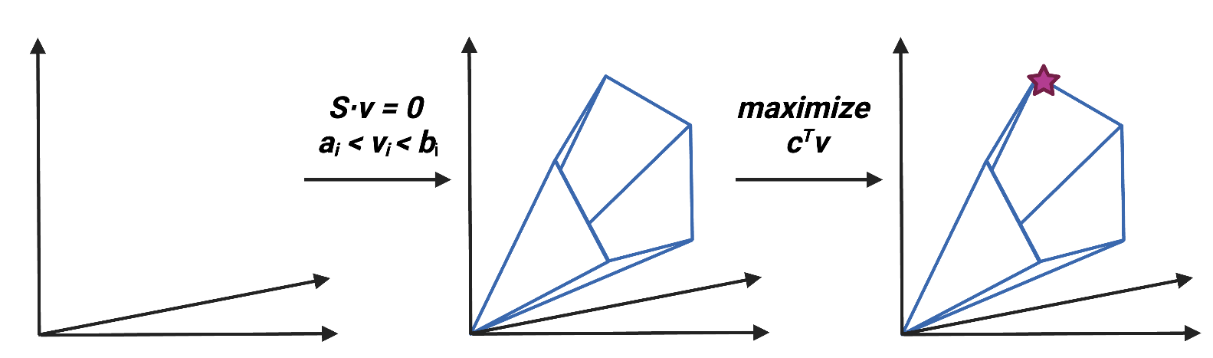
Flux Balance Analysis
Create metabolic reaction network of the system being modeled
Construct stoichiometric matrix of the reaction network
Impose constraints on the network based on assumptions, physiology, environment
Find solution in the allowable flux space that optimizes objective function
Adapted from Orth, Thiele, Palsson 2010, Created with BioRender.com

Slide 8
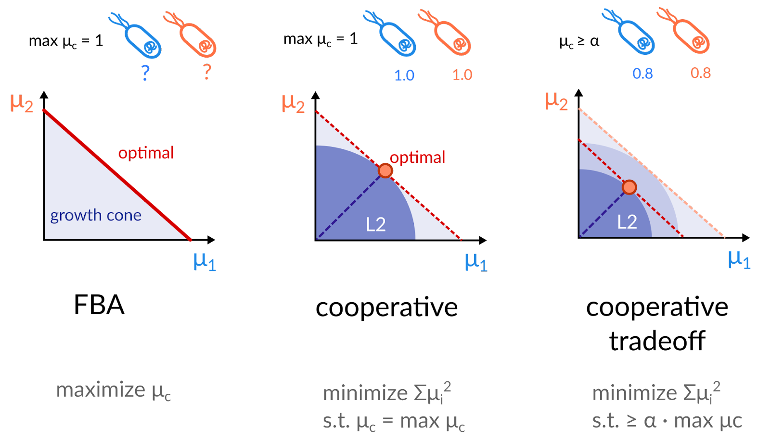
Cooperative Tradeoff Extends FBA into Community Scale
Diener et al., 2020, mSystems
Notes:
fix

Slide 9
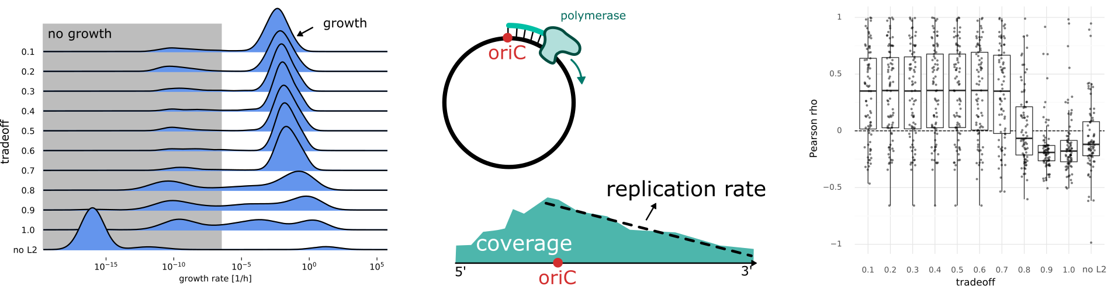
Predicted Growth Rates Associate with Measured Replication Rate
Diener et al., 2020, mSystems

Slide 10
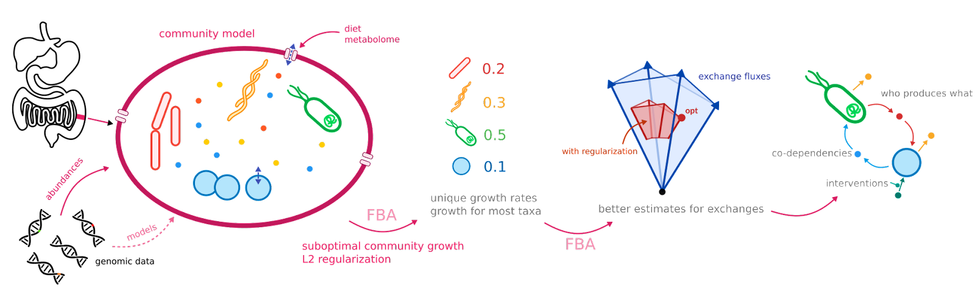
Microbial Community-Scale Metabolic Modeling Enables Mechanistic Understanding of the Human Gut Microbiome
We can now ask how interventions reshape community metabolism before testing them in humans →
Courtesy of the Gibbons Lab

Slide 11
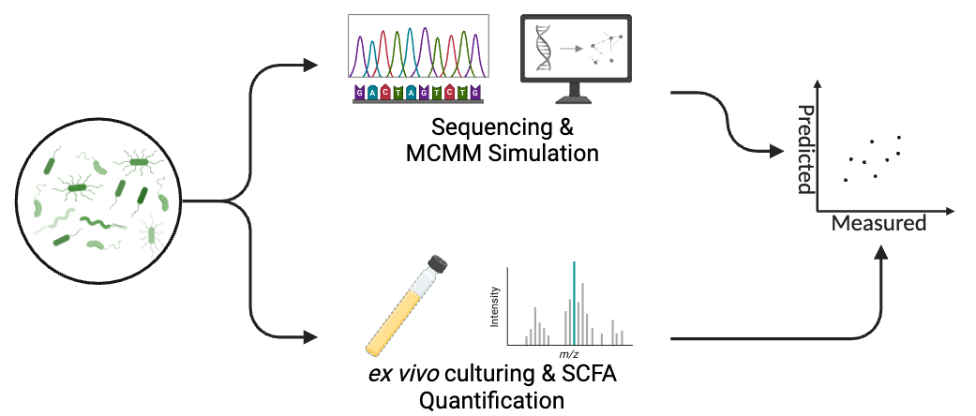
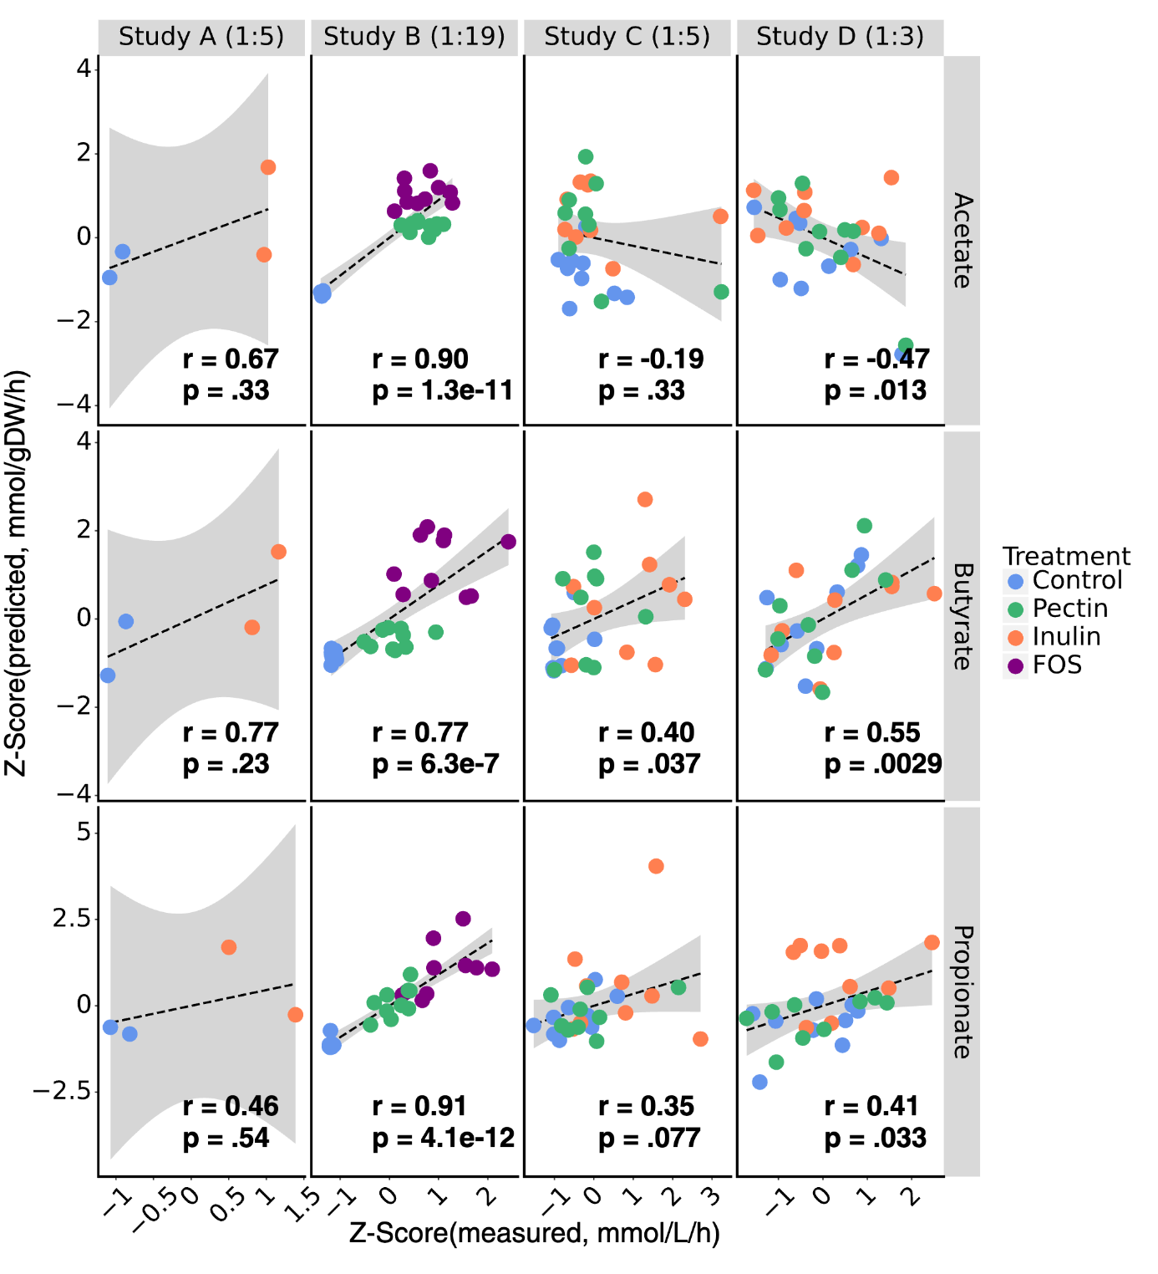
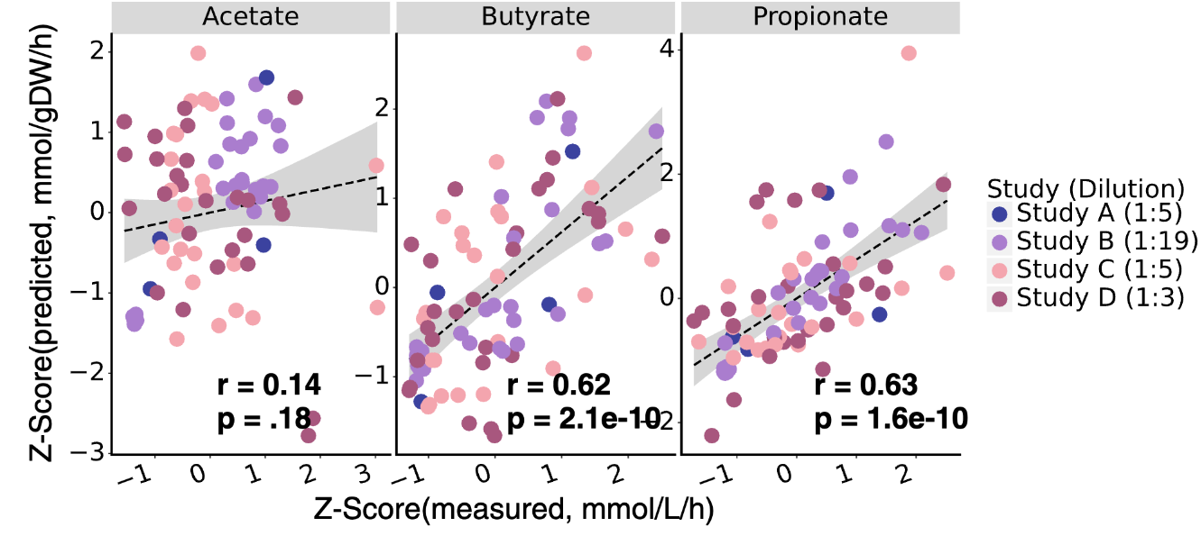
Predicting SCFA Production from Microbial Communities
Created with BioRender.com

Slide 12
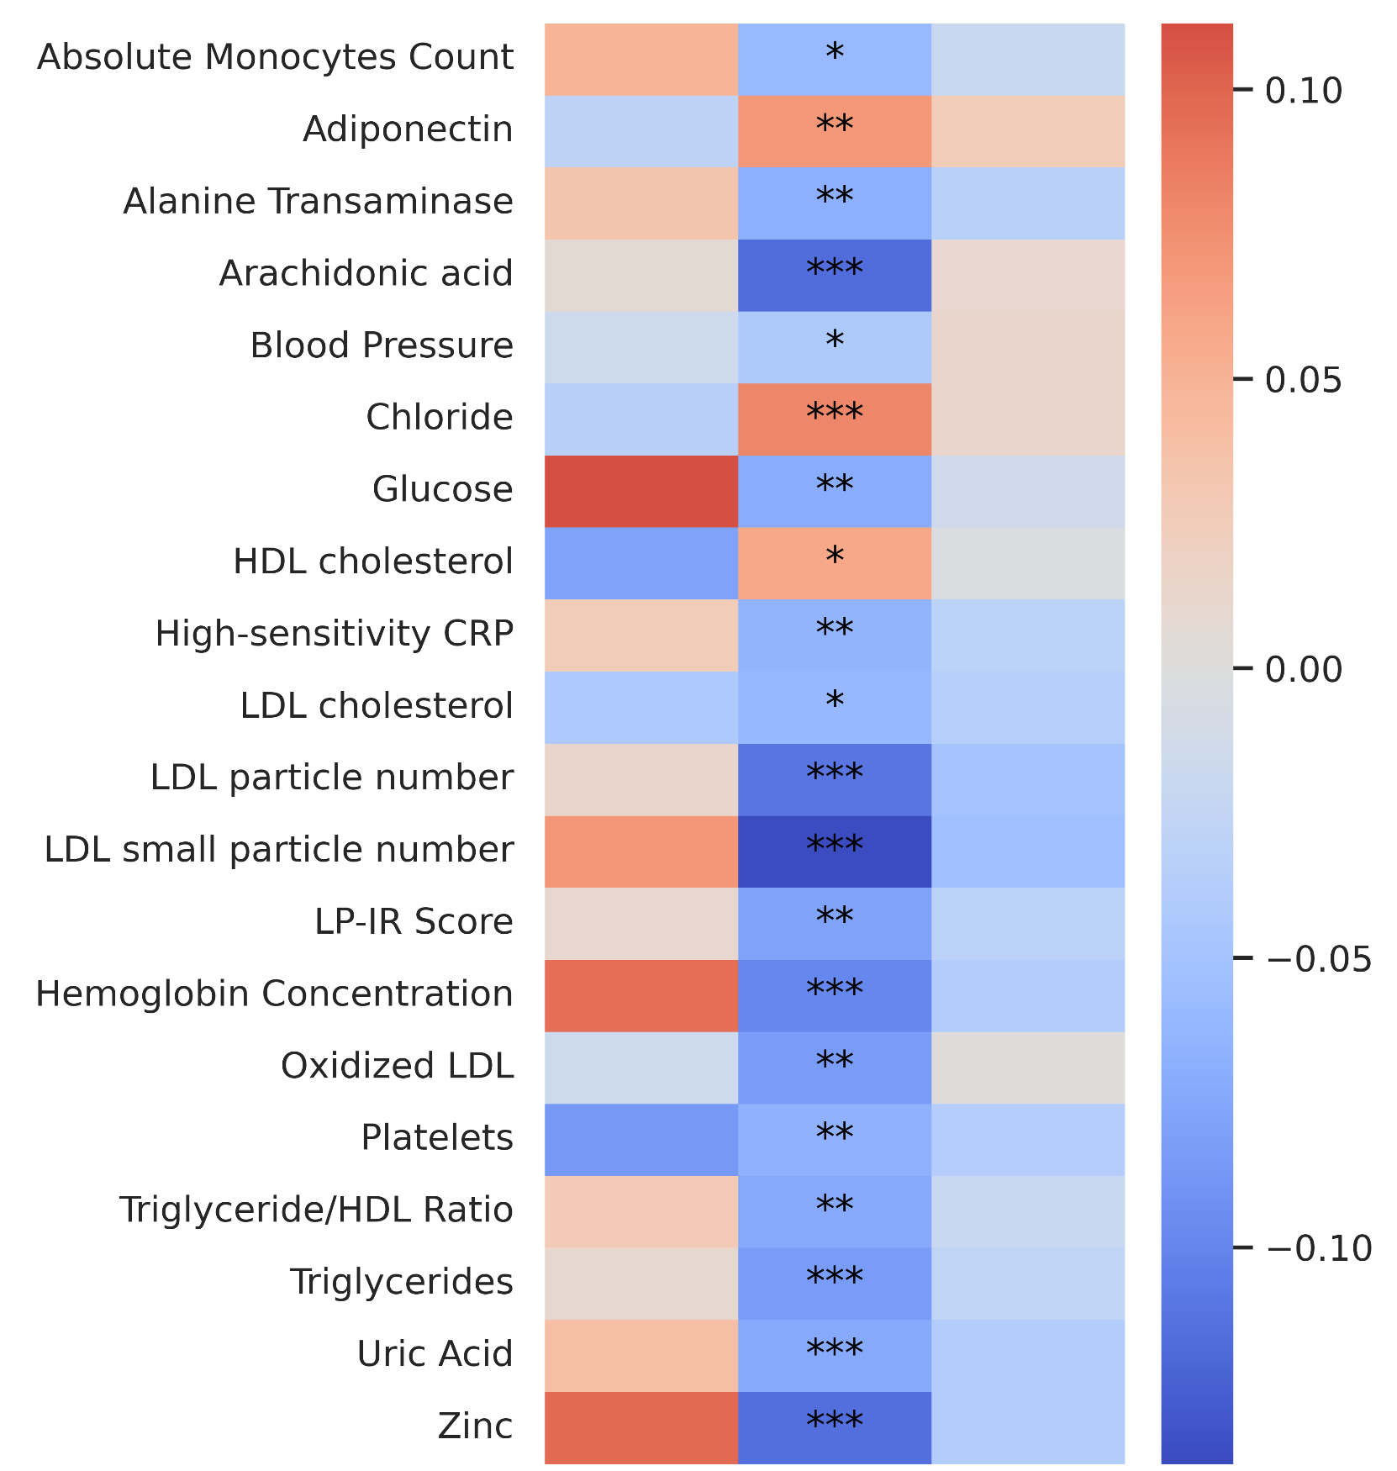
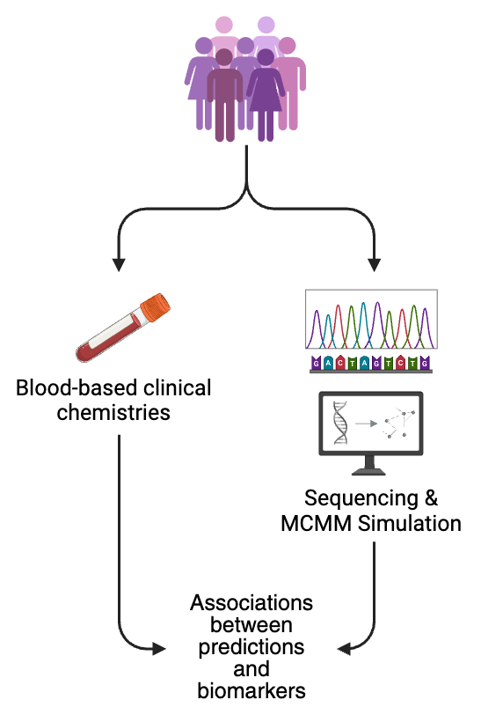
Predicted SCFAs Associate with Cardiometabolic Health Measures
Arachidonic acid: exacerbates inflammation when elevated
Blood pressure: associated with inflammatory disease, cardiovascular disease
C-Reactive Protein: clinical marker for systemic inflammation
LDL Cholesterol: associated with inflammatory diseases, cardiovascular disease
LP-IR: measure of insulin resistance
Triglycerides: increase incidence of atherosclerosis and cardiovascular disease
Measured butyrate in blood shows no association with expected markers
Measured Butyrate in Blood
Model Predicted Butyrate
Model Predicted Propionate
Created with BioRender.com

Slide 13
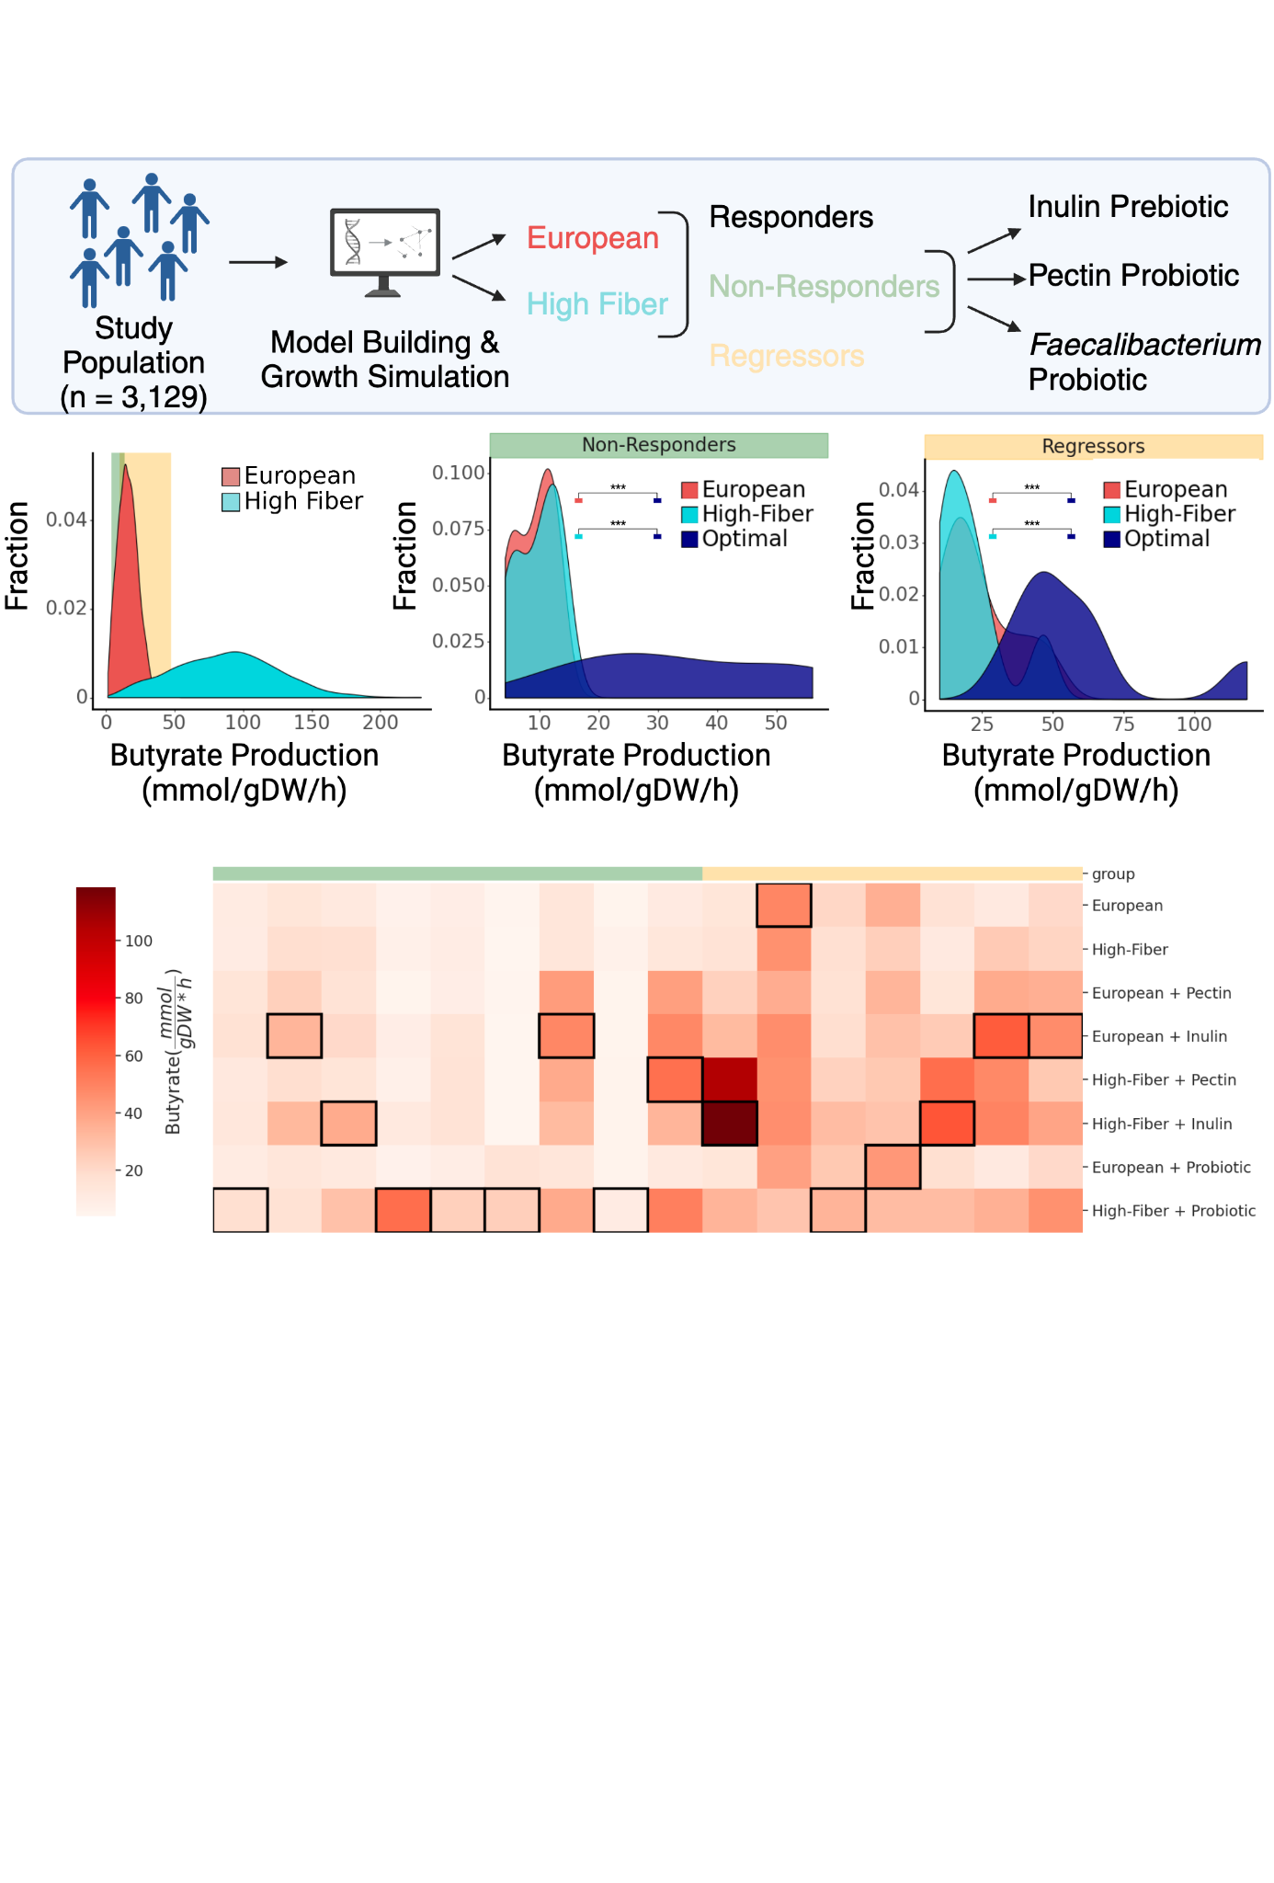
Heterogeneous Response to a Simulated High-Fiber Diet
Non-Responders: < 10 mmol/gDW/h butyrate on European diet, < 20% increase on High Fiber diet
Regressors: Decrease in butyrate on High Fiber diet compared to European Diet

Slide 14
Heterogeneous Response to Prebiotic & Probiotic Interventions
Non-Responders
Regressors

Slide 15
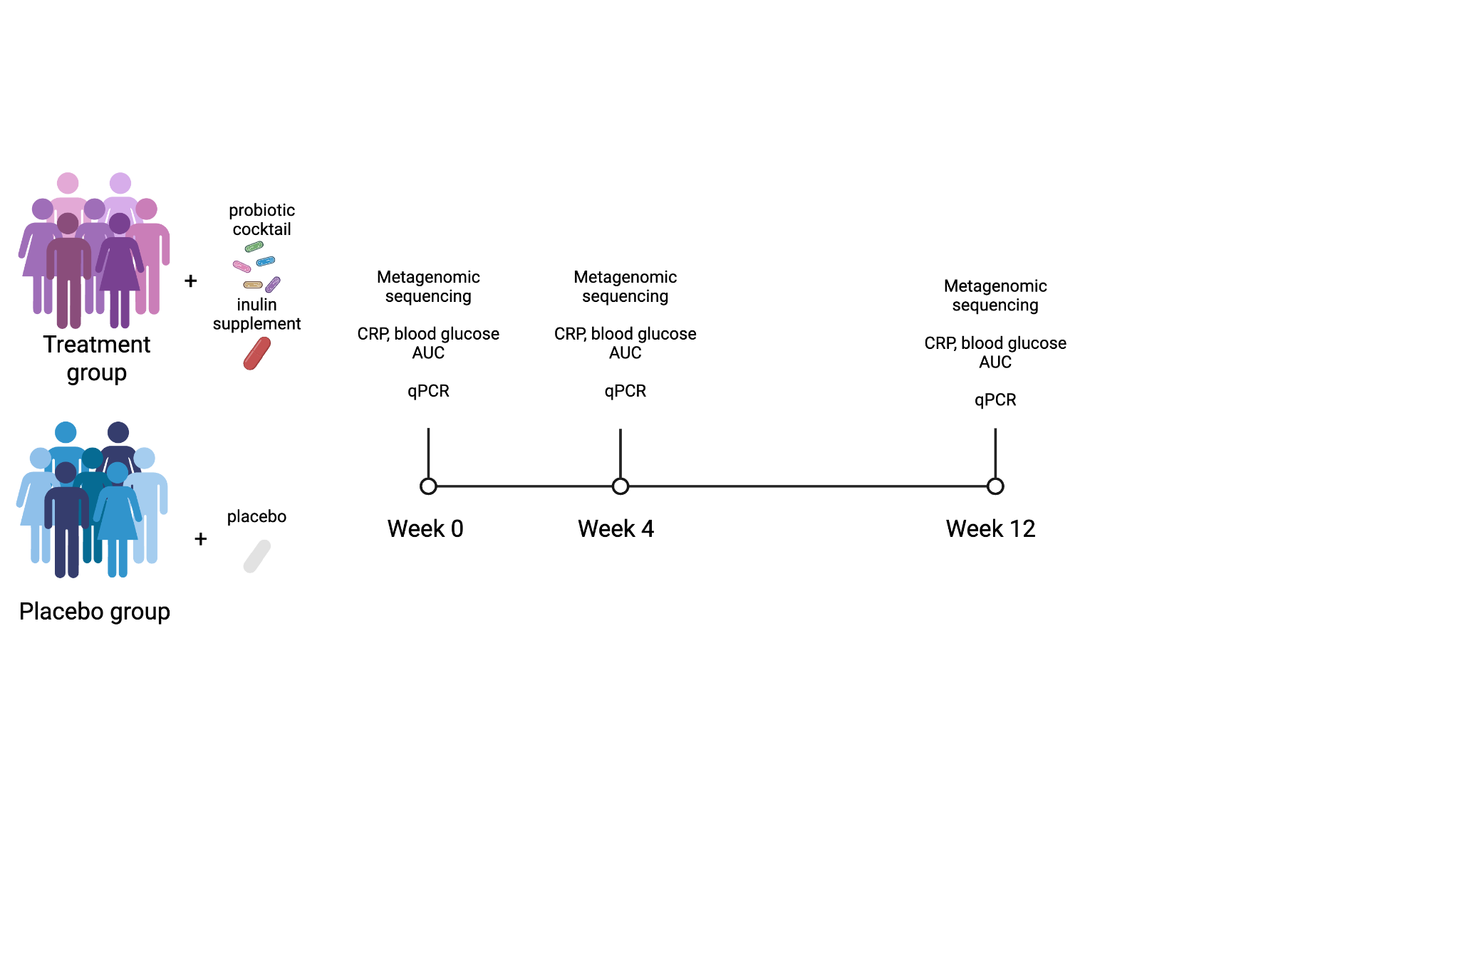
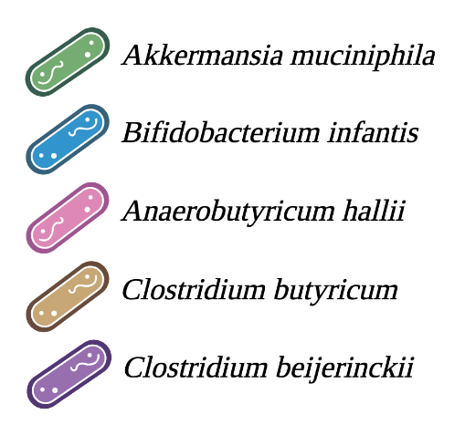
Longitudinal Study of Probiotic Efficacy Displayed Improves Postprandial Glucose Control
Treatment vs. Control:
Glucose AUC ⬇️
CRP ↔️

Slide 16
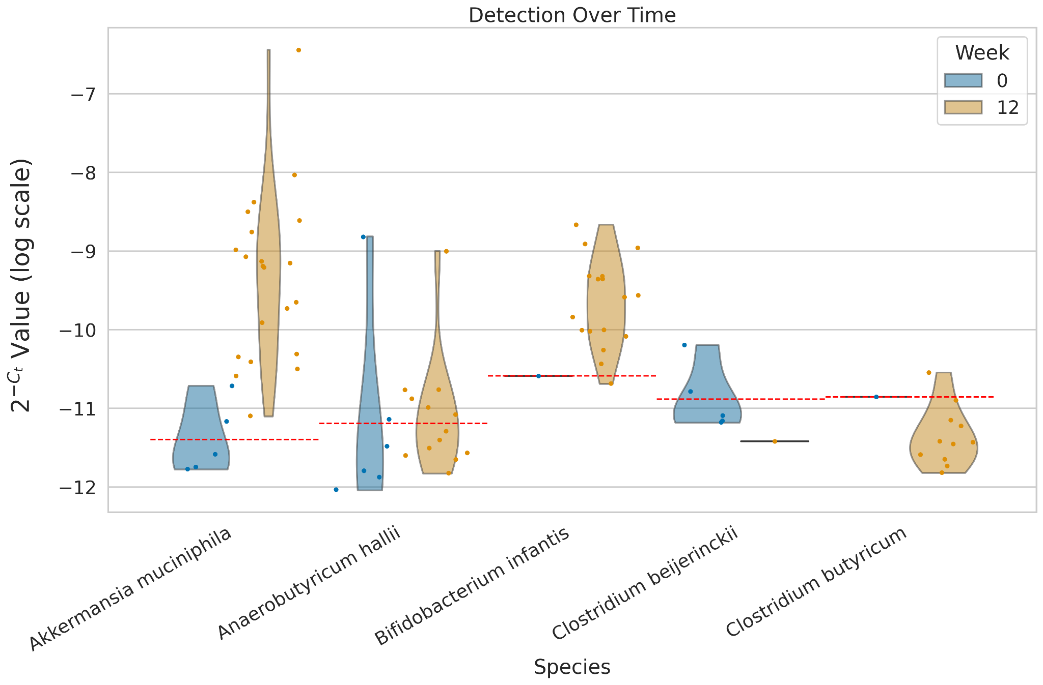
qPCR results show enrichment of A. muciniphila, B. infantis after 12 weeks
Notes:
Add in qPCR thresholding

Slide 17
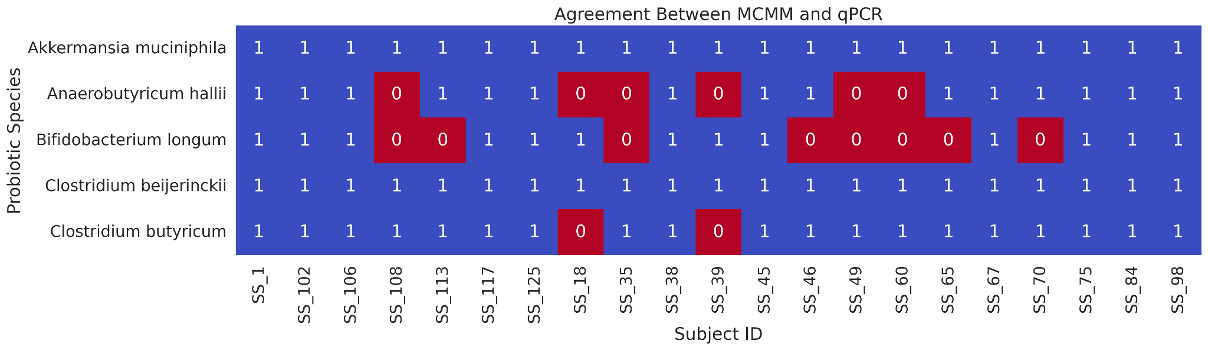


MCMM-predicted growth rates agree with qPCR ground truth
= agree
= disagree
agreement in 89/105 observations
Notes:
Update growth rate predictions

Slide 18
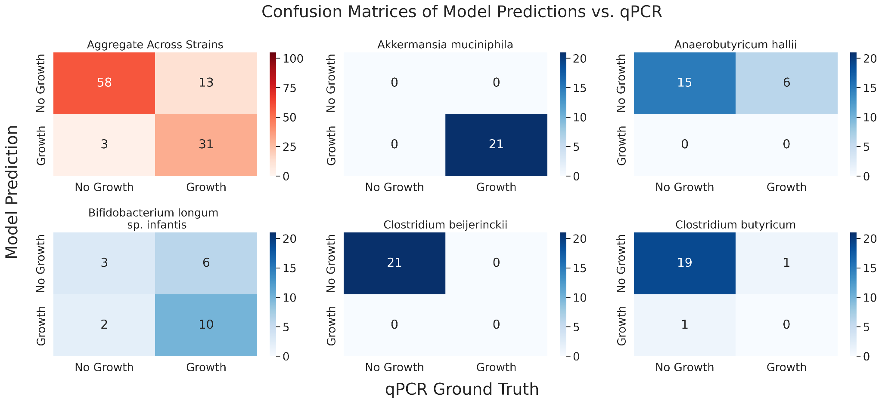
MCMM-predicted growth rates agree with qPCR ground truth
Fisher’s exact test, p = 4.4x10⁻¹³

Slide 19
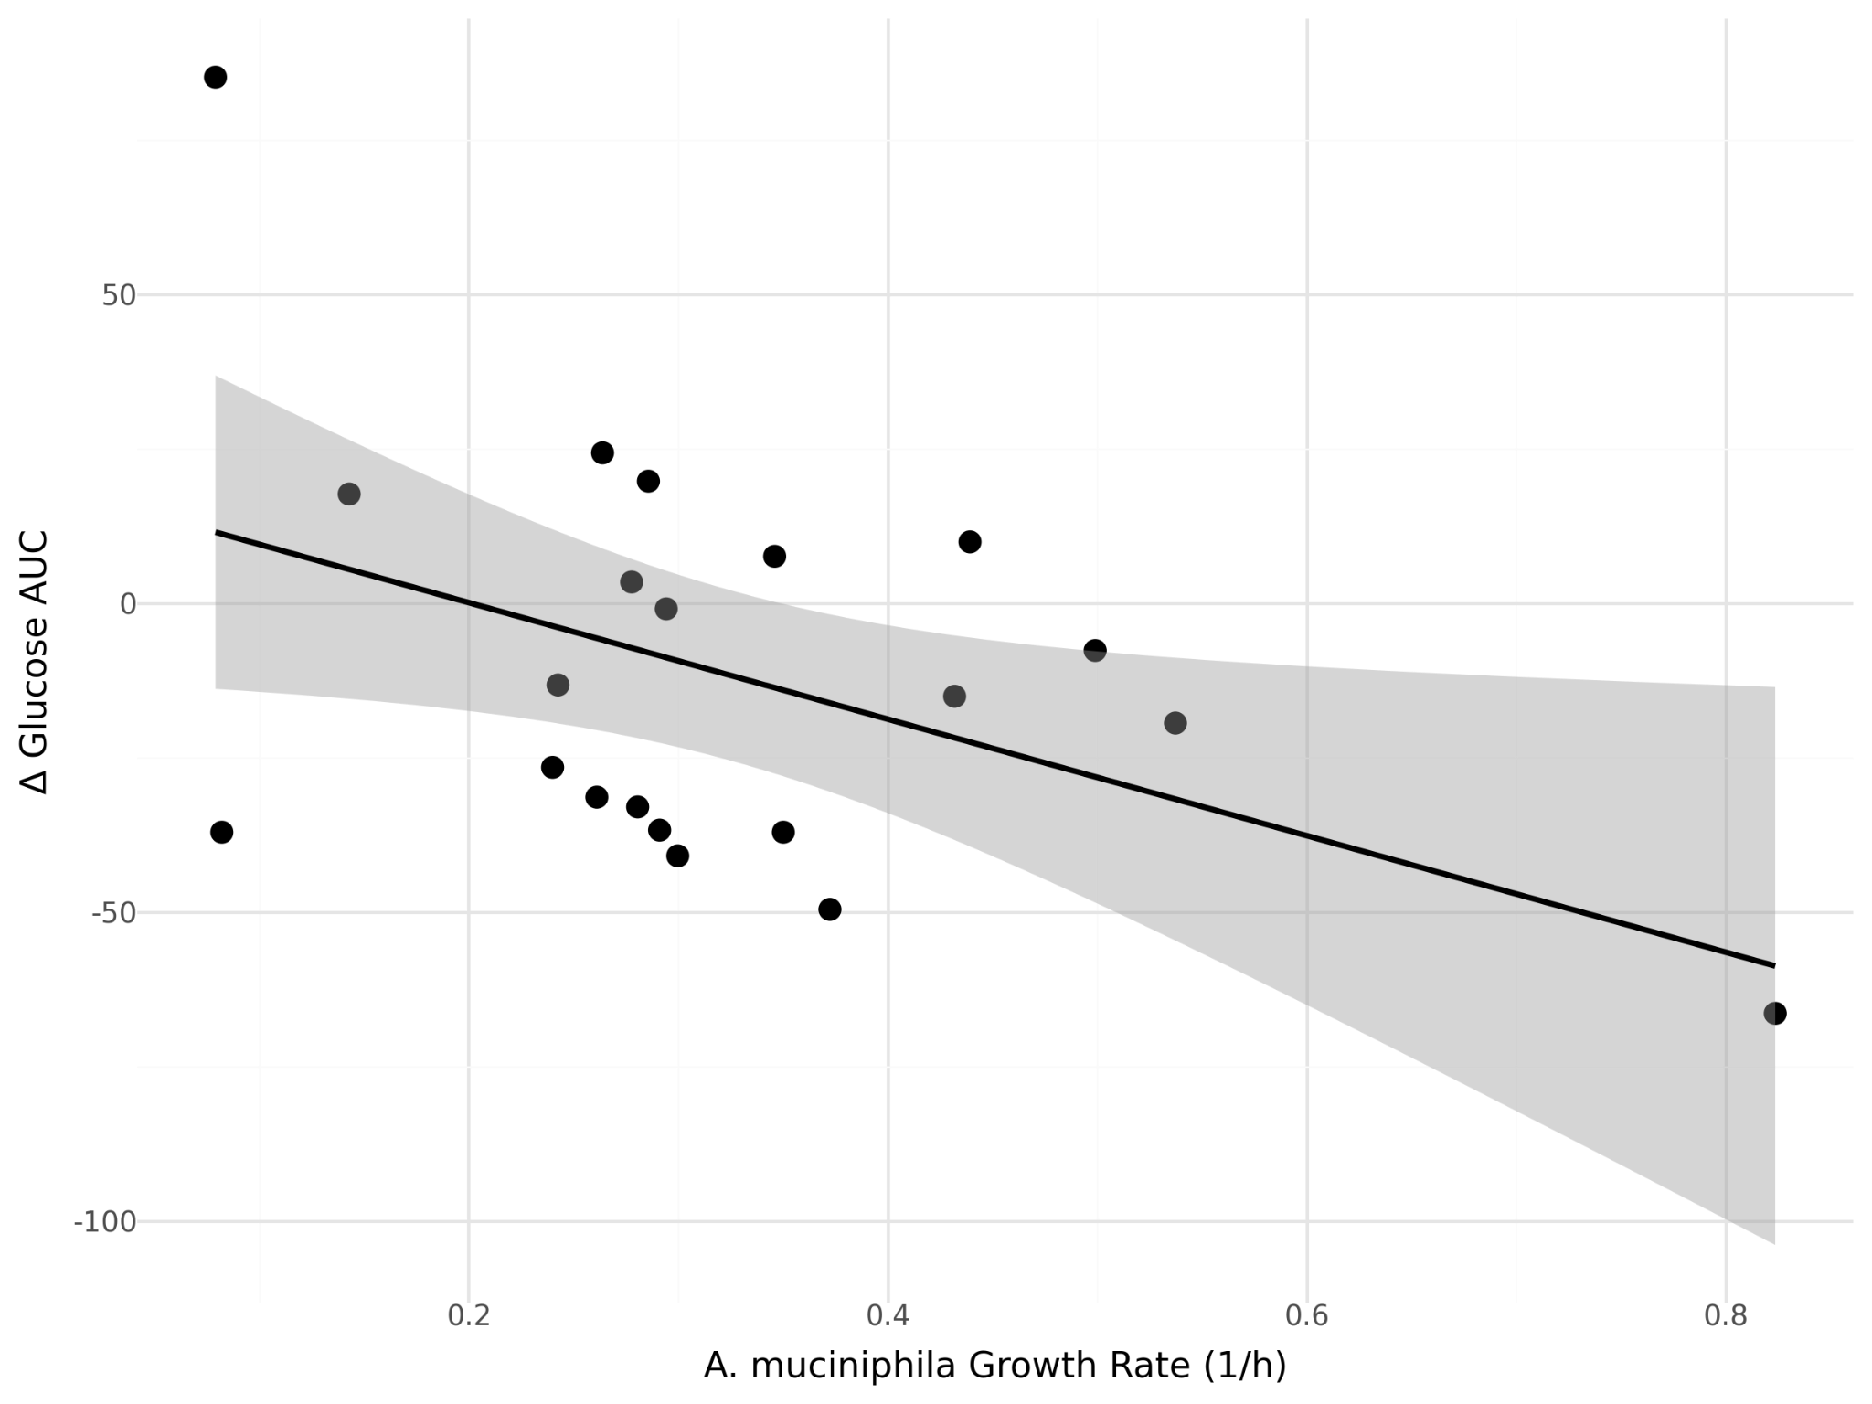
Predicted growth of A. muciniphila correlates with change in glucose AUC
R² = 0.23
p = 0.027

Slide 20
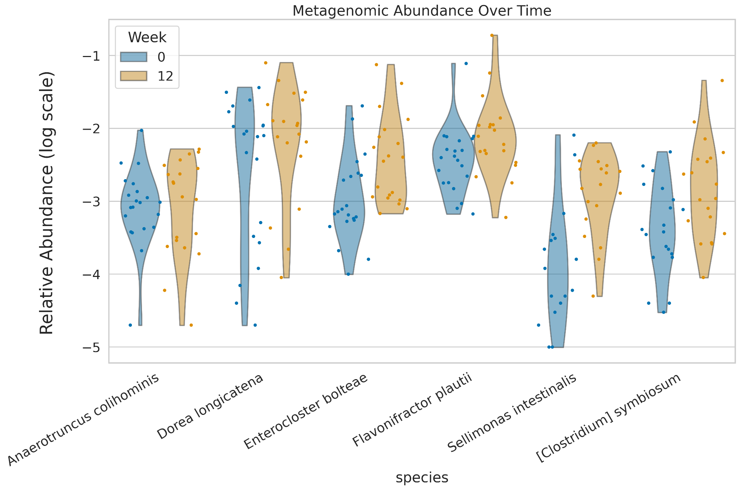
MCMM-predicted growth rates agree with observations in second validation study

Slide 21
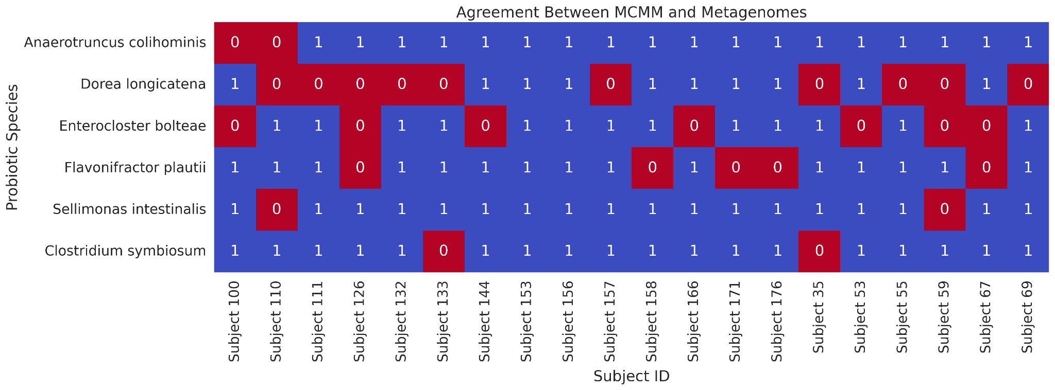
MCMM-predicted growth rates agree with observations in second study
= agree
= disagree
agreement in 92/120 observations
Notes:
Update growth rate predictions

Slide 22
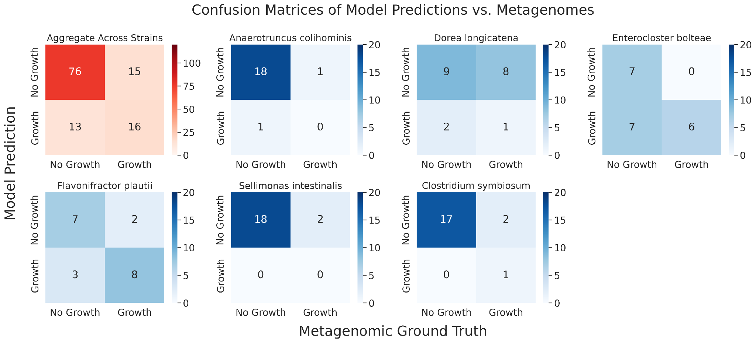
MCMM-predicted growth rates agree with observations in second study
Fisher’s exact test, p = 1.3x10⁻¹³

Slide 23
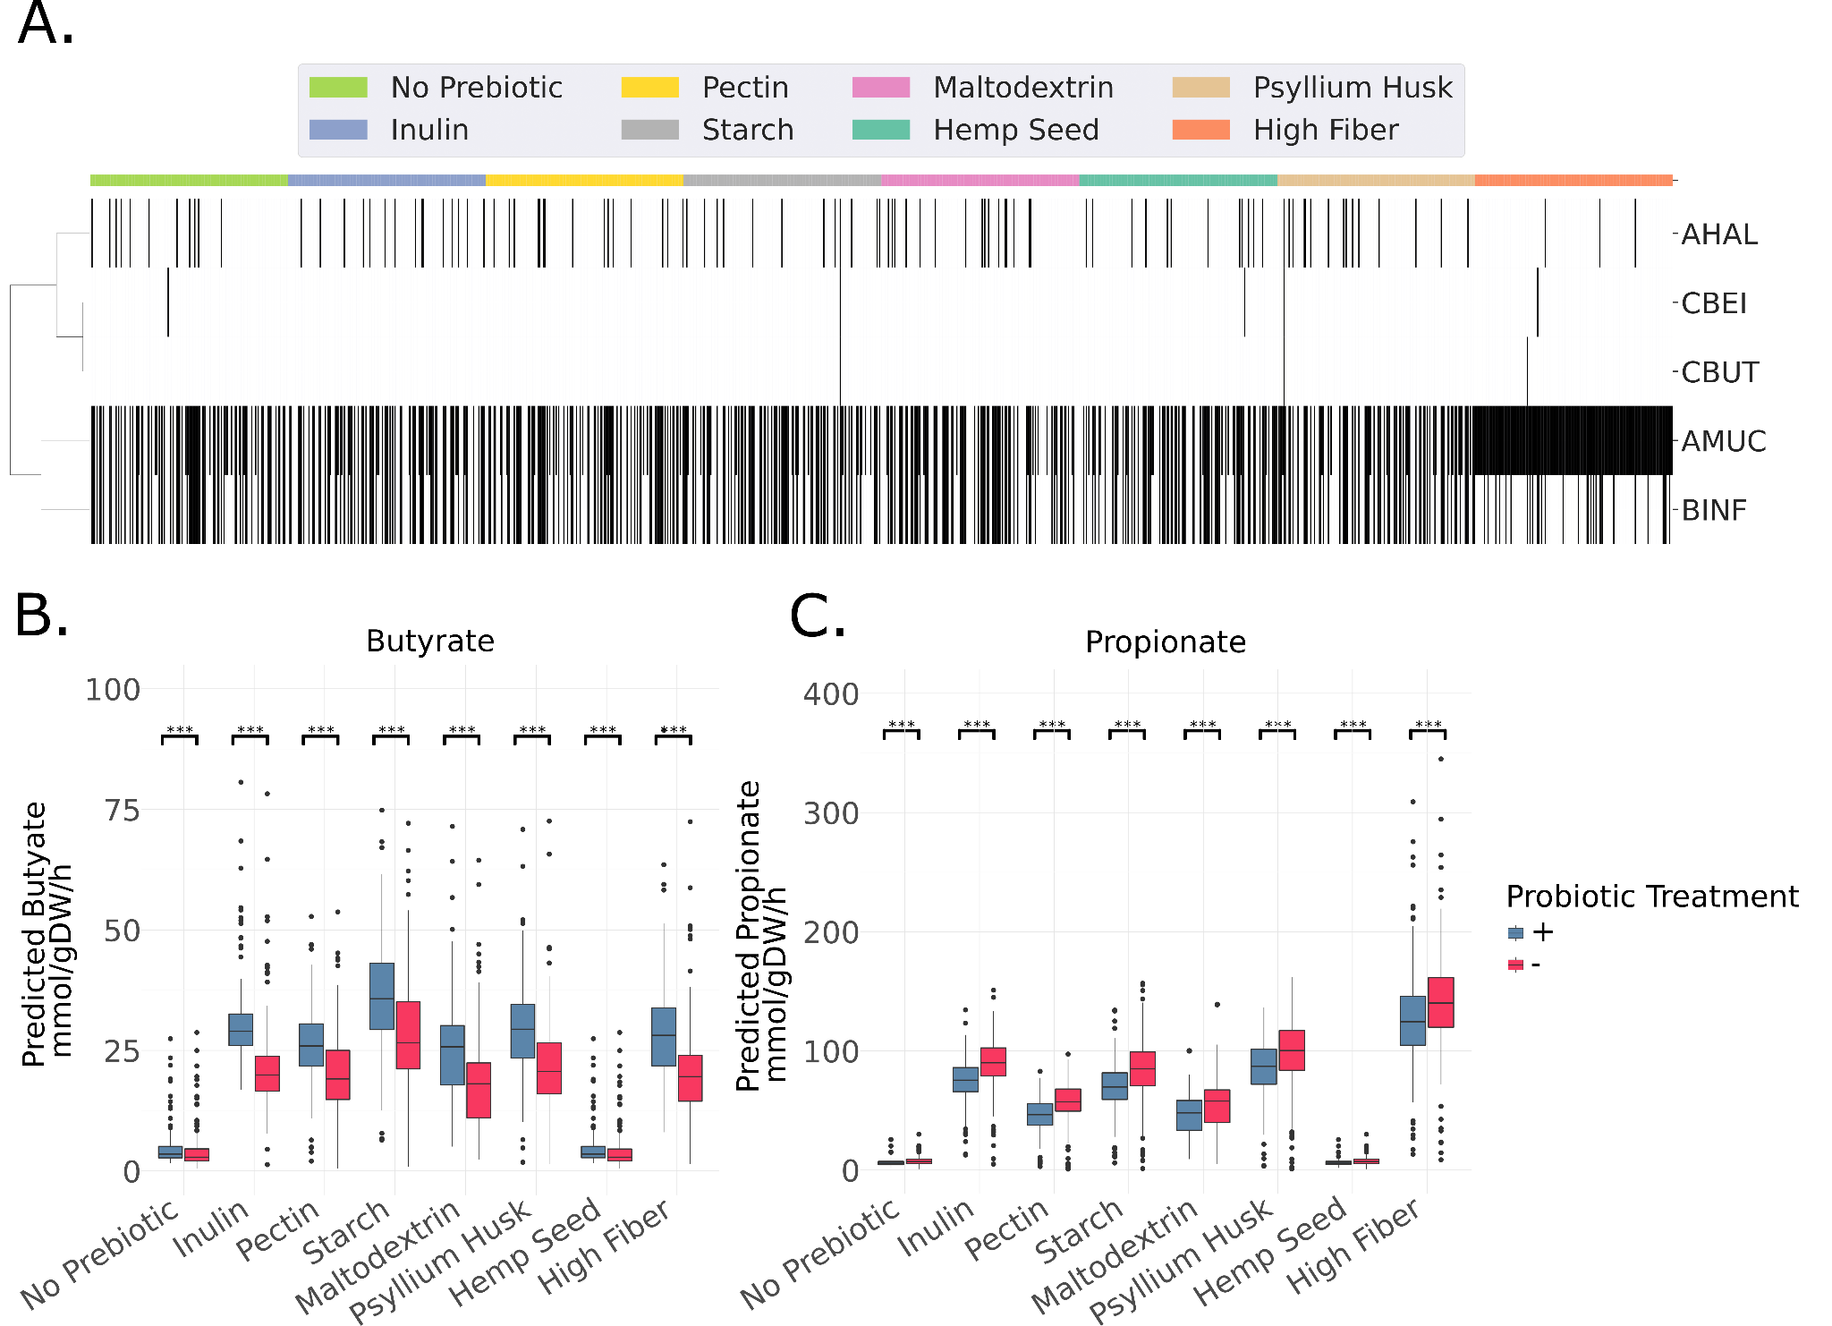
Putting it All Together: Designing Precision Synbiotic Interventions
= Engraftment
= No Engraftment
Notes:
Engraftment black,

Slide 24
Putting it All Together: Designing Precision Synbiotic Interventions

Slide 25
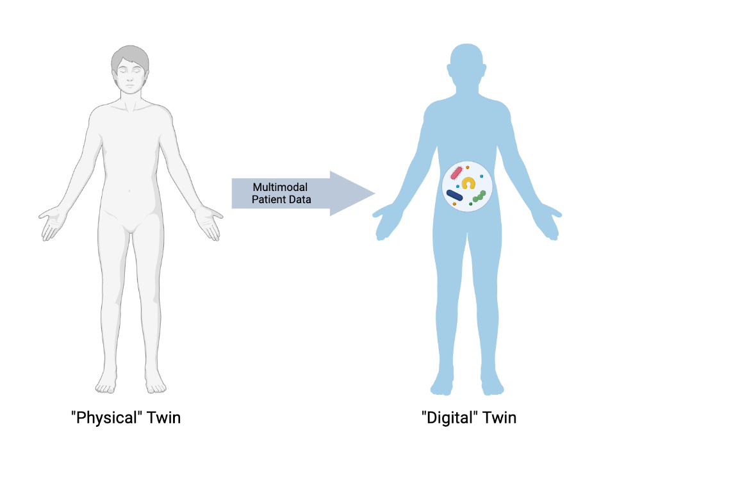
Digital Twins can Help Inform Precision Intervention Design
Virtual representation of individual physiology and microbiome dynamics
Enables in silico testing of dietary, prebiotic, and probiotic interventions before clinical application
Bridges data-driven discovery and clinical translation — guiding precision nutrition and therapeutic design

Slide 26
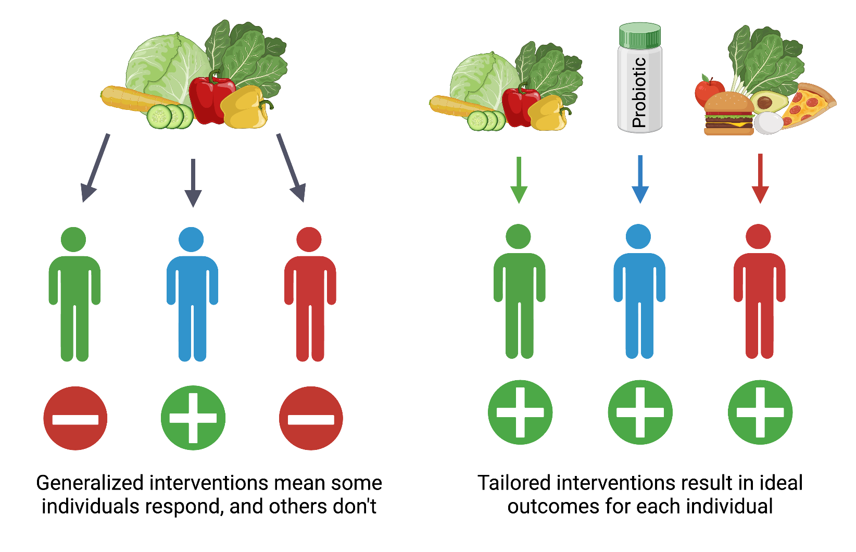
Precision Interventions can Replace Classical Nutrition at Population Scales

Slide 27
Key Takeaways
✅ Robust Predictions: SCFA production is accurately and consistently predicted across diverse dietary contexts and prebiotic conditions
📈 Reliable Growth Estimates: Probiotic species' growth rates match observed trends, validating model accuracy
🔎 Personalized Design: Microbiome-targeted interventions can be rationally tailored to individual needs for maximal impact, combining pre- and probiotics

Slide 28






Acknowledgements
Dr. Sean Gibbons
Dr. Christian Diener
Dr. Andrew Magis
Dr. Tomasz Wilmanski
Katherine Ramos Sarmiento
Dr. Lisa Levy
Dr. Johanna Lampe
Dr. Thomas Gurry
Dr. Noa Rappaport
Dr. Ophelia Venturelli
& the rest of the Gibbons Lab & ISB

