Slide 1
Metagenomic applications for military health and performance
Future of the Microbiome Winter Summit
November 19th
Car Reen Kok, Staff Scientist, Biosciences & Biotechnology Division
Lawrence Livermore National Laboratory

Slide 2




Applying microbiome features toward outcome prediction for military service members
Composition
Antimicrobial resistance
Virulence

Slide 3
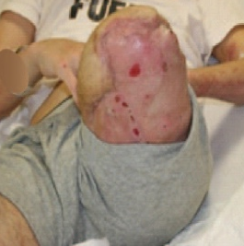
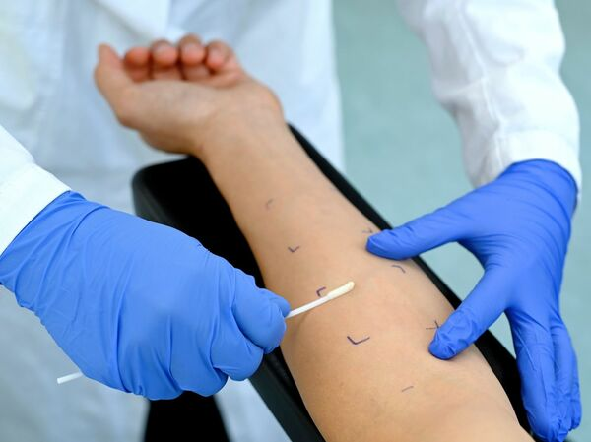

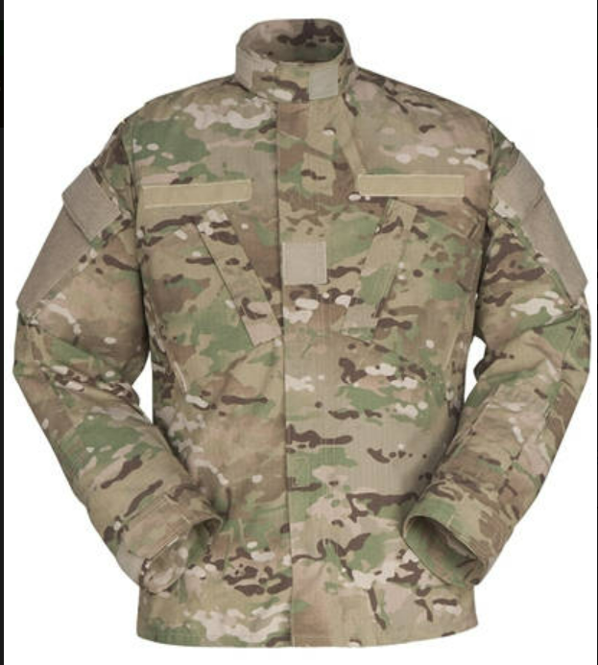
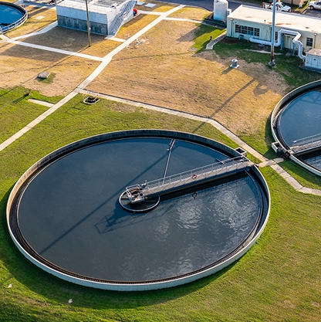
Applying microbiome features toward outcome prediction for military service members
Host-Associated Microbiomes
Composition
Antimicrobial resistance
Environmental Microbiome Surveillance
Virulence

Slide 4

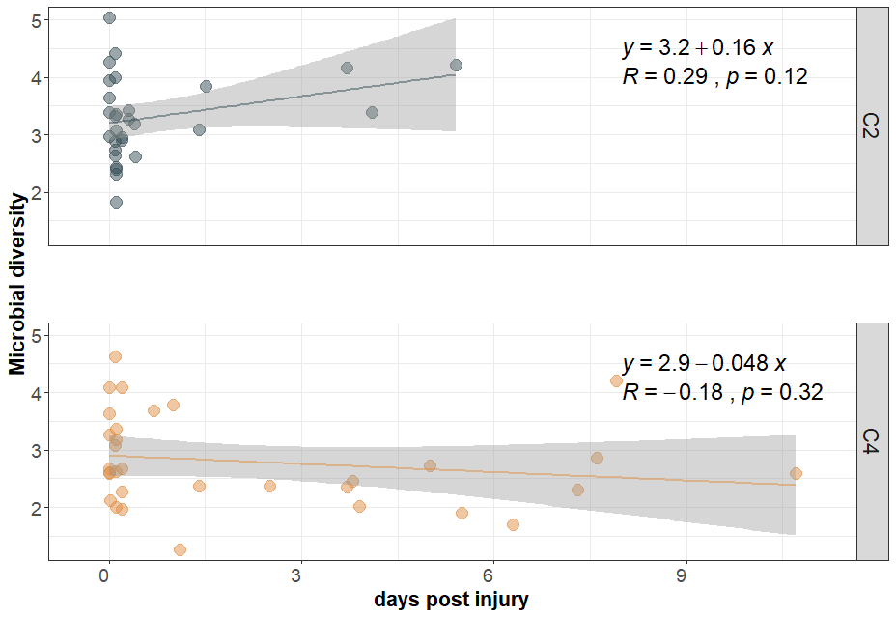
Microbiome features predict combat wound outcomes
No complications
Multiple complications
Avila-Herrera et al. Sci Rep. 2022.
Kok et al. Manuscript in preparation.

Slide 5
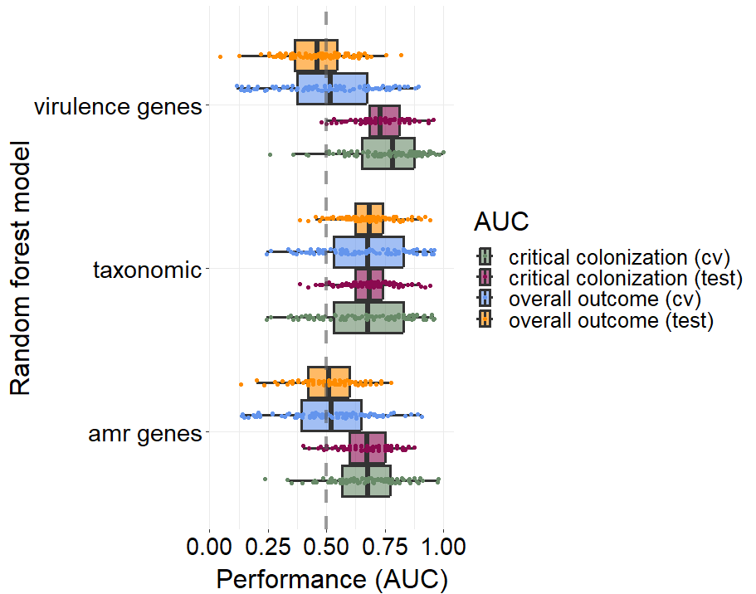
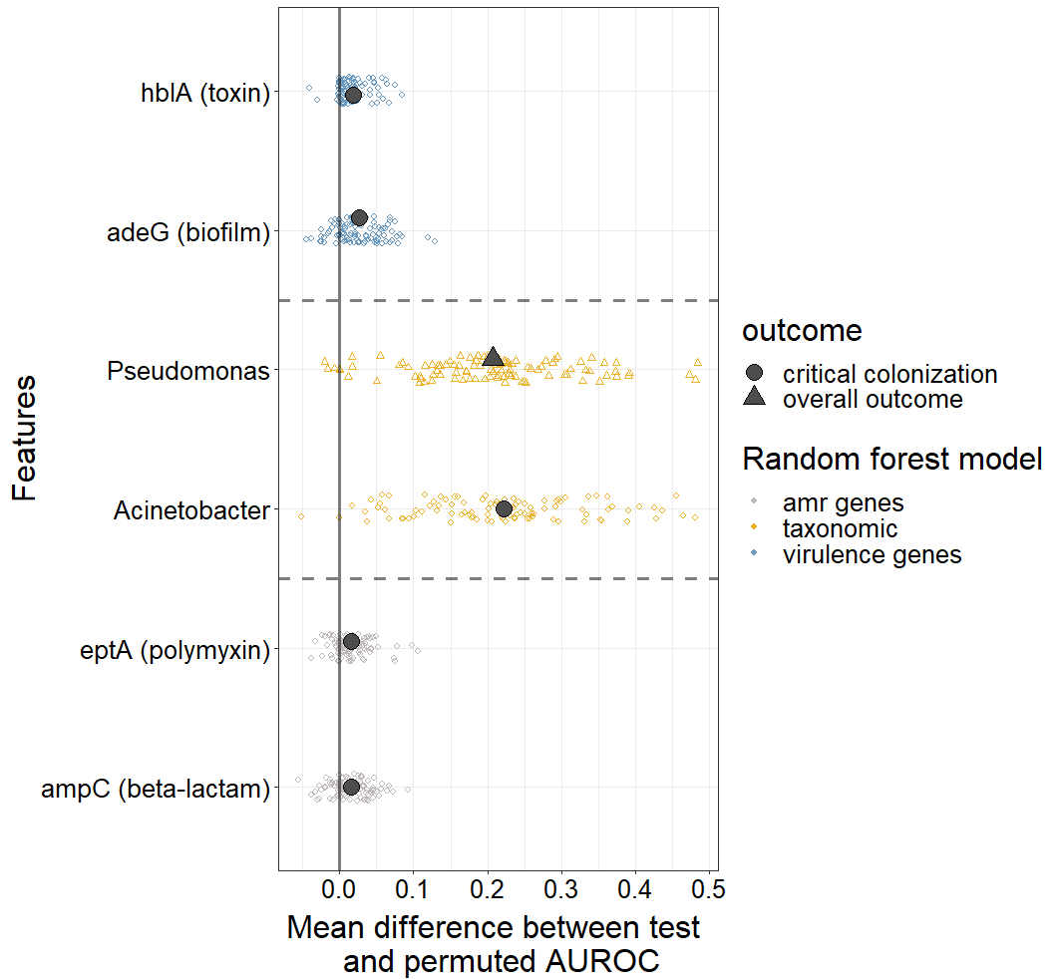
Microbiome features predict combat wound outcomes
Importance score
Kok et al. Microbiol Spectr. 2023.

Slide 6
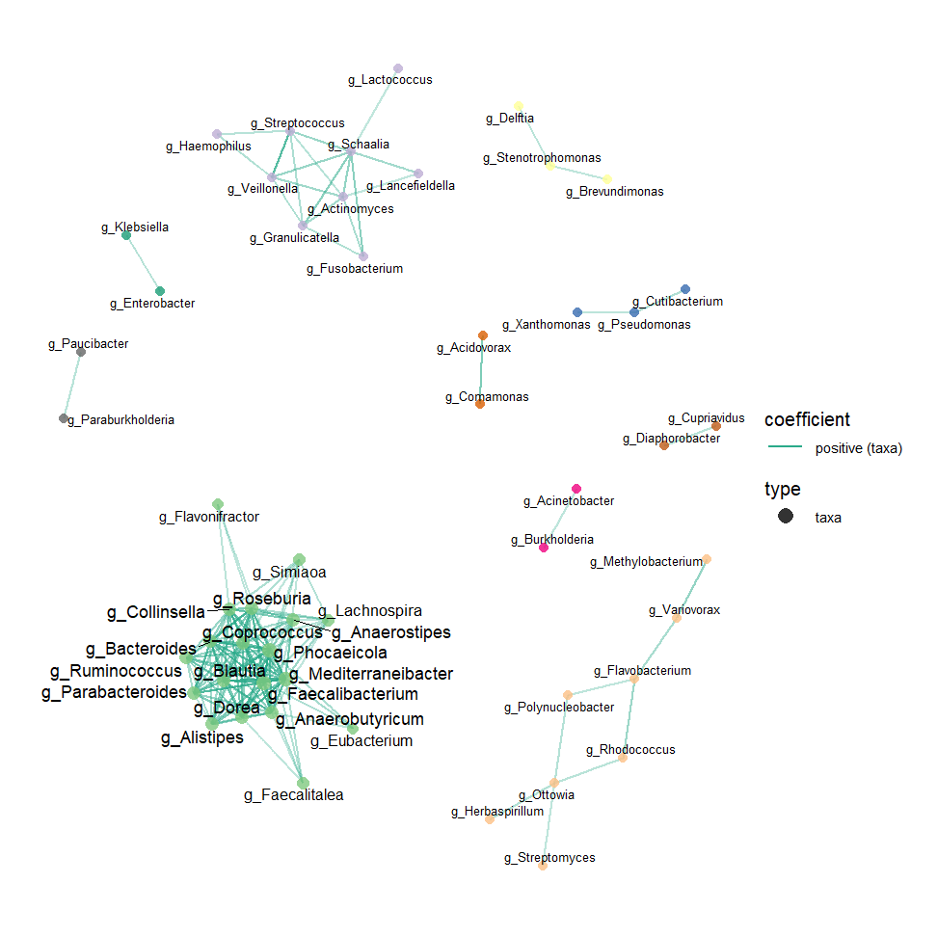
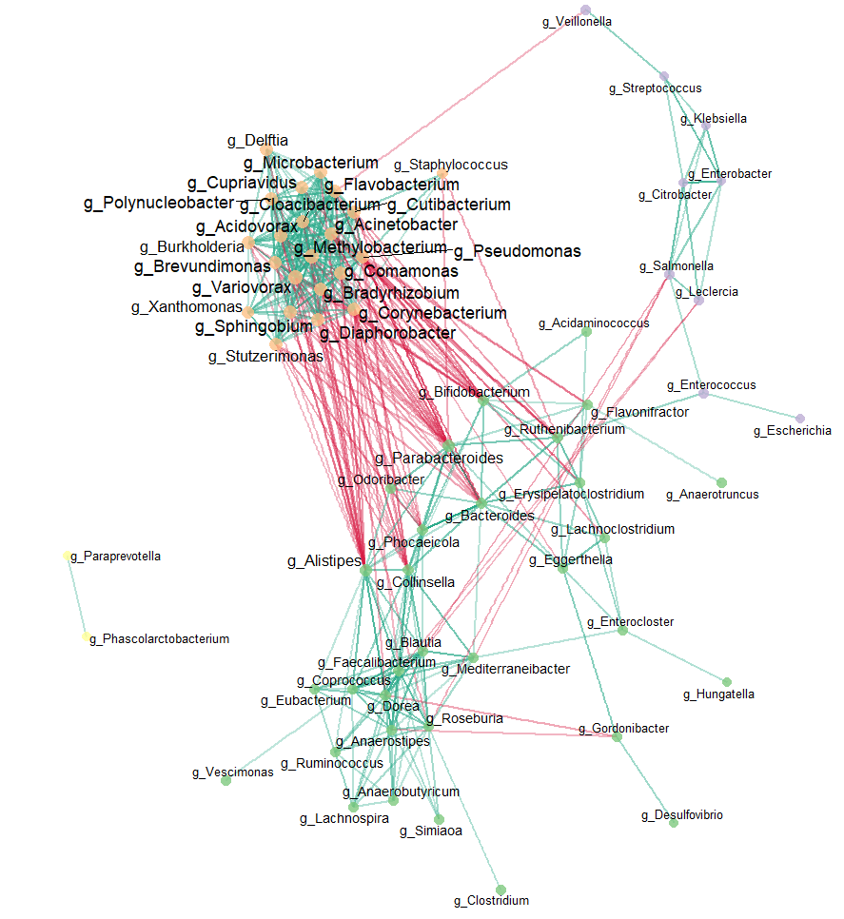
Microbial networks vary with wound complication severity
No complications
Multiple complications
positive (taxa)
Environmental taxa
negative (taxa)
GI taxa

Slide 7
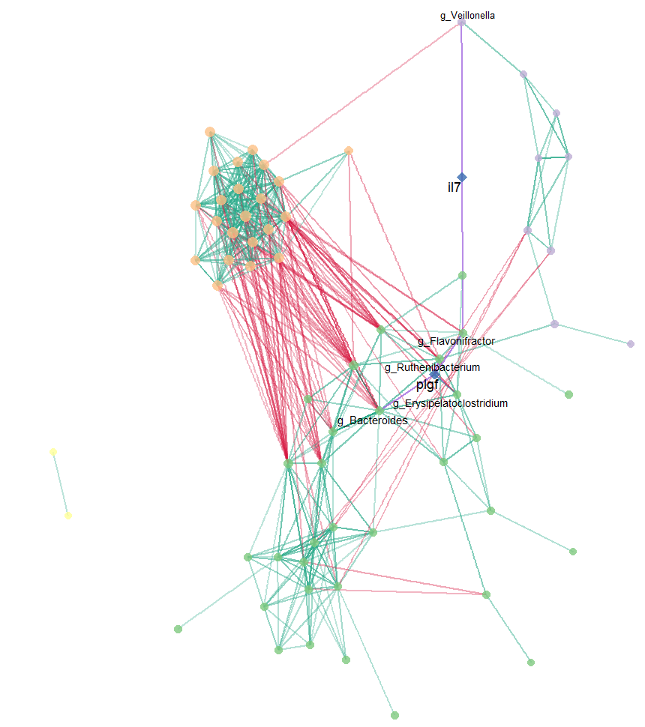
Microbial networks vary with wound complication severity
No complications
Multiple complications
positive (taxa)
negative (taxa)
Environmental taxa
positive (cytokines)
proinflammatory cytokines
GI taxa

Slide 8
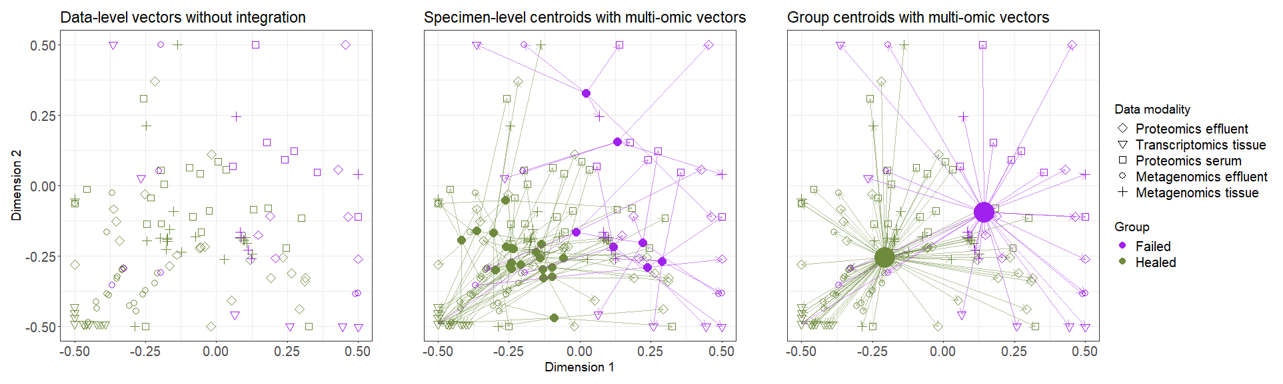
Multi-omic integration effectively distinguishes wound outcomes
Healed wounds
Failed wounds
Data-level vectors
host proteomics
host transcriptomics
metagenomics

Slide 9
Multi-omic integration effectively distinguishes wound outcomes
Healed wounds
Failed wounds
Specimen-level centroids with multi-omic vectors
Data-level vectors
host proteomics
host transcriptomics
metagenomics

Slide 10
Multi-omic integration effectively distinguishes wound outcomes
Healed wounds
Failed wounds
Specimen-level centroids with multi-omic vectors
Group-level centroids with multi-omic vectors
Data-level vectors
host proteomics
host transcriptomics
metagenomics

Slide 11
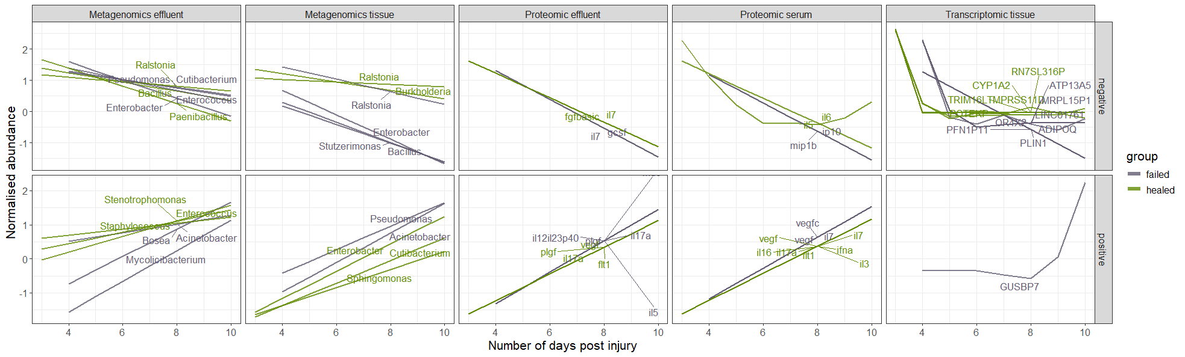
Temporal patterns of multi-omic signatures
Healed wounds
Failed wounds

Slide 12


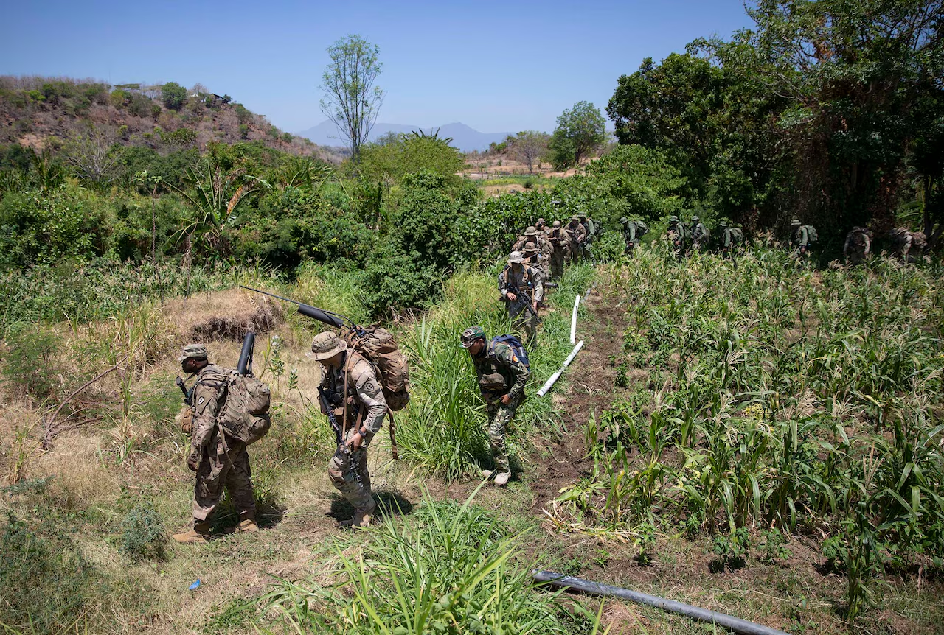
Environmental biosurveillance in operational settings
Jungle Operations Training Course
Oahu, Hawaii
Garuda Shield
Indonesia

Slide 13
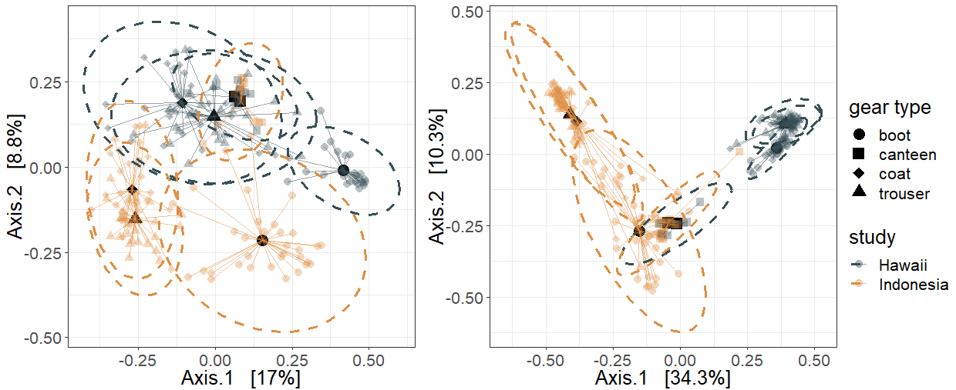
Operational location drives microbial community structure
Day 0
Day 14
Hawaii
Hawaii
Indonesia
Indonesia
Kok et al. AEM. 2024.

Slide 14
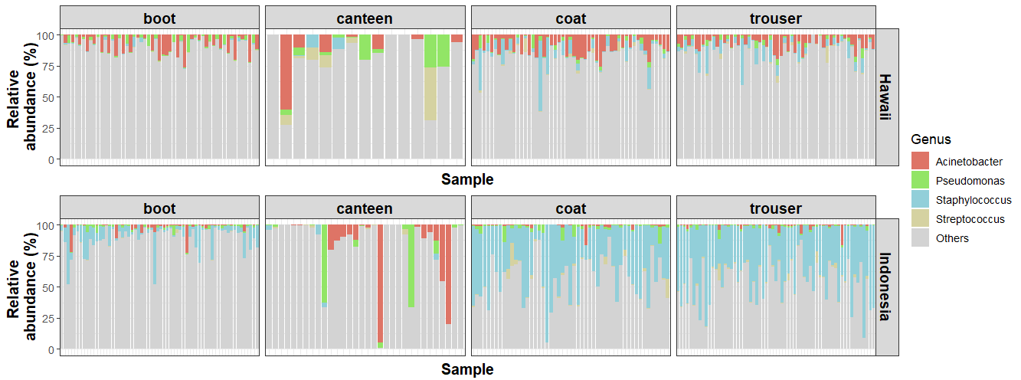
Operational location drives microbial community structure
Hawaii
Acinetobacter
Indonesia
Kok et al. AEM. 2024.
Staphyloccous

Slide 15

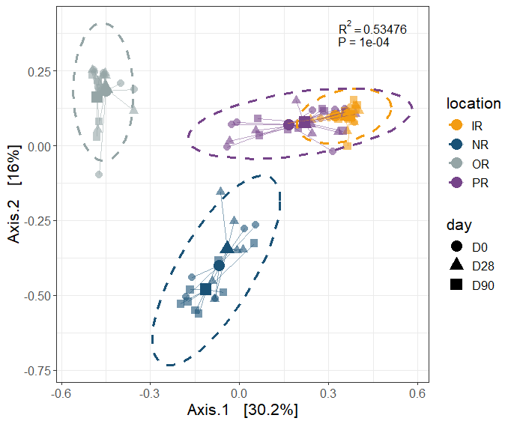
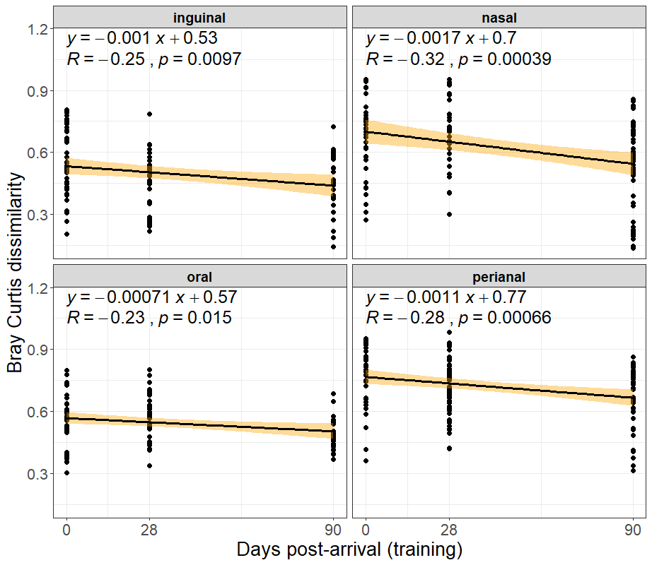
Microbiome convergence in the congregate environment of U.S. Army Infantry training
Oral
Perianal
Inguinal
Nasal
Kok et al. Microbiology Spectrum. In press.

Slide 16
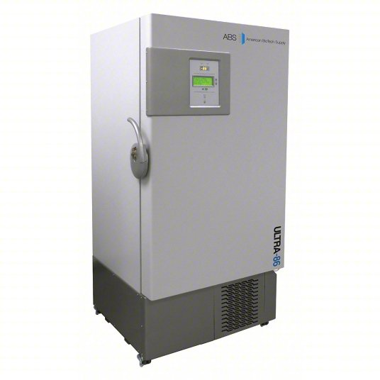
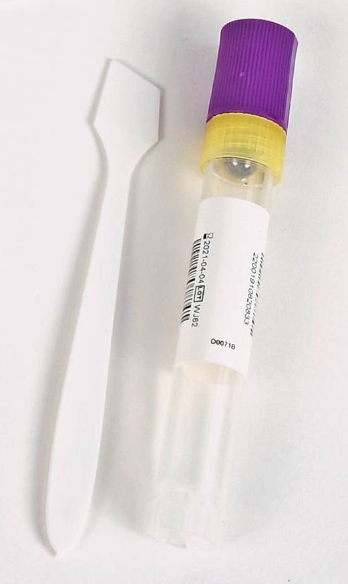
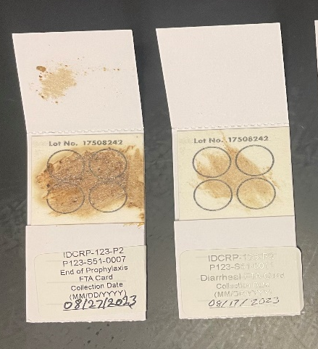
Evaluating field study fecal collection methods in deployed environments
FTA cards
OMNIgene® gut
Field collection
- Harsh, remote environments
Temperature fluctuations
Limited access to cold chain storage
Operational constraints
Participant compliance
Immediate freezing
“Gold standard”

Slide 17
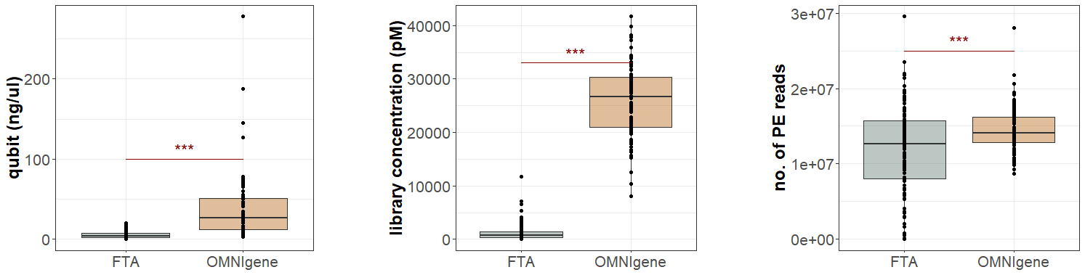
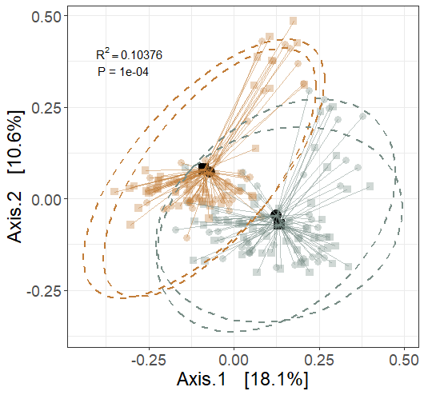
Collection methods impact DNA yield and microbiome composition
FTA
OMNIgene
Kok et al. mSphere. 2025.

Slide 18
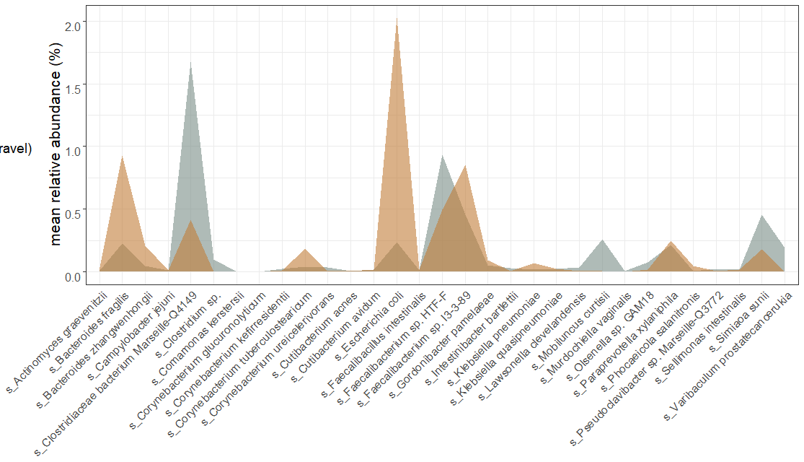
Diarrheal-associated microbiome features in deployed military service members
Healthy
Diarrhea
Microbial species

Slide 19

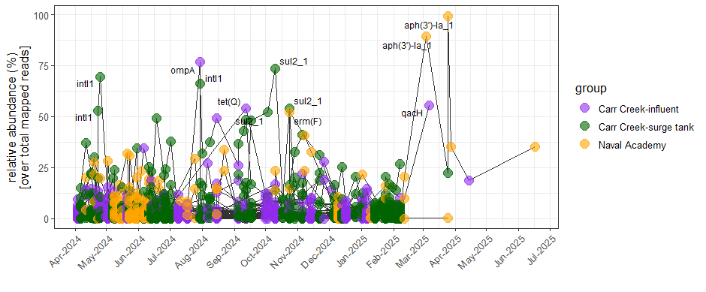
Wastewater surveillance for pathogenic signatures at the US Naval Academy
Virulence + antimicrobial resistance gene targets

Slide 20
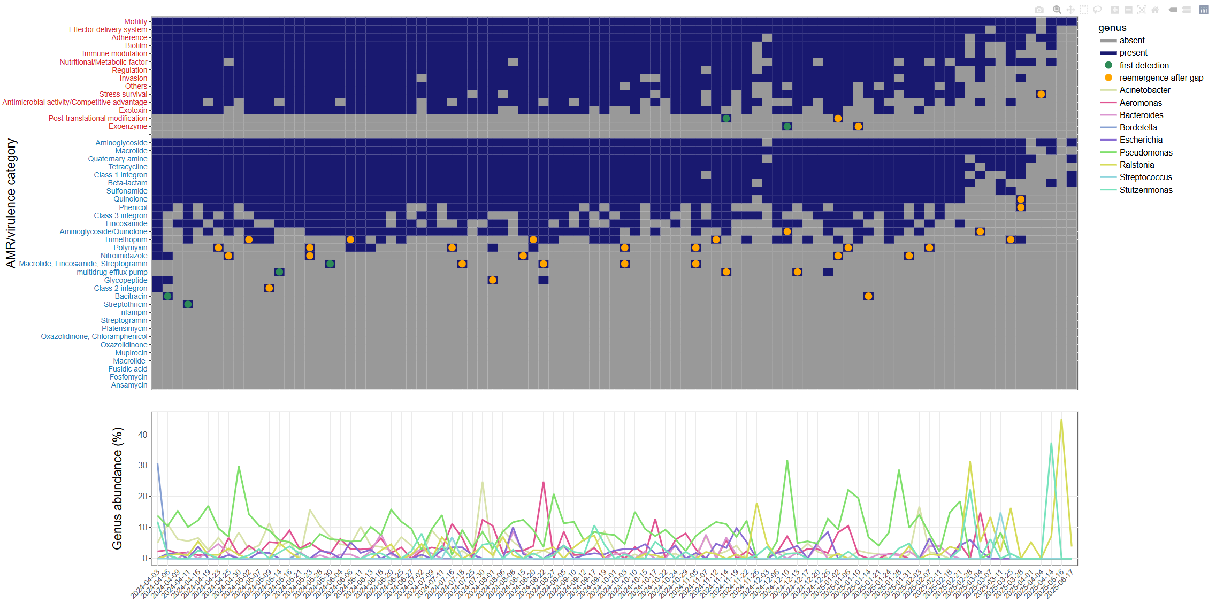
Wastewater surveillance for pathogenic signatures at the US Naval Academy

Slide 21
Meta2DB : Curated Shotgun Metagenomic Feature Sets and Metadata for Health State Prediction
50 TB
13,897 samples, 23 disease states
Meta2DB
Data source
Data processing
Data output
Raw sequences
- 84 studies
- 13,897 samples
Taxonomic classification (centrifuge/ recentrifuge)
metagenomic sequence
NCBI,EBI,
iHMP
Quality filtering (fastp)
Taxonomic count table
NCBI, EBI,
iHMP, publication
MIxS standardization and unification across studies
metadata
Manual curation
Metadata table
Kok et al. bioRxiv. 2024.

Slide 22
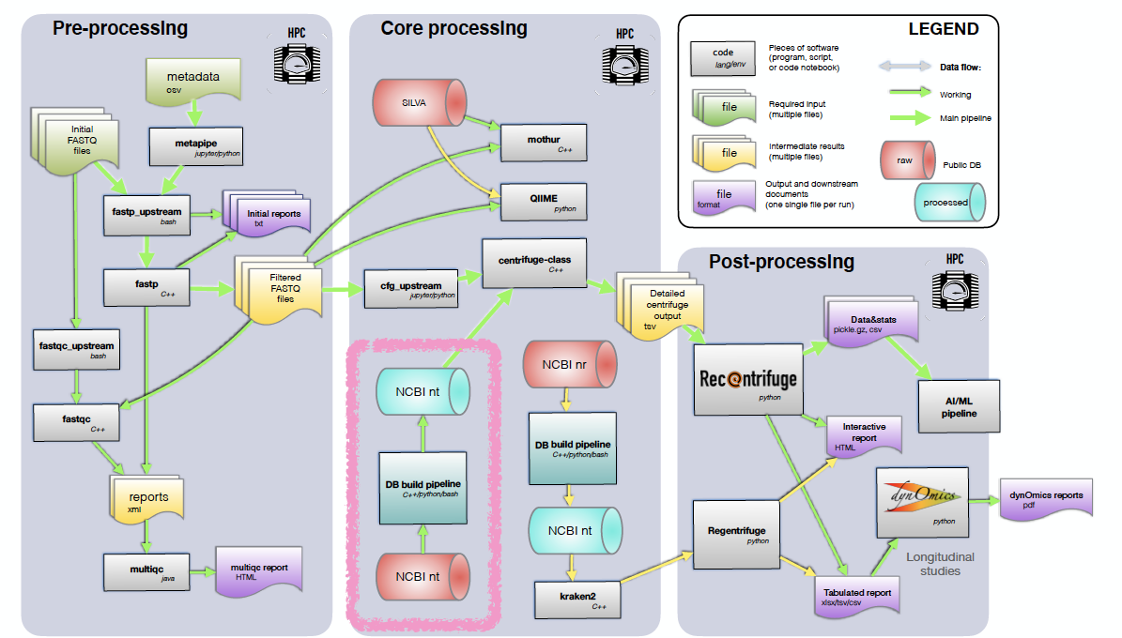

LLNL’s custom metagenomic database and analytical pipeline
Jose Manuel Marti Martinez
Marti et al. mSystems. 2025.

Slide 23
Applying microbiome features toward outcome prediction for military service members
Host-Associated Microbiomes
Composition
Antimicrobial resistance
Environmental Microbiome Surveillance
Virulence

Slide 24



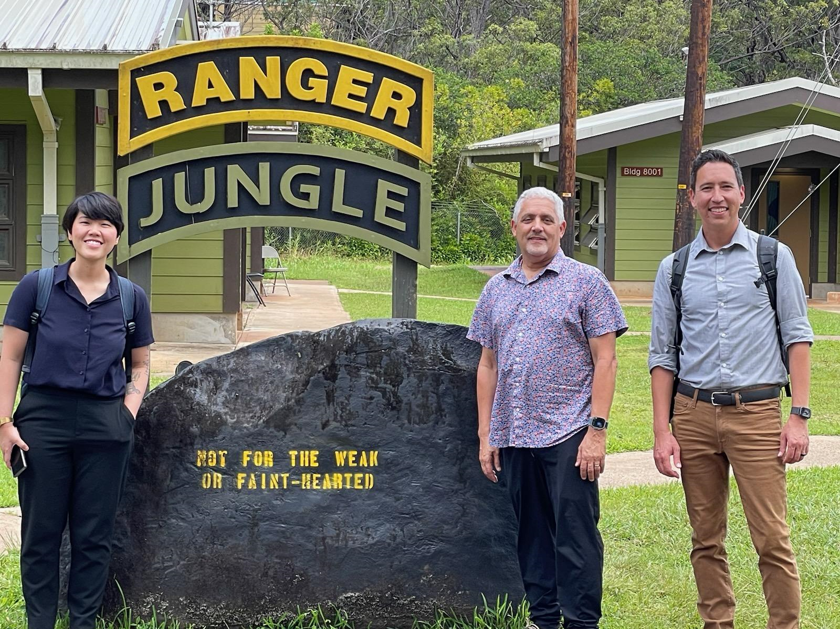

Thank you!
Nisha Mulakken
Aram Avila-Herrera
James B. Thissen
Shalini Mabery
Jose Manuel Marti Martinez
Crystal Jaing
Nicholas A. Be
Scott F. Grey
Felipe A. Lisboa
Eric A. Elster
Seth A. Schobel
Eric Gann
Michael Rouse
Kimberly Mclaughlin
Zakariae Bram
Timothy S. Horseman
Kristina Thompson
Viseth Ngauy
Catherine F. Uyehara
Richard Agans
Capt William Kowallis
Madeline Gruenberg
Tahaniyat Lalani
David Tribble
Michele Cerroni
Katrin Mende
Leigh Carson
Contact: kok1@llnl.gov

