Slide 1

Upcycling Byproducts - Unlocking Nutrition
Notes:
The short positioning statement should be 3 – 5 words long. It should convey your business’s primary objective and who you are. Plan on 15 seconds for this slide.

Slide 2
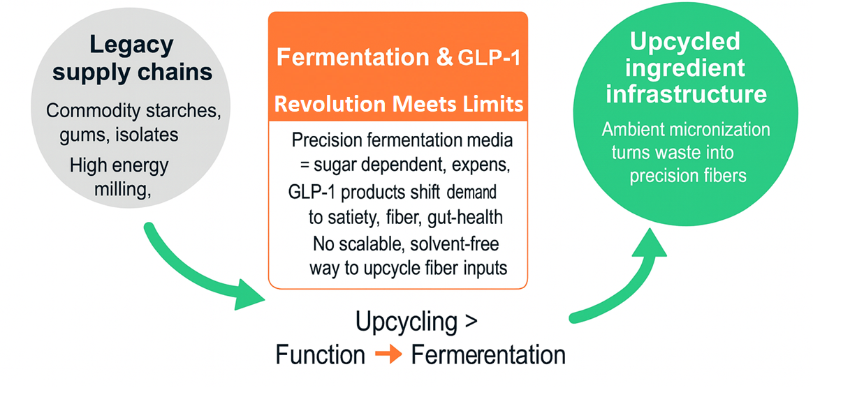
Next-generation nutrition needs new supply chains.
Notes:
Nutritious byproducts sent to Landfill
10M wet pounds of fruit seed is underutilized in Pacific Northwest United States alone annually
40-50M pounds when including peanut skins and entire US
Composting, throw it out
“Finely milled fibers meet a technology gap/need for us”
Clive R Norton, Research Fellow, Mondelēz International

Slide 3
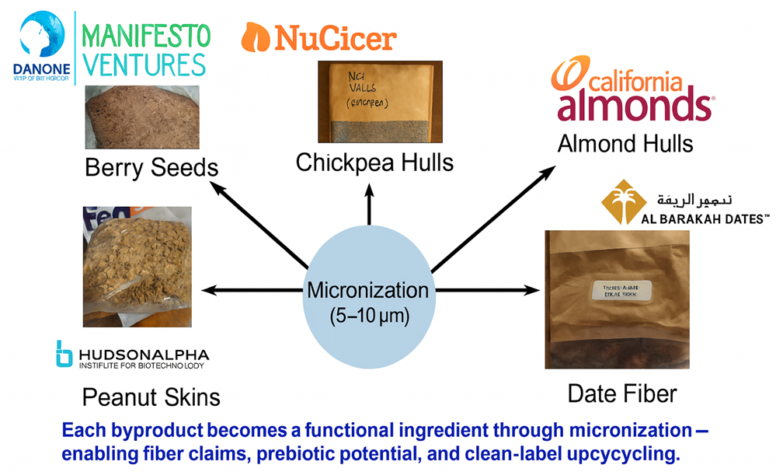
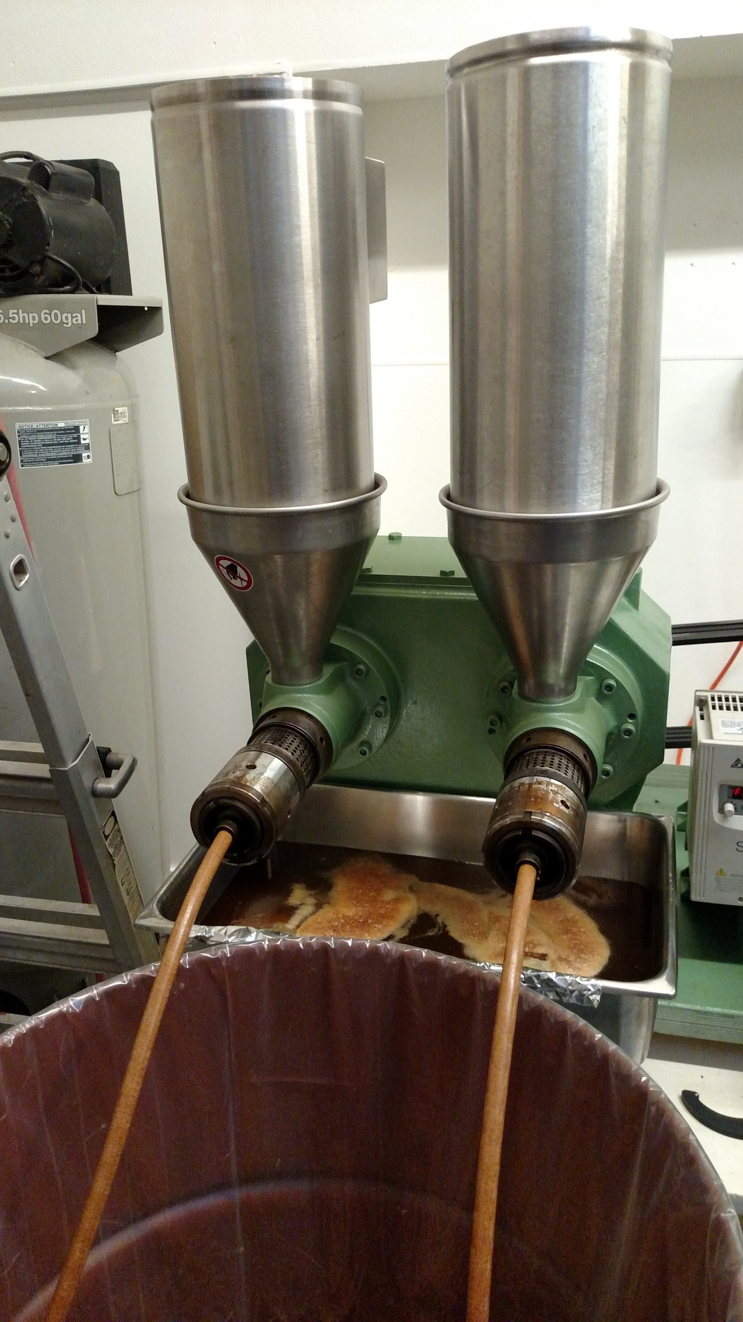

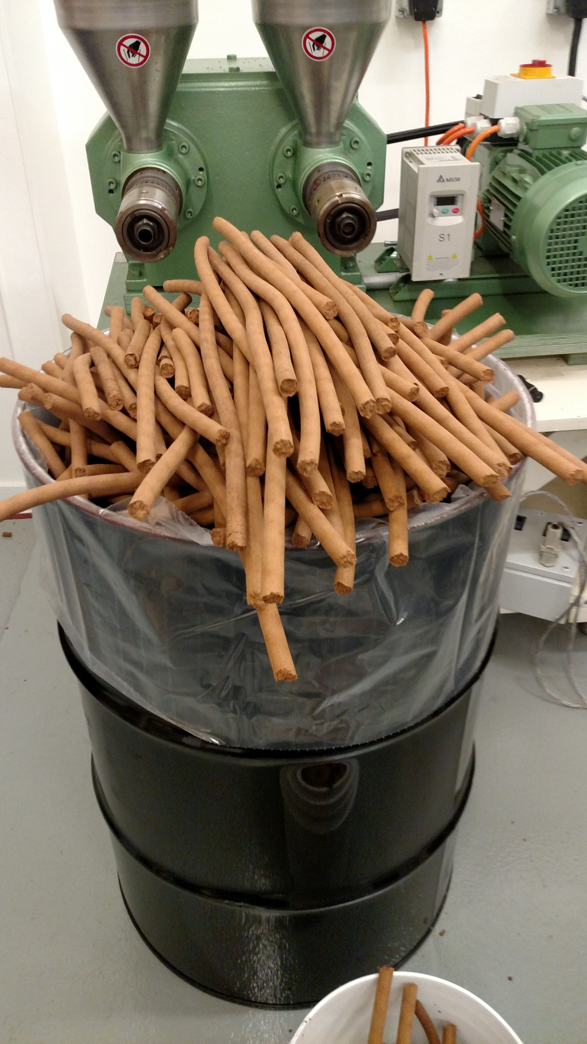
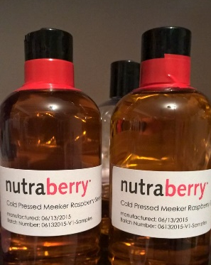
Berry Seeds to a Broad Upcycling Platform:
Logos shown for relationship context; not endorsements

Slide 4
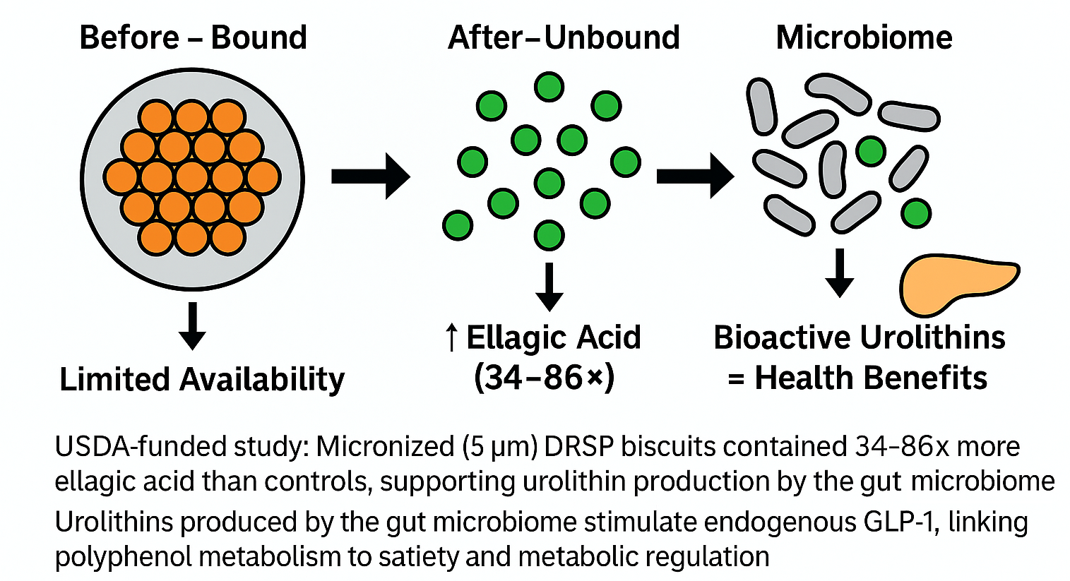
Micronization Frees Bound Polyphenols
For Microbiome Action

Slide 5
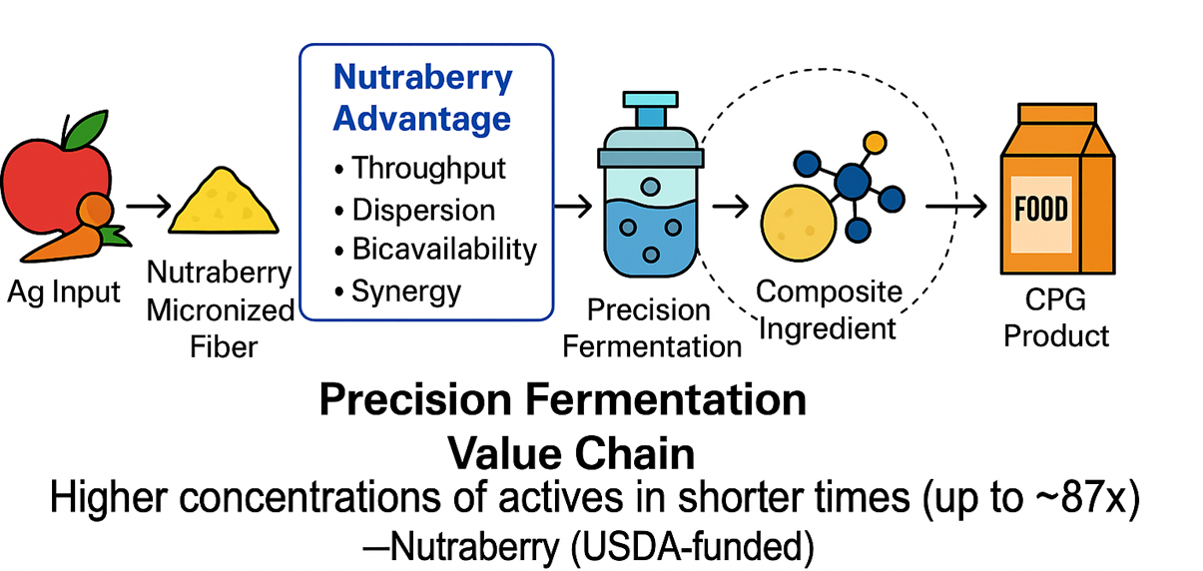
Nutraberry in the Precision Fermentation Value Chain

Slide 6
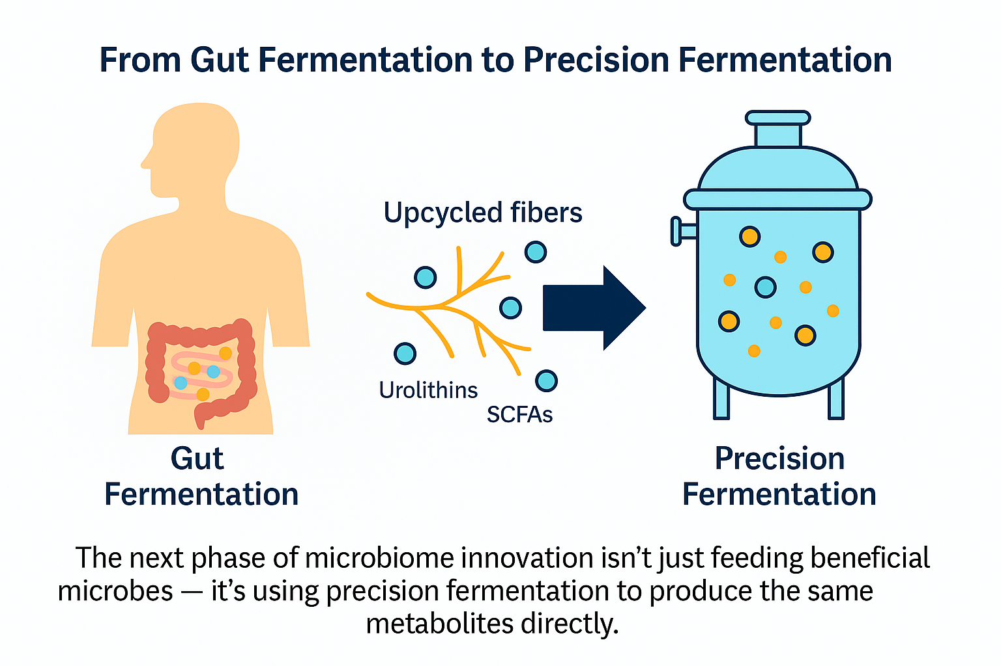

Slide 7
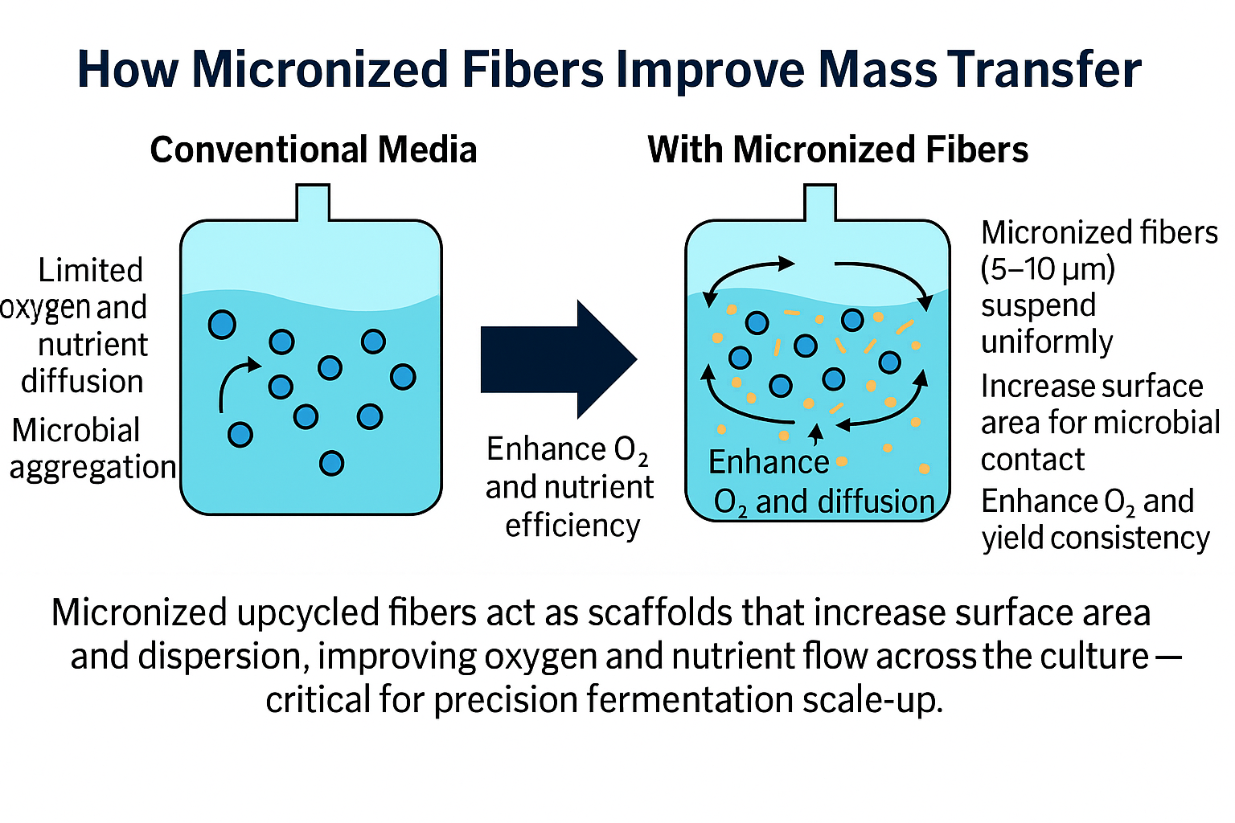

Slide 8
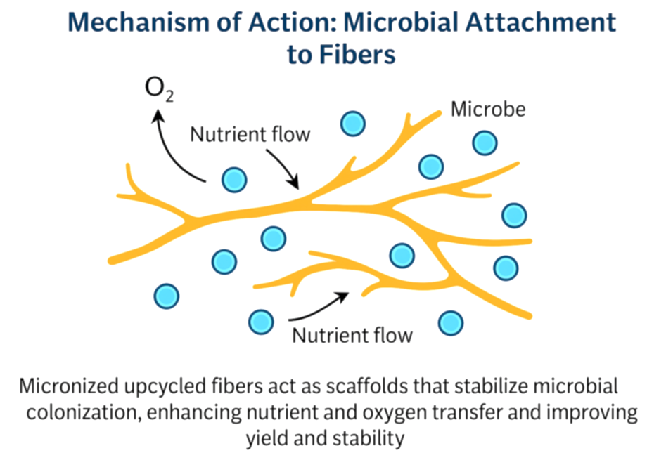

Slide 9
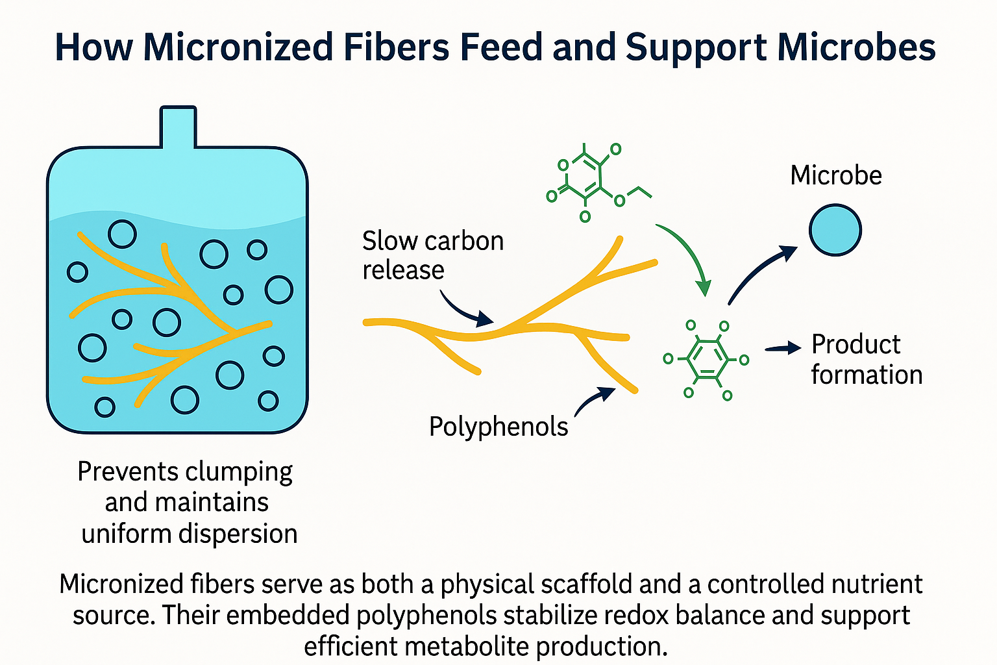

Slide 10
Why Micronized Fibers Improve Scale-Up in Precision Fermentation
Particle addition in fermentations reduces cell clumping and pellet size → shorter diffusion path for nutrients & O₂ → higher productivity.
Literature shows: phytase production doubled, polysaccharide yields ~2×, metabolite yields up to ~8× when microparticles added.
Fibers mimic this “microparticle effect” and add functional benefit (polyphenols, carbon source) — making them ideal for fast, uniform, high-yield precision fermentation.

Slide 11
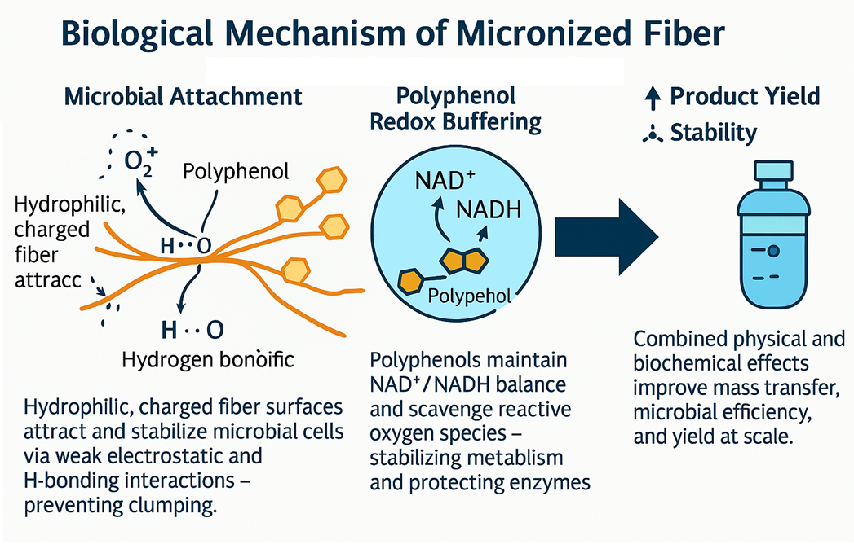

Slide 12
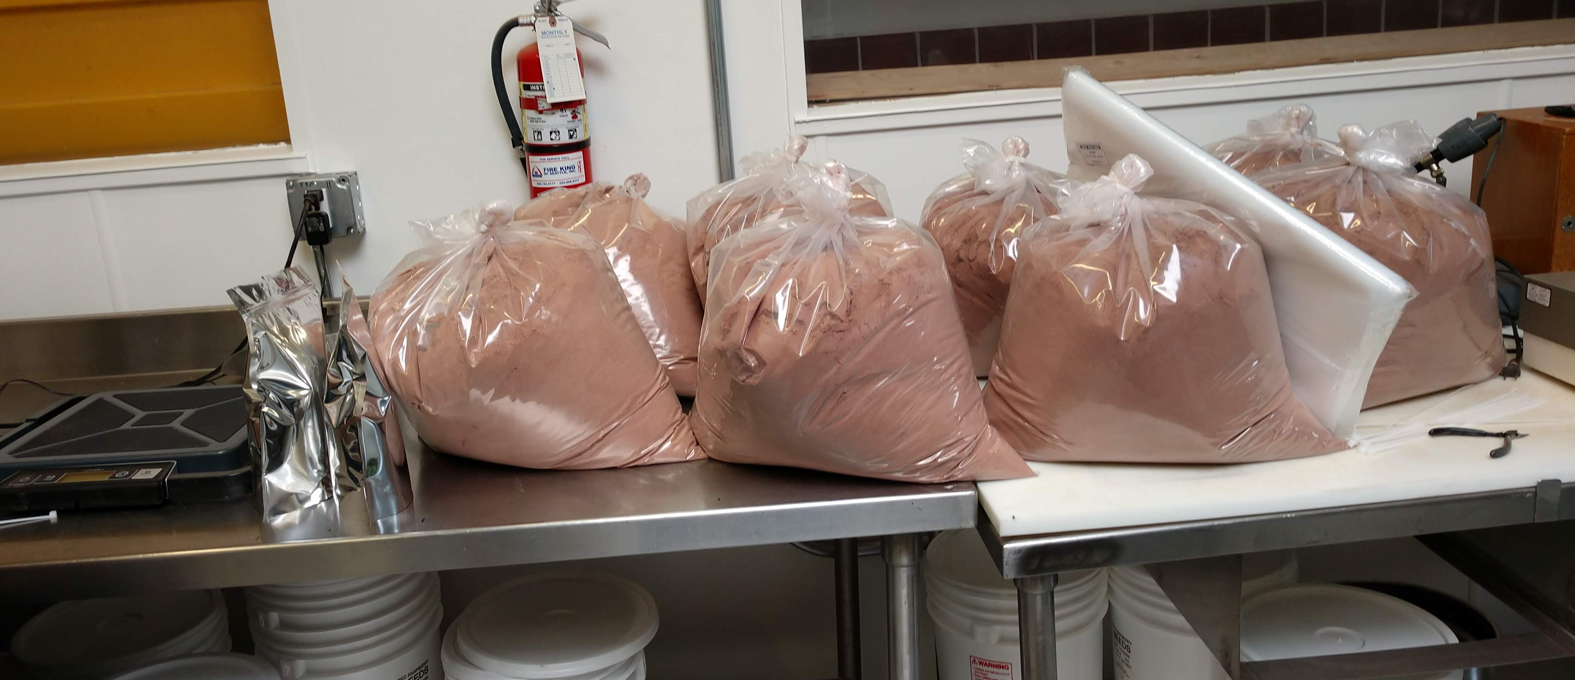
Questions?
David Wishnick
david@nutraberryinc.com
425-577-9020

