Slide 1
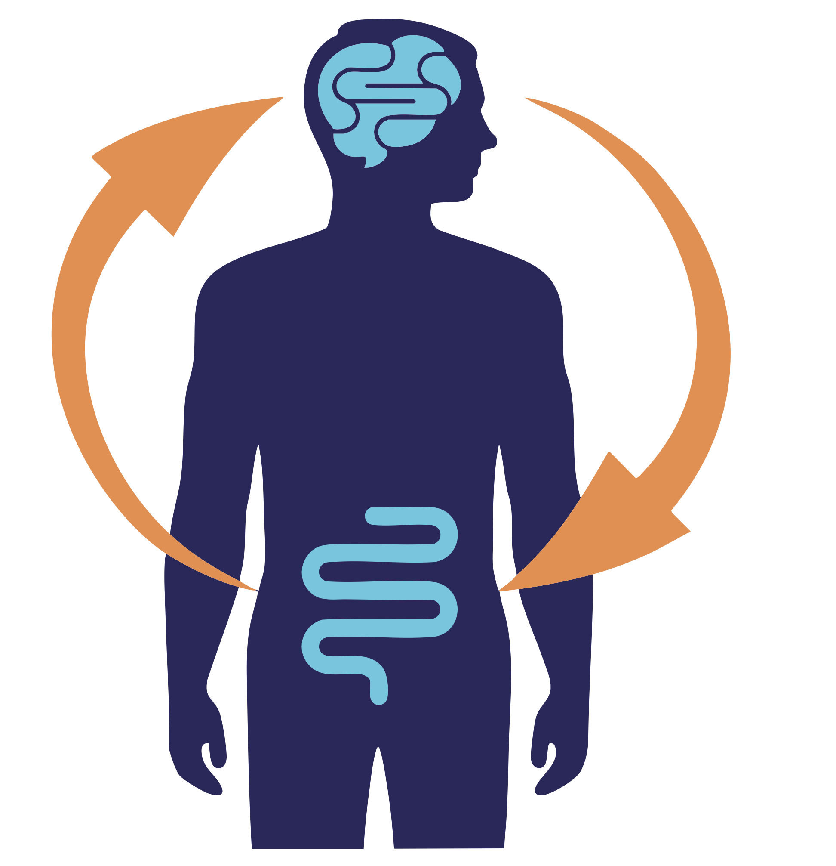
Brain Health Starts in the Gut:
Leveraging Dietary Fiber to
Modulate the Gut-Microbiome-Brain Axis
in Neurodegenerative Diseases
Olivia Adele Todd, PhD
Director of Clinical Studies and Academic Collaborations
Future of the Microbiome Winter Summit 2025

Slide 2
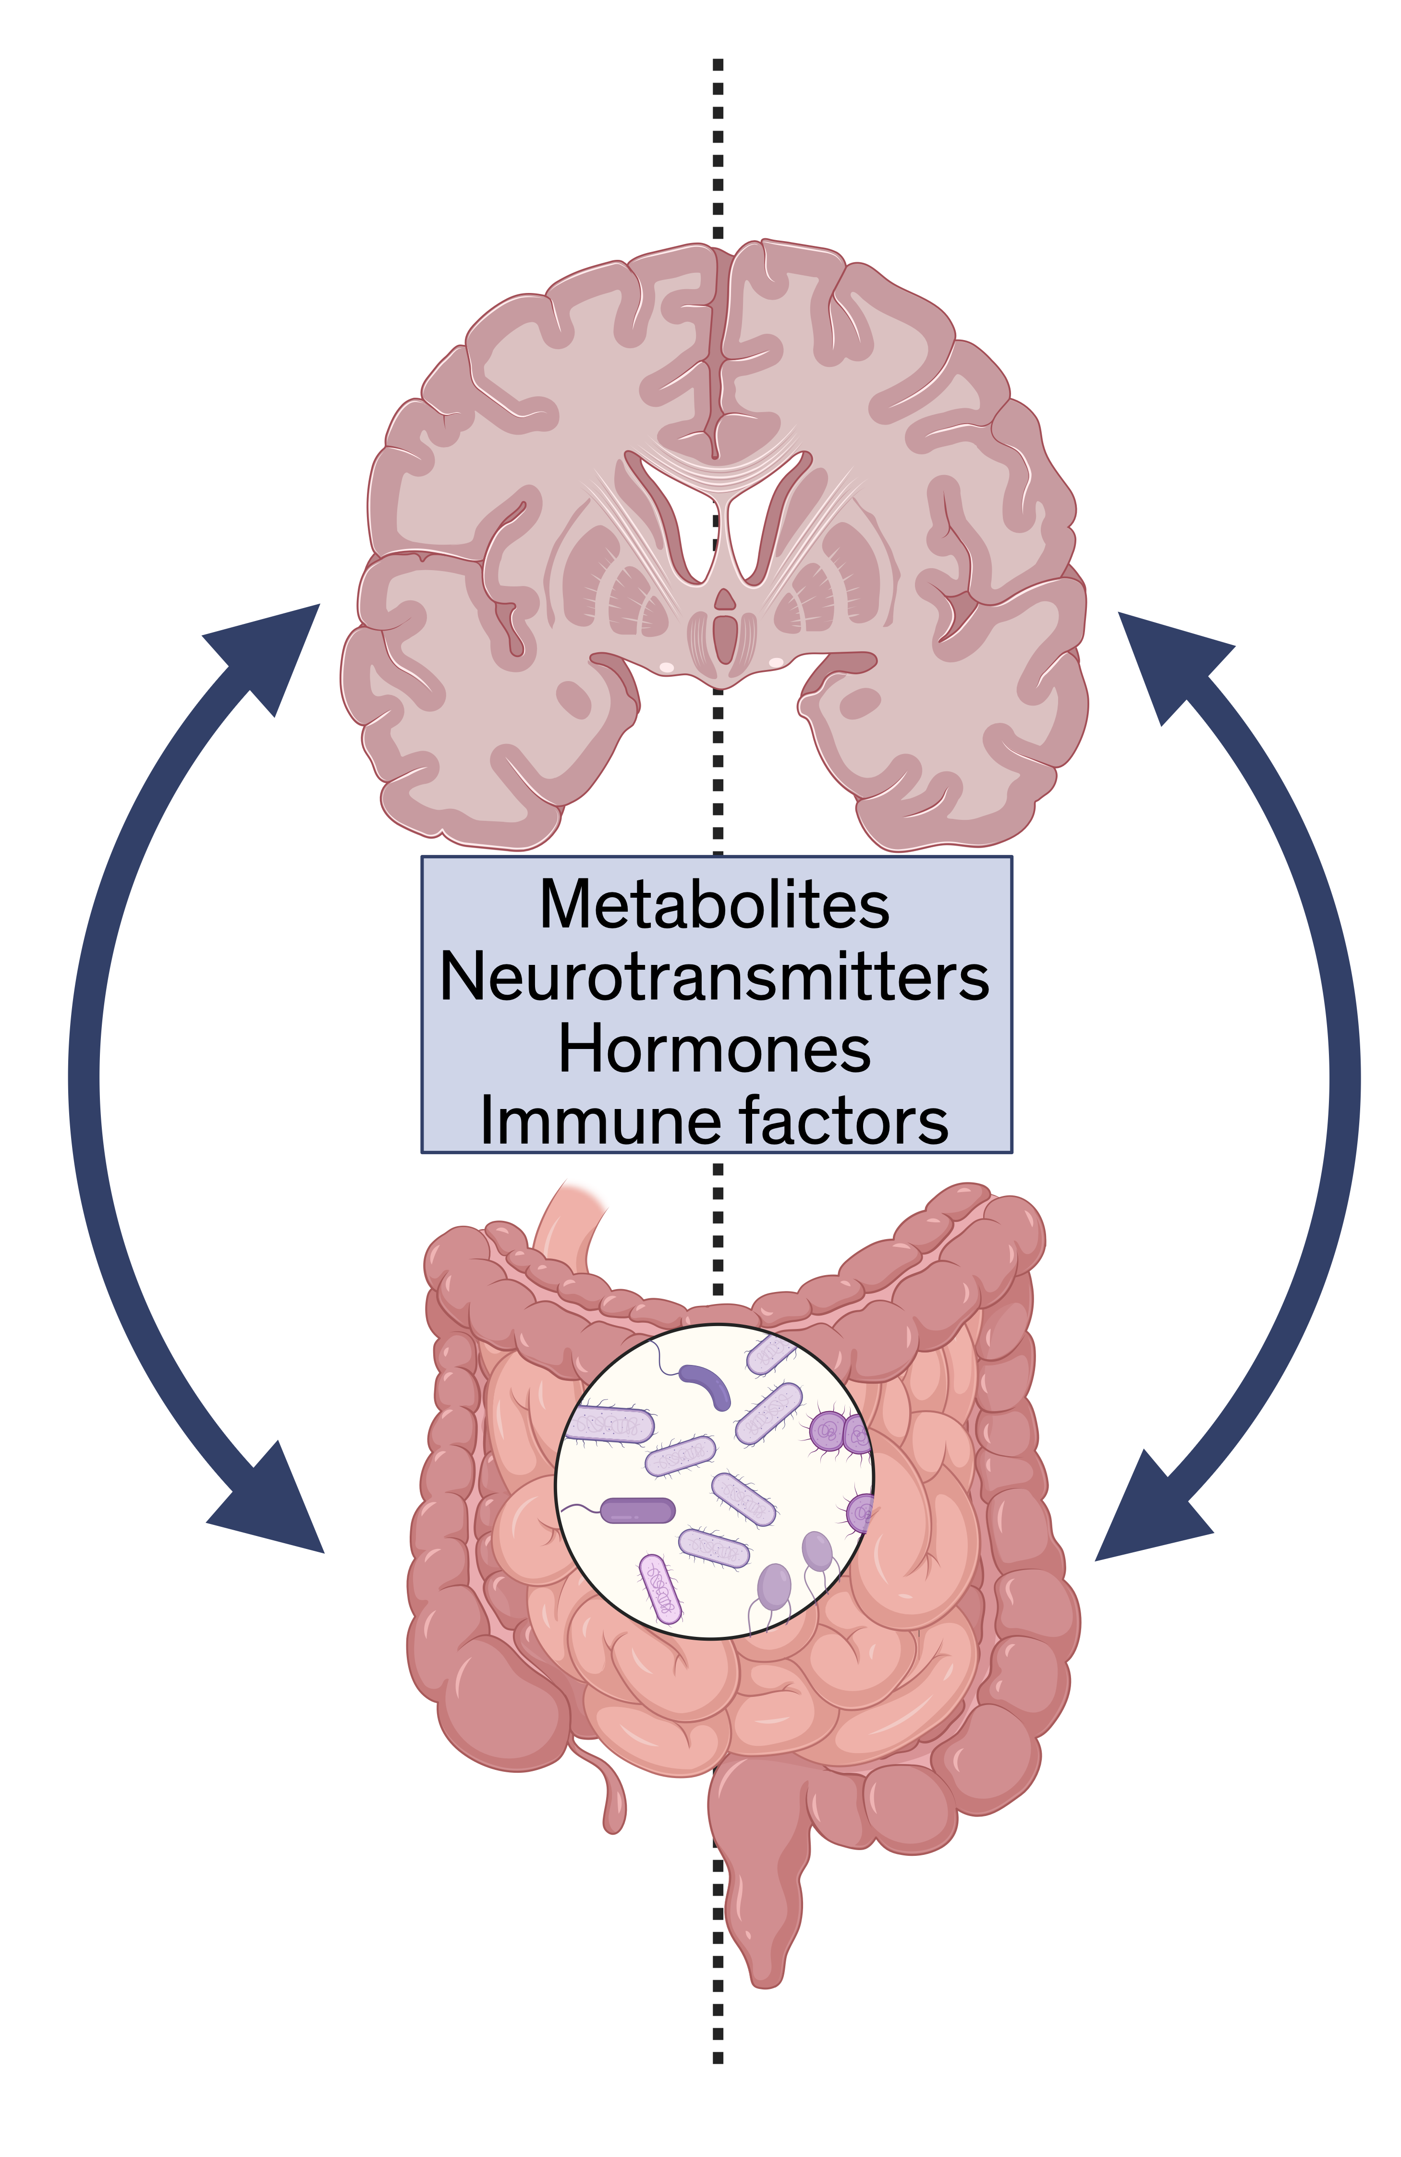
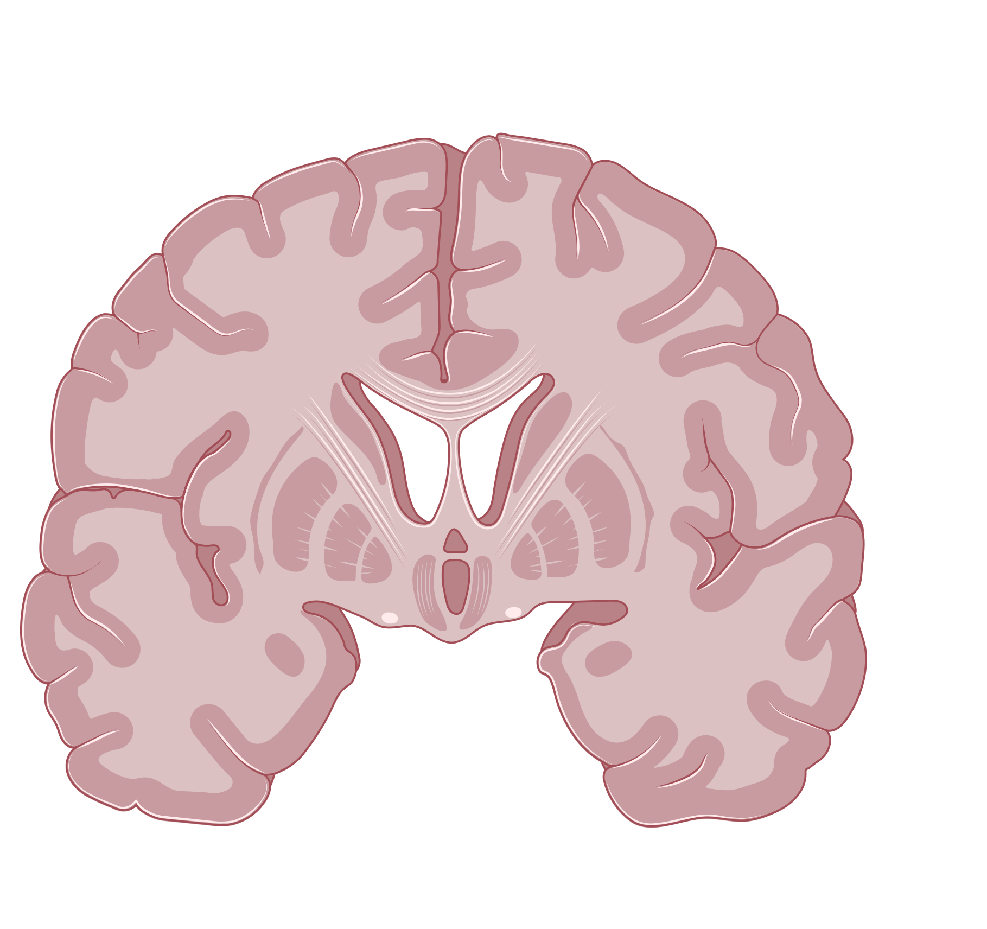
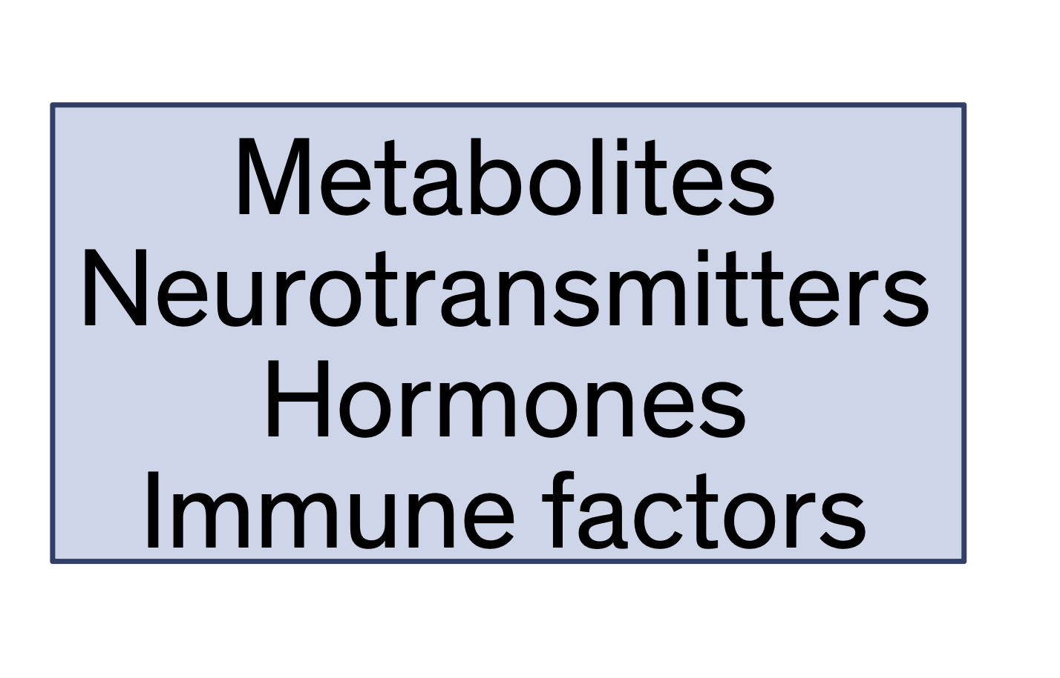
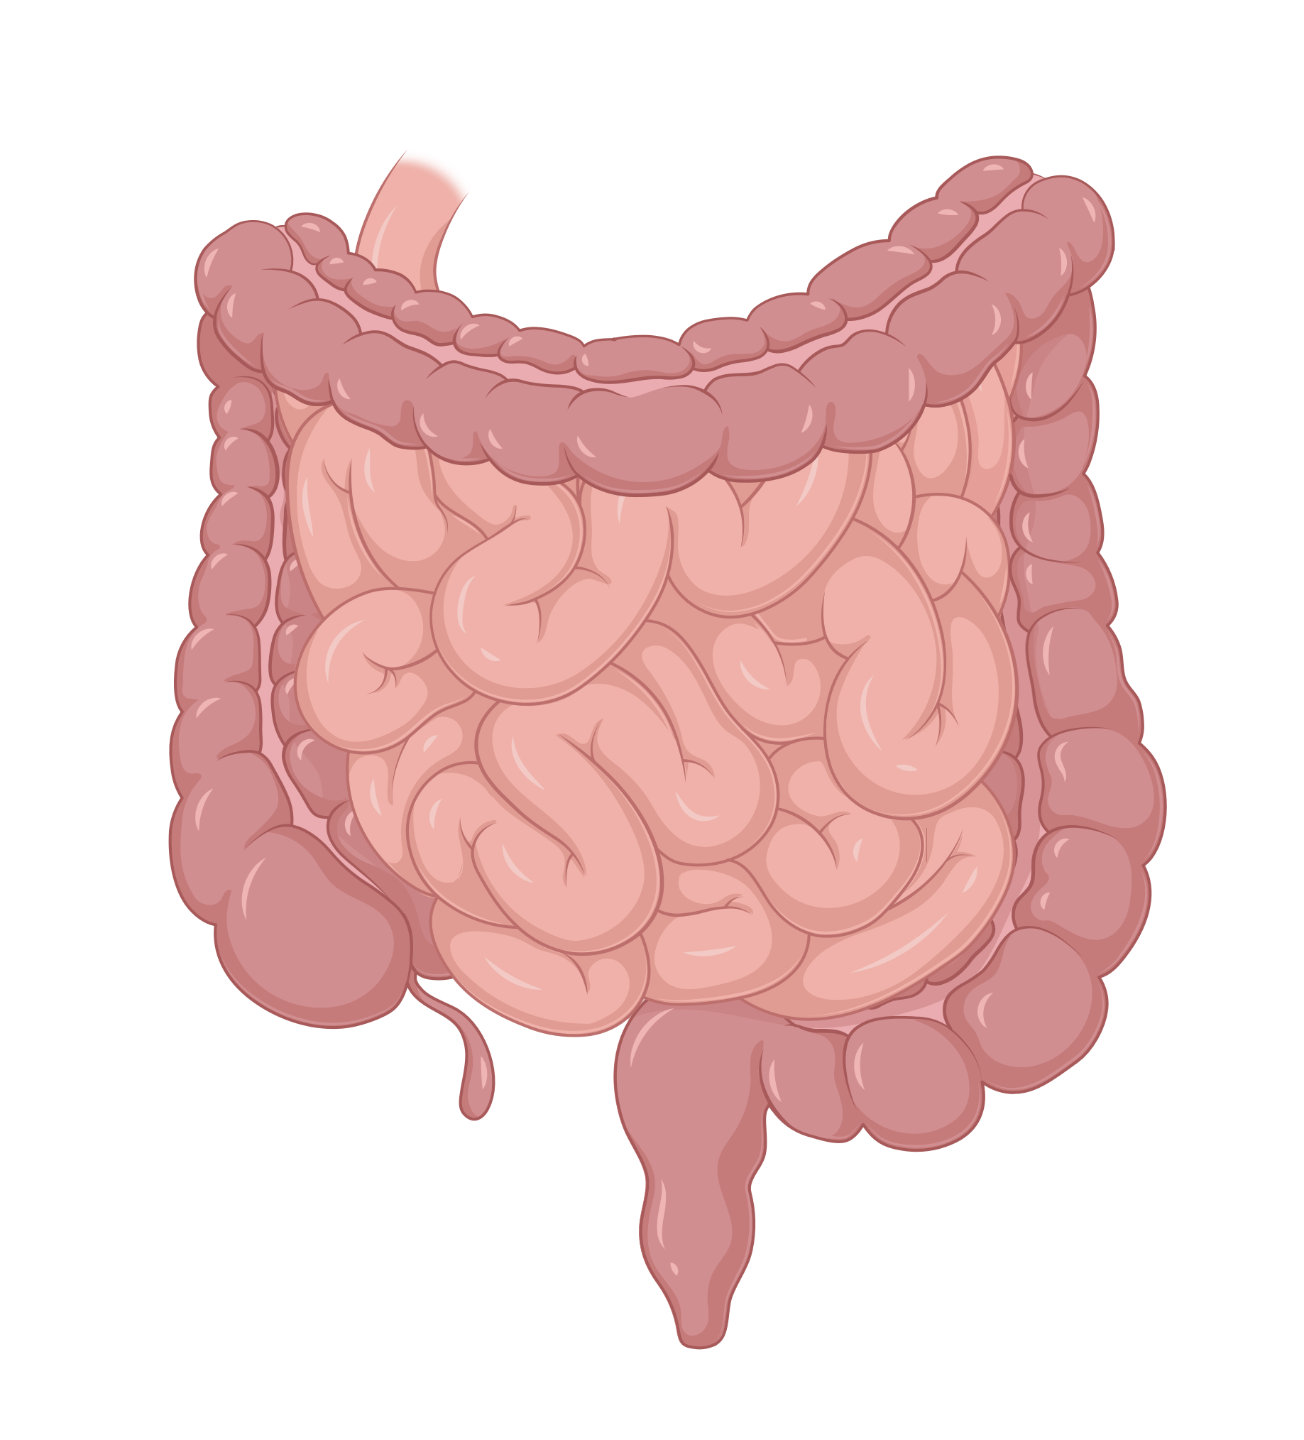

The Gut-Microbiome-Brain Axis
Central Nervous System
(CNS)
Bidirectional Communication Network
Pathways involved
Neural: vagus nerve, CNS to ENS
Immune: cytokines, inflammation
Metabolic: microbial metabolites, SCFA, bile acids
Endocrine: hormones, GLP-1, serotonin
Enteric Nervous System (ENS)
Gut Microbiome
Notes:
Were going to use what weve learned thus far with gut microbiome, nutrition, prebiotic fibers, and look at how this has impacts outside of the gut-in the brain! Gut informs brain about nutrient status, inflammation, microbial metabolites, and motility. Brain modulates digestion, gastric emptying, vagal tone

Slide 3
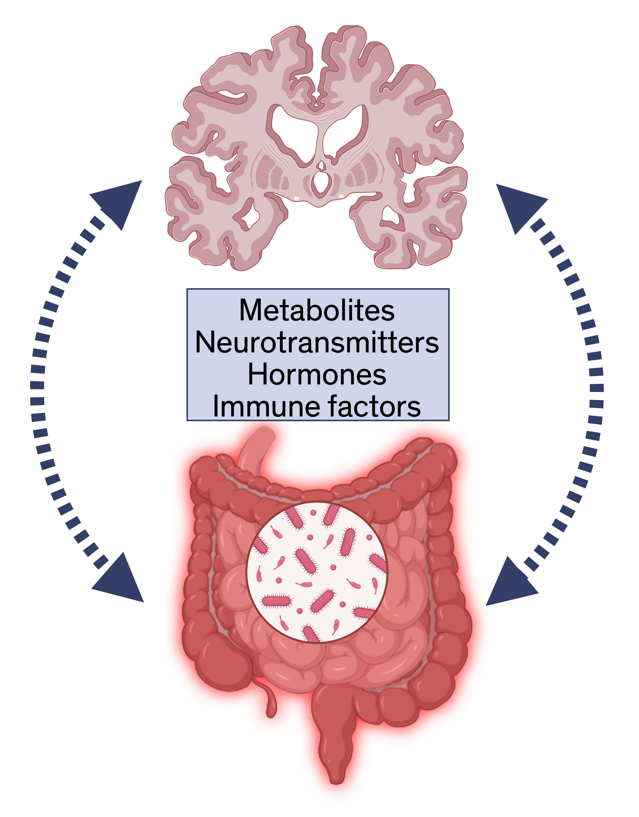
The Gut-Microbiome-Brain Axis
What if this connection is disrupted?
Dysbiosis
Inflammation
Neurodegeneration

Slide 4
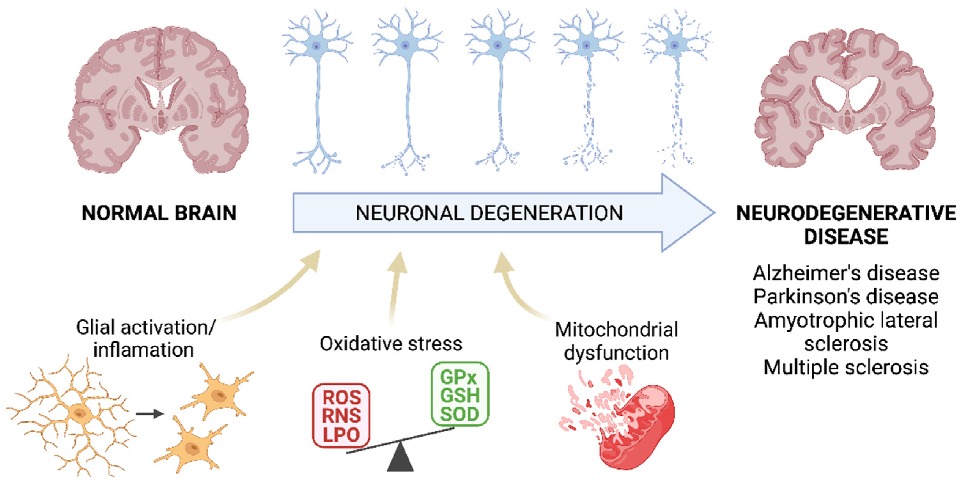
Neurodegenerative Diseases
Disorders affecting the nervous system, progressive decline in brain function and structure
Genetics + Environmental Exposures + Lifestyle + Inflammation + Protein misfolding
Adapted from: Pardillo-Díaz R, Pérez-García P, Castro C, Nunez-Abades P, Carrascal L. Oxidative Stress as a Potential Mechanism Underlying Membrane Hyperexcitability in Neurodegenerative Diseases. Antioxidants. 2022;11(8):1511. doi:10.3390/antiox11081511
Notes:
Parkinson’s Disease (PD), Alzheimer’s Disease (AD), Huntington’s Disease, ALS, Multiple Sclerosis (MS), etc

Slide 5
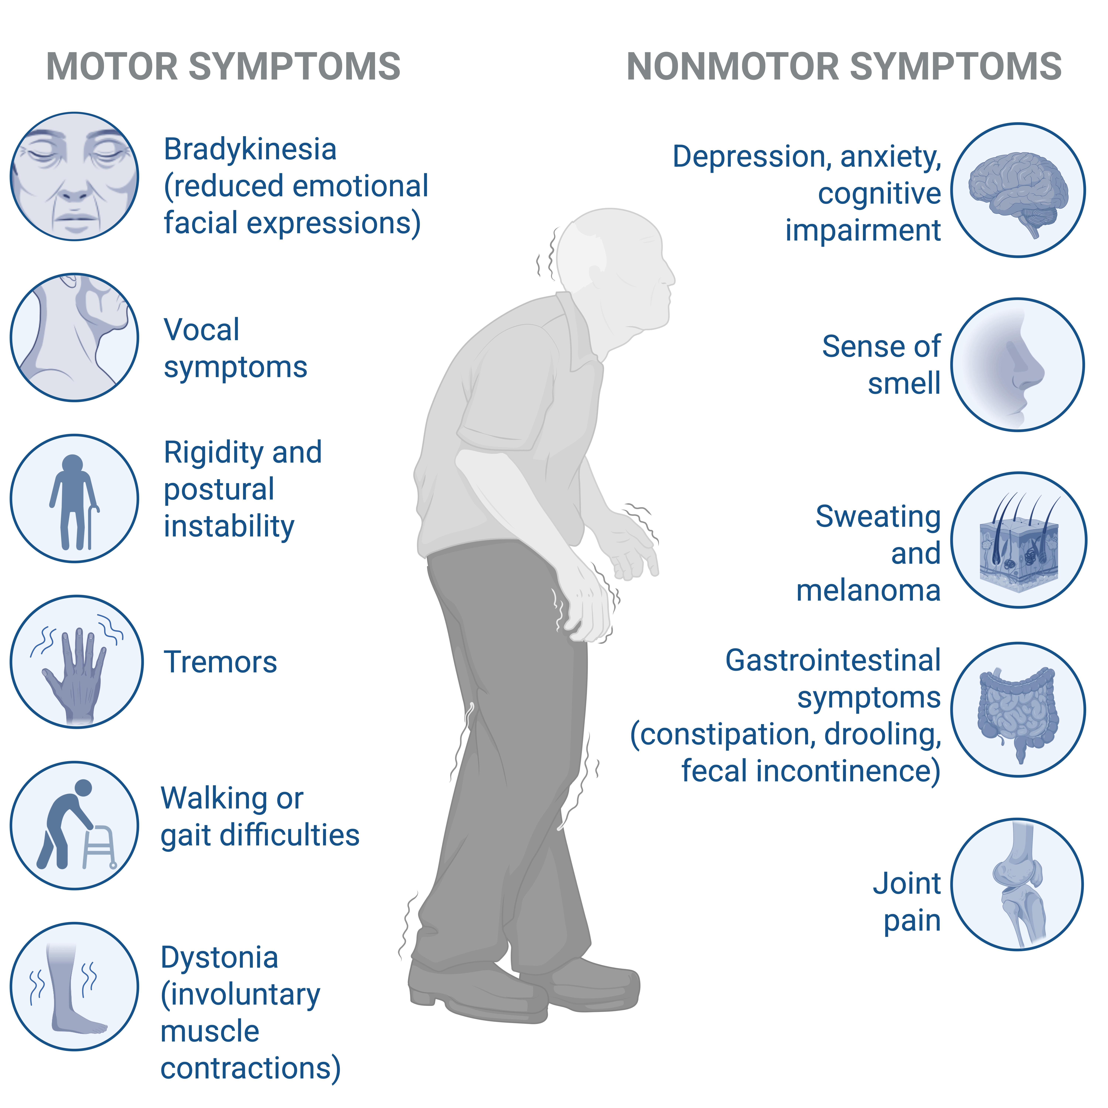
Parkinson’s Disease
Loss of Dopamine-producing Neurons
𝛼-Synuclein Misfolding and Aggregation
Constipation¹
Prodromal Symptom
Prevalence: over 70%
𝛼-Synuclein in the gut
Brain first vs. Body first²
Knudsen K, Krogh K, Østergaard K, Borghammer P. Constipation in parkinson’s disease: subjective symptoms, objective markers, and new perspectives. Mov Disord 2017;32:94–105.
Horsager J, Borghammer P. Brain-first vs. body-first Parkinson’s disease: An update on recent evidence. Parkinsonism & Related Disorders. 2024;122:106101. doi:10.1016/j.parkreldis.2024.106101
Image adapted from Biorender: Huang, E. (2025). Symptoms of Parkinson's Disease. https://app.biorender.com/biorender-templates/details/t-62ce20f1b05a71471333493b-symptoms-of-parkinsons-disease/?source=gallery
Notes:
𝛼-Synuclein
Protein in presynaptic terminals
Lipid binding and trafficking
Dopamine synthesis and transport

Slide 6
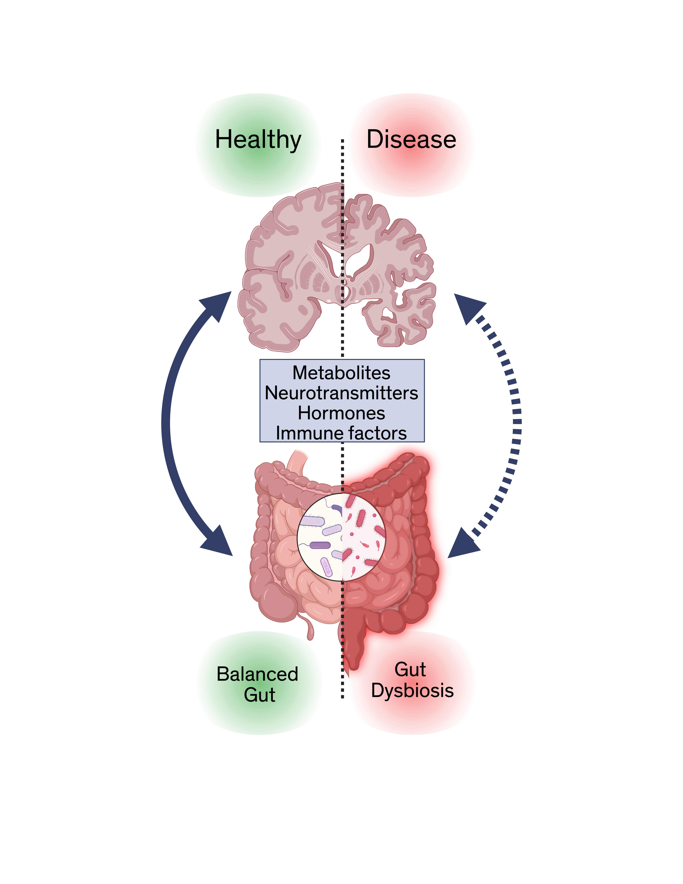
The Gut-Microbiome-Brain Axis in Health and Disease
Notes:
Microbiome composition
Short Chain Fatty Acids (SCFA)
Bile Acid metabolism
Gut barrier function
Gut Inflammation
Neuroactive metabolites
Neuroinflammation
Neurodegeneration

Slide 7
The Gut-Microbiome-Brain Axis
Genera of bacteria across 13 separate studies
Consistencies may help define the “PD microbiome”
Adapted from: Li Z, Liang H, Hu Y, et al. Gut bacterial profiles in Parkinson's disease: A systematic review. CNS Neurosci Ther. 2023;29(1):140-157. doi:10.1111/cns.13990

Slide 8
The Gut-Microbiome-Brain Axis
Healthy
PD
SCFA-producing bacteria
Faecalibacterium
Roseburia
Blautia
Eubacterium
SCFA-producing bacteria
Faecalibacterium
Roseburia
Blautia
Mucin-degrading bacteria
Akkermansia
Ruminococcus gnavus
Prevotella
Mucin-degrading bacteria
Akkermansia
Prevotella
Pro-inflammatory/ pathogenic bacteria
Enterobacteriaceae
Pro-inflammatory/ pathogenic bacteria
Enterobacteriaceae
Compiled from 15 research articles, citations on hidden slide
Notes:
Loss of key butyrate producers, increase in pro-inbflammatory

Slide 9
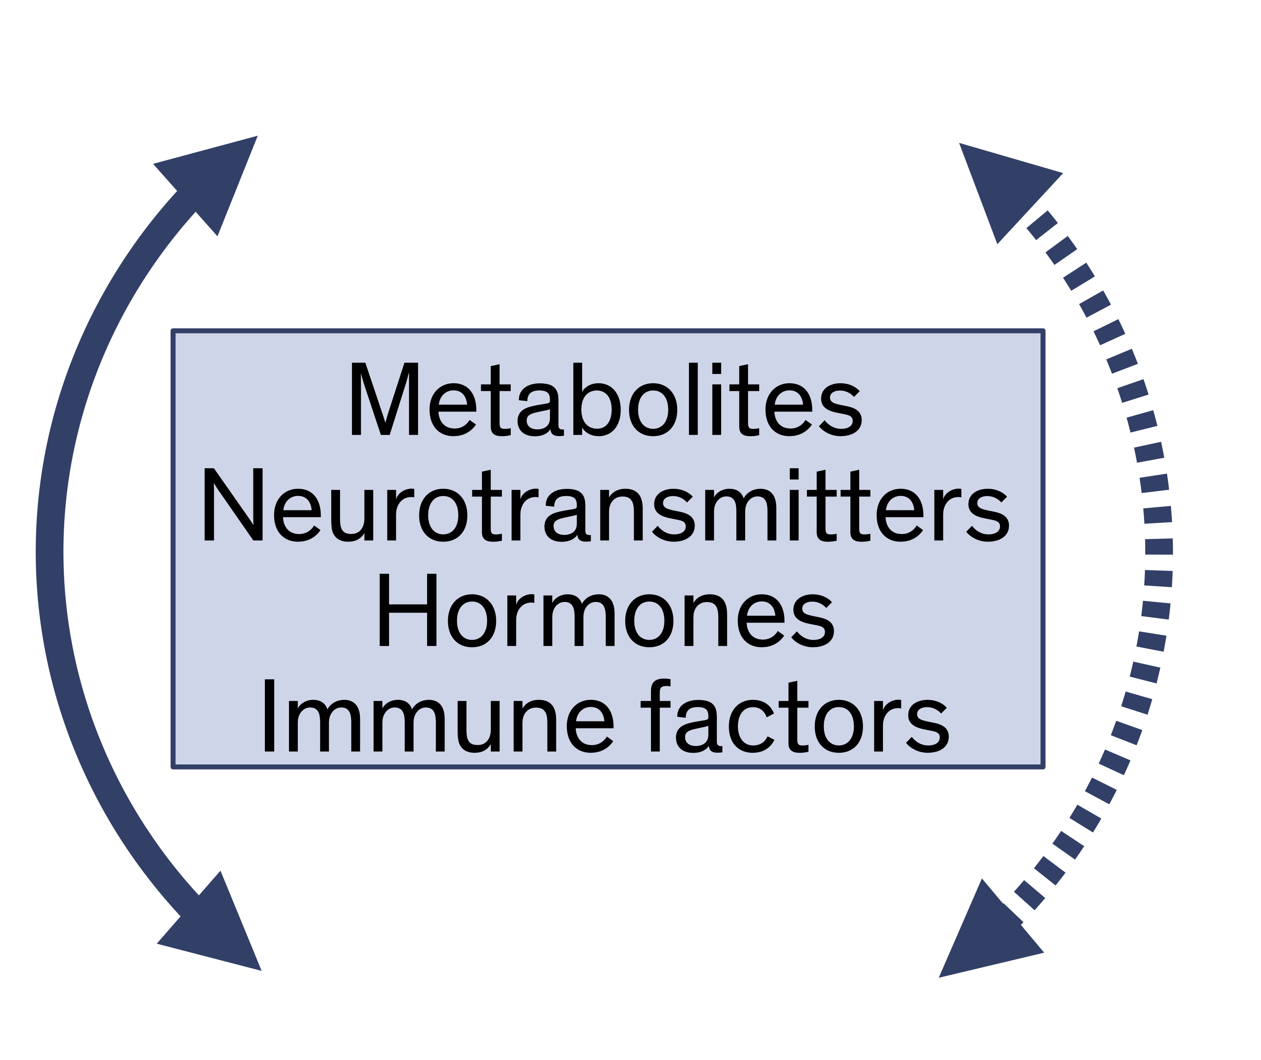
The Gut-Microbiome-Brain Axis
Gut barrier permeability
Systemic inflammation
Neuroinflammation
SCFA
Microglia metabolism
Adapted from: Chen SJ, Chen CC, Liao HY, et al. Association of Fecal and Plasma Levels of Short-Chain Fatty Acids With Gut Microbiota and Clinical Severity in Patients With Parkinson Disease. Neurology. 2022;98(8):e848-e858. doi:10.1212/WNL.0000000000013225
Notes:
Microbiome composition
Short Chain Fatty Acids (SCFA)
Bile Acid metabolism
Gut barrier function
Gut Inflammation
Neuroactive metabolites
Neuroinflammation
Neurodegeneration

Slide 10
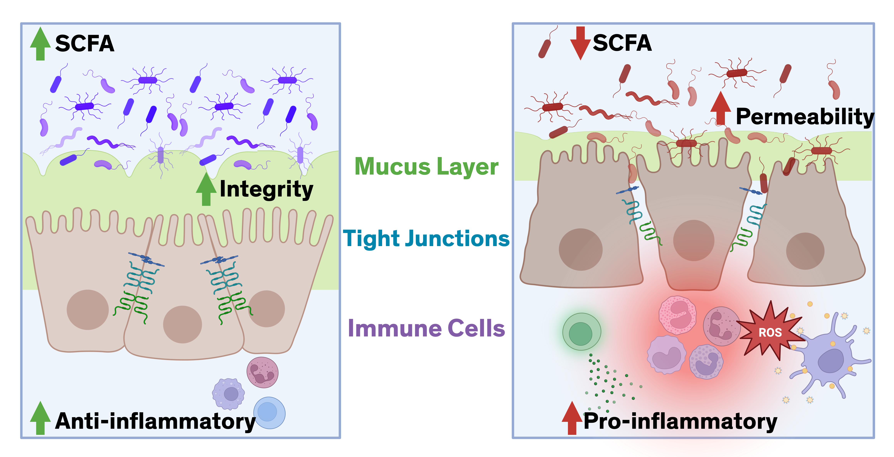
The Gut-Microbiome-Brain Axis
Healthy
PD
Adapted from: Armet AM, Deehan EC, O’Sullivan AF, et al. Rethinking healthy eating in light of the gut microbiome. Cell Host & Microbe. 2022;30(6):764-785. doi:10.1016/j.chom.2022.04.016
Notes:
“Butyrate is the primary energy source for colonocytes, the cells that line the intestinal wall. When SCFA levels are high, these cells can maintain tight junctions and a thick, protective mucus layer. This keeps the gut barrier strong and prevents unwanted molecules from leaking into the bloodstream.”
“When SCFA levels drop, colonocytes essentially become energy-deprived. The tight junctions weaken, the mucus layer thins, and the gut becomes more permeable — what we often refer to as ‘leaky gut.’”
SCFAs are some of the most important immune regulators in the body. They promote regulatory T cells and suppress pro-inflammatory signaling pathways like NF-κB.”
“Without adequate SCFAs, the immune system shifts toward activation instead of tolerance. We see higher levels of inflammatory cytokines, and this is reflected clinically in elevated fecal calprotectin in many patients.”
“Acetate and butyrate travel beyond the gut. They influence liver metabolism, systemic inflammation, and even microglial activity in the brain.”
“Reduced SCFAs remove these anti-inflammatory signals. Microglia become more reactive, systemic inflammation increases, and the neuroimmune system loses an important layer of regulation.”
“SCFAs stimulate colonic motility. A drop in SCFAs slows transit time — which we see clinically as constipation. That slower transit further decreases fermentation, creating a feedback loop that reinforces dysbiosis.”

Slide 11
The Gut-Microbiome-Brain Axis
Healthy
PD
Leaky gut
Systemic inflammation
Constipation
Intestinal Inflammation
Barrier Permeability
Adapted from: Dumitrescu L, Marta D, Dănău A, et al. Serum and Fecal Markers of Intestinal Inflammation and Intestinal Barrier Permeability Are Elevated in Parkinson's Disease. Front Neurosci. 2021;15:689723. Published 2021 Jun 18. doi:10.3389/fnins.2021.689723
Adapted from: Armet AM, Deehan EC, O’Sullivan AF, et al. Rethinking healthy eating in light of the gut microbiome. Cell Host & Microbe. 2022;30(6):764-785. doi:10.1016/j.chom.2022.04.016
Notes:
“Butyrate is the primary energy source for colonocytes, the cells that line the intestinal wall. When SCFA levels are high, these cells can maintain tight junctions and a thick, protective mucus layer. This keeps the gut barrier strong and prevents unwanted molecules from leaking into the bloodstream.”
“When SCFA levels drop, colonocytes essentially become energy-deprived. The tight junctions weaken, the mucus layer thins, and the gut becomes more permeable — what we often refer to as ‘leaky gut.’”
SCFAs are some of the most important immune regulators in the body. They promote regulatory T cells and suppress pro-inflammatory signaling pathways like NF-κB.”
“Without adequate SCFAs, the immune system shifts toward activation instead of tolerance. We see higher levels of inflammatory cytokines, and this is reflected clinically in elevated fecal calprotectin in many patients.”
“Acetate and butyrate travel beyond the gut. They influence liver metabolism, systemic inflammation, and even microglial activity in the brain.”
“Reduced SCFAs remove these anti-inflammatory signals. Microglia become more reactive, systemic inflammation increases, and the neuroimmune system loses an important layer of regulation.”
“SCFAs stimulate colonic motility. A drop in SCFAs slows transit time — which we see clinically as constipation. That slower transit further decreases fermentation, creating a feedback loop that reinforces dysbiosis.”

Slide 12
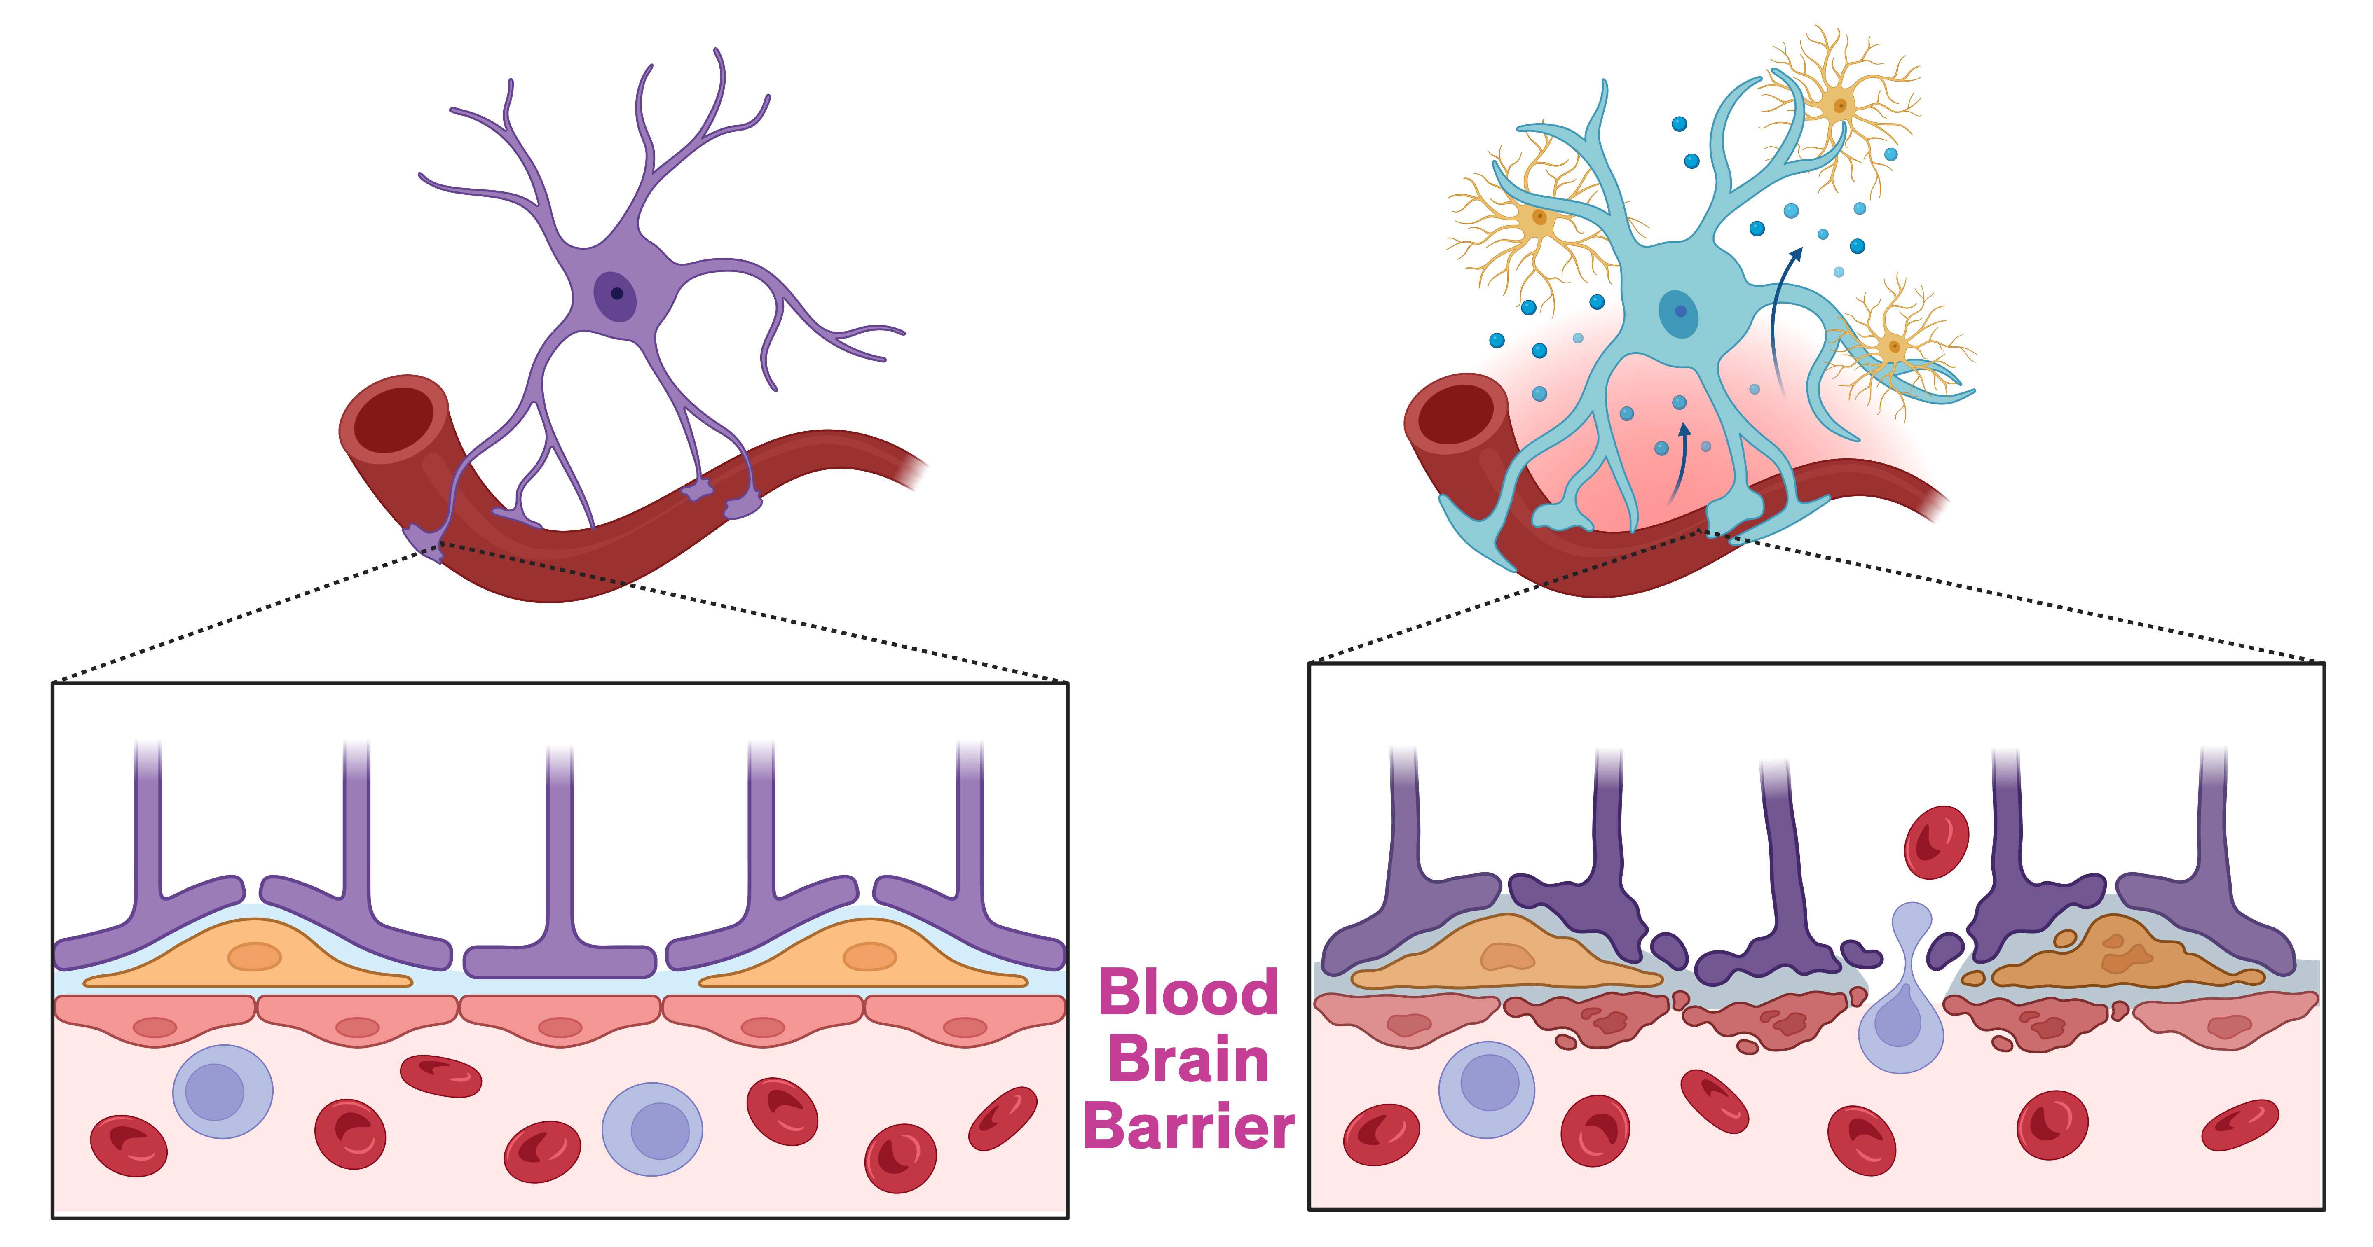
The Gut-Microbiome-Brain Axis
Healthy
PD
Intact BBB
Resting microglia
Dopamine signaling
Disrupted BBB
Chronic microglia activation
Dopamine depletion

Slide 13
The Gut-Microbiome-Brain Axis
Ventricular CSF
Adapted from: Mogi M, Harada M, Narabayashi H, Inagaki H, Minami M, Nagatsu T. Interleukin (IL)-1β, IL-2, IL-4, IL-6 and transforming growth factor-α levels are elevated in ventricular cerebrospinal fluid in juvenile parkinsonism and Parkinson’s disease. Neuroscience Letters. 1996;211(1):13-16. doi:10.1016/0304-3940(96)12706-3; 1.
Notes:
EGF:epidermal growth factor. TGFa: transforming growth factor

Slide 14
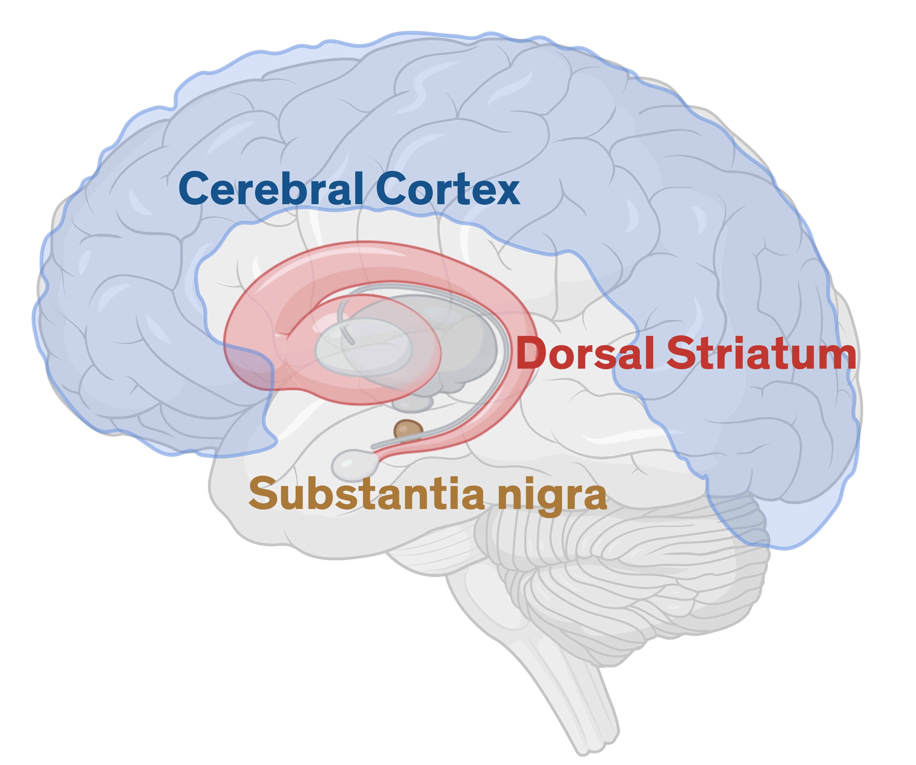
The Gut-Microbiome-Brain Axis
Adapted from: Mogi M, Harada M, Kondo T, et al. Interleukin-1 beta, interleukin-6, epidermal growth factor and transforming growth factor-alpha are elevated in the brain from parkinsonian patients. Neurosci Lett. 1994;180(2):147-150. doi:10.1016/0304-3940(94)90508-8
Notes:
EGF:epidermal growth factor. TGFa: transforming growth factor

Slide 15
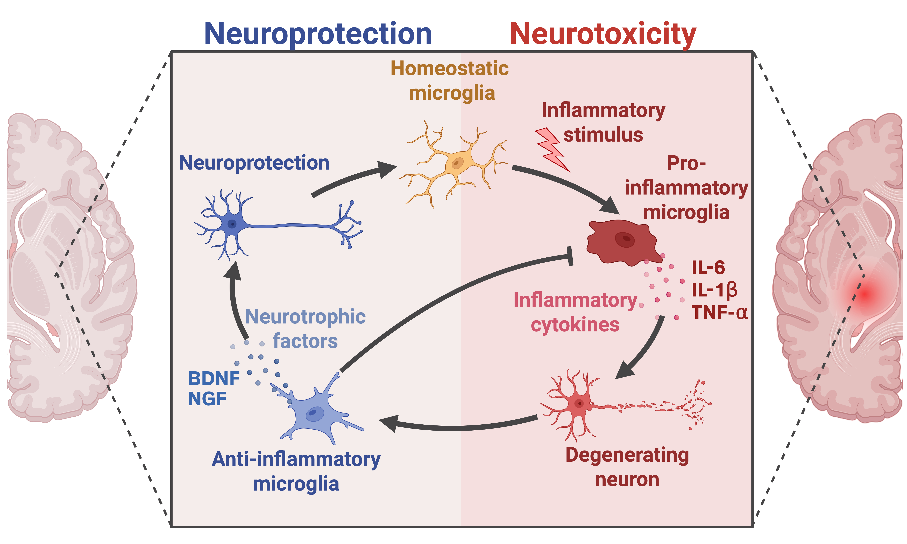
The Gut-Microbiome-Brain Axis
Adapted from: Subramaniam SR, Federoff HJ. Targeting Microglial Activation States as a Therapeutic Avenue in Parkinson’s Disease. Front Aging Neurosci. 2017;9. doi:10.3389/fnagi.2017.00176

Slide 16
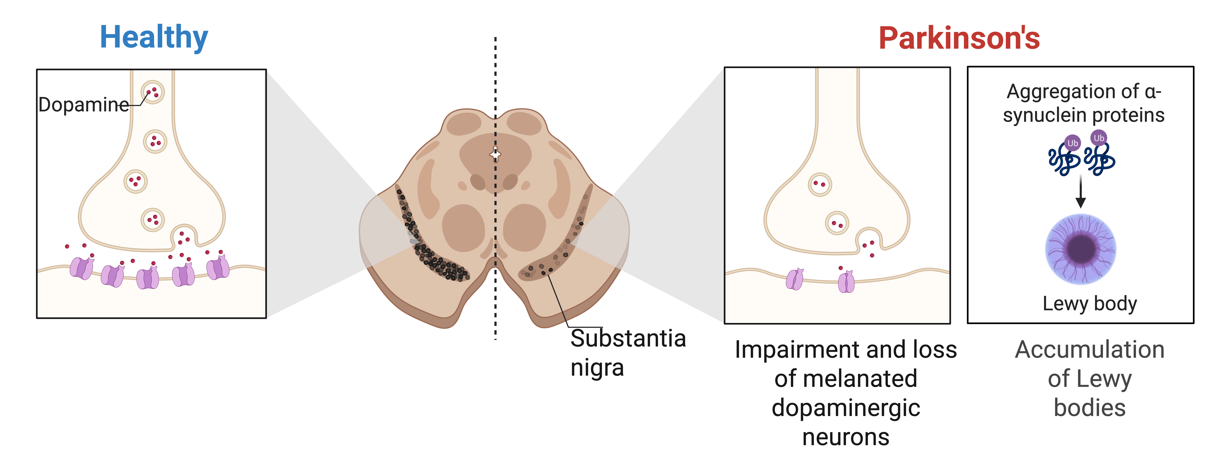
The Gut-Microbiome-Brain Axis
Adapted from: Kufta, A. (2025). Progression of Parkinson's Disease in the Substantia Nigra. https://app.biorender.com/biorender-templates/details/t-5fc9738fff8c1c00a4226b2f-progression-of-parkinsons-disease-in-the-substantia-nigra

Slide 17
The Gut-Microbiome-Brain Axis
SCFA
SCFA
Barrier
Permeability
Prebiotic Fiber
Barrier
Permeability
Inflammation
Inflammation
Notes:
Fiber as a neurological substrate.

Slide 18
Prebiotic Fibers: Many Types
Microbiome balance
SCFA production
Anti-inflammatory
Tolerability
Constipation relief
Notes:
When we think about designing fiber for brain health, we want to balance three goals: 1️⃣ Support a stable, diverse microbiome 2️⃣ Restore SCFA and bile acid signaling 3️⃣ Reduce inflammation without GI intolerance.”
Combine fast + slow fermenters → cover proximal & distal colon
Balance soluble + resistant fibers → broad microbial engagement
Ensure low-FODMAP compatibility for tolerability
Target SCFA yield and immune modulation rather than total fiber grams
Evaluate clinical biomarkers: fecal SCFAs, calprotectin, bile acids, inflammation markers

Slide 19
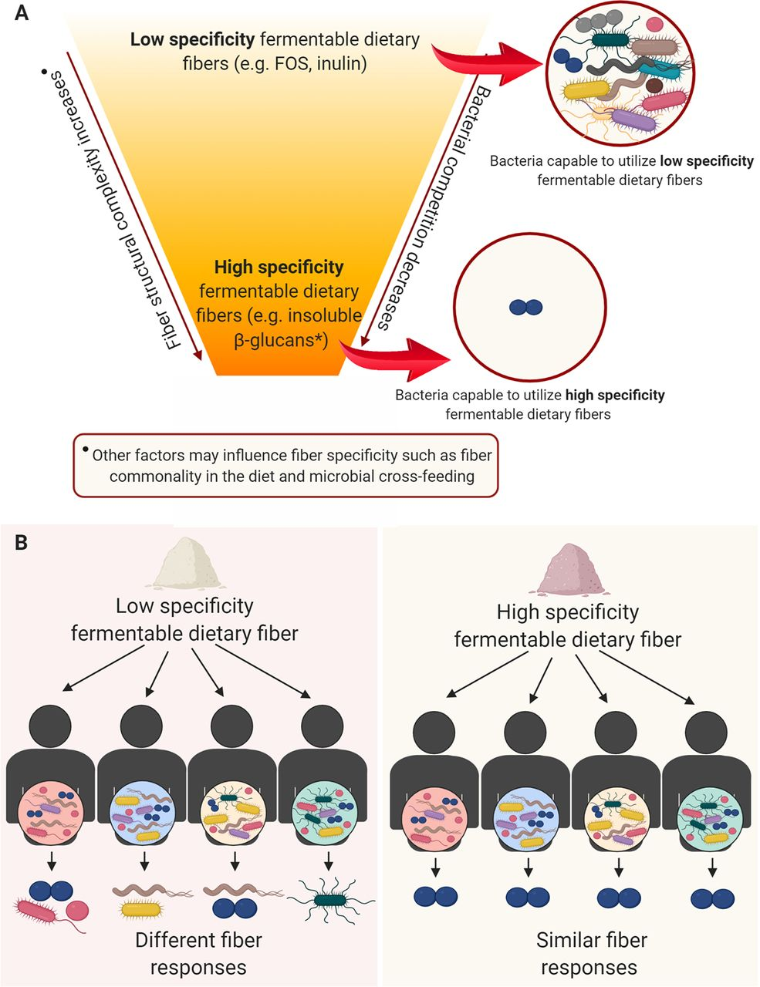
Prebiotic Fibers: Many Types
Cantu-Jungles TM, Hamaker BR. 2020. New View on Dietary Fiber Selection for Predictable Shifts in Gut Microbiota. mBio 11:10.1128/mbio.02179-19.https://doi.org/10.1128/mbio.02179-19
Notes:
When we think about designing fiber for brain health, we want to balance three goals: 1️⃣ Support a stable, diverse microbiome 2️⃣ Restore SCFA and bile acid signaling 3️⃣ Reduce inflammation without GI intolerance.”
Combine fast + slow fermenters → cover proximal & distal colon
Balance soluble + resistant fibers → broad microbial engagement
Ensure low-FODMAP compatibility for tolerability
Target SCFA yield and immune modulation rather than total fiber grams
Evaluate clinical biomarkers: fecal SCFAs, calprotectin, bile acids, inflammation markers

Slide 20
Prebiotic Fibers: Many Types
Cantu-Jungles TM, Hamaker BR. 2020. New View on Dietary Fiber Selection for Predictable Shifts in Gut Microbiota. mBio 11:10.1128/mbio.02179-19.https://doi.org/10.1128/mbio.02179-19
Notes:
Use highly specific fibers

Slide 21
Prebiotic Fibers with PD microbiota
Ex vivo fermentation reactions
Adapted from: Baert, F., Matthys, C., Maselyne, J. et al. Parkinson’s disease patients’ short chain fatty acids production capacity after in vitro fecal fiber fermentation. npj Parkinsons Dis. 7, 72 (2021). https://doi.org/10.1038/s41531-021-00215-5

Slide 22
Prebiotic Fibers with PD microbiota
Ex vivo fermentation reactions
Adapted from: Hall DA, Voigt RM, Cantu-Jungles TM, et al. An open label, non-randomized study assessing a prebiotic fiber intervention in a small cohort of Parkinson’s disease participants. Nat Commun. 2023;14(1):926. doi:10.1038/s41467-023-36497-x

Slide 23
Prebiotic Fibers with PD microbiota
Ex vivo fermentation reactions
Formulations with different types and many sources enhance the effectiveness

Slide 24
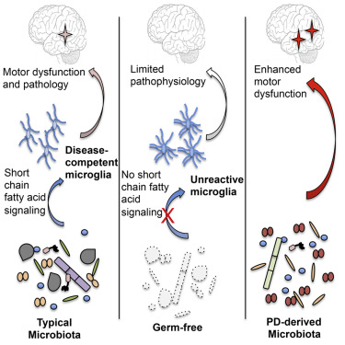
Preclinical Evidence
Gut Microbiota Regulate Motor Deficits and Neuroinflammation in a Model of Parkinson’s Disease
Sampson TR, Debelius JW, Thron T, et al. Gut Microbiota Regulate Motor Deficits and Neuroinflammation in a Model of Parkinson’s Disease. Cell. 2016;167(6):1469-1480.e12. doi:10.1016/j.cell.2016.11.018
Notes:
Gut microbes promote α-synuclein-mediated motor deficits and brain pathology
•
Depletion of gut bacteria reduces microglia activation
•
SCFAs modulate microglia and enhance PD pathophysiology
•
Human gut microbiota from PD patients induce enhanced motor dysfunction in mice

Slide 25
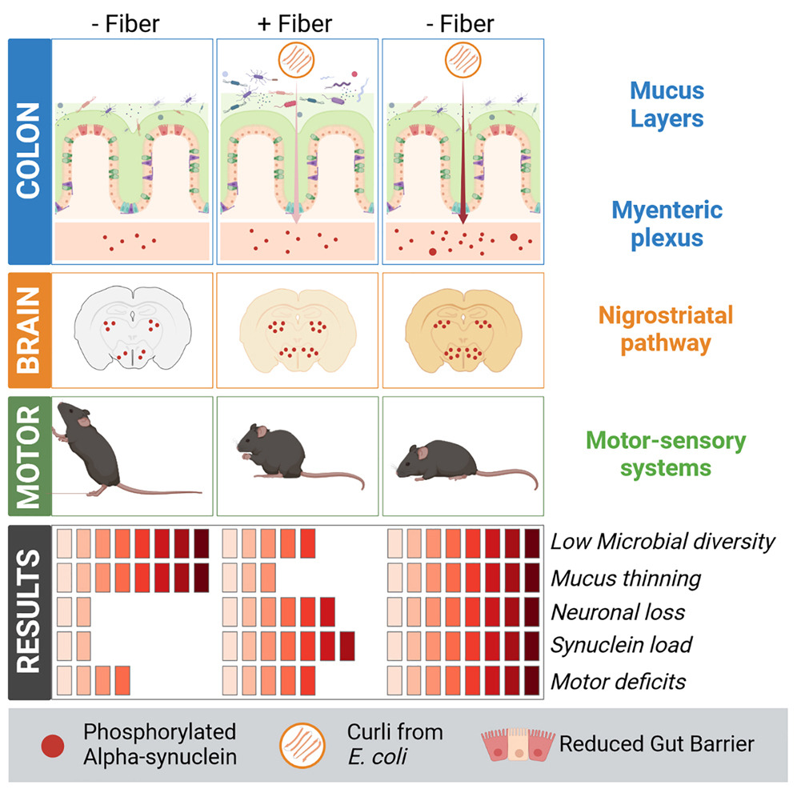
Preclinical Evidence
Fiber deprivation and microbiome-borne curli shift gut bacterial populations and accelerate disease in a mouse model of Parkinson’s disease
Schmit KJ, Garcia P, Sciortino A, et al. Fiber deprivation and microbiome-borne curli shift gut bacterial populations and accelerate disease in a mouse model of Parkinson’s disease. Cell Reports. 2023;42(9):113071. doi:10.1016/j.celrep.2023.113071

Slide 26
NeuroFiber with PD microbiota
Ex vivo fermentation reactions
Notes:
Saw encouraging results with key species that we wanted to target

Slide 27
Clinical Trials with Prebiotic Fiber Interventions
10 days prebiotic bar
(resistant starch, rice bran, resistant maltodextrin, inulin)
Plasma SCFA
Adapted from: Hall DA, Voigt RM, Cantu-Jungles TM, et al. An open label, non-randomized study assessing a prebiotic fiber intervention in a small cohort of Parkinson’s disease participants. Nat Commun. 2023;14(1):926. doi:10.1038/s41467-023-36497-x

Slide 28
Clinical Trials with Prebiotic Fiber Interventions
10 days prebiotic bar
(resistant starch, rice bran, resistant maltodextrin, inulin)
Adapted from: Hall DA, Voigt RM, Cantu-Jungles TM, et al. An open label, non-randomized study assessing a prebiotic fiber intervention in a small cohort of Parkinson’s disease participants. Nat Commun. 2023;14(1):926. doi:10.1038/s41467-023-36497-x

Slide 29
Clinical Trials with Prebiotic Fiber Interventions
10 days prebiotic bar
(resistant starch, rice bran, resistant maltodextrin, inulin)
Adapted from: Hall DA, Voigt RM, Cantu-Jungles TM, et al. An open label, non-randomized study assessing a prebiotic fiber intervention in a small cohort of Parkinson’s disease participants. Nat Commun. 2023;14(1):926. doi:10.1038/s41467-023-36497-x

Slide 30
Clinical Trials with Prebiotic Fiber Interventions
10 days prebiotic bar
(resistant starch, rice bran, resistant maltodextrin, inulin)
Adapted from: Hall DA, Voigt RM, Cantu-Jungles TM, et al. An open label, non-randomized study assessing a prebiotic fiber intervention in a small cohort of Parkinson’s disease participants. Nat Commun. 2023;14(1):926. doi:10.1038/s41467-023-36497-x

Slide 31
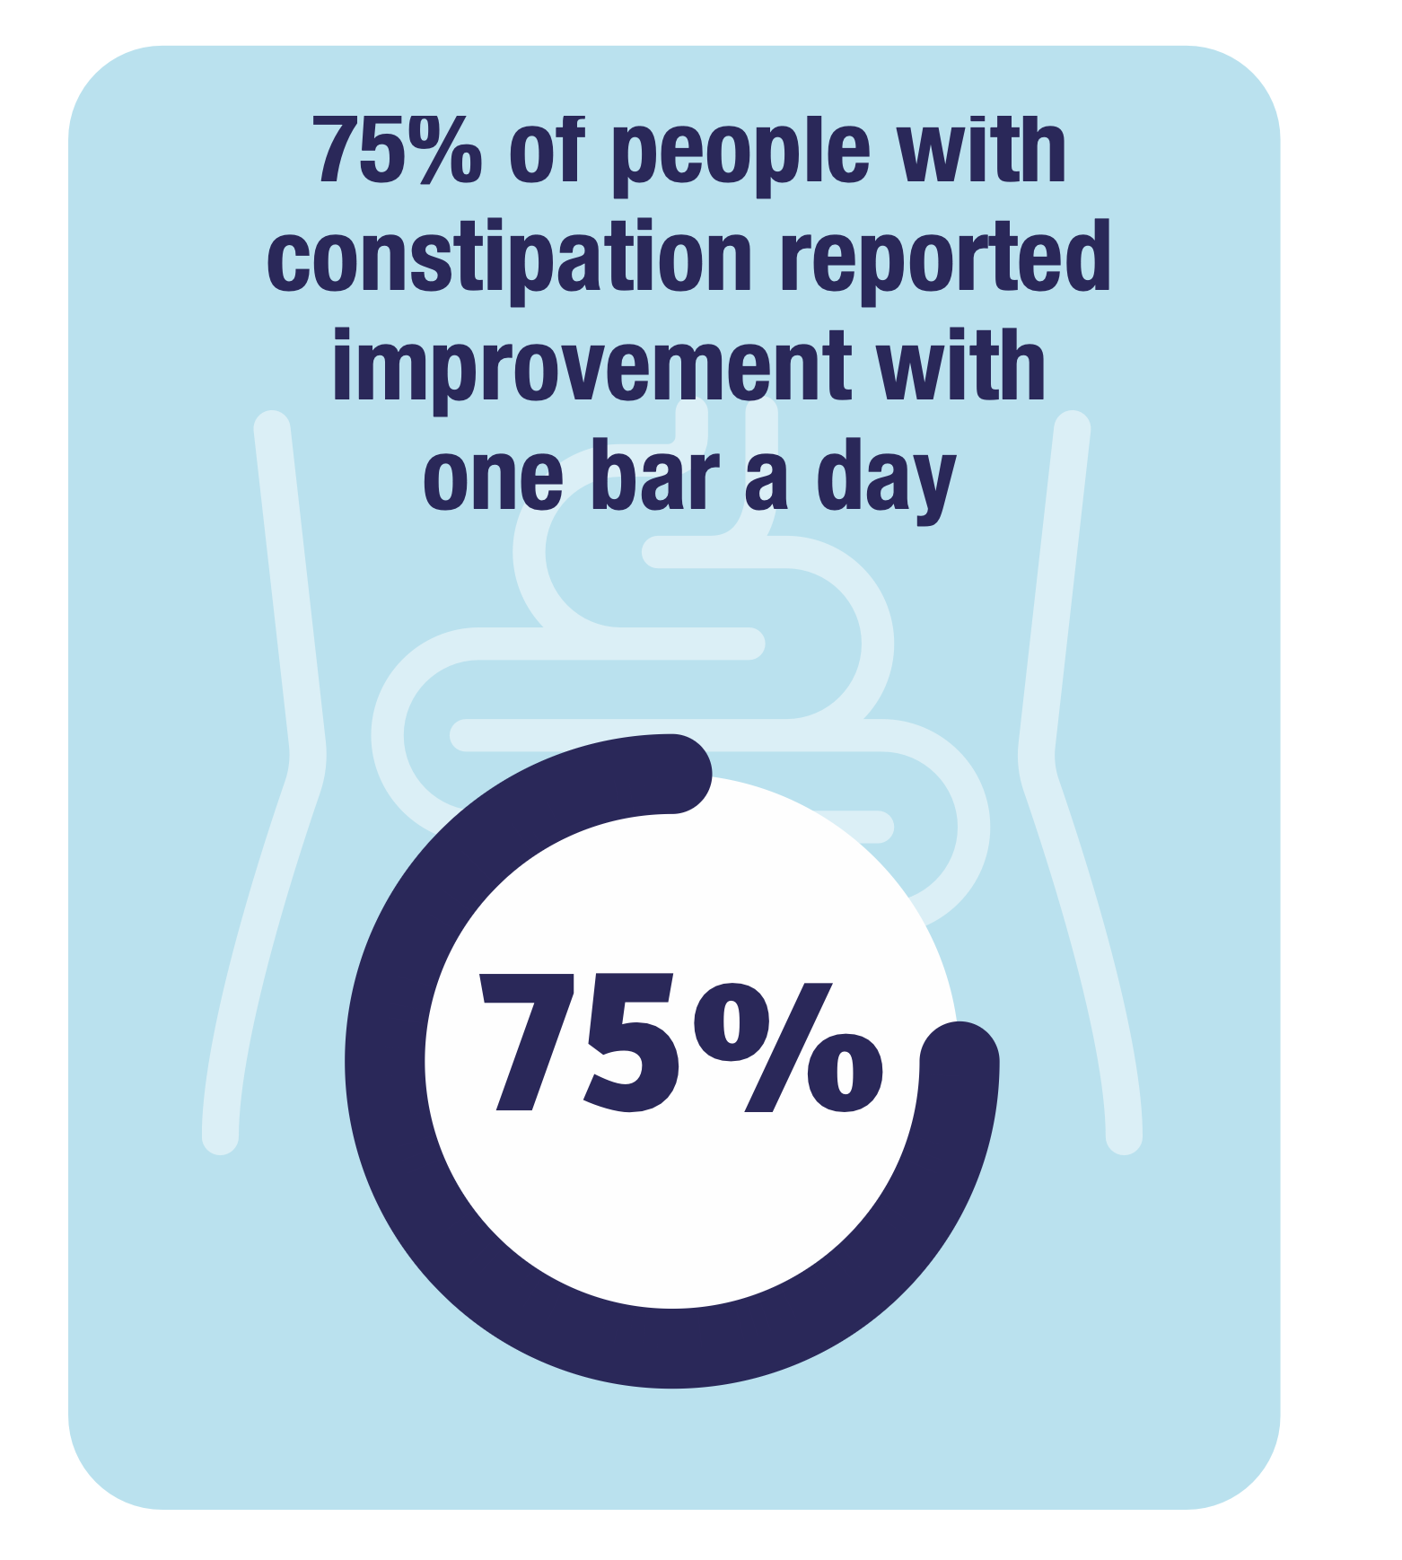
Clinical Trials with NeuroFiber
4 weeks prebiotic bar
Clinicaltrials.gov: NCT07127120
Notes:
Glial fibrillary acidic protein: intermediate filaments in astrocytes and glial cells, marker of injury to brain.

Slide 32
Clinical Trials with NeuroFiber
4 weeks prebiotic bar
MDS-UPDRS Part 1, 2: non-motor and motor experiences
Clinicaltrials.gov: NCT07127120

Slide 33
The Gut-Microbiome-Brain Axis
SCFA
SCFA
Barrier
Permeability
Prebiotic Fiber
Barrier
Permeability
Inflammation
Inflammation
Notes:
Fiber as a neurological substrate.

Slide 34
Brain Health Starts in the Gut
Gut dysfunction appears years before neurological symptoms
Microbial metabolites drive neuroinflammation and resilience
Fiber is a direct lever to reshape these metabolic pathways
Clinical evidence shows measurable improvements in gut and systemic inflammation

Slide 35
The Future of the Microbiome
Integrating precision nutrition, carbohydrate chemistry, microbiology, and neurology
Tailored prebiotic fibers for distinct disease states

Slide 36
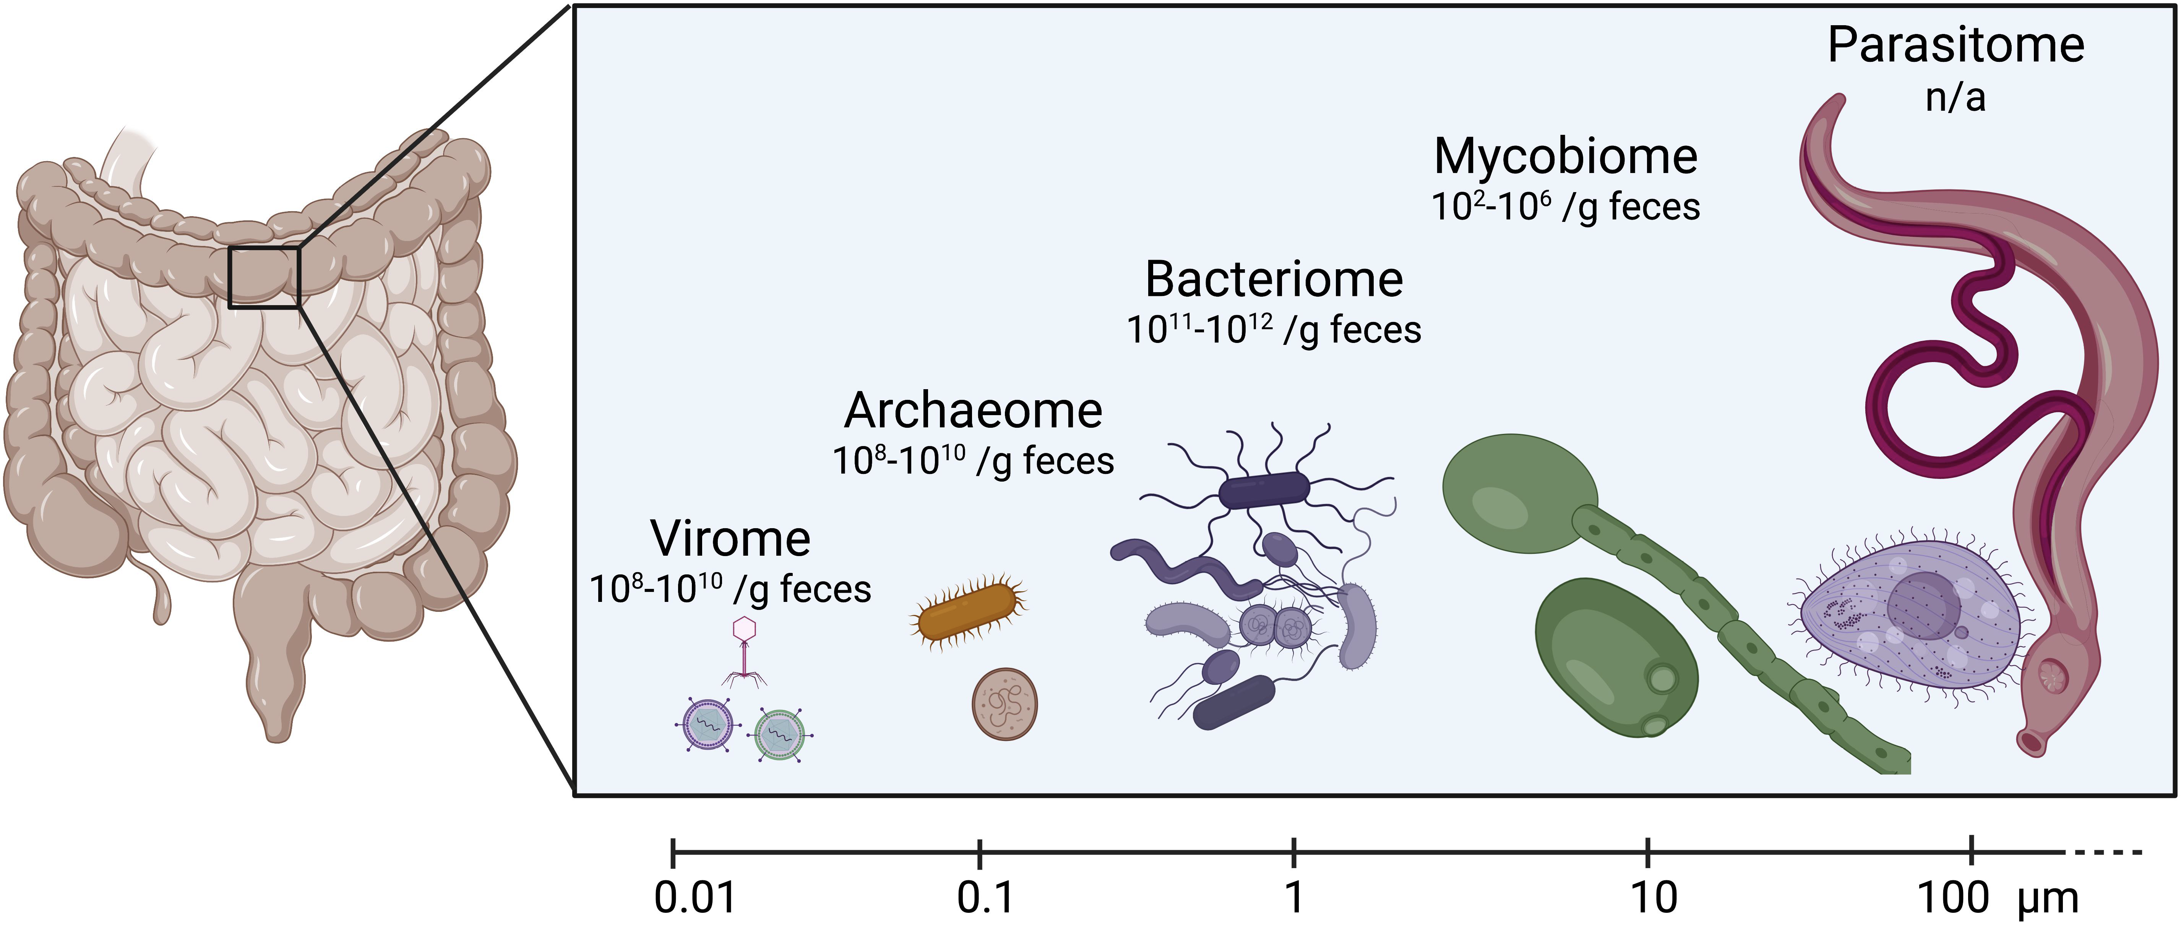
The Future of the Microbiome
Non-bacterial components of gut microbiome
Jaswal K, Todd OA, Behnsen J. Gut Microbes 2023

Slide 37


Brain Health Starts in the Gut
Leveraging Dietary Fiber to Modulate the Gut-Microbiome-Brain Axis in Neurodegenerative Diseases
NeuroFiberHealth.com
Olivia Adele Todd, PhD
olivia@sorriditherapeutics.com

