Slide 1
SeqBiome
Nov 2025

Slide 2


SeqBiome
We are a leading Contract Research organisation specialised in Microbiome analysis
Clinical Research
Clinical Sample Testing
Statistical Reporting
Food, Pharma, Nutraceutical, Academic
Microbiome Intelligence Platform
Healthcare/Research Professionals
Focused Programmes
Gut Health
Women’s Health
Digital Health Tools, AI/ML/LLMs
Personalised Health Reports

Slide 3
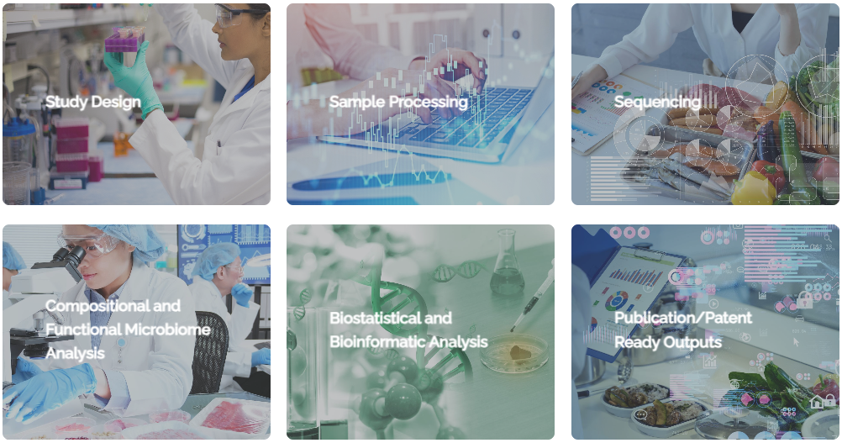
SeqBiome Solution
Our process is extensive, and we provide a total service for our customers and…

Slide 4
SeqBiome Solution
...most of our customers work with us using our end-to-end approach to maintain consistency/continuity
Consulting Services
Study Design
Sequencing Services
Multiple Sample Types
Proprietary Extraction Workflows
Bioinformatic Services
Bioinformatic Analysis
Customised Reporting
Design for Publication/Patent Outputs
Expert Library Preparation
Publication Writing/Advice
User needs/requirement specification
End-to-End Solution
We have implemented ISO9001 and will continue to add to our QMS, led by customers’ requirements
  Ensures continuous improvement/delivery of high quality outputs and in pre-agreed timeframes
  Maintains consistency of the workflows/approaches we take, which can be variable in e.g., University environments
Our laboratory staff have been trained in GCP

Slide 5
Capabilities
Testing/Analysis Capabilities
Bioinformatics Capabilities
DNA/RNA extraction from a variety of materials
Enrichment of microbial DNA for shotgun sequencing of samples with an abundance of host cells (e.g. milk, skin, vaginal swabs)
Ribosomal RNA depletion, enrichment of mRNA
Sequencing - 16S rDNA, 16S rRNA, ITS amplicon, Other amplicon, Shotgun metagenomics, Meta-transcriptomics
Use of multiple positive (including mock community controls) and negative controls among a wider variety of QA approaches
Quantitative Microbiome Profiling using qPCR of 16S RNA genes
Short and long read sequencing platforms (Oxford Nanopore Technology – MinION, GridION; Illumina – MiSeq, NextSeq, NovaSeq)
Robotic (Echo-BioMek) platforms
Amplicon seq/analysis: 16S gDNA/cDNA, ITS & other marker genes
Shotgun seq/analysis: metagenomics, metatranscriptomics & phageomics
Isolate strain genome annotation, mining & comparative genomics
Contamination checking/tracking/removal (low biomass samples)
Quantitative Microbiome Profiling using qPCR of 16S RNA genes
Custom ref-db design for improved taxonomic & functional annotation
Compositionally-aware SOPs (CLR/Aitchison/ALDEx2/LinDA)
FoodSeq: amplicon seq/analysis of chloroplast trnL & mitochondria 12S rRNA
Machine Learning classification & prediction
Multiomics datasets and pipelines

Slide 6
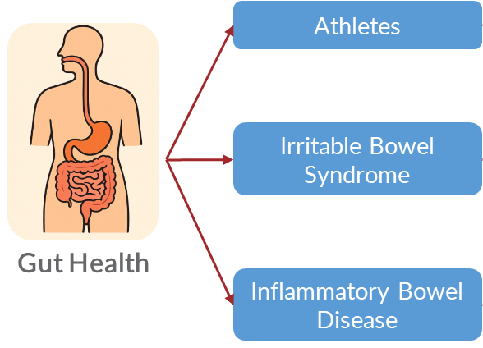
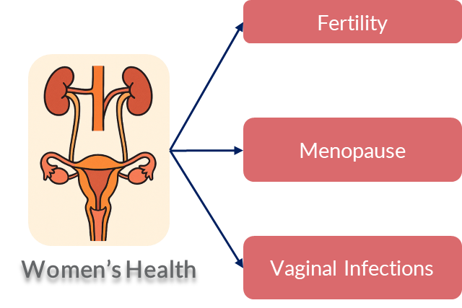

Focused Programmes
Leveraging laboratory expertise, digital health integration, and AI technologies towards personalisation
Traditional studies involve “population” level analyses – Microbiome assessment is a promising route towards “Personalised Health”
For studies we can also provide longitudinal reports on an individual basis

Slide 7
Project Models
Clinical Research Model
Digital Health/AI Model
Hybrid Model
  Supporting R&D, Clinical Trials
  Tens to hundreds of samples
  Project-level reporting
  Food, Pharma, Academia
  Researchers, clinicians, wellness professionals
  Individual-level testing
  Individual reporting, personalisation
  Researchers, Clinical Trials led by clinicians/wellness professionals
  Grouped samples (trial)
  Project-level reporting AND Individual reporting, personalisation
  Per-project and individual reports
For Researchers: Reliable, compliant, and precise testing with strong analytical support.
For Healthcare Providers: Actionable, AI-enhanced reports that improve client decision-making.
For Individuals/Study Participants: Trial recruitment and retention incentive, high quality feedback to support personalised care.

Slide 8
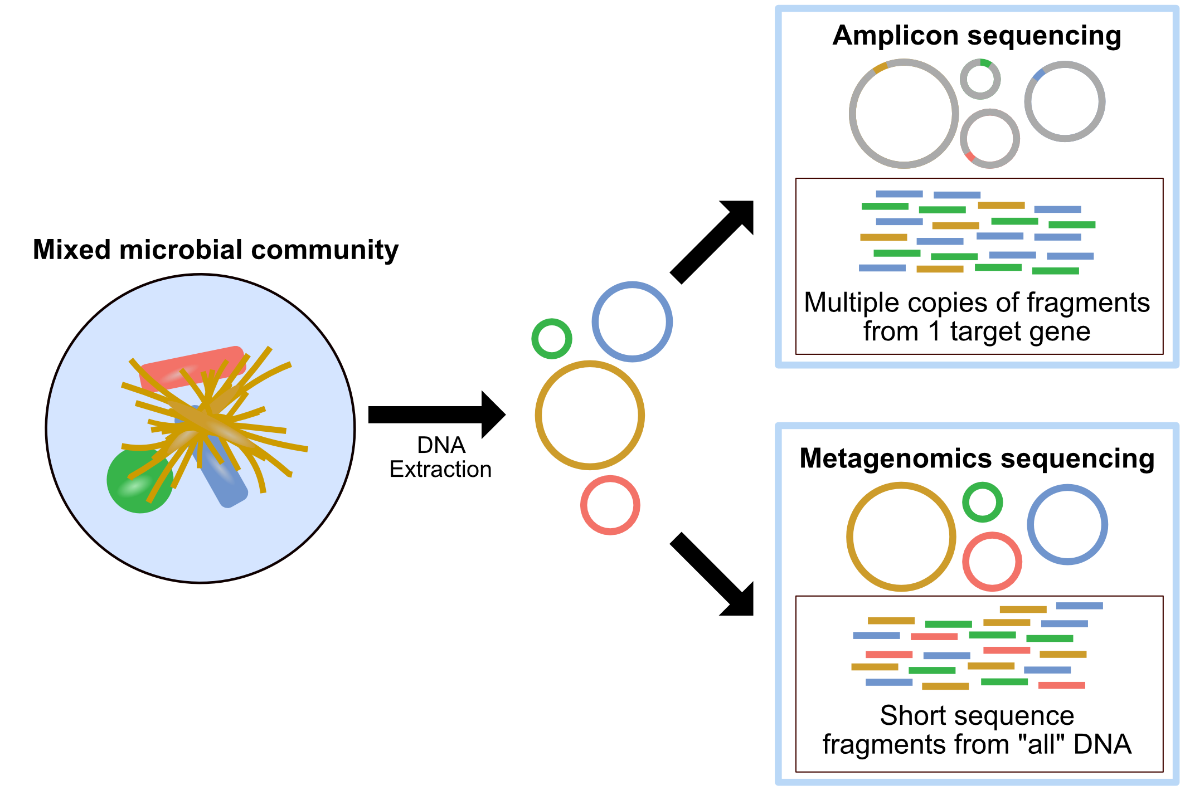
R&D: Improving sequencing-based classification
Who is there?
Ubiquitous 16S rRNA gene
Cons:
Limited species resolution
Limited functional information
Varying gene copy numbers
Amplification bias
What can they do?
All microbial DNA
Cons:
Requires more DNA
More expensive than amplicon seq.
Higher analytical & computational costs

Slide 9
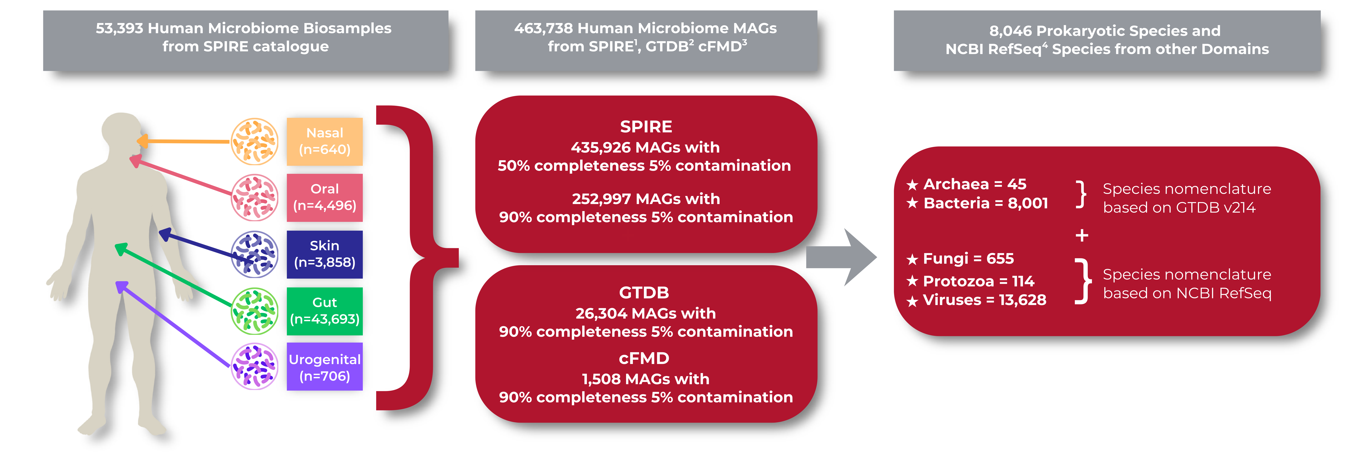
TRIDENT™
An Integrated Three-Pronged Approach for Accurate Microbiome Taxonomic Classification (Shotgun data)
TRIDENT™ integrates the strengths of modern classification strategies into a unified, intelligent system for high-confidence microbiome profiling.

Slide 10
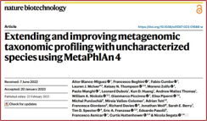
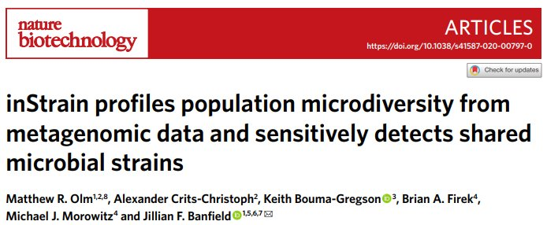


TRIDENT™
Traditional profilers are based on either clade/marker genes or k-mer statistics
Uniquely, TRIDENT™ combines both methods, by introducing a genome-level mapping step.
This validates & precisely estimates coverage, depth & relative abundance for each detected genome.

Slide 11
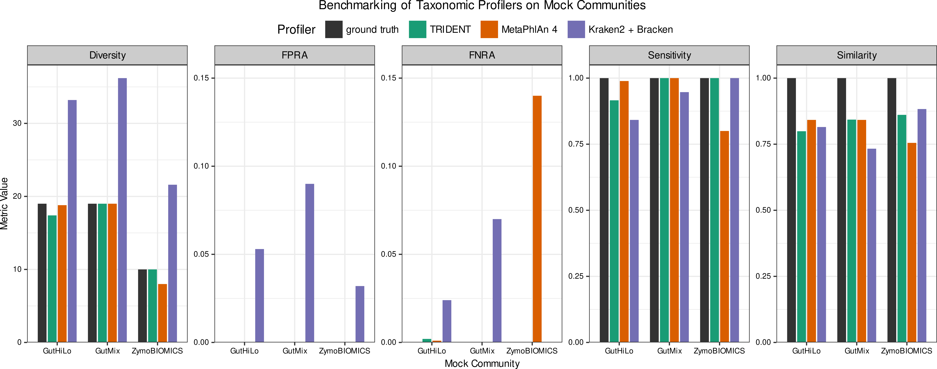
Benchmarking Results
Profilers: TRIDENT™ was evaluated against MetaPhlAn4 and Kraken2 using standardized microbial mock communities
Mock communities:
NIBSC DNA reference reagents: Gut-HiLo-RR (even mix of 19 gut species) & Gut-Mix-RR (staggered abundances)
ZymoBIOMICS microbial standard (8 bacterial & 2 fungal species)
Evaluation metrics: NIBSC standards (diversity, sensitivity, similarity, false-positive/false-negative relative abundances)
Performance: Overall, TRIDENT™ showed superior results compared to competing profilers
We are now rolling out TRIDENT™ for enhanced shotgun analysis of select projects
FPRA/ FNRA - false-positive and false-negative relative abundance

Slide 12
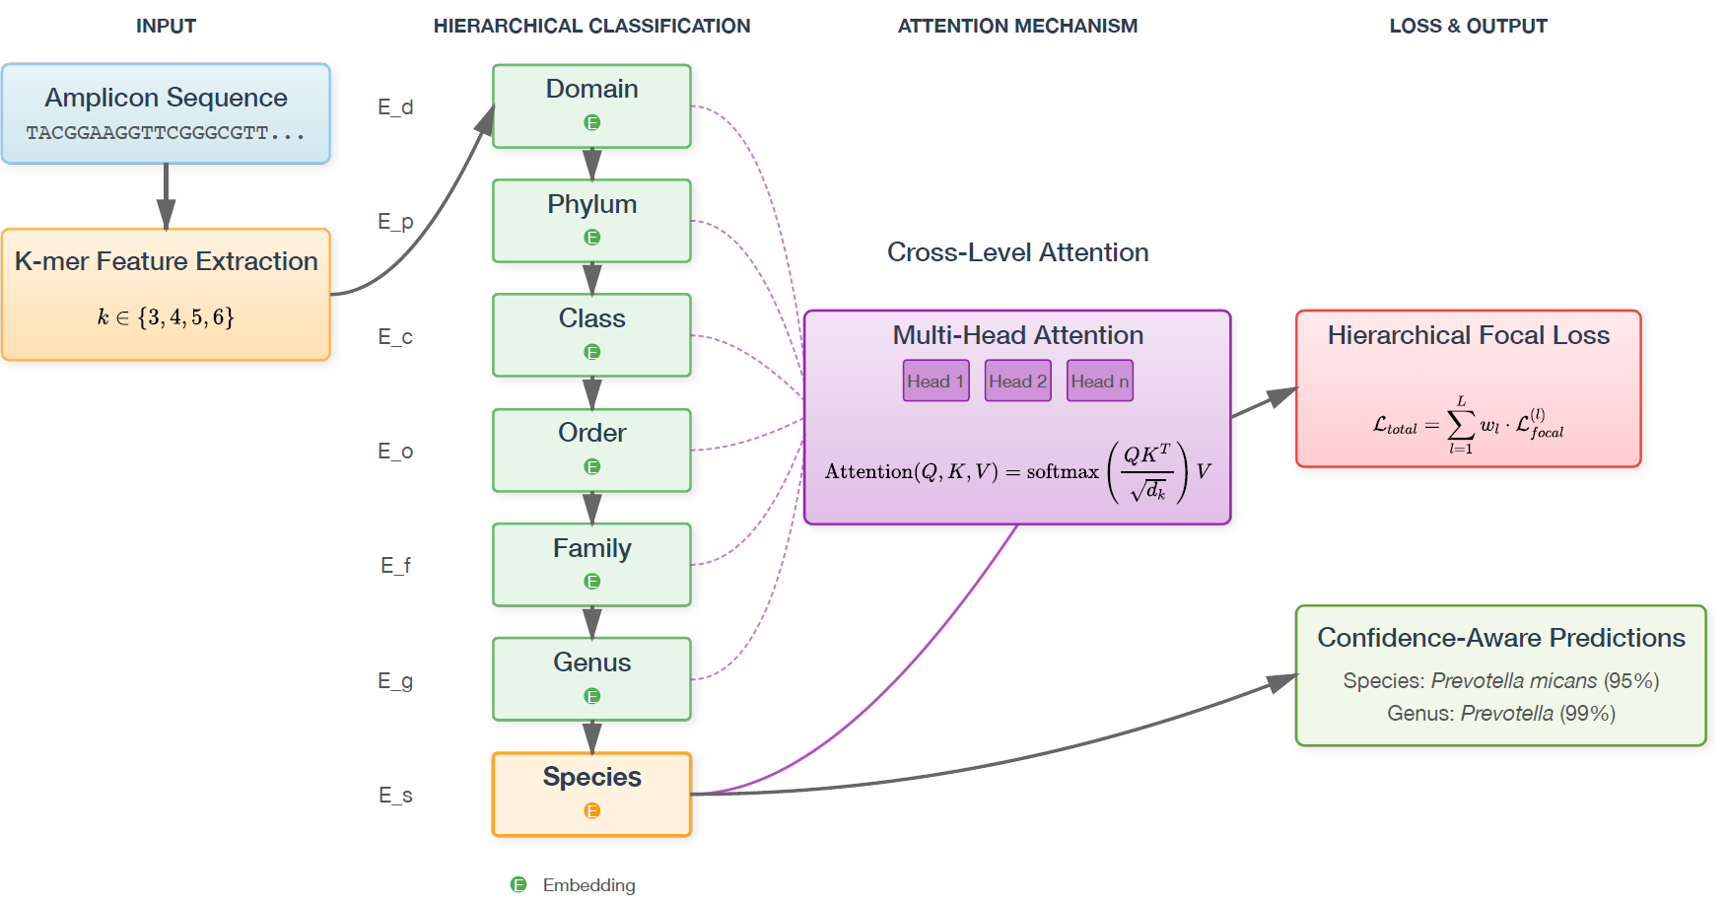
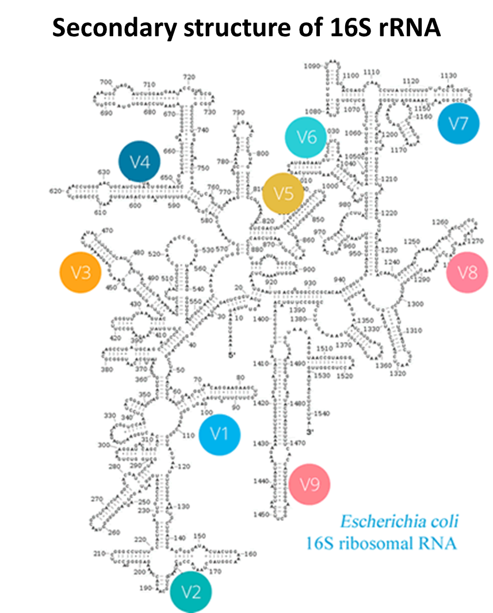
Taxonova
Hierarchical deep learning for microbiome species-level amplicon classification (16S rRNA data)
Up to now, bacterial species-level classification rarely possible from 16S rRNA sequences.
UCC/APC collaboration: Recent development of DL-enabled hierarchical taxonomic classification with attention mechanisms.
Works for both short (eg Illumina) and long reads (eg ONT).
KakaBra et al. Under review 2025

Slide 13
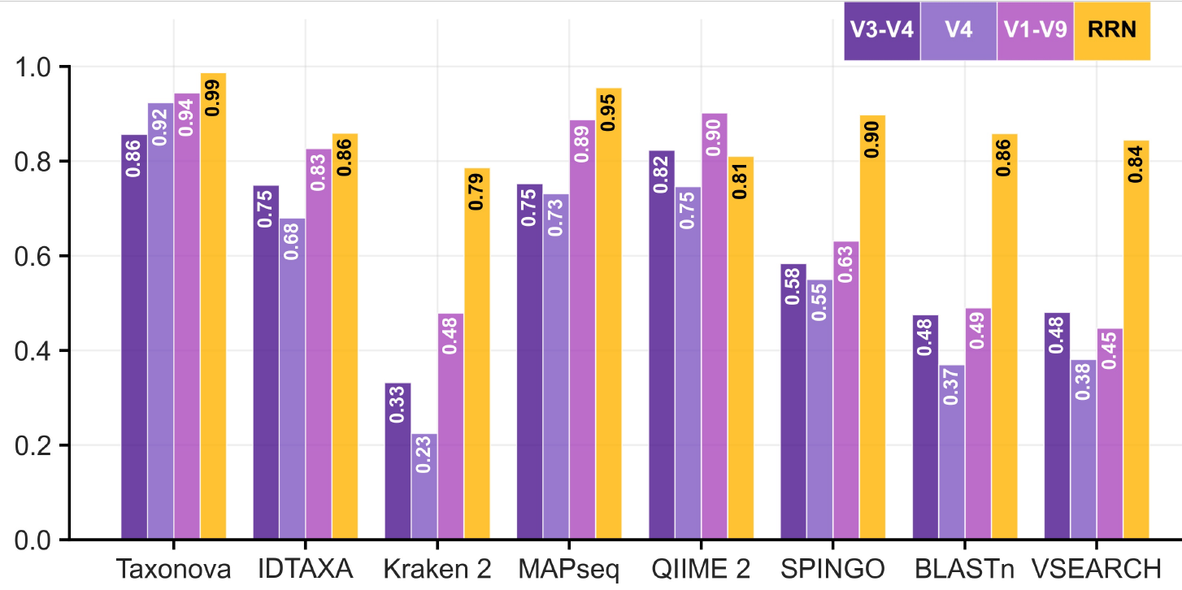
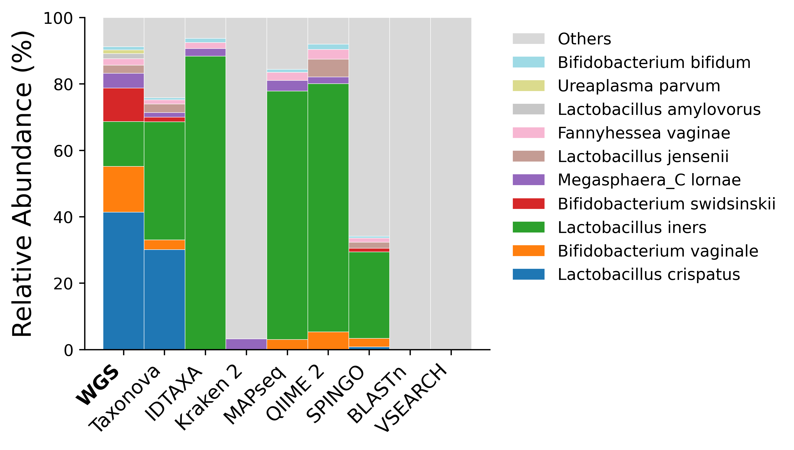
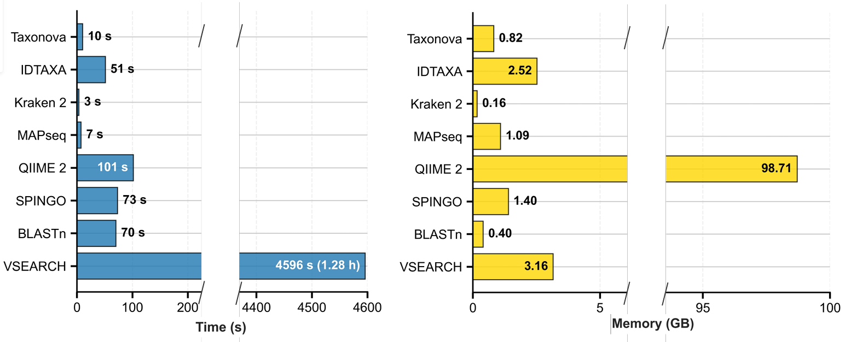
Taxonova
KakaBra et al. Under review 2025
Average F-score
Shotgun
Taxonova outperforms all existing classifiers!
Run time
Memory usage

Slide 14
Enhancing domain knowledge through LLMs
SeqBiome experts in microbiome analysis, with significant domain knowledge across a wide range of niches.
BUT: Impossible to know all relevant literature in all domains.
Large Language Models increasing dominating R&D world-wide.
However, only huge multi-nationals can develop LLMs from scratch.
Fine-tuning LLMs: Additional training of existing LLMs using task-specific datasets and literature.
We are currently fine-tuning LLMs on 1000s peer-reviewed papers in select medical/biological domains (IBD, physical performance, female health etc).
=> Improved interpretation of microbiome findings relevant to clients' needs

Slide 15
Summary / Conclusions
Comprehensive end-to-end microbiome analysis solutions
Advanced capabilities across wet lab, sequencing, and bioinformatics
Proprietary tools (TRIDENT™, Taxonova) enhance accuracy and insight
Personalised reporting supports research, clinical, and individual needs
Ongoing innovation through AI/LLM integration and ISO-driven quality

