Slide 1





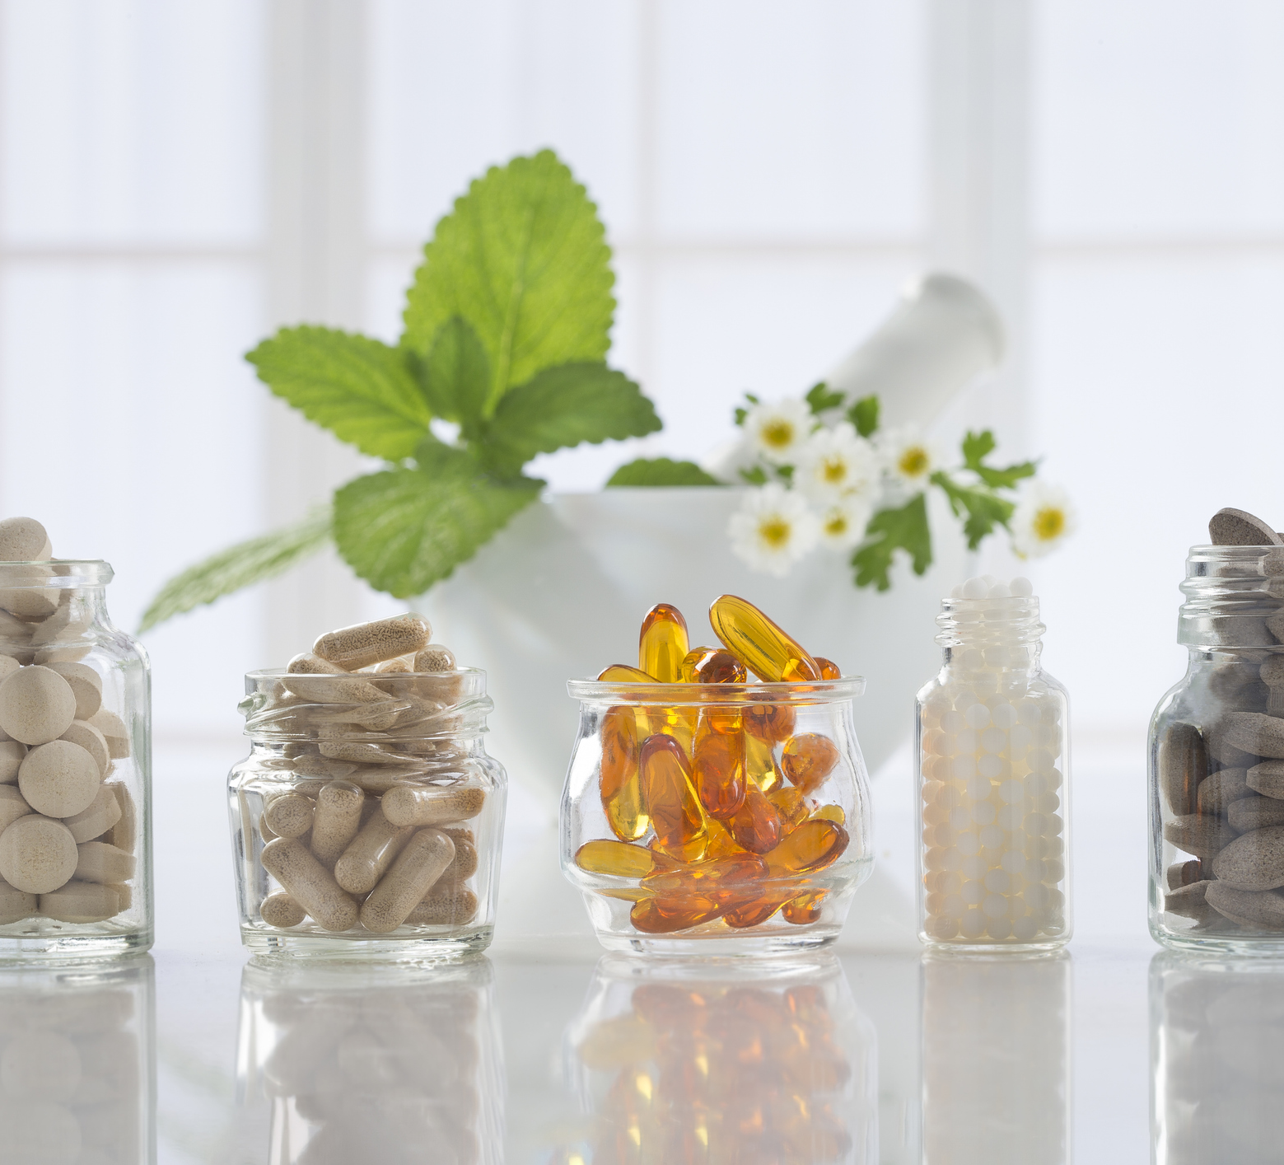
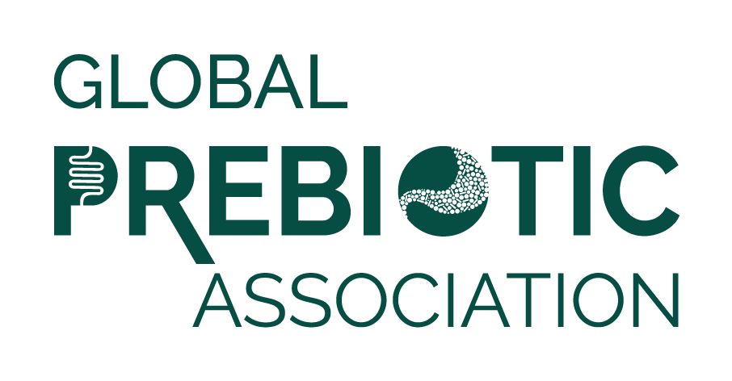
The Clinical Potential of Postbiotics: Evidence, Applications, and Design Considerations
Stephanie-Anne Girard, PhD
Director, Scientific Affairs
SGS Nutrasource
PROUD MEMBER

Slide 2

Speaker
15+ years of natural health product/dietary supplement and pharmaceutical clinical research experience
Education
  PhD in Nutritional Sciences from the University of Florida
  Post–Doctoral degree through an Industrial R&D Fellowship Program from the Natural Sciences and Engineering Research Council of Canada (NSERC) in collaboration with Lallemand Health Solutions.
Director, Scientific Affairs at SGS Nutrasource
  Lead the development of high-quality scientific documents, data interpretation, and clinical trial design, working closely with teams across biostatistics, medical writing, and regulatory affairs.
15+ published scientific articles in peer-reviewed journals
WIN
  Scientific Committee Member
  Webinar Committee Co-Chair
Stephanie-Anne Girard, PhD
Director, Scientific Affairs
SGS Nutrasource

Slide 3
Agenda
What are postbiotics?
Definition
Mechanism of action
Clinical Evidence
Gastrointestinal Health
Metabolic Health
Exercise Performance & Recovery
Skin Health
Pre- vs Pro- vs Post-biotics
Characteristics
Clinical Trial Advantages/Disadvantages
Ongoing Clinical Trials

Slide 4
What are Postbiotics?
A postbiotic is defined as a “preparation of inanimate microorganisms and/or their components that confers a health benefit on the host” (ISAPP, 2021)
3 Core Criteria to qualify as a Postbiotic
  Known Microbes
    Molecular characterization of the progenitor microorganisms (for example, fully annotated genome sequence) to enable accurate identification and screen for potential genes of safety concern
  Inactivation
    Detailed description of the inactivation procedure and the matrix
    Confirmation that inactivation has occurred
  Proven Health Benefit
    Evidence of a health benefit in the host from a controlled, high-quality trial
    Assessment of safety of the postbiotic preparation in the target host for the intended use
Salminen et al 2021 Nat Rev Gastroenterol Hepatol. ISAPP consensus statement. 18(9):649-67. doi: 10.1038/s41575-021-00440-6

Slide 5
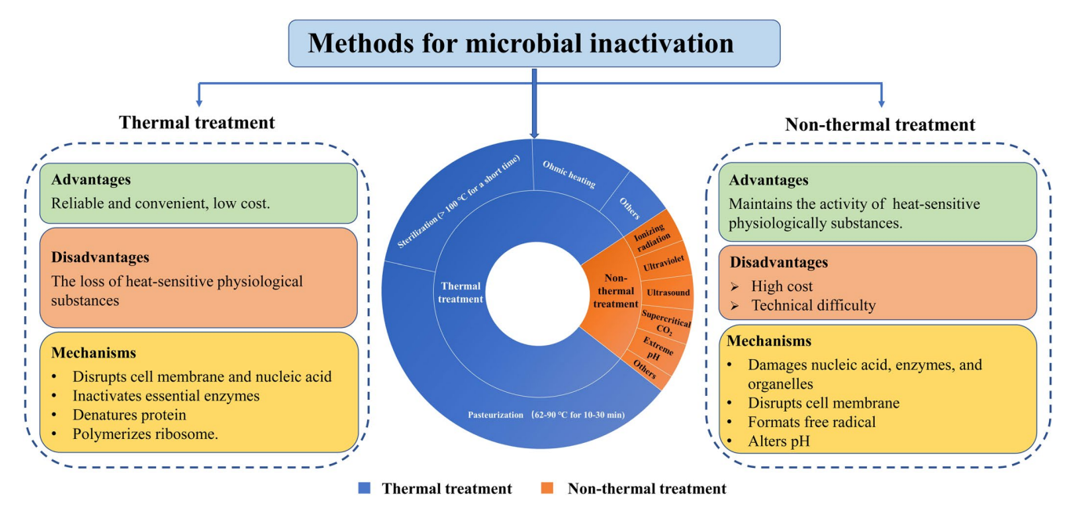
How to obtain Postbiotics?
Inactivation
Zhong et al 2024 Crit Rev Food Sci Nutr
https://pubmed.ncbi.nlm.nih.gov/36537328/

Slide 6
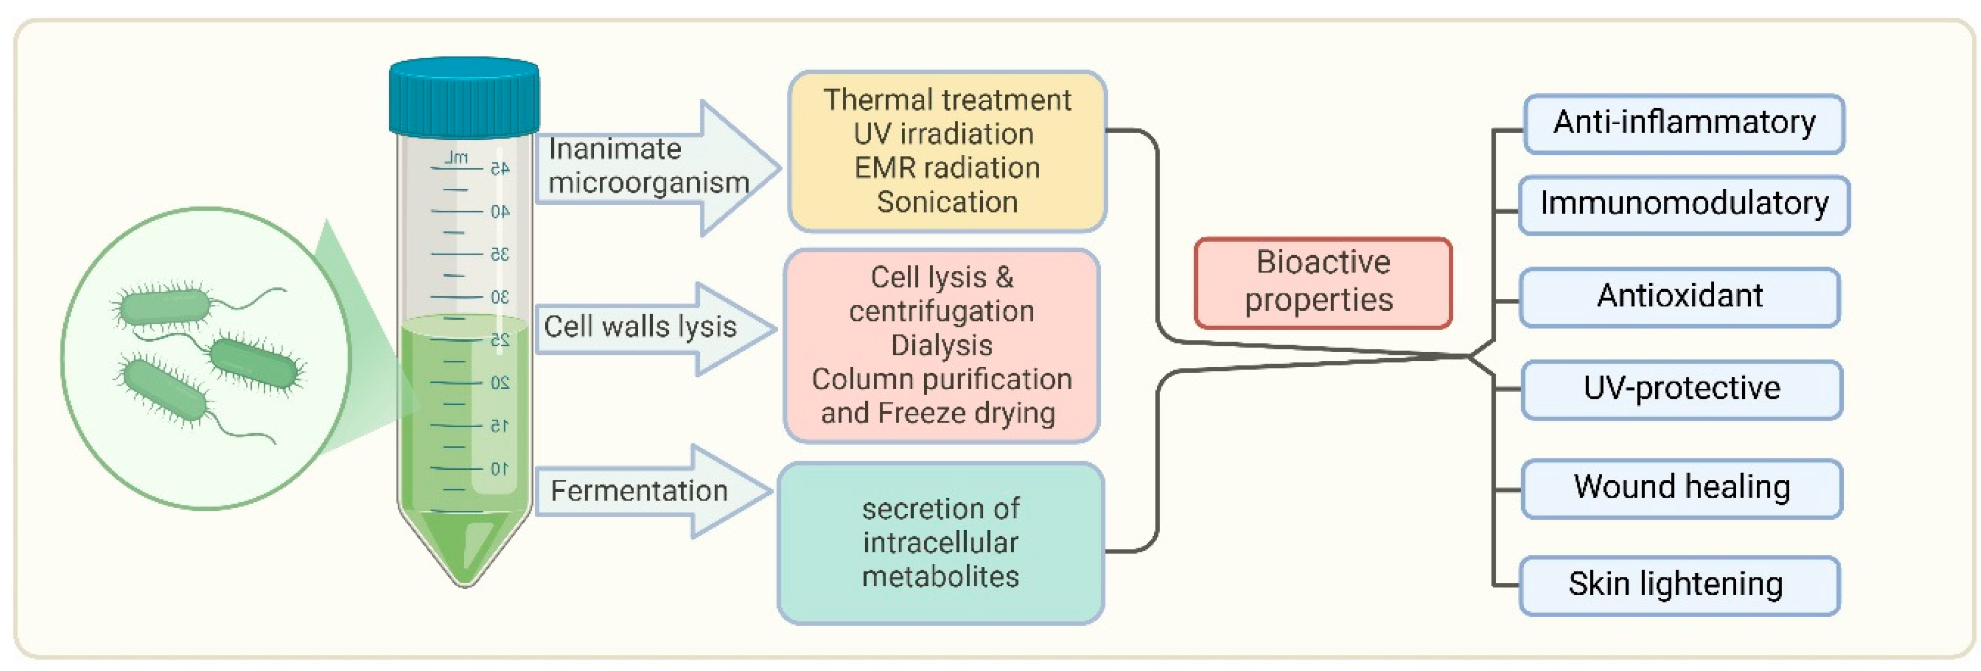
What are Postbiotics?
Prajapati et al 2025 Biomedicines.
https://doi.org/10.3390/biomedicines13040791
Notes:
This diagram illustrates the process of obtaining bioactive properties from microorganisms through various treatments such as thermal treatment, UV irradiation, EMR radiation, sonication, cell wall lysis, and fermentation. Fermentation leads to the secretion of intracellular metabolites that contribute to postbiotic activity. Bioactive properties include diverse therapeutic effects against acne, rosacea, psoriasis, atopic dermatitis, and vitiligo/hyperpigmentation. It also shows immunomodulatory, UV-protective, and wound healing properties. This highlights the promising therapeutic potential of postbiotics in maintaining health and addressing skin-related issues.

Slide 7
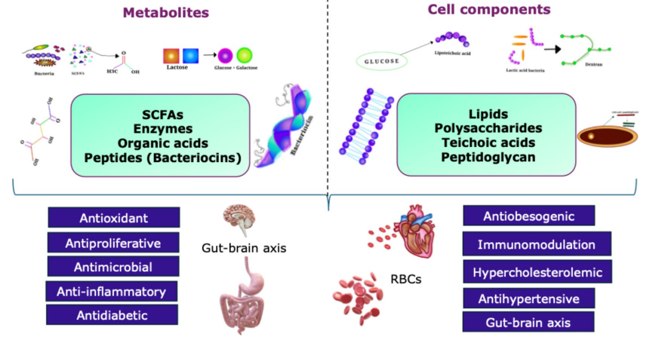
What are Postbiotics?
Categories
Amobonye et al 2025 World J Microbiol Biotechnol
https://doi.org/10.1007/s11274-025-04483-8
Notes:
A large number of in vitro and in vivo studies have demonstrated the ameliorative effects of postbiotics against various health conditions, including infections, cardiovascular diseases, diabetes, hypertension, and skin health. These health benefits are mediated by various mechanisms such as alteration of the gut microbiota, enhancement of immune responses, antiproliferation, antioxidation and the direct induction of apoptosis

Slide 8
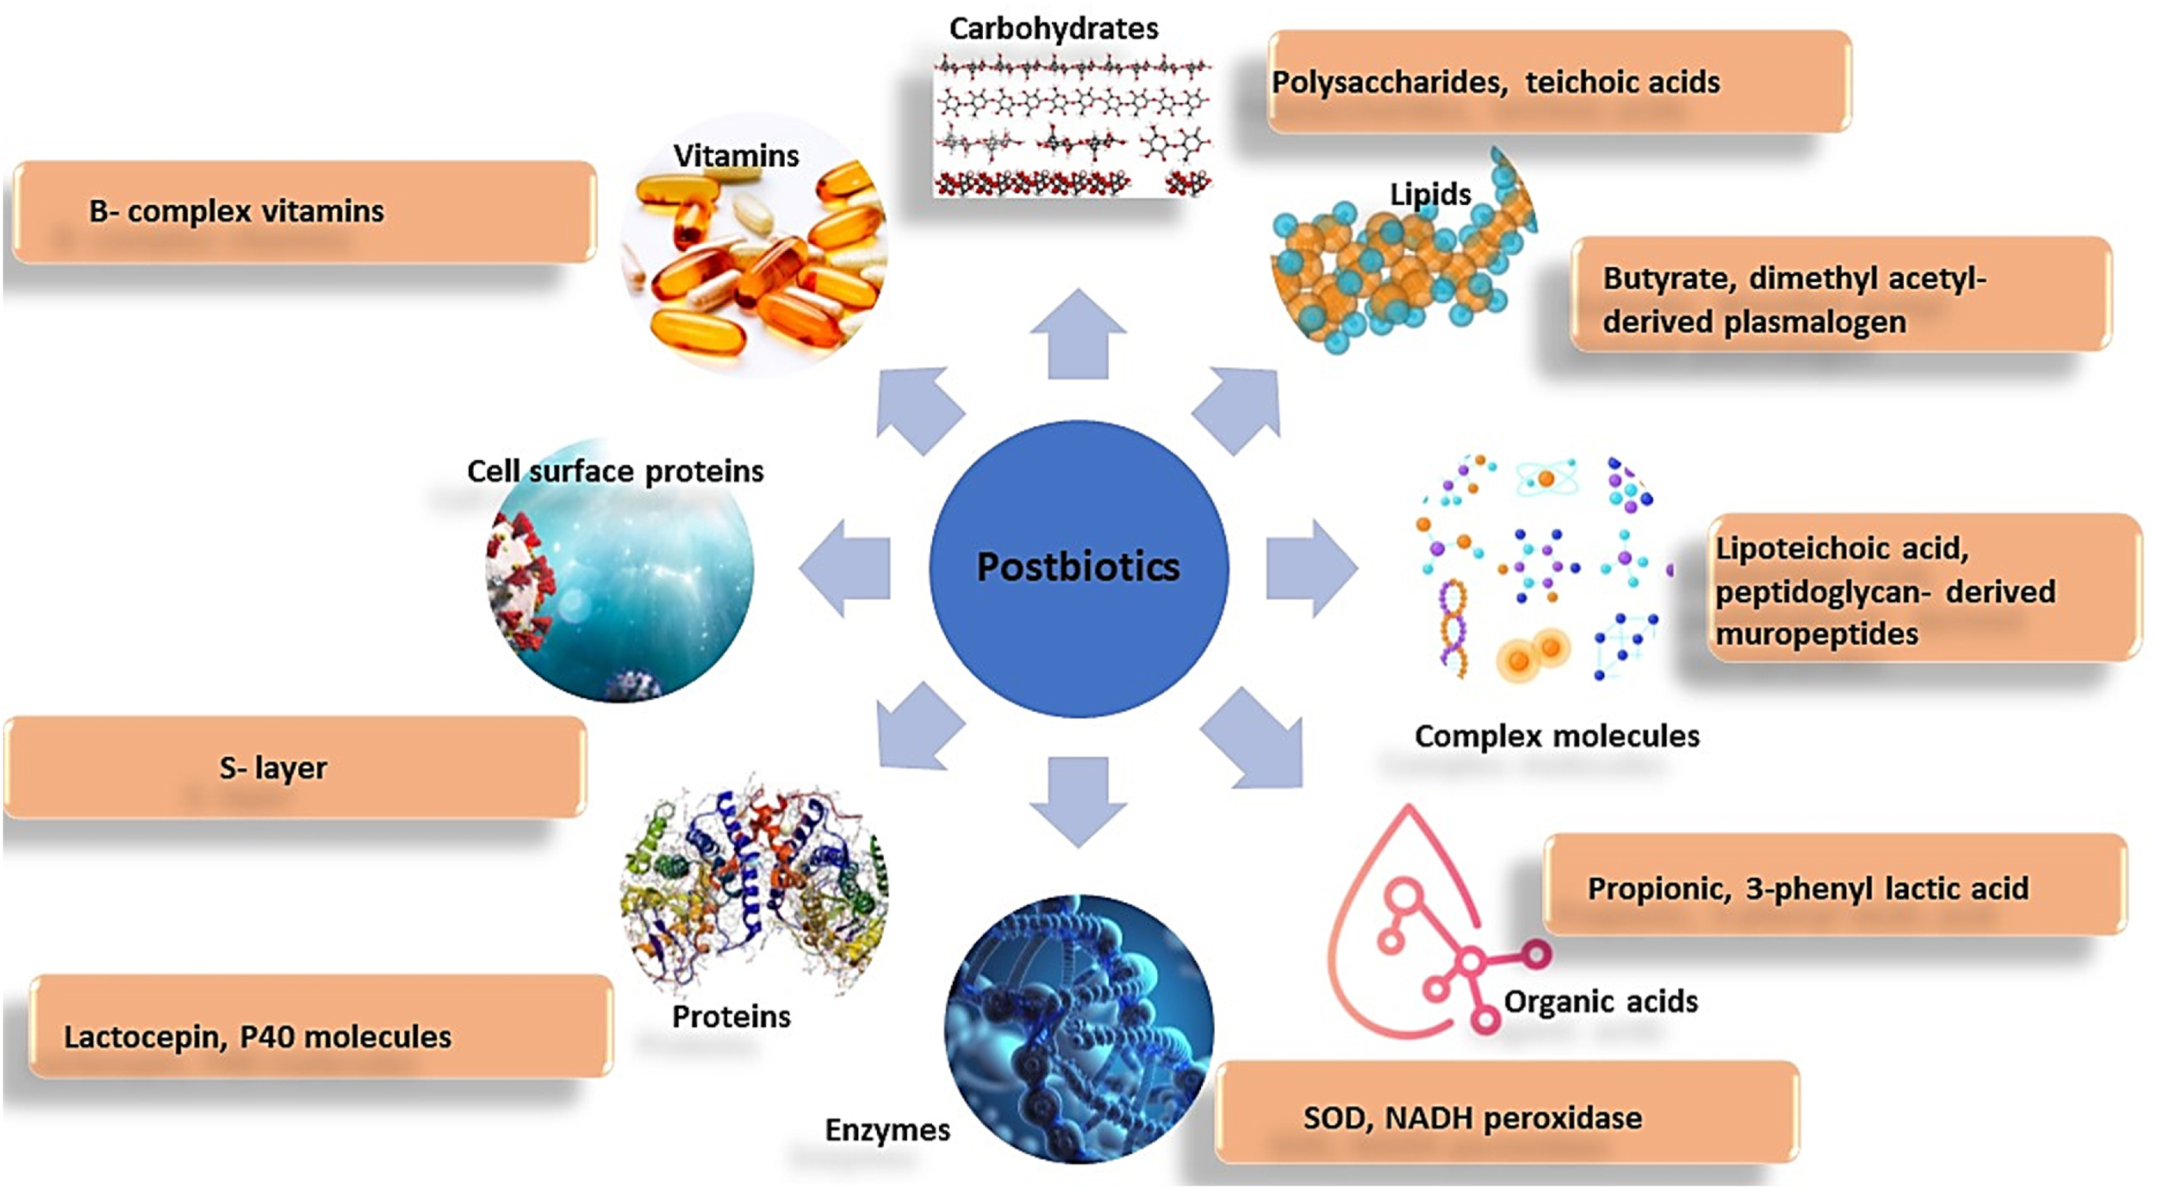
What are Postbiotics?
Rafique et al 2023 J Agriculture Food Research.
https://doi.org/10.1016/j.jafr.2023.100708
Notes:
https://www.sciencedirect.com/science/article/pii/S2666154323002156?via%3Dihub
Postbiotics are categorized into groups based on the elements they include, proteins (such as lactocepin, the p75 molecule), organic acids (such as propionate), lipids (such as butyrate, lactate), carbohydrates (such as teichoic acids), vitamins/cofactors (e.g. B-group vitamins) and complex molecules such as lipoteichoic acids, or simply by their physiological functions that include anti-inflammatory, anti-hypertensive, immunomodulation, hypocholesterolemic, anti-proliferative, antiobesogenic and antioxidant effects.

Slide 9
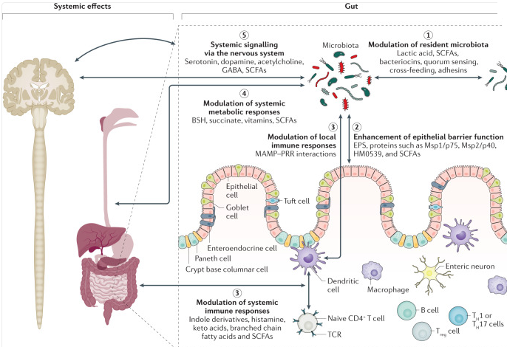
Mechanisms of Action
① Direct antimicrobial activity
Compete with adhesion sites on gut lining
② Help promote tight junctions between the cells
③ Binding of MPs to TLR promoting healing or anti-inflammatory
④ Functional enzymes (BSH) influencing BA metabolism (cholesterol, blood sugar)
⑤ Produce or stimulate the release of neuroactive compounds (serotonin, dopamine, GABA)
Salminen et al 2021 Nat Rev Gastroenterol Hepatol. ISAPP consensus statement. 18(9):649-67. doi: 10.1038/s41575-021-00440-6

Slide 10
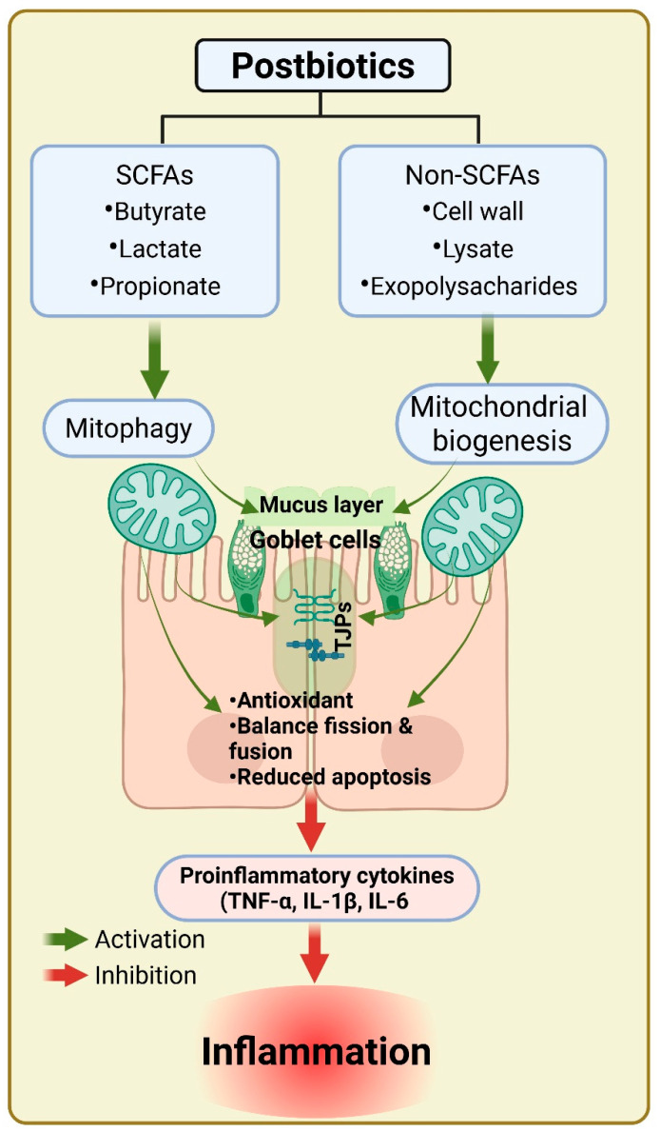
Gastrointestinal Health
Mitochondrial dysfunction linked to
  Chronic inflammation
  Impaired barrier function
  Increased gastrointestinal (GI) permeability
Compromised mitochondrial function is implicated in many GI disorders
  IBS
  Celiac disease
  Food allergy and food intolerance
  Functional dyspepsia
  Gastroparesis & motility disorders
  SIBO (secondary link)
  Colorectal cancer (mechanistic link)
Postbiotics (e.g. SCFAs) have been shown to target mitochondrial function and reduce inflammation leading to intestinal homeostasis.
Prajapati et al 2025 Biomolecules. 15(7):954. doi: 10.3390/biom15070954
Notes:
https://pmc.ncbi.nlm.nih.gov/articles/PMC12292398/#sec4-biomolecules-15-00954
https://pmc.ncbi.nlm.nih.gov/articles/PMC11464740/

Slide 11
Gastrointestinal Health
Disease
Chronic diarrhea (Guo et al 2024)
  Randomized, DB, placebo-controlled crossover trial in young adults (n=69)
  Postbiotic product (including L. paracasei, L. plantarum p-8, B. animalis subsp. Lactis V9) and placebo for 3 weeks each, 14-day washout
  Sig improvements in bowel frequency, Bristol Stool Form Scale, anxiety, non-sig increase beneficial bacteria
IBS-D (Srivastava et al 2024)
  Randomized, DB, placebo-controlled trial in adults (n=200)
  Probiotic, Postbiotic, or placebo daily for 12 weeks (Bifidobacterium longum)
  Both sig improved IBS-SSS from baseline compared to placebo, QoL, stool consistency, and anxiety
IBD (Facchin et al 2020)
  Randomized, DB placebo-controlled trial in adults (Crohn’s Disease n=19; Ulcerative Colitis n=30)
  Microencapsulated sodium butyrate or placebo for 8 weeks
  Gut microbiota of patients altered (non-sig), species producing SCFA increased in UC (Lachnospiraceae spp.) and butyrogenic bacteria increased in CD (Butyricicoccus)
Notes:
https://pmc.ncbi.nlm.nih.gov/articles/PMC11352714/#s0001
https://pmc.ncbi.nlm.nih.gov/articles/PMC11028008/
https://pmc.ncbi.nlm.nih.gov/articles/PMC7583468/

Slide 12
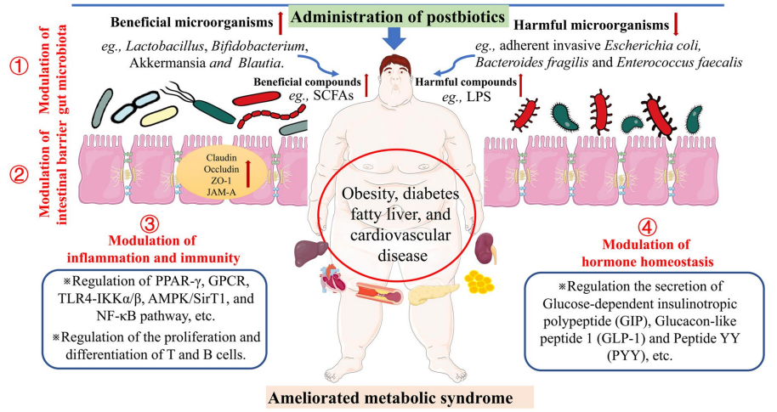
Metabolic Health
Metabolic Health is influenced by microbiota composition.
Bacterial metabolites (e.g. SCFAs) can impact intestinal health
  Energy source
  Signaling molecules affecting gut-brain axis and immune systems
Postbiotics shown to regulate gut microbiota, enhance intestinal barrier function, and modulate inflammatory/immune processes and hormones associated with the characteristics of metabolic syndrome and associated metabolic diseases.
Zhong et al 2024 Crit Rev Food Sci Nutr
https://pubmed.ncbi.nlm.nih.gov/36537328/
Notes:
https://pmc.ncbi.nlm.nih.gov/articles/PMC3266401/
https://www.nature.com/articles/s41598-019-48775-0
https://www.sciencedirect.com/science/article/pii/S000629522500053X
New reference (official link - https://www.tandfonline.com/doi/full/10.1080/10408398.2022.2158174)
Actual paper - https://www.researchgate.net/profile/Tao-Wang-17/publication/366442624_Recent_advances_and_potentiality_of_postbiotics_in_the_food_industry_Composition_inactivation_methods_current_applications_in_metabolic_syndrome_and_future_trends/links/63a51d8e03aad5368e334f47/Recent-advances-and-potentiality-of-postbiotics-in-the-food-industry-Composition-inactivation-methods-current-applications-in-metabolic-syndrome-and-future-trends.pdf

Slide 13
Metabolic Health
Obesity
Population | Intervention | Study Design | Outcome | Reference
Obese children (5-17 y.o., BMI >95%-ile), n=54 | Std care plus sodium butyrate (20mg/kg body weight/day) | Randomized, quad-blind placebo, oral ingestion for 6 months | Significantly greater decrease in BMI with butyrate | Coppola et al 2022 NCT04620057
Obese adults, n=50 | Hypo-caloric diet plus sodium butyrate | Randomized, triple-blind placebo, oral ingestion for 8 weeks | Significant decrease in weight, BMI, WC, fasting blood sugar and LDL-C. Significant increase in HDL-C | Amiri et al 2024 IRCT20190303042905N2
Notes:
https://pmc.ncbi.nlm.nih.gov/articles/PMC9855301/
https://www.nature.com/articles/s41430-024-01512-x

Slide 14
Exercise Performance and Recovery
Kerksick et al 2024 – Systematic review of double-blind, placebo-controlled RCTs on outcomes related to exercise performance and recovery
  Search terms (PubMed & Google Scholar)
    paraprobiotics
    Tyndallized probiotics
    ghost biotics
    heat-killed probiotics
    inactivated probiotics
    nonviable probiotics
    exercise
    exercise performance
    recovery
  9 manuscripts and 2 abstracts
  Supplementation ranged from 13 days to 12 weeks
  Sample size n=16 to 105/study
  Early evidence to suggest support mood, reduce fatigue, and increase athlete readiness
  Limitations include short supplementation periods and diverse designs/outcomes
Notes:
https://pmc.ncbi.nlm.nih.gov/articles/PMC10933997/

Slide 15
Exercise Performance and Recovery
Studies have directly compared pro- (live cells) with postbiotic (heat-killed) of the same bacterial strain
  Lacticaseibacillus paracasei PS23 for 6 weeks (Lee et al., 2022)
  Both L-PS23 and HK-PS23
  sig slowed loss of muscle strength after muscle injury
  sig reduced the production of markers of muscle damage and inflammation
  Lactiplantibacillus plantarum TWK10 for 6 weeks (Lee et al., 2022)
  Both TWK10 and TWK10-HK
  improved exercise performance
  attenuated exercise-induced inflammatory responses
  Viable TWK10 was highly effective in regulating body composition
Notes:
https://pmc.ncbi.nlm.nih.gov/articles/PMC10933997/

Slide 16
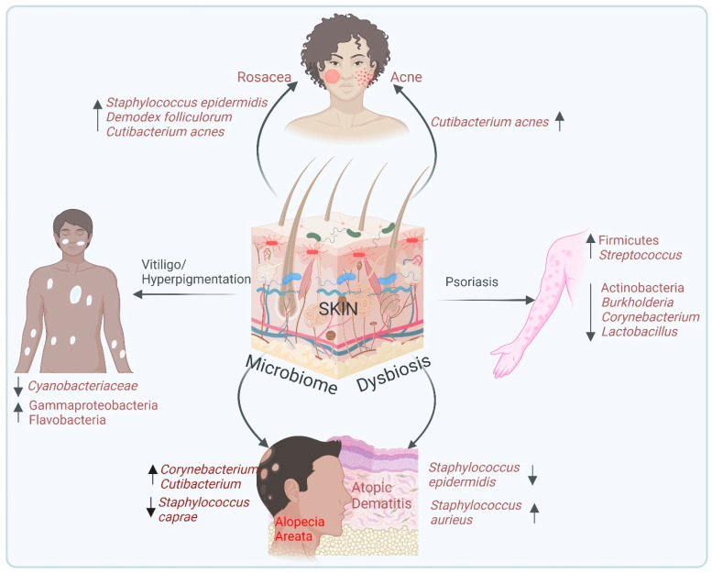
Skin Health
Skin Conditions
Skin microbiome dysbiosis is implicated in many conditions.
Postbiotics may retain the beneficial properties of probiotics - promoting a healthy skin environment - provide immediate functional benefit in stable topical forms
  Anti-inflammatory and antioxidant effects
  Strengthen skin barrier
  Support growth of beneficial bacteria while inhibit pathogenic colonization
Prajapati et al 2025 Biomolecules. 15(7):954. doi: 10.3390/biom15070954
Notes:
https://pmc.ncbi.nlm.nih.gov/articles/PMC12025169/

Slide 17
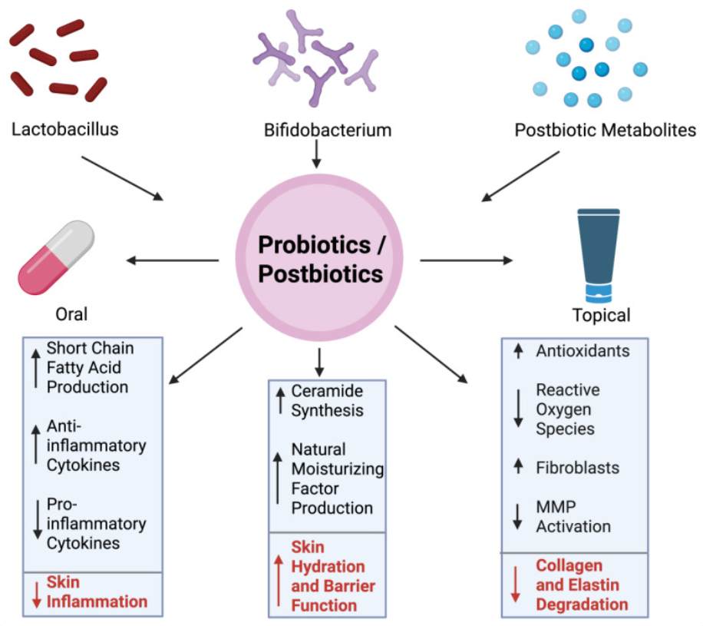
Skin Health
Healthy Aging
 | Postbiotic | Study Design | Outcome
Kim et al 2023 | Epidermidibacterium Keratini ferment filtrate of Actinobacteria in a cream | Split-face design with placebo, cream 2x/day, 3 weeks (n=15) | Sig. altered skin microbiota Sig. improved barrier function, elasticity
Catic et al 2022 | Postbiotic blend of metabolites from Lactiplantibacillus casei, L. plantarum, S. thermophilus in cream | Split-face design with placebo, cream 2x/day, 4 weeks (n=50) | Sig. improved hydration, elasticity, Sig. reduced pore size/wrinkles
Notes:
Mechanism of wrinkle reduction
https://pmc.ncbi.nlm.nih.gov/articles/PMC12564825/#sec5-ijms-26-10022
https://pmc.ncbi.nlm.nih.gov/articles/PMC10003698/ (Kim study)
https://pmc.ncbi.nlm.nih.gov/articles/PMC9233453/ (Catic study)

Slide 18
Skin Health
Opportunities
Topical and oral flexibility: Postbiotics can be incorporated into creams, serums, or capsules without stability issues.
Postbiotics offer an alternative to traditional topical treatments, systemic steroids, and antimicrobial agents
  Traditional treatments can be difficult to administer, difficult to tolerate, and have side effects which include altering the composition of the skin microbiome (i.e., alopecia areata, psoriasis, atopic dermatitis)
To date, clinical trials and efficacy studies are limited.
Notes:
https://pmc.ncbi.nlm.nih.gov/articles/PMC12295770/#sec4-ijms-26-06745

Slide 19
Children
Opportunities
While much more research is needed, preliminary evidence suggests that postbiotics could be promising therapeutics for children.
Condition | Intervention | Study Design | Outcome | Reference
Atopic dermatitis – children | L-92 (derived from heat-killed Lactobacillus acidophilus) | Randomized, double-blind placebo, oral ingestion 8 weeks | Sig. symptom improvement by regulation Th1/Th2 immune axis | Torii et al 2011
Diarrhea in children (Systematic review, 4 RCTs) | Heat-killed Lactobacillus acidophilus | Randomized, placebo-controlled | Decreased duration of diarrhea | Malagon-Rojas et al 2020
Healthy children (age 4-12) attending school/daycare (n=256) | Postbiotic derived from yeast fermentate | Randomized, double-blind placebo, oral ingestion 12 weeks | Supplementation significantly lowered cold/flu symptom severity (not incidence) and medication use | Singh et al 2024
Notes:
https://pubmed.ncbi.nlm.nih.gov/20861645/
https://pmc.ncbi.nlm.nih.gov/articles/PMC11772231/
https://pmc.ncbi.nlm.nih.gov/articles/PMC7071176/

Slide 20
Ongoing Clinical Trials
Active, not recruiting OR Recruiting OR Not yet recruiting
clinicaltrials.gov
Search conducted on 12NOV2025
Intervention/treatment: Postbiotic OR Postbiotics OR “Postbiotics Supplementation” OR postbiotic OR postbiotics OR “postbiotics supplementation” OR “Postbiotic Supplementation” OR “postbiotic supplementation”
Results: 29 Clinical Studies

Slide 21
Ongoing Clinical Trials
Health Segments
Gastrointestinal (GI) Health
SIBO
GI Symptoms
Overweight/Obesity
Body Fat
Mood
Mood Disorder
Healthy Aging
Stress/Anxiety/Cognition
IBS
IBS-D
Ulcerative colitis/Microbiota
Metabolism (GIP, GLP-1, PYY)
Weight Loss
Glucose Control
Adiposity/Glucose Metabolism (CHILDREN)
Body Composition
Autism (CHILDREN)
Cognition
Hemodialysis
Grip Strength
Cancer
Cachexia
Immunity
Allergic Rhinitis
Skin
Atopic Dermatitis
Women’s Health
PCOS
Xerosis cutis
Gastrointestinal Health
Vaginal Candidiasis
Melanoma Metastatic
Colon Cancer Dysbiosis
Wound Healing
Atopic Dermatitis (CHILDREN)
Exercise
Oxidative Stress

Slide 22
Pre- vs Pro- vs Post-biotics
 | Stability | Quantification / Dosing | Safety Assessment
Prebiotics | Typically high stability (substrates are chemically stable) | Easier to dose by weight or grams; quantification straightforward | Generally good safety (substrate fibers)
Probiotics | Stability more challenging: viability must be maintained through shelf-life and stomach transit Sensitive to O₂, Heat, Moisture… | Quantified by CFU or viability count; dosing often defined in CFU | Safety acceptable for many strains, but live microbes carry risk (especially in immunocompromised)
Postbiotics | Very high stability (no live cells to maintain) Can be stored for years at room temperature | Quantification more complex: may involve microbial cell fragments, metabolites, or inactivated microbes; no single gold standard | Potentially superior safety profile (no risk of replication) but still requires assessment (LPS from Gram negative bacteria)
Salminen et al 2021. ISAPP consensus statement on the definition and scope of postbiotics. Nat Rev Gastroenterol Hepatol. 18(9):649-67. https://doi.org/10.1038/s41575-021-00440-6
Mishra et al 2024. Postbiotics: the new horizons of microbial functional bioactive compounds in food preservation and security. Food Production, Processing and Nutrition. 6(28). https://fppn.biomedcentral.com/articles/10.1186/s43014-023-00200-w?utm
Vinderola et al 2025. Postbiotics: a perspective on their quantification. Front Nutr Sec Nutr Microbes. 12. https://doi.org/10.3389/fnut.2025.1582733

Slide 23
Pre- vs Pro- vs Post-biotics
 | Clinical-Trial Advantages | Clinical-Trial Disadvantages/Considerations
Prebiotics | Good for screening dose-response in healthy volunteers Less regulatory complexity | Indirect mechanism (relies on host microbiota) Interindividual microbiome variability may reduce effect size Harder to attribute effect directly to ingredient rather than microbiome changes
Probiotics | Direct mechanism (live microbe) allows mechanistic biomarkers Established framework for GI indications | Viability drops over time; formulation and shipping logistics are complex Need to confirm survival Regulatory scrutiny (live organism)
Postbiotics | Great for formulation simplicity and shelf-life Reduced complexity for blinding/placebo matching Better control of dose and reproducibility Good for populations where live microbes are contraindicated (elderly, immunocompromised) | Field is newer; fewer large human trials Quantification/dose standardization less mature Mechanism may be more indirect or less well understood Regulatory pathway still be evolving
Salminen et al 2021. ISAPP consensus statement on the definition and scope of postbiotics. Nat Rev Gastroenterol Hepatol. 18(9):649-67. https://doi.org/10.1038/s41575-021-00440-6
Mishra et al 2024. Postbiotics: the new horizons of microbial functional bioactive compounds in food preservation and security. Food Production, Processing and Nutrition. 6(28). https://fppn.biomedcentral.com/articles/10.1186/s43014-023-00200-w?utm
Vinderola et al 2025. Postbiotics: a perspective on their quantification. Front Nutr Sec Nutr Microbes. 12. https://doi.org/10.3389/fnut.2025.1582733

Slide 24
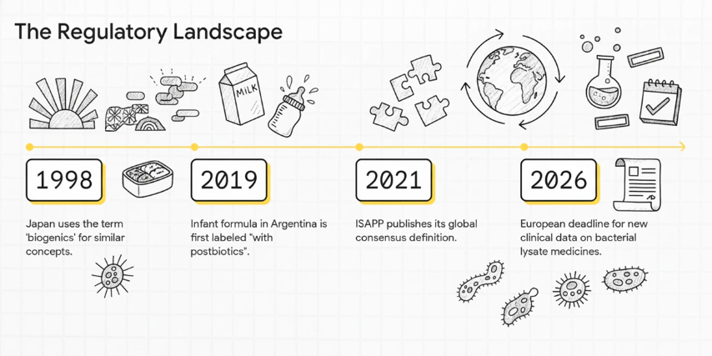
Regulatory Landscape

Slide 25

Key Considerations for Postbiotics Clinical Trials in Canada
No dedicated Health Canada (HC) guidance specifically addressing postbiotics as NHPs or foods.
Currently, there are no licensed NHPs with postbiotic claims. However, there are 10 licensed products that include the word “postbiotic” in their brand name.
EpiCor® a dried yeast fermentate from Saccharomyces cerevisiae has been licensed in Canada with multiple NHP claims (immune/digestive support) but does not include postbiotic claims.
According to HC Probiotic Monograph, non-viable probiotics (e.g., heat-killed, inactivated, thermostabilized) are excluded from the monograph and the compendial application process.
For clinical trials with postbiotics, consult HC early via pre-CTA meeting to confirm product classification (i.e., NHP, food, or drug) since classification dictates submission type and evidence requirements.
Due to the lack of regulatory guidance, it is critical to ensure that the desired claims are adequately supported by appropriate endpoints. Which is why it is so valuable to seek guidance early while designing the clinical trial.

Slide 26

Key Considerations for Postbiotics Clinical Trials in USA
No FDA or FTC guidance specific to postbiotics in foods or dietary supplements.
Use of the term “postbiotic” is growing: 27 labels in the voluntary Dietary Supplement Label Database; >1,000 products on Amazon uses the word.
Several postbiotic NDIs submitted; some products (e.g., EpiCor®) avoid the term and focus on immune-support claims.
Structure/Function claims must be substantiated in healthy populations; data from diseased groups cannot be extrapolated.
No National Advertising Division cases referencing “postbiotic,” suggesting limited challenge history to date.
FTC expects specific, benefit-focused claims; use of “postbiotic” should be supported by evidence demonstrating a clear consumer health benefit.
Notes:
The FDA and FTC have not provided any guidance on the regulation/substantiation of postbiotics, either as foods or supplements.
As there is no registration/notification of dietary supplements in the USA, we are not able to confirm how many products using the word “postbiotic” are on the market in the US, however there are 27 labels that use this word in the Dietary Supplement Label Database which is a voluntary database, and over 1,000 products on Amazon.com that use the word.
The US has had NDIs submitted for postbiotics. On the US market, Epicor products don’t always use the word “postbiotics”, but typically use immune support claims
For the substantiation of structure/function claims on US dietary supplements, ideally clinical trials would not be done on diseased populations. Postbiotic foods and dietary supplements are intended for healthy populations, and as such are not meant to treat, cure, or prevent disease. Extrapolating data from diseased populations to the general population that the DS market is intended for leaves a lot of room for the challenge of the claim substantiation.
There are no instances of the word “Postbiotic” in the National Advertising Division’s website, indicating that to date, there have not been any challenge on this general claim in the industry self-regulation space.
While FTC has never commented on the word “postbiotic”, they typically recommend being more specific with claims in order to be clear in messaging for consumers. For using the word “postbiotic”, substantiation should show that the ingredient infers a health benefit to the consumer. The FTC would recommend that the specific health benefit is described on the label/advertising.

Slide 27
Take Aways
The potential of postbiotics is significant
Early clinical data showing promising effects
However,
The field is still emerging, and our understanding continues to evolve
Robust, well-designed human clinical trials are still needed to fully validate efficacy and mechanisms

Slide 28
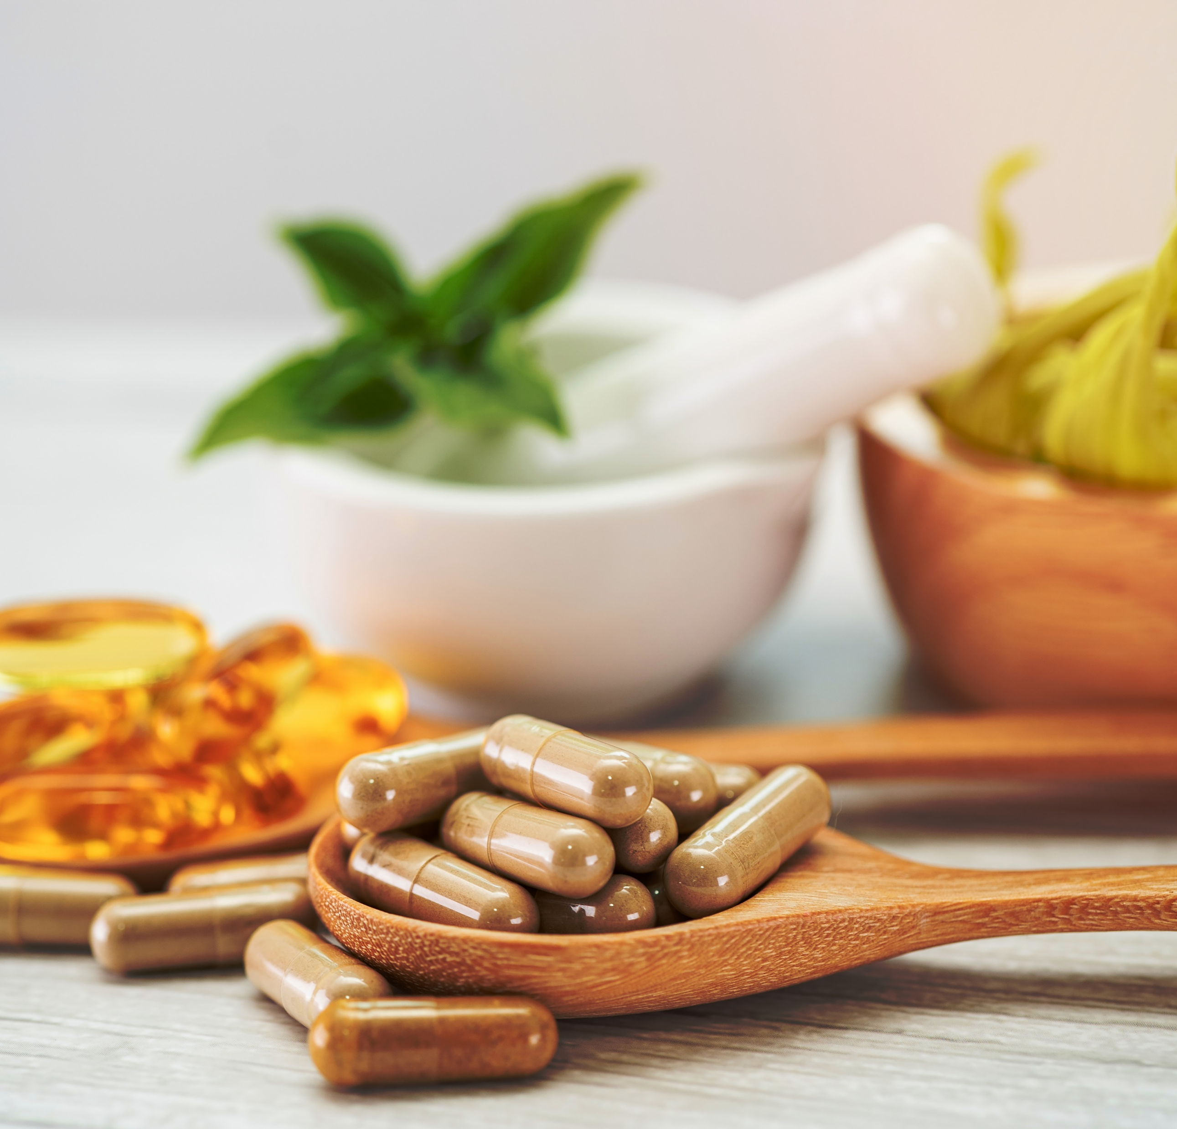
For more information, please contact:
Stephanie-Anne Girard, PhD
Director, Scientific Affairs
sgirard@nutrasource.ca

Slide 29
Trial design implications
For your CRO/site, postbiotic trials have clear design advantages:
Shorter duration studies (often 4–8 weeks) due to rapid measurable outcomes.
Broader inclusion criteria, including immunocompromised or pediatric groups.
Endpoints easily linked to mechanism: cytokine profiles, HRV, cortisol, sleep indices, skin hydration/barrier function, SCFA panels, or intestinal permeability markers.

Slide 30
Immunomodulation and Inflammation
Why Postbiotics Excel
Defined composition: Postbiotics deliver specific, measurable immunomodulatory molecules (e.g., SCFAs, peptidoglycans, EPS, cell wall fractions, lipoteichoic acid), avoiding the variability of live strain colonization.
Regulatory advantage: Because they are non-viable, they sidestep many safety concerns linked to live organisms (e.g., in immunocompromised participants, children, elderly).
Clinical edge: More consistent dose–response, easier placebo control, and measurable mechanism (cytokines, CRP, IL-6, TNF-α, etc.).
Clinical niches:
Atopic dermatitis, allergic rhinitis, mild autoimmune modulation
Post-viral or vaccine response support (e.g., immune readiness, mucosal IgA)
IBD/IBS flare prevention (less risk of exacerbation than live probiotics)

Slide 31
Examples
Sawada et al 2016
  Tendency toward constipation or frequent bowel movements (otherwise healthy)
  DB placebo controlled – ingestion of heat-inactivated strain fermented milk-based beverage or acidified milk-based placebo for 3 weeks with 2-week follow-up
  Stool characteristics improved, SCFA concentration sig increased
Henn et al 2020
  Phase 1b DB of an oral formulation of Firmicutes spores in UC, weekly and daily for 8 weeks, 4-week follow-up
  Safe and tolerated, Vancomycin pretreatment more effective for remission induction

Slide 32
Gut barrier and intestinal permeability
Why Postbiotics Excel
Direct epithelial signaling: Many postbiotics (e.g., heat-killed L. plantarum, B. breve fractions) upregulate tight-junction proteins (ZO-1, occludin) directly.
Controlled composition: Unlike probiotics, which depend on host colonization, postbiotics can target enterocytes reproducibly.
Complementary to pre/probiotics: Ideal for short-term or adjunctive interventions where live strains might not survive gastric transit.
Clinical niches:
“Leaky gut”/intestinal permeability studies using lactulose:mannitol or LBP/FABP2 biomarkers
Metabolic endotoxemia and low-grade inflammation in overweight populations
Adjunct to NSAID or antibiotic recovery

Slide 33
Metabolic health and GLP-1 linked studies
Why Postbiotics Excel
Certain bacterial metabolites (e.g., SCFAs, propionate, acetate) influence GLP-1 secretion, insulin sensitivity, and appetite signaling directly.
They avoid the variability of microbiome colonization and allow precise pharmacodynamic correlations.
Clinical niches:
Early metabolic dysfunction / pre-diabetes
Weight management programs (adjunctive to dietary intervention)
Post-antibiotic metabolic reset

Slide 34
Skin health and atopic conditions
Why Postbiotics Excel
Topical and oral flexibility: Postbiotics can be incorporated into creams, serums, or capsules without stability issues.
Defined anti-inflammatory peptides and short-chain fatty acids improve barrier function and microbiome balance even without live cells.
Clinical niches:
Eczema, acne, and sensitive skin formulations
Post-antibiotic or post-retinoid recovery
Cosmetic microbiome care (claims easier to substantiate with non-viable lysates)

Slide 35
Skin Health
Condition | Treatment | Study Design | Outcome | Reference
Acne – mild to moderate | LactoSporin (derived from Bacillus coagulans) | Open label, randomized, comparator (benzoyl peroxide) for 3 weeks | Reduced oiliness, acne, and redness | Majeed et al 2020 https://www.mdpi.com/2079-9284/7/3/70
Alopecia areata | Various postbiotics in a gel | DB, randomized, placebo, application daily for 3 months | 47.5% vs 5% experienced complete hair regrowth | Rinaldi et al 2020 https://pmc.ncbi.nlm.nih.gov/articles/PMC7211773/
Anti-aging | Epidermidibacterium Keratini ferment filtrate of actinobacteria in a cream | Split-face design with placebo, cream 2x/day, 3 weeks (n=15) | Altered skin microbiota, improved barrier function, elasticity | Kim et al 2023 https://pmc.ncbi.nlm.nih.gov/articles/PMC10003698/
Anti-aging | Lactiplantibacillus casei, L. plantarum, S. thermophilus in cream | Split-face design with placebo, cream 2x/day, 4 weeks (n=50) | Improved hydration, elasticity, reduce pore size/wrinkles | Catic et al 2022 https://pmc.ncbi.nlm.nih.gov/articles/PMC9233453/
Notes:
https://pmc.ncbi.nlm.nih.gov/articles/PMC12025169/#sec7-biomedicines-13-00791

Slide 36
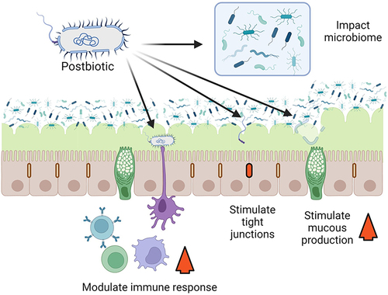
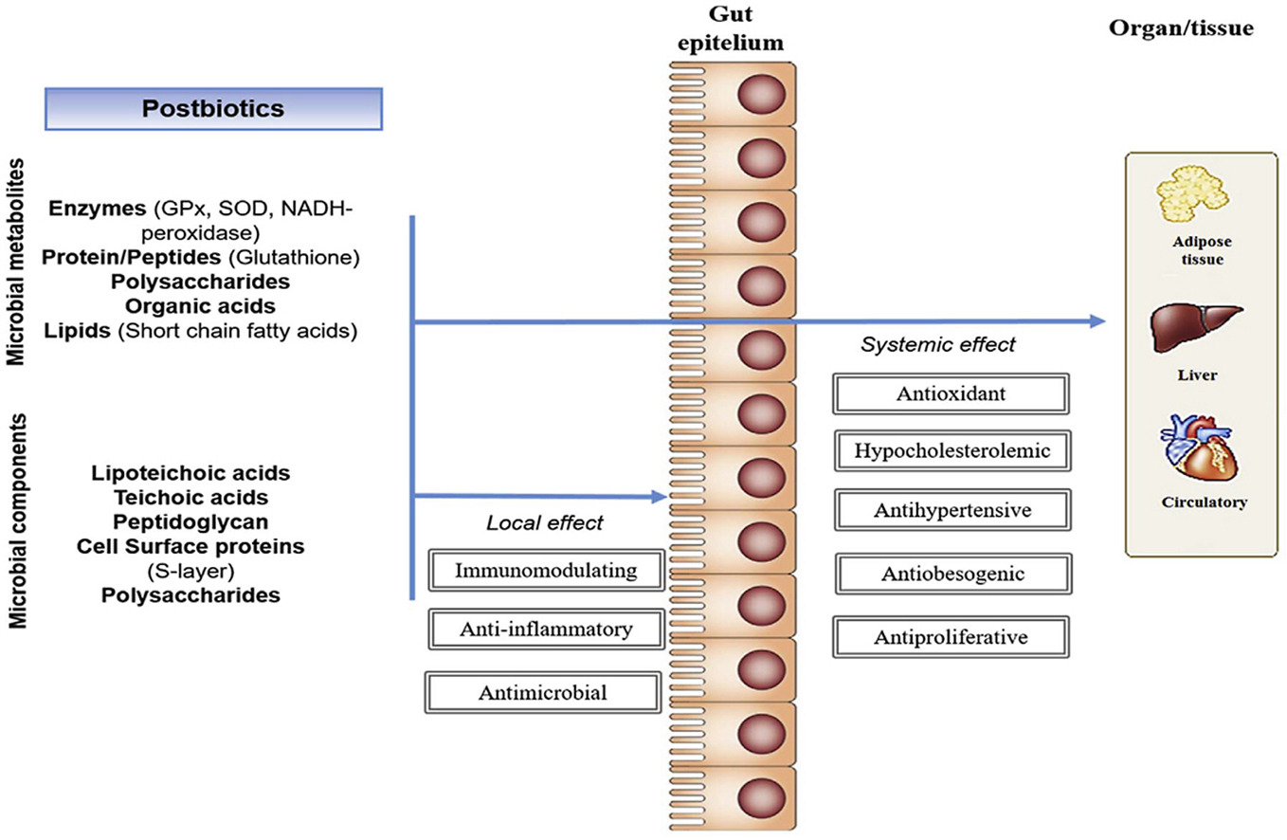
MoA
Notes:
https://www.sciencedirect.com/science/article/pii/S2666154323002156?via%3Dihub#bib158

Slide 37
Post- vs Pre- vs Pro-biotics
 | Pre | Post | Pro
 | Energy source used by host microorganisms | Live microorganisms | Non-viable cells or cell components
Stability |  | Susceptible to degradation from environmental factors | Very – Long shelf-life
Quantification |  | Live : Inactivated components should be evaluated over product life and safety assessed | Fixed level at manufacture will be maintained over product life
Safety assessment | Yes | Required | Required

Slide 38
Trial design considerations
Product stability
  Long shelf-life, conducive to use in geographic areas where cold storage/ambient temperatures prove a challenge for maintaining live organisms
  Can be used with antimicrobials without losing efficacy
Standardization of dose
  Predictable amount of bioactive compounds
  Amount of live bacterial units not a concern
Comparator selection
  Placebo to include non-active ingredients minus the test product
Notes:
https://www.sciencedirect.com/science/article/pii/S2666154323002156?via%3Dihub#bib31

Slide 39
Trial design considerations
Study population and safety
  Risks associated with live bacteria administration in certain patient groups not a factor
  Minimal risk of microbial translocation or AEs in immunocompromised individuals
  Door opened to including infants, children, those with intestinal barrier dysfunction
Study duration
  4-8 weeks to determine initial effects
  Long-term efficacy and safety still important
Regulatory advantage
  No safety concerns linked to live organisms
Protect your IP
  Microorganisms that postbiotics are derived from cannot be isolated from commercial product
Notes:
Risks can include risk of translocation from the gut into the blood, the risk of acquiring and transferring antibiotic resistance genes and the risk of interfering with normal colonization of neonatal gut microbiota
https://www.tandfonline.com/doi/full/10.1080/19490976.2022.2117508#abstract
https://pmc.ncbi.nlm.nih.gov/articles/PMC6566317/
https://www.sciencedirect.com/science/article/pii/S2666154323002156?via%3Dihub#bib31
https://pmc.ncbi.nlm.nih.gov/articles/PMC12025169/

Slide 40
Gut-Brain Axis
Why Postbiotics Excel
Neuroactive metabolites (e.g., GABA, tryptophan metabolites, SCFAs, extracellular vesicles) can act systemically without live bacterial colonization.
Rapid onset: Postbiotics show effects on cortisol, HRV, and mood endpoints within days due to bioactive metabolite absorption.
Mechanistic clarity: Easier to link specific metabolite concentrations (e.g., butyrate, indole derivatives) to neuroendocrine outcomes.
Clinical niches:
Stress resilience, anxiety, mood regulation (PSS, DASS-21, cortisol)
Sleep quality improvement (PSQI, ISI, HRV, melatonin signaling modulation)
Cognitive fatigue and burnout populations (healthy adults under stress)
(This category is gaining traction because regulators prefer well-defined mechanisms, and postbiotics’ non-viable status simplifies study design in vulnerable populations.)

